Slide 1
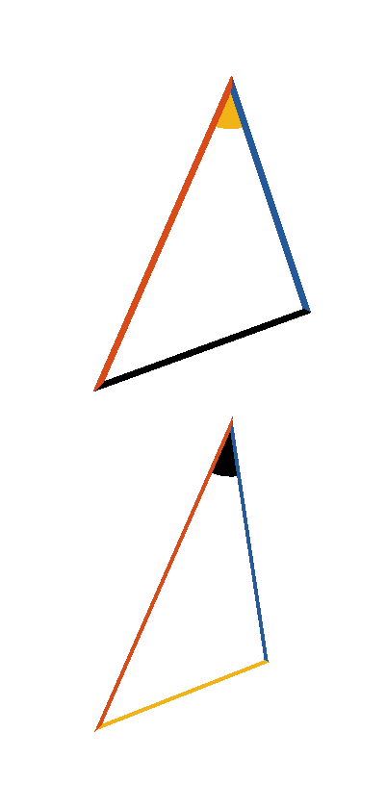






Book I. Prop. XXV. Theor. Statement
If two triangles have two sides (
and
) of the one respectively equal
to two sides (
and
) of the
other, but their bases unequal, the angle
subtended by the greater base (
) of
the one, must be greater than the angle
subtended by the less base (
) of the
other.

Slide 2








Book I. Prop. XXV. Theor. Proof
is not equal to
for if
then
(pr. I.4)
which is contrary to the hypothesis;
is not less than
for if
then
(pr. I.24),
which is also contrary to the hypothesis:
. Q. E. D.

