Slide 1
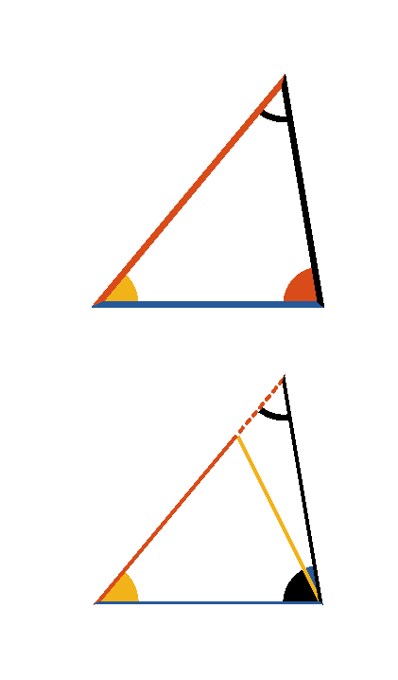


Book I. Prop. XXVI. Theor. Statement
If two triangles have two angles of the one
respectively equal to two angles of the
other (
and
), and a side
of the one equal to a side of the other
similarly placed with respect to the equal
angles, the remaining sides and angles are
respectively equal to one another.

Slide 2















Book I. Prop. XXVI. Theor. Proof — Case 1
Case I.
Let
and
which lie between the equal angles be equal,
then
.
For if it be possible, let one of them
be greater; make
, draw
.
In
and
we have
,
,
;
(pr. I.4)
but
(hyp.)
and therefore
, which is absurd;
hence neither of the sides
and
is greater than the other;
and
they are equal;
, and
(pr. I.4).

Slide 3
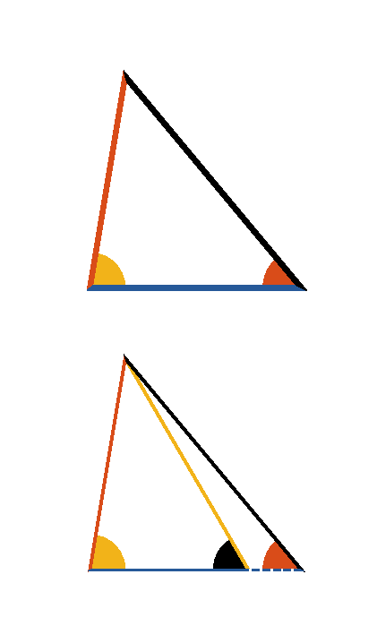










Book I. Prop. XXVI. Theor. Proof — Case 2
Case II.
Again, let
, which lie opposite the equal
angles
and
.
If it be possible, let
, then take
, draw
.
Then in
and
we have
,
and
,
(pr. I.4)
but
(hyp.)
which is absurd (pr. I.16).
Consequently, neither of the sides
or
is greater
than the other, hence they must be equal. It follows (pr. I.4) that
the triangles are equal in all respects. Q. E. D.

