Slide 1
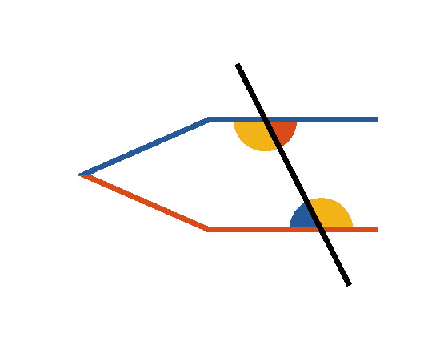







Book I. Prop. XXVII. Theor. Statement
If a straight line (
) meeting two
other straight lines (
and
)
makes with them the alternate angles (
and
;
and
) equal, these two
straight lines are parallel.

Slide 2

Book I. Prop. XXVII. Theor. Proof
If
be not parallel to
they shall meet
when produced.
If it be possible, let those lines be not parallel, but
meet when produced; then the external angle
is
greater than
(pr. I.16), but they are also equal
(hyp.), which is absurd: in the same manner it may
be shown that they cannot meet on the other side;
they are parallel. Q. E. D.

