Slide 1
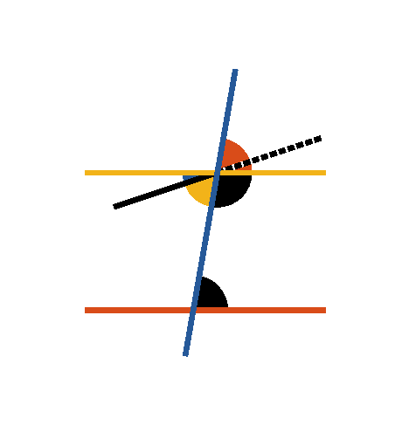



Book I. Prop. XXIX. Theor. Statement
A straight line (
) falling on two
parallel straight lines (
and
), makes the alternate angles equal to one
another; and also the external equal to the
internal and opposite angle on the same
side; and the two internal angles on the
same side together equal to two right
angles.

Slide 2









Book I. Prop. XXIX. Theor. Proof
For if the alternate angles
and
be not equal,
draw
, making
(pr. I.23).
Therefore
(pr. I.27) and therefore
two straight lines which intersect are parallel to the
same straight line, which is impossible (ax. XII).
Hence
and
are not unequal, that is, they are
equal:
(pr. I.15);
, the external angle
equal to the internal and opposite on the same side: if
be added to both, then
(pr. I.13).
That is to say, the two internal angles at the same side
of the cutting line are equal to two right angles. Q. E.
D.

