Slide 1
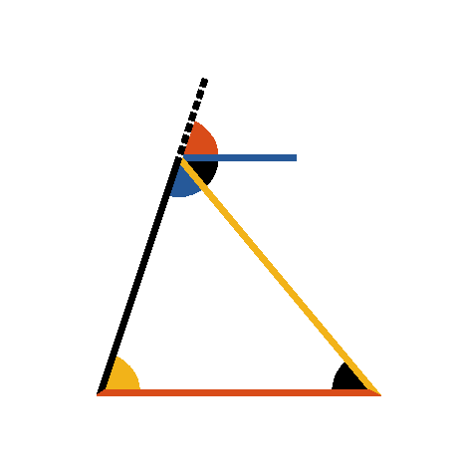




Book I. Prop. XXXII. Theor. Statement
If any side (
) of a triangle be
produced, the external angle (
) is equal
to the sum of the two internal and
opposite angles (
and
), and the
three internal angles of any triangle taken
together are equal to two right angles.

Slide 2





Book I. Prop. XXXII. Theor. Proof
Through the point [middle][AD,AE]A draw
(pr. I.31).
Then
(pr. I.29),
(ax. II),
and therefore
(pr. I.13). Q. E. D.

