Slide 1
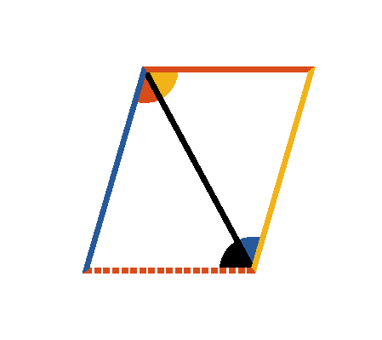




Book I. Prop. XXXIII. Theor. Statement
Straight lines (
and
) which
join the adjacent extremities of two equal
and parallel straight lines (
and
), are themselves equal and parallel.

Slide 2






Book I. Prop. XXXIII. Theor. Proof
Draw
the diagonal.
(hyp.)
(pr. I.29)
and
common to the two triangles;
, and
(pr. I.4);
and
(pr. I.27). Q. E. D.

