Slide 1
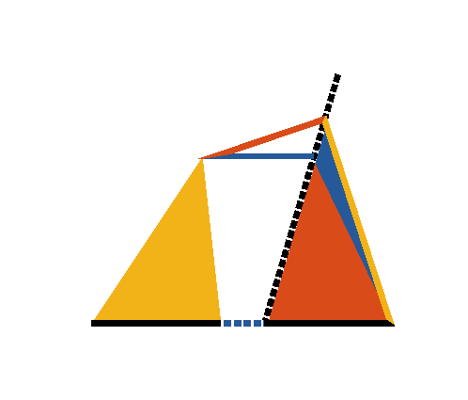


Book I. Prop. XL. Theor. Statement
Equal triangles (
and
) on equal bases,
and on the same side, are between the same
parallels.

Slide 2











Book I. Prop. XL. Theor. Proof
If
which joins the vertices of triangles be not
,
draw
(pr. I.31),
meeting
.
Draw
.
(const.)
(pr. I.38)
but
(hyp.)
,
a part equal to the whole, which is absurd.
: and in the same manner it can be demonstrated
that no other line except
is
:
.
Q. E. D.

