Slide 1



Book I. Prop. XLIII. Theor. Statement
The complements
and
of the
parallelograms which are about the
diagonal of a parallelogram are equal.

Slide 2

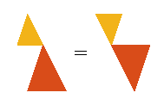

Book I. Prop. XLIII. Theor. Proof
(pr. I.34)
and
(pr. I.34)
(ax. III). Q. E. D.

