Slide 1
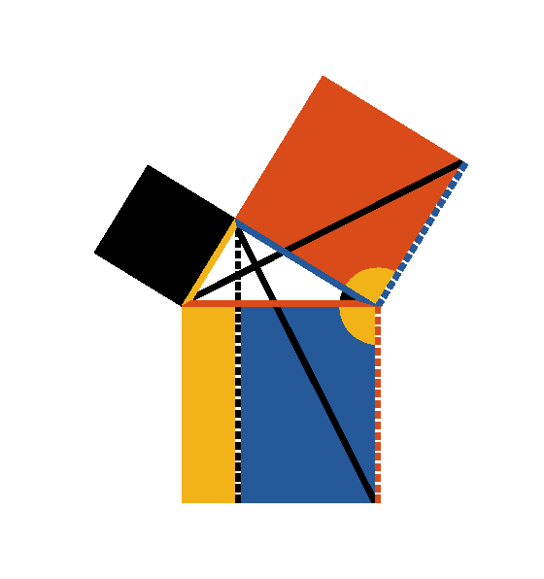




Book I. Prop. XLVII. Theor. Statement
In a right angled triangle
the square
on the hypotenuse
is equal to the
sum of the squares of the sides (
and
).

Slide 2







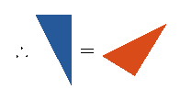




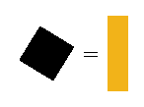

Book I. Prop. XLVII. Theor. Proof
On
,
,
describe squares (pr. I.46)
Draw
(pr. I.31); also draw
and
.
.
To each add
:
,
and
;
(pr. I.4).
Again
(pr. I.41),
and
(pr. I.41);
.
In the same manner it may be shown that
;
hence
. Q. E. D.

