Slide 1
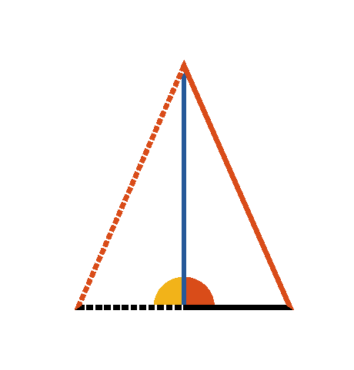




Book I. Prop. XLVIII. Theor. Statement
If the square of one side (
) of a
triangle is equal to the squares of the other
two sides (
and
), the angle (
) subtended by that side is a right angle.

Slide 2











Book I. Prop. XLVIII. Theor. Proof
Draw
and
(pr. I.11, I.3)
and draw
also.
Since
(const.)
;
but
(pr. I.47),
and
(hyp.)
,
;
and
(pr. I.8),
consequently
is a right angle. Q. E. D.

