Slide 1
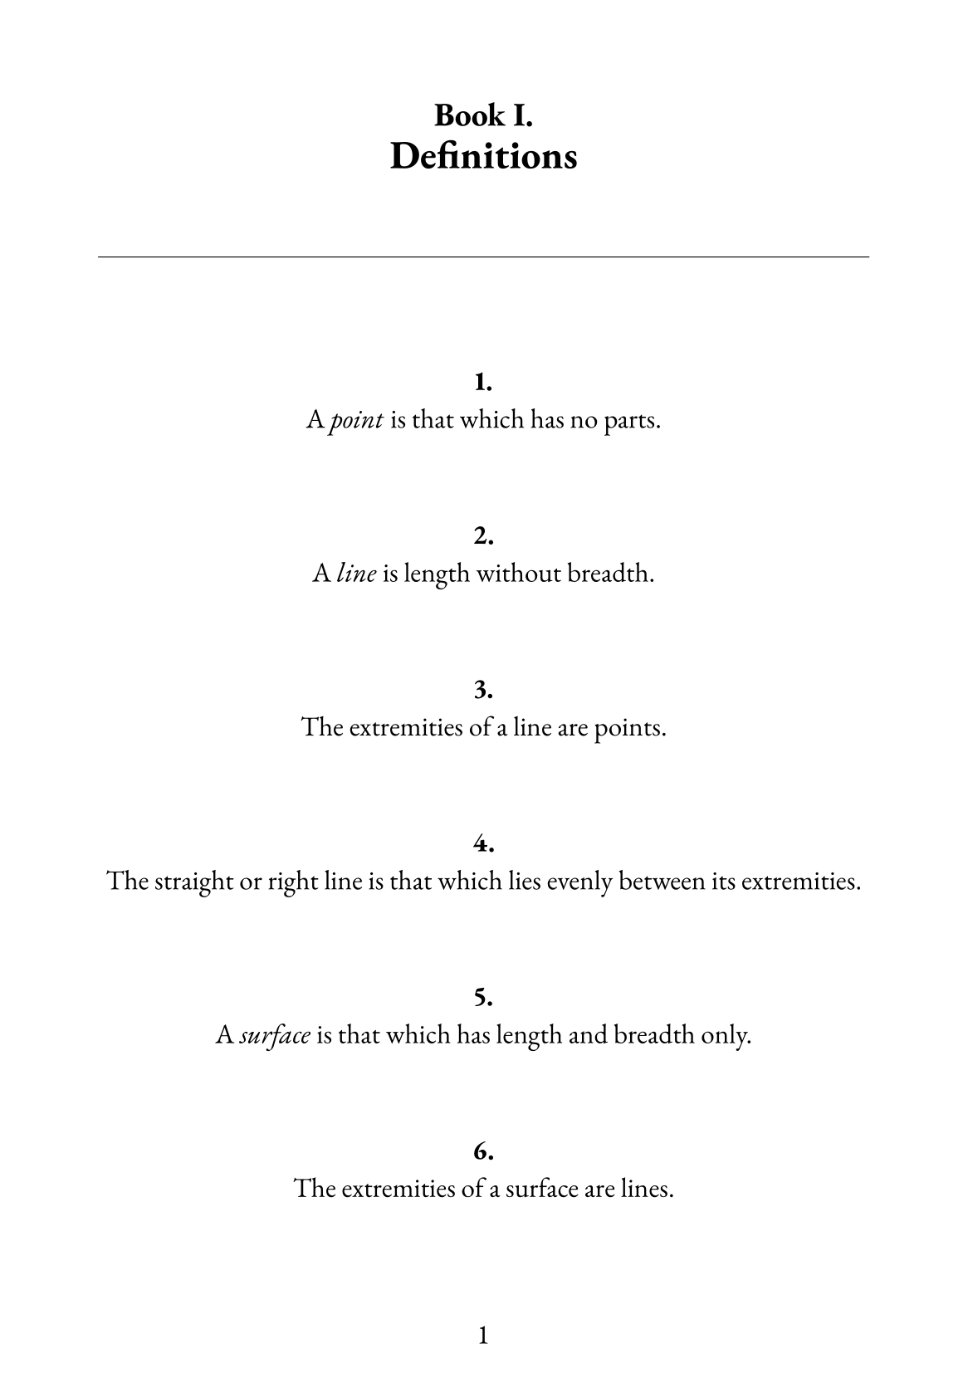

Slide 2
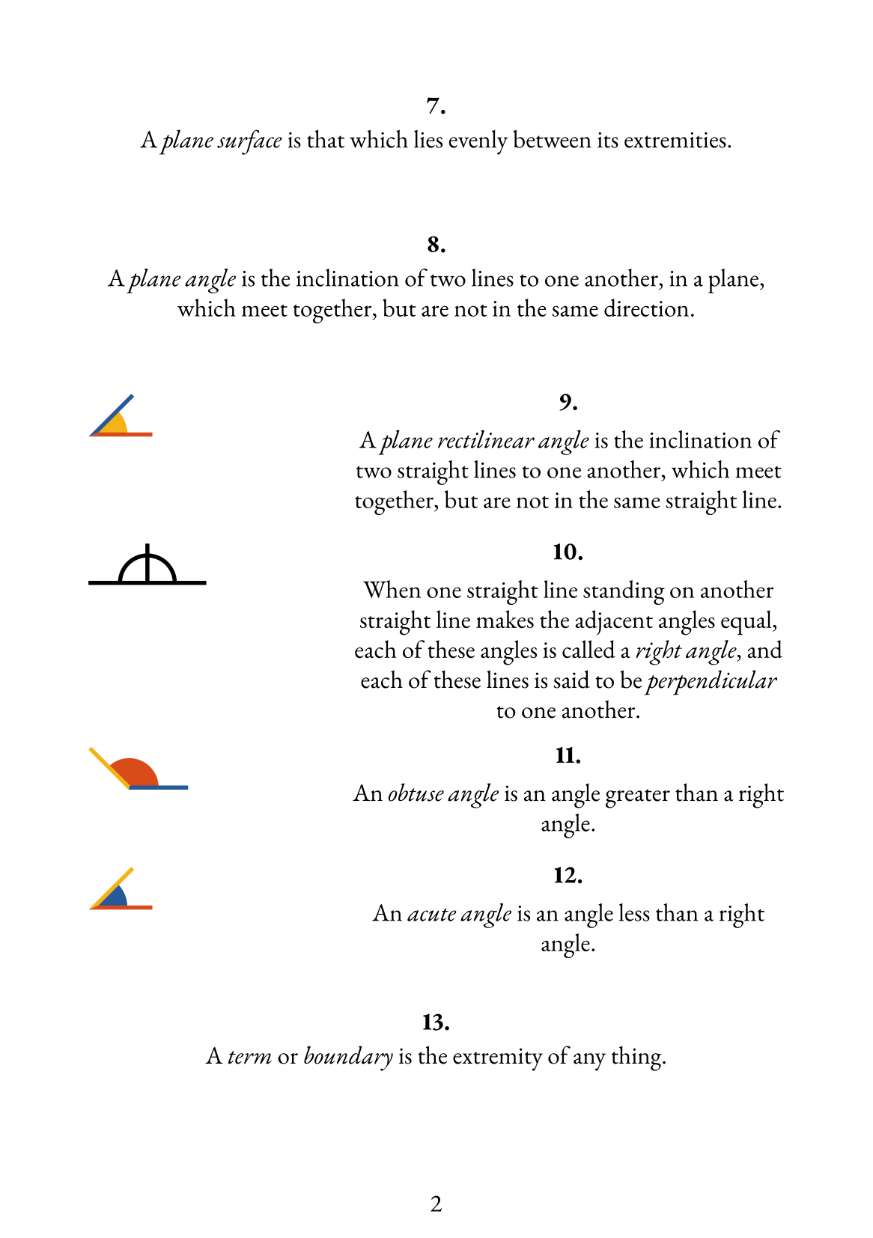

Slide 3
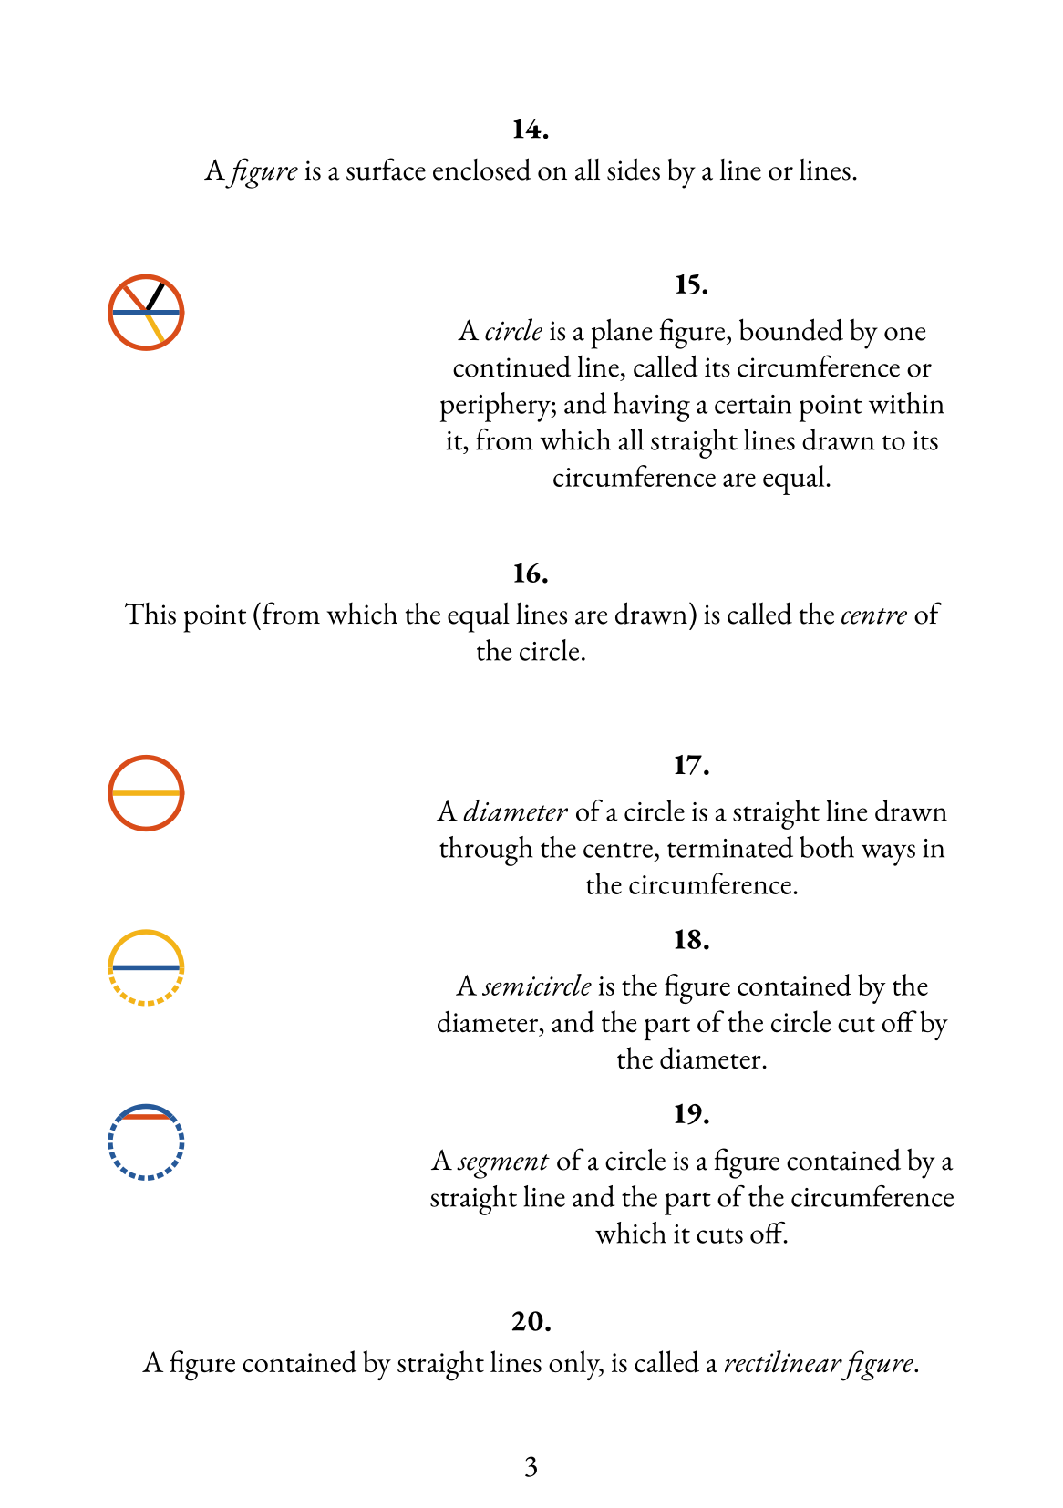

Slide 4
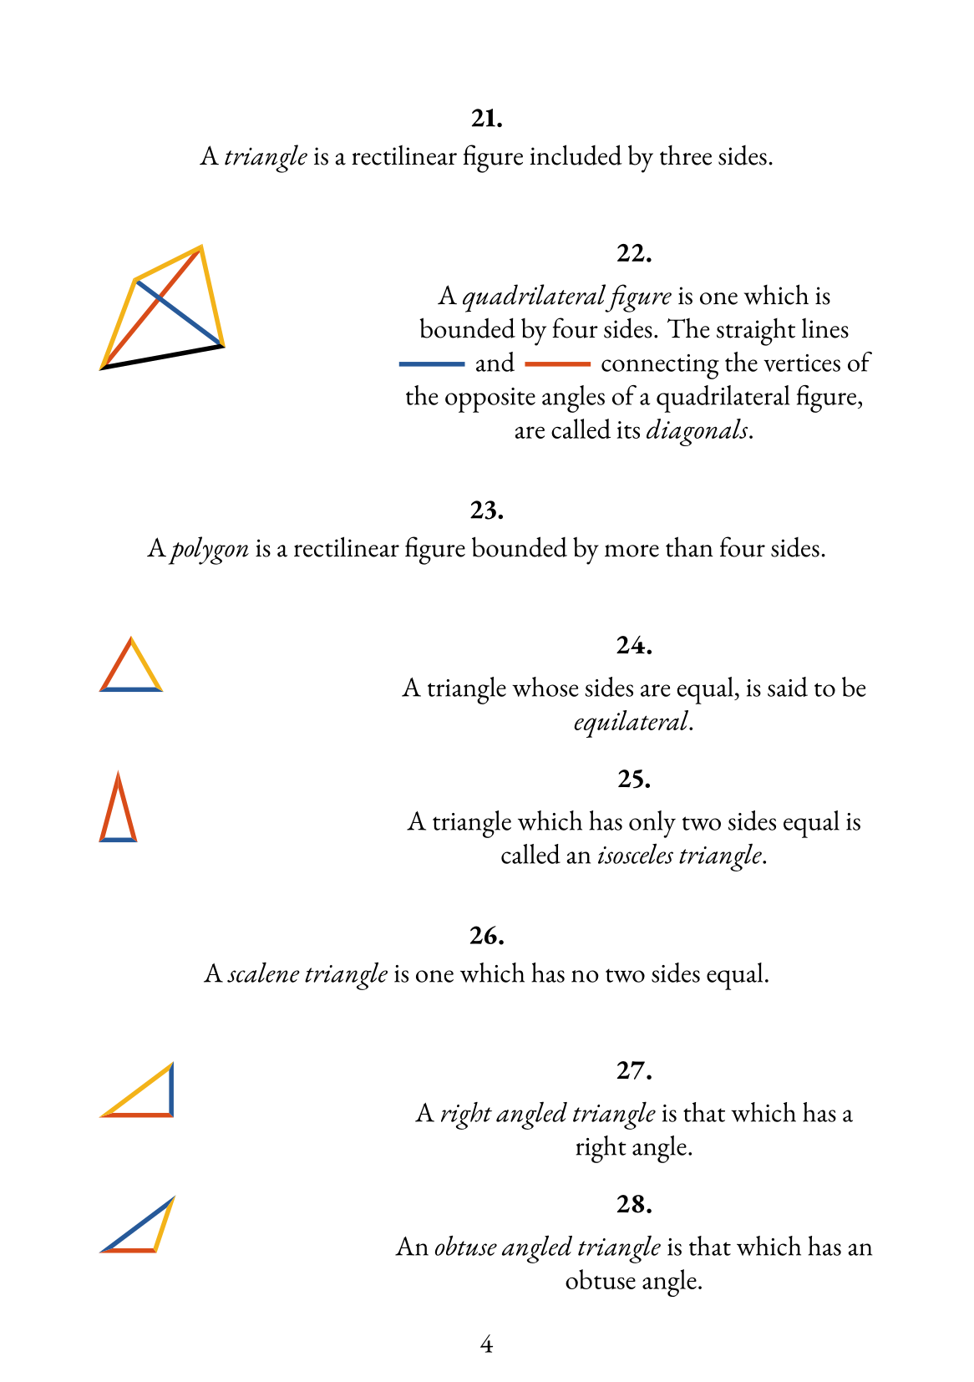

Slide 5
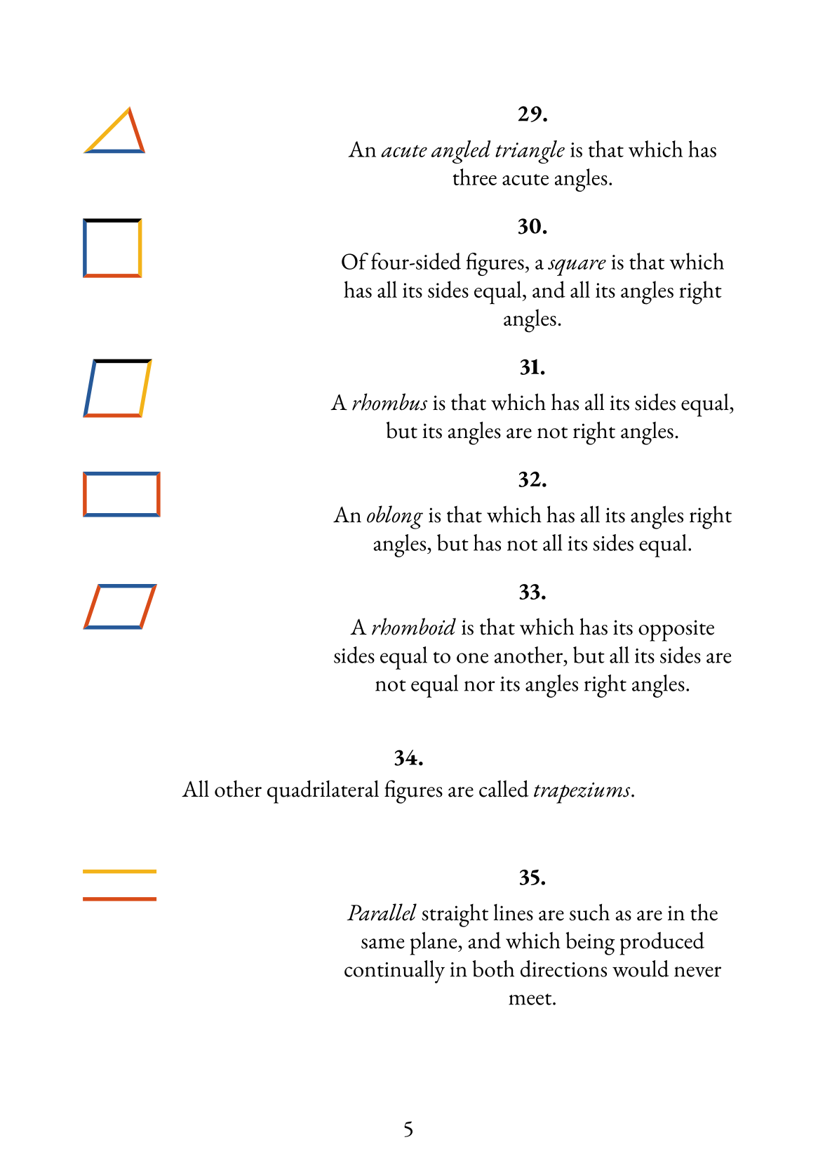

Slide 6
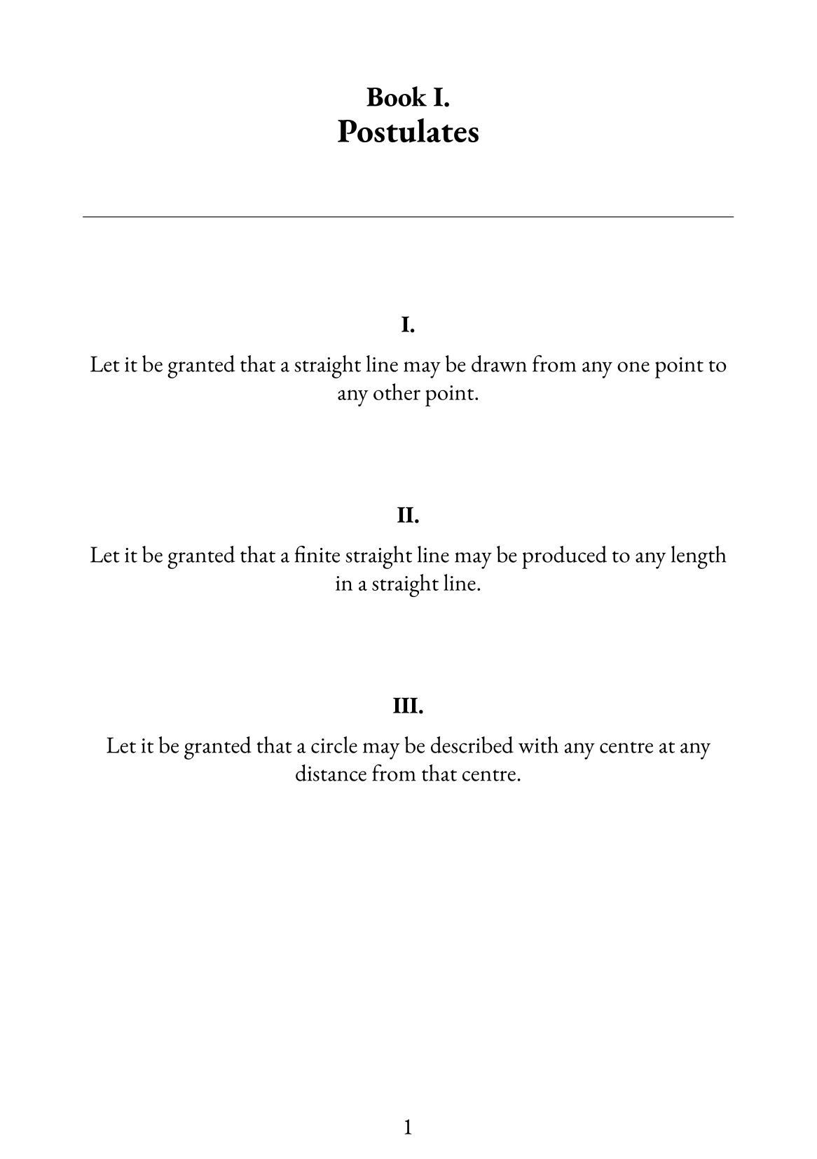

Slide 7
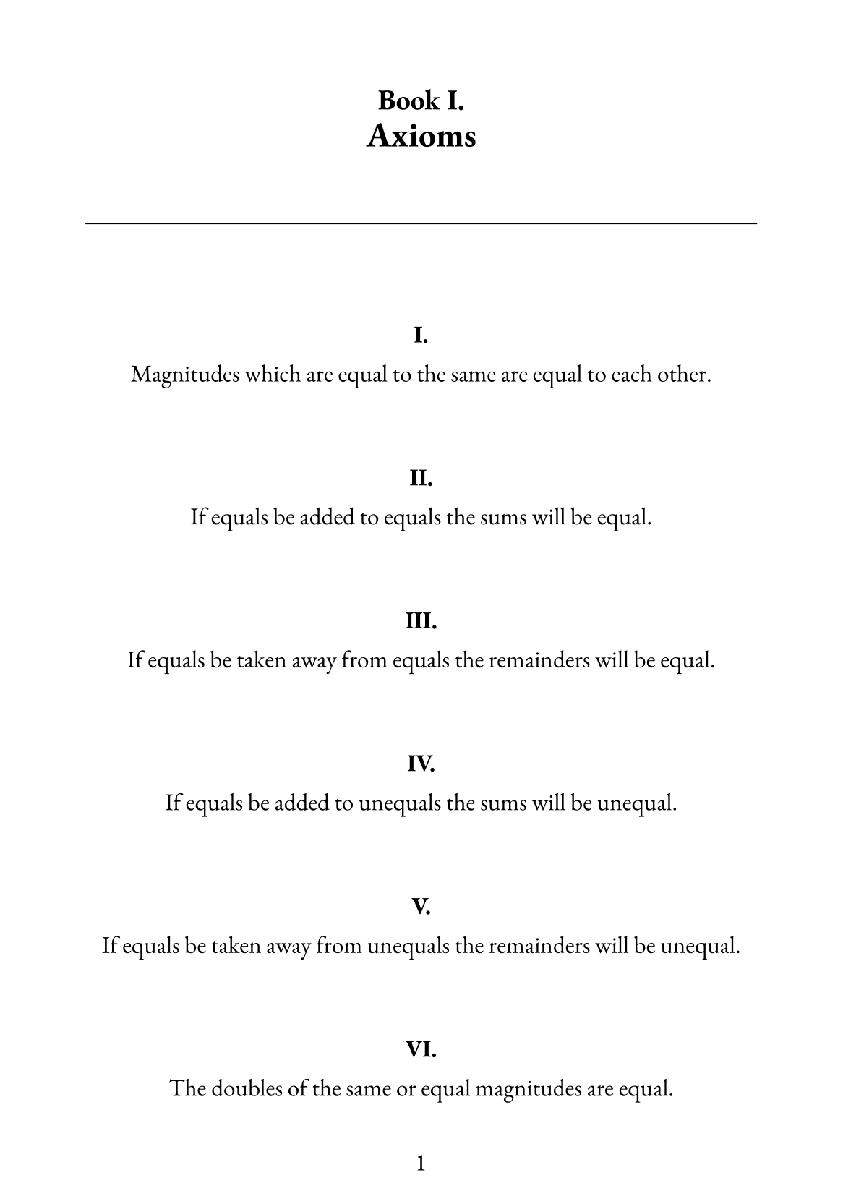

Slide 8
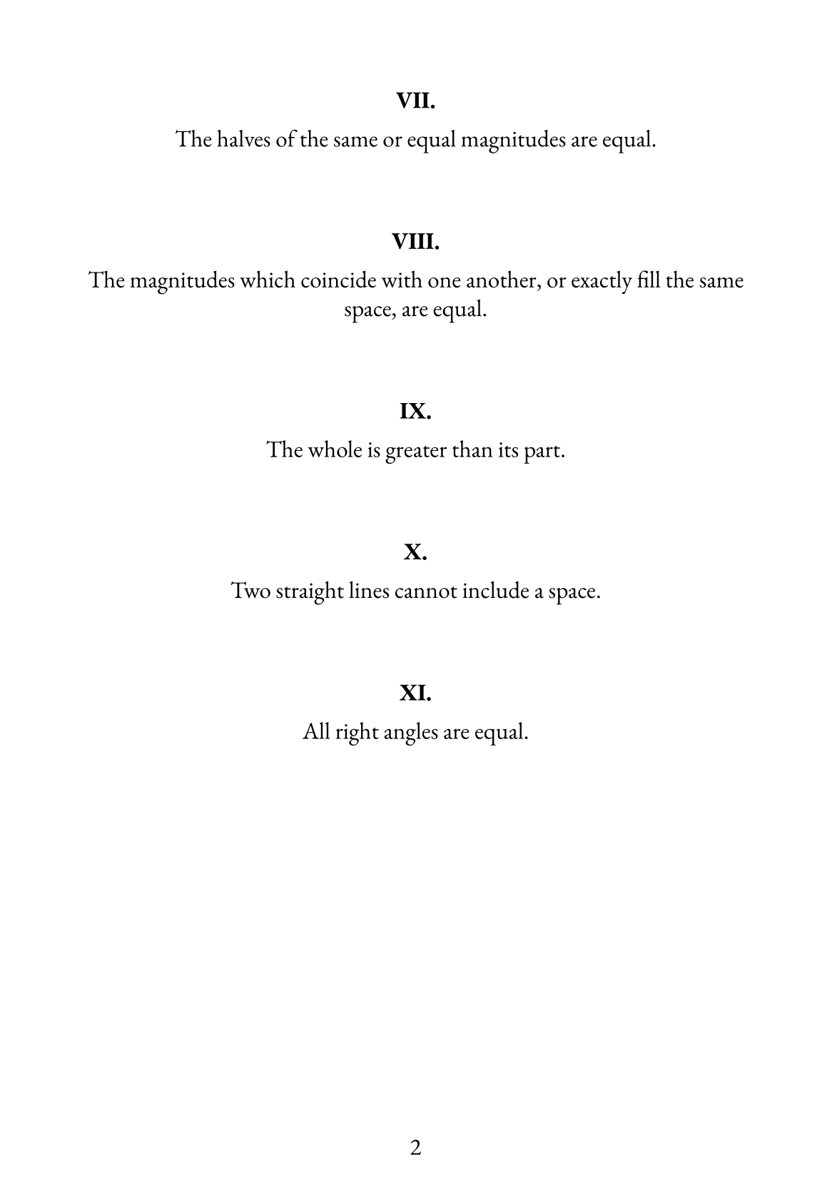

Slide 9
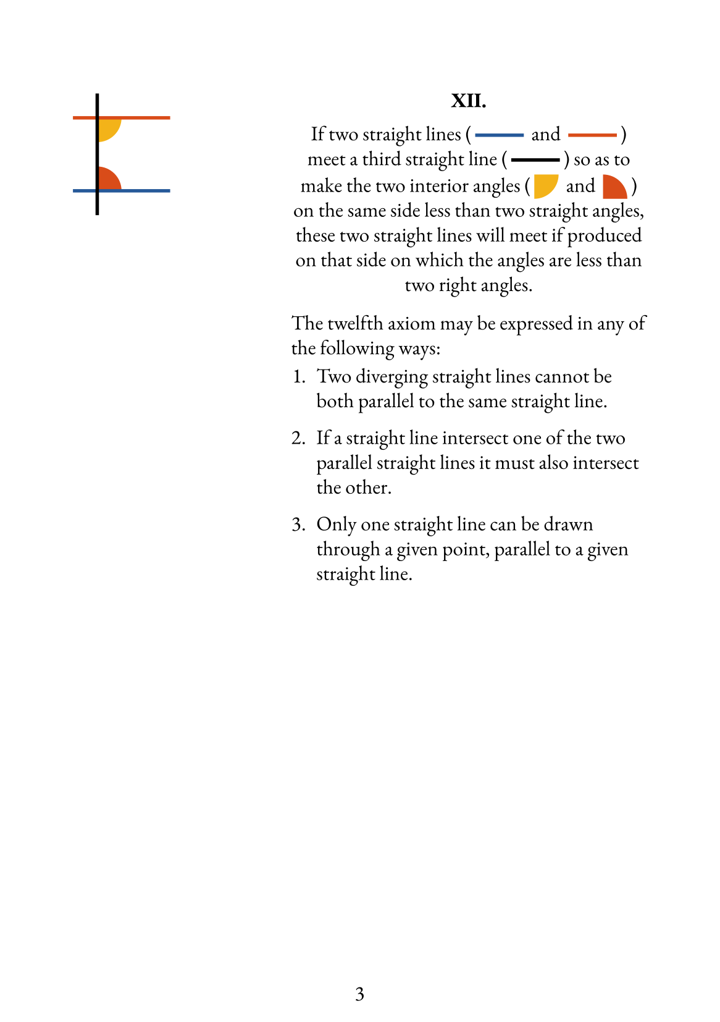

Slide 10
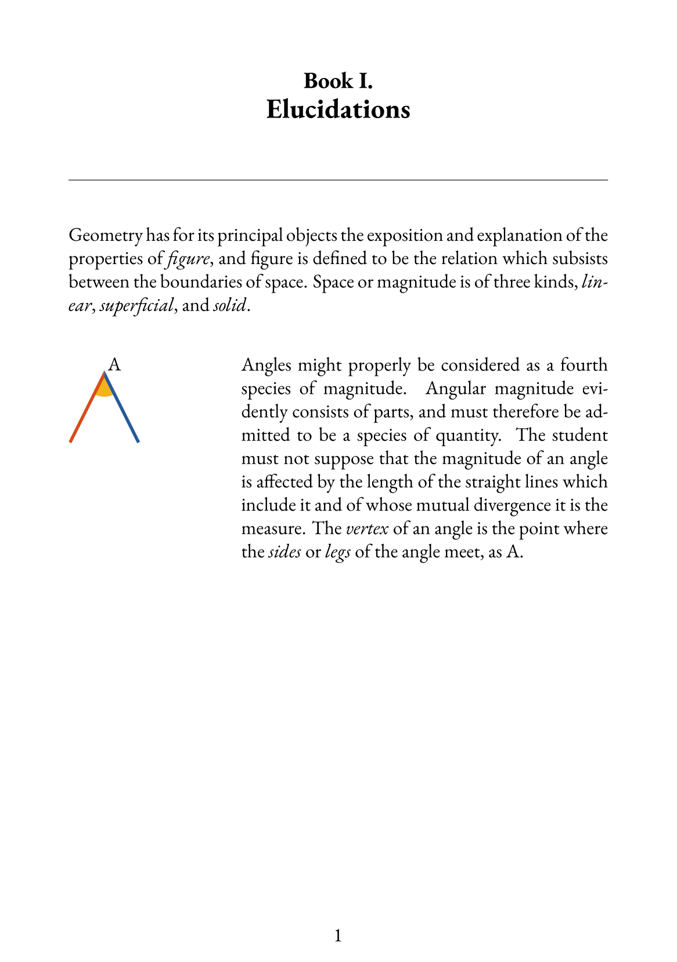

Slide 11
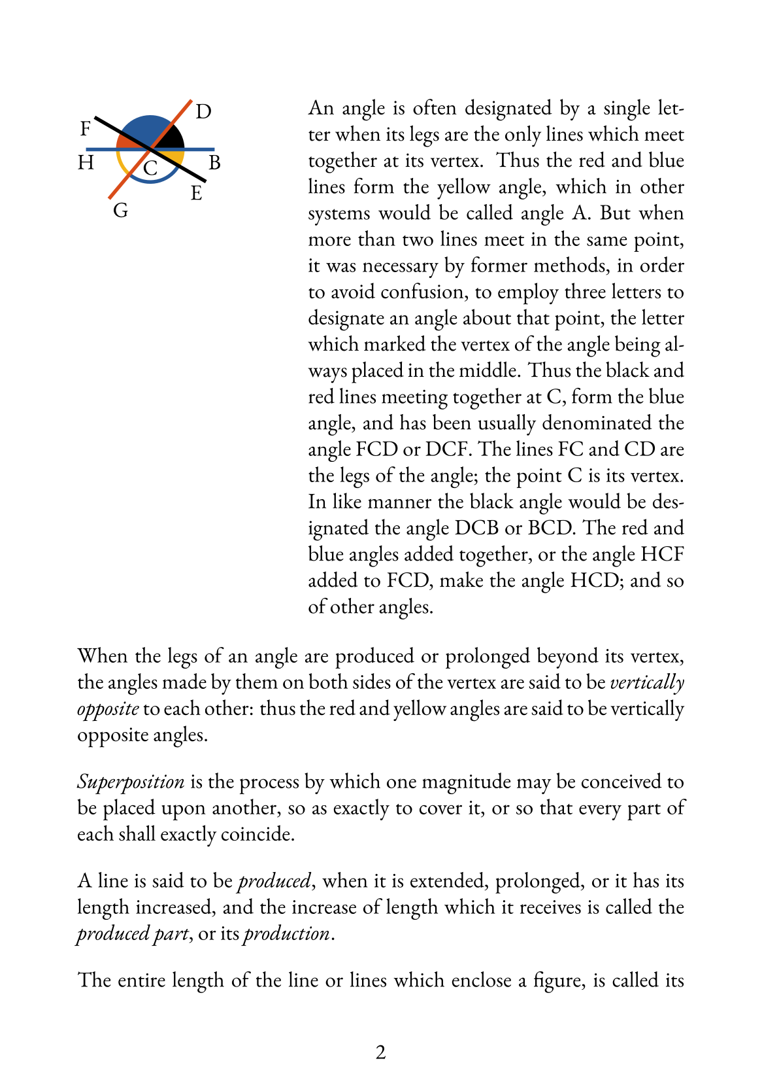

Slide 12
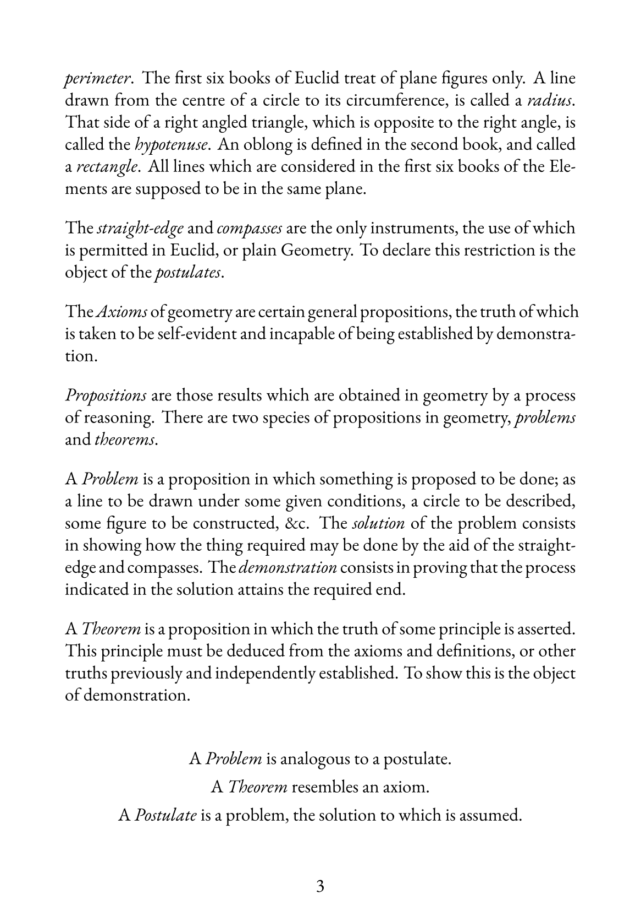

Slide 13
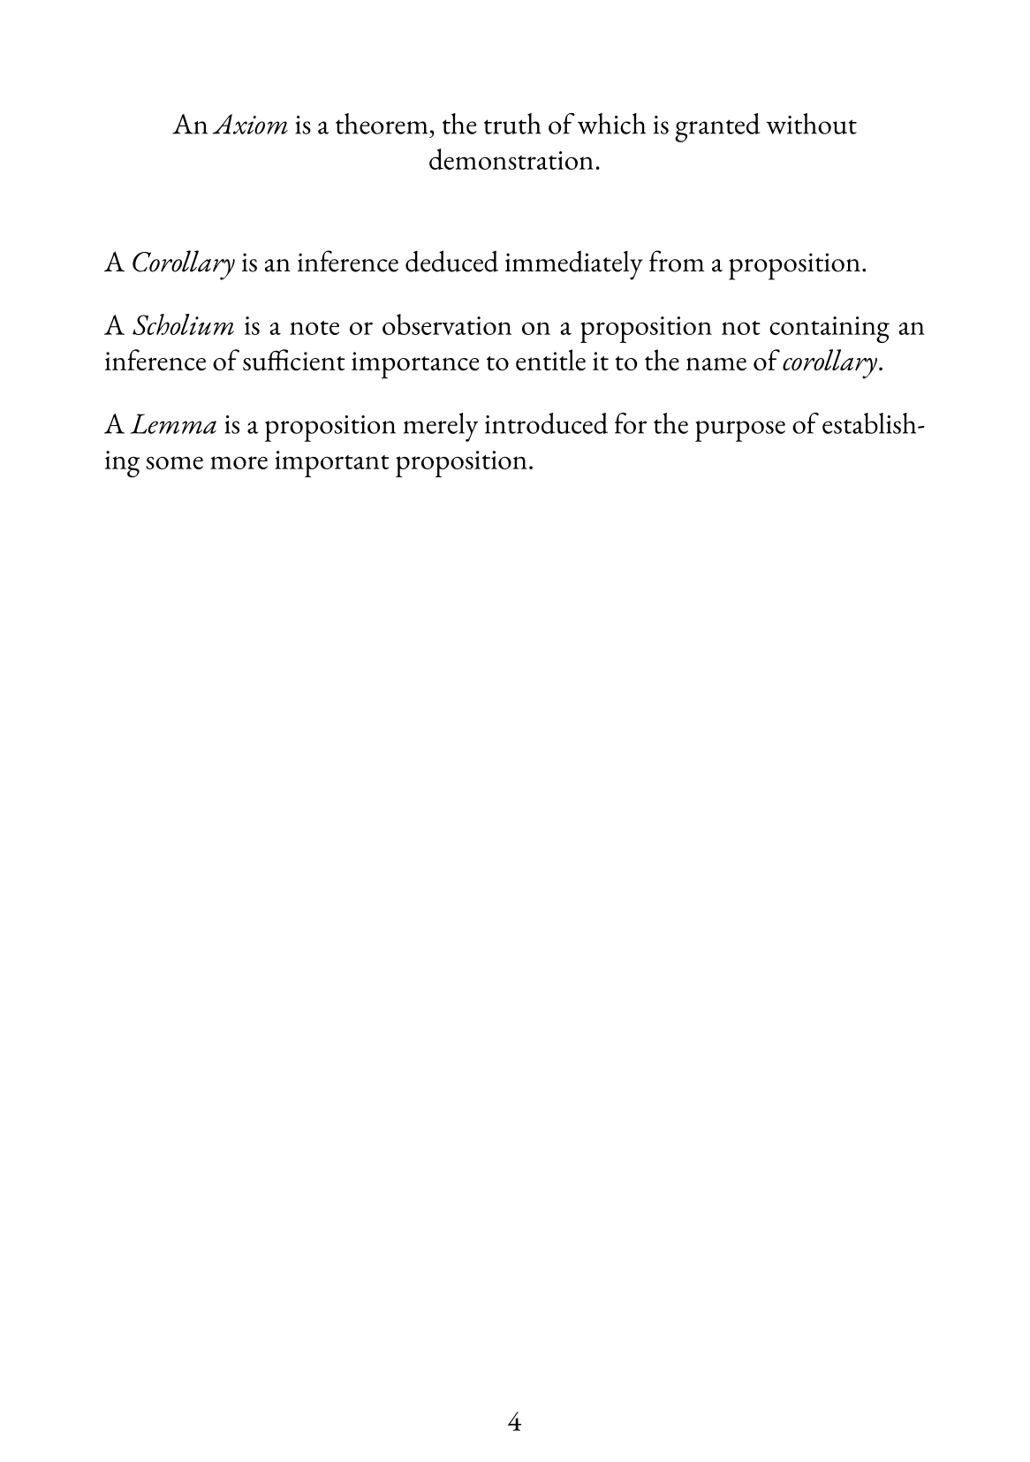

Slide 14
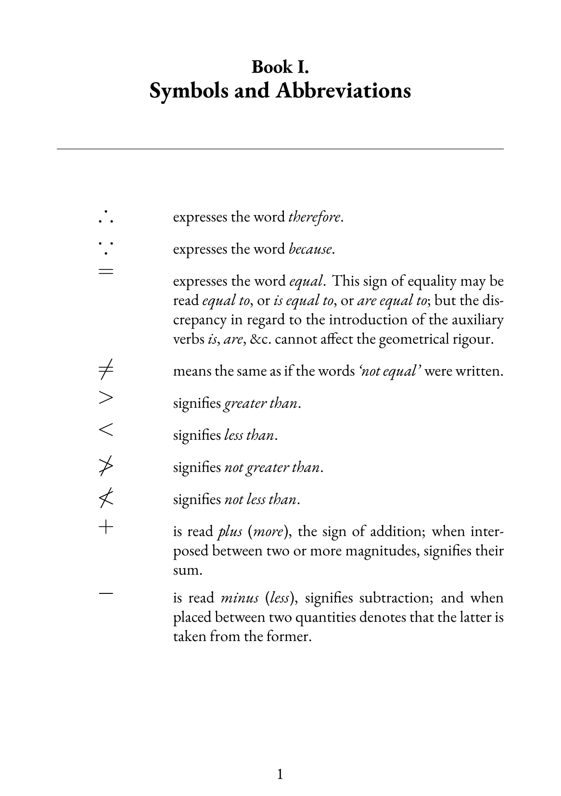

Slide 15
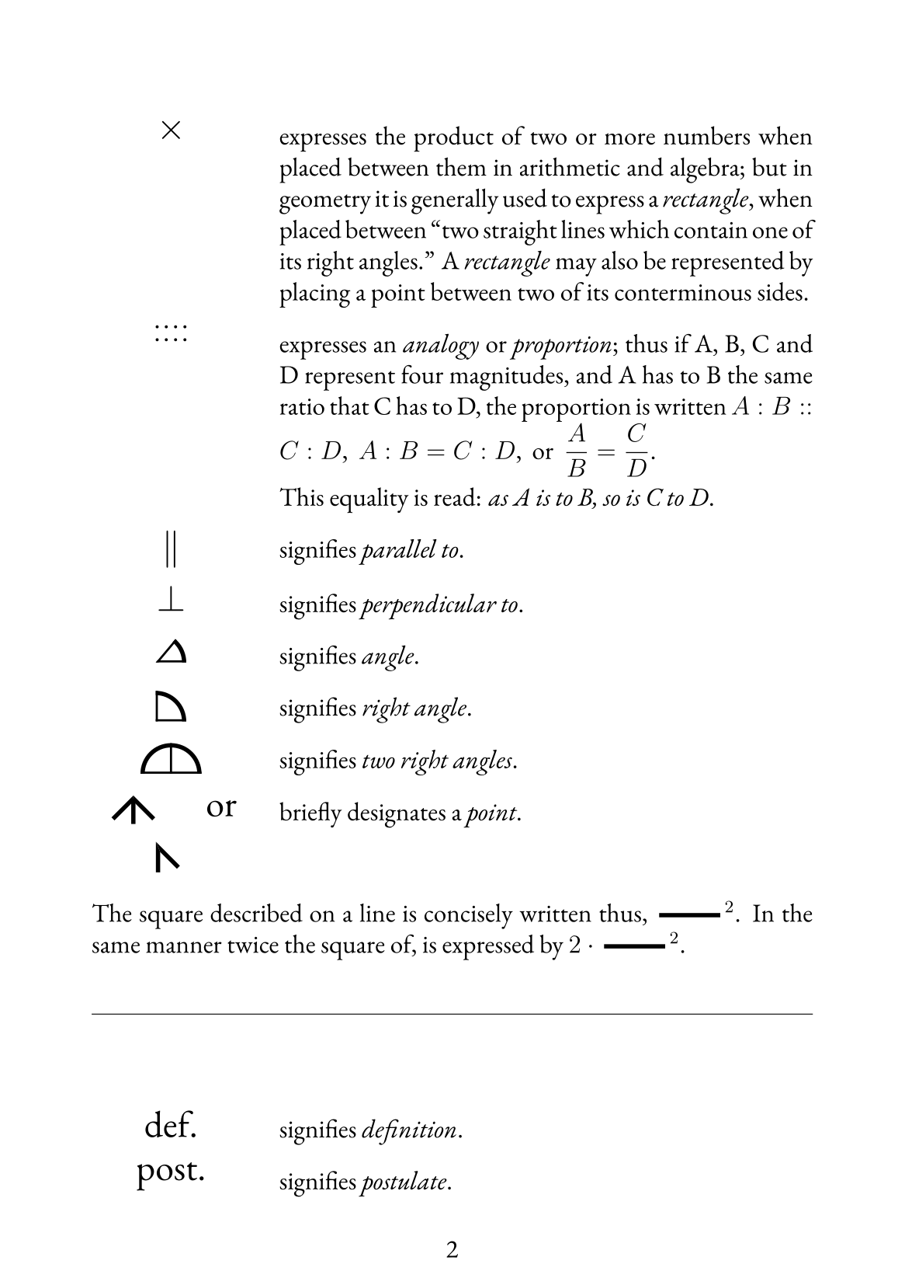

Slide 16
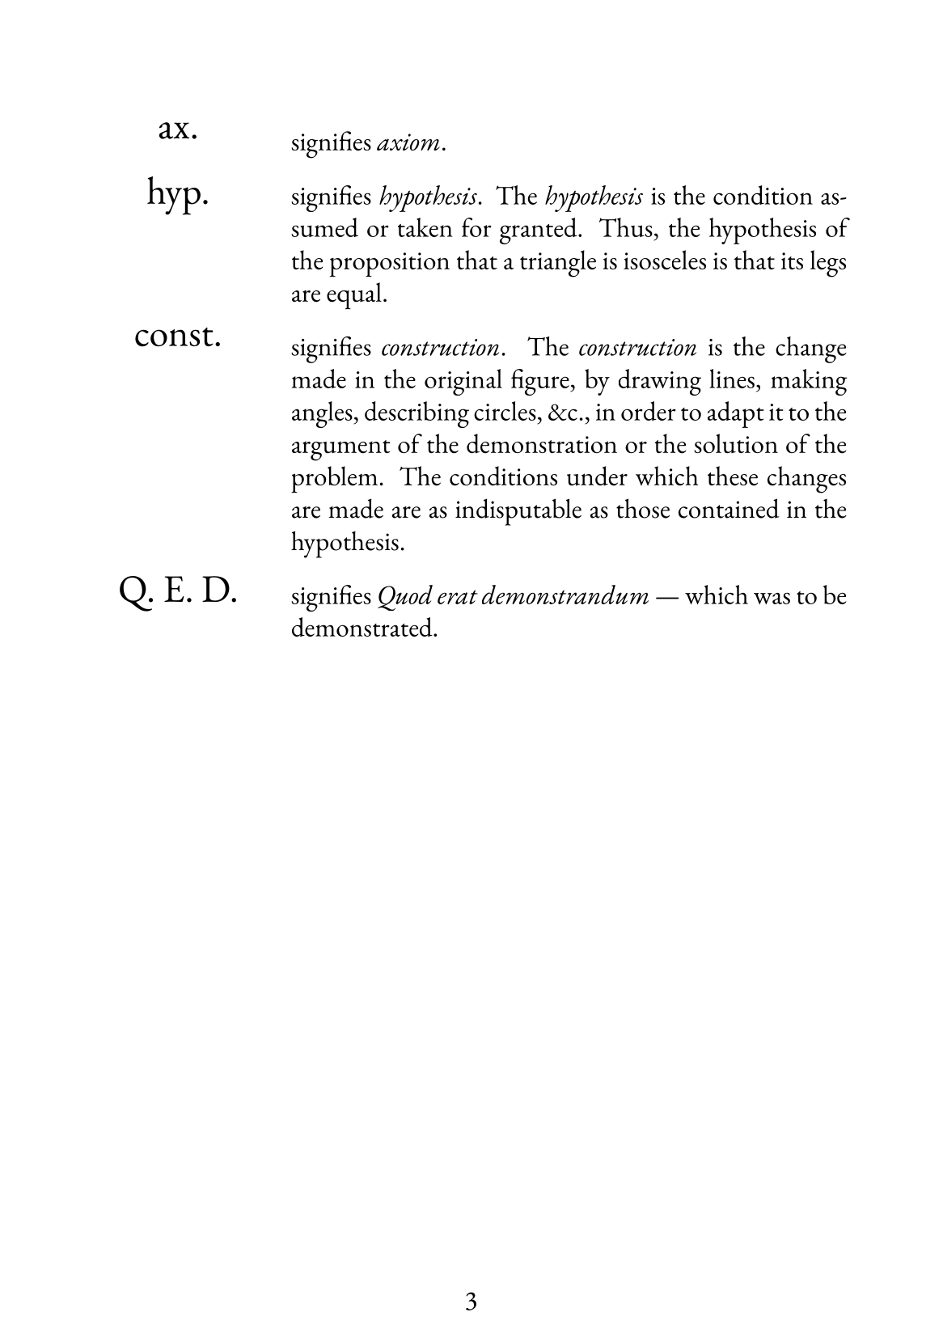

Slide 17
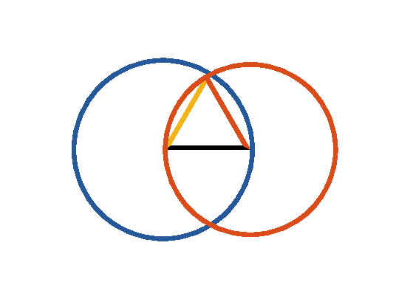

Book I. Prop. I. Prob. Statement
On a given finite straight line (
) to
describe an equilateral triangle.

Slide 18








Book I. Prop. I. Prob. Proof
Describe
and
(post. III);
draw
and
(post. I).
Then will
be equilateral.
For
(def. 15);
and
(def. 15);
(ax. I);
and therefore
is the equilateral triangle
required. Q. E. D.

Slide 19
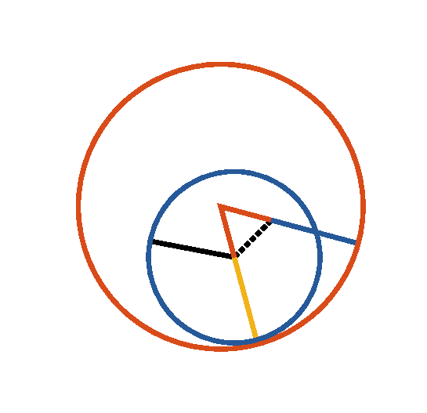
Book I. Prop. II. Prob. Statement
From a given point (
), to draw a
straight line equal to a given straight line (
).

Slide 20











Book I. Prop. II. Prob. Proof
Draw
(post. I), describe
(pr. I.1),
produce
(post. II),
describe
and
(post. III);
produce
(post. II),
then
is the line required.
For
(def. 15),
and
(const.),
(post. III),
but (def. 15)
;
drawn from the given point (
), is equal to
the given line
. Q. E. D.

Slide 21
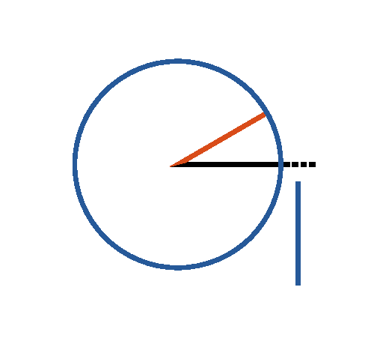

Book I. Prop. III. Prob. Statement
From the greater (
) of two given
straight lines, to cut off a part equal to the
less (
).

Slide 22






Book I. Prop. III. Prob. Proof
Draw
(pr. I.2);
describe
(post. III),
then
.
For
(def. 15),
and
(const.);
(ax. I). Q. E. D.

Slide 23
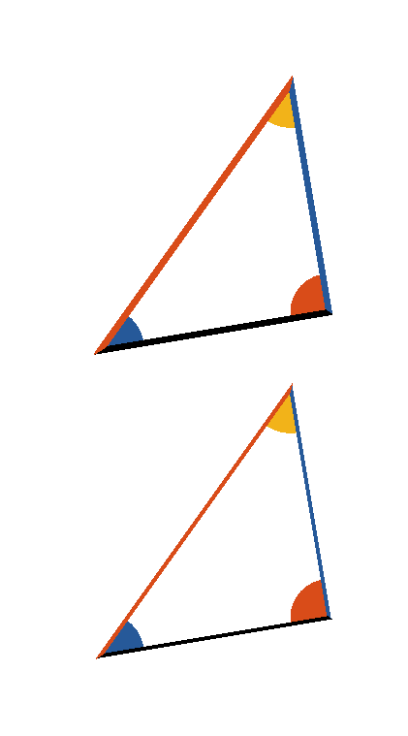






Book I. Prop. IV. Theor. Statement
If two triangles have two sides of the one
respectively equal to two sides of the
other, (
to
and
to
) and the angles (
and
)
contained by those equal sides also equal;
then their bases or their sides (
and
) are also equal: and the remaining
angles opposite to equal sides are
respectively equal (
and
):
and the triangles are equal in every respect.

Slide 24



Book I. Prop. IV. Theor. Proof
Let two triangles be conceived, to be so placed, that
the vertex of one of the equal angles (
or
)
shall fall upon that of the other, and
to
coincide with
, then will
coincide
with
if applied: consequently
will
coincide with
, or two straight lines will
enclose a space, which is impossible (ax. X),
therefore
,
and
, and as the triangles
and
coincide,
when applied, they are equal in every respect. Q. E.
D.

Slide 25


Book I. Prop. V. Theor. Statement
In any isosceles triangle
if the equal
sides be produced, the external angles at
the base are equal, and the internal angles
at the base are also equal.

Slide 26














Book I. Prop. V. Theor. Proof
Produce
and
(post. II),
take
(pr. I.3);
draw
and
. Then in
and
we have
(const.),
common to both,
and
(hyp.)
,
and
(pr. I.4). Again in
and
we have
,
and
,
and
(pr. I.4)
but
,
(ax. III). Q. E. D.

Slide 27
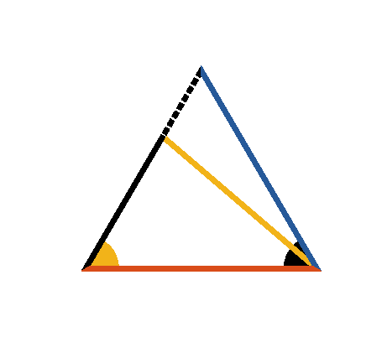




Book I. Prop. VI. Theor. Statement
In any triangle (
) if two angles (
and
) are equal, the sides (
and
) opposite to them are also equal.

Slide 28




Book I. Prop. VI. Theor. Proof
For if the sides be not equal, let one of them
be
greater than the other
, and from it cut off
(pr. I.3), draw
. in
and
,
(const.),
(hyp.)
and
common,
the triangles are equal (pr. I.4)
a part equal to the whole, which is absurd;
neither of the sides
or
is greater than the
other,
hence they are equal. Q. E. D.

Slide 29
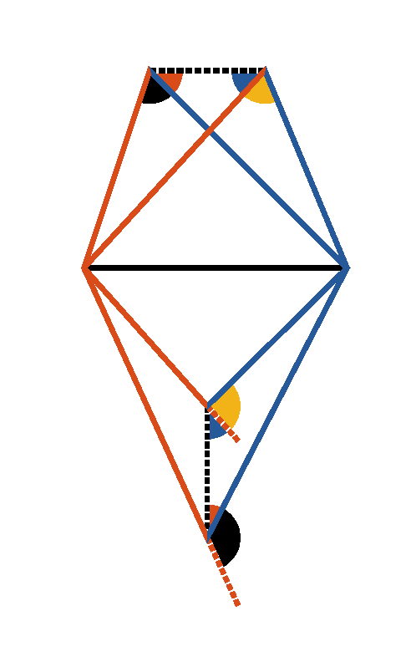
Book I. Prop. VII. Theor. Statement
On the same base (
), and on the
same side of it there cannot be two
triangles having their conterminous sides (
and
,
and
)
at both extremities of the base, equal to
each other.

Slide 30




Book I. Prop. VII. Theor. Proof
When two triangles stand on the same base, and on
the same side of it, the vertex of the one shall either
fall outside of the other triangle, or within it; or,
lastly, on one of its sides. If it be possible let the
two triangles be constructed so that
, then draw
and,
(pr. I.5)
and
therefore the two
triangles cannot have their conterminous sides
equal at both extremities of the base. Q. E. D.

Slide 31
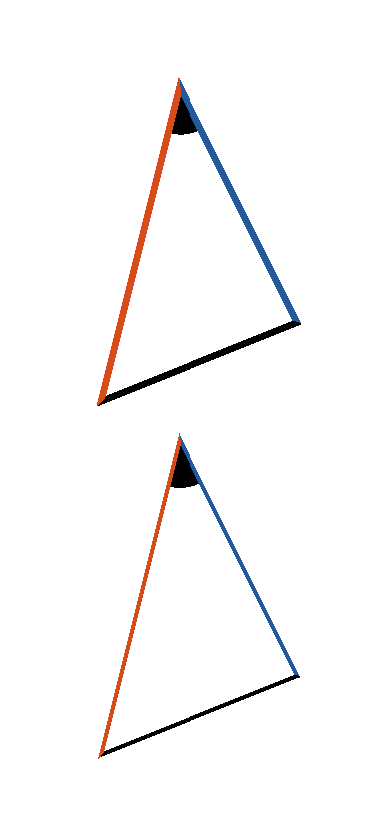


Book I. Prop. VIII. Theor. Statement
If two triangles have two sides of the one
respectively equal to two sides of the other
(
and
) and also their bases (
), equal; then the
angles (
and
) contained by
their equal sides are also equal.

Slide 32

Book I. Prop. VIII. Theor. Proof
If the equal bases
and
be
conceived to be placed one upon the other, so that
the triangles shall lie at the same side of them, and
that the equal sides
and
,
and
be conterminous, the vertex of the
one must fall on the vertex of the other; for to
suppose them not coincident would contradict the
last proposition. Therefore sides
and
, being coincident with
and
,
. Q. E. D.

Slide 33


Book I. Prop. IX. Prob. Statement
To bisect a given rectilinear angle (
).

Slide 34



Book I. Prop. IX. Prob. Proof
Take
(pr. I.3) draw
,
upon which describe
(pr. I.1),
draw
.
(const.)
and
common to the two triangles
and
(const.),
(pr. I.8).
Q. E. D.

Slide 35
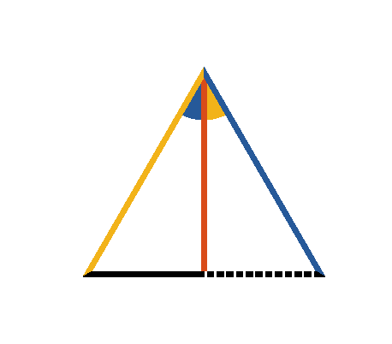

Book I. Prop. X. Prob. Statement
To bisect a given finite straight line (
).

Slide 36
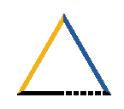



Book I. Prop. X. Prob. Proof
Construct
(pr. I.1),
draw
, making
(pr. I.9). Then
by (pr. I.4), for
(const.)
and
common to the two triangles.
Therefore the given line is bisected. Q. E. D.

Slide 37
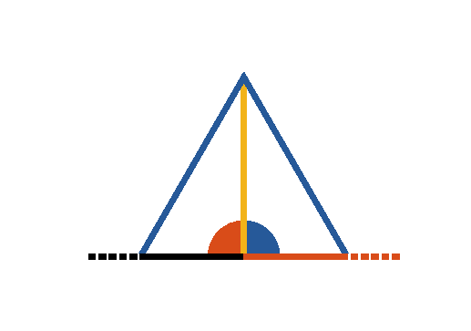

Book I. Prop. XI. Prob. Statement
From a given point ([middle]D), in a given
straight line (
), to draw a
perpendicular.

Slide 38



Book I. Prop. XI. Prob. Proof
Take any point ([middle]C) in the given line,
cut off
(pr. I.3),
construct
(pr. I.1),
draw
and it shall be perpendicular to the
given line.
For
(const.)
(const.)
and
common to the two triangles.
Therefore
(pr. I.8)
(def. 10). Q. E. D.

Slide 39
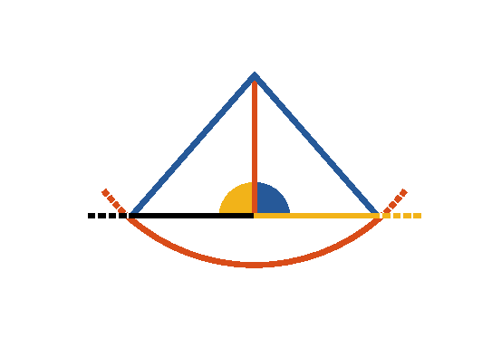

Book I. Prop. XII. Prob. Statement
To draw a straight line perpendicular to a
given indefinite straight line (
)
from a given point (A) without.

Slide 40




Book I. Prop. XII. Prob. Proof
With the given point A as centre, at one side of the line,
and any distance
capable of extending to the other
side, describe
.
Make
(pr. I.10),
draw
,
and
,
then
.
For (pr. I.8) since
(const.),
common to both,
and
(def. 15),
, and
(def. 10). Q. E. D.

Slide 41
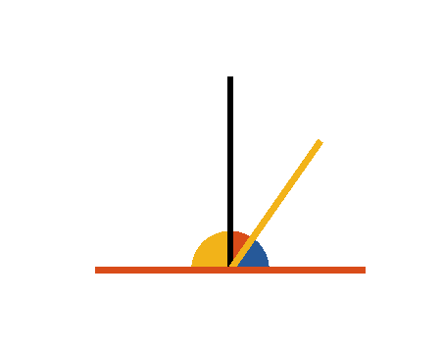
Book I. Prop. XIII. Theor. Statement
When a straight line (
) standing
upon another straight line (
) makes
angles with it; they are either two right
angles or together equal to two right
angles.

Slide 42







Book I. Prop. XIII. Theor. Proof
If
be to
then,
and
(def. 10),
but if
be not to
,
draw
(pr. I.11);
(const.),
(ax. II)
. Q. E. D.

Slide 43



Book I. Prop. XIV. Theor. Statement
If two straight lines (
and
),
meeting a third straight line (
), at
the same point, and at opposite sides of it,
make with it adjacent angles (
and
)
equal to two right angles; these straight
lines lie in one continuous straight line.

Slide 44





Book I. Prop. XIV. Theor. Proof
For, if possible let
, and not
,
be the continuation of
,
then
but by the hypothesis
(ax. III); which is absurd (ax. IX).
is not the continuation of
, and
the like may be demonstrated of any other straight
line except
,
is the continuation
of
. Q. E. D.

Slide 45





Book I. Prop. XV. Theor. Statement
If two right lines (
and
)
intersect one another, the vertical angles
and
,
and
are equal.

Slide 46




Book I. Prop. XV. Theor. Proof
.
In the same manner it may be shown that
. Q. E. D.

Slide 47
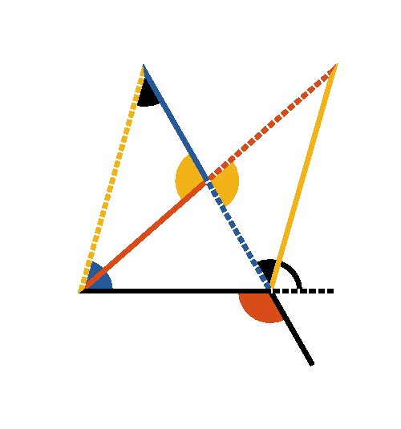




Book I. Prop. XVI. Theor. Statement
If a side of a triangle (
) is produced, the
external angle (
) is greater than
either of the internal remote angles (
or
).

Slide 48













Book I. Prop. XVI. Theor. Proof
Make
(pr. I.10);
draw
and produce it until
;
draw
.
In
and
;
,
and
(const.,
pr. I.15),
(pr. I.4),
.
In like manner it can be shown, that if
be produced,
and therefore
which is
is
. Q. E. D.

Slide 49
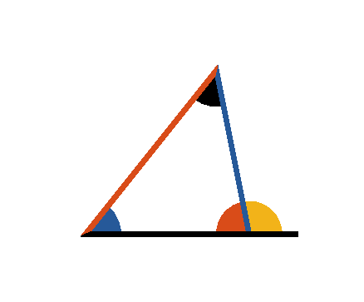

Book I. Prop. XVII. Theor. Statement
Any two angles of a triangle
are
together less than two right angles.

Slide 50



Book I. Prop. XVII. Theor. Proof
Produce
, then will
.
But
(pr. I.16)
, and in the same manner it may be
shown that any other two angles of the triangle
taken together are less than two right angles. Q. E.
D.

Slide 51
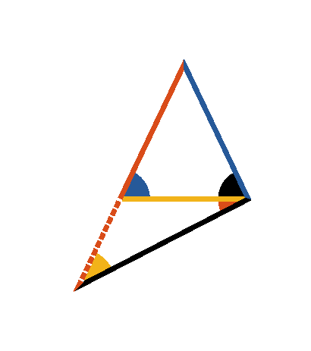



Book I. Prop. XVIII. Theor. Statement
In any triangle
if one side
be
greater than another
, the angle
opposite to the greater side is greater than
the angle opposite to the less. I.e.
.

Slide 52



Book I. Prop. XVIII. Theor. Proof
Make
(pr. I.3), draw
.
Then will
(pr. I.5);
but
(pr. I.16)
and much more
is
. Q. E. D.

Slide 53
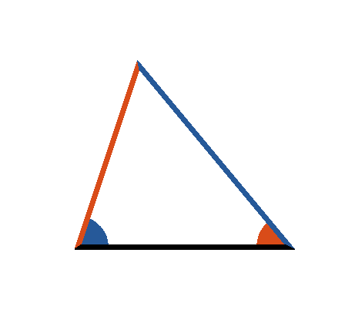



Book I. Prop. XIX. Theor. Statement
If in any triangle
one angle
be
greater than another
the side
which is opposite to the greater angle, is
greater than the side
opposite the
less.

Slide 54





Book I. Prop. XIX. Theor. Proof
If
be not greater than
then must
or
.
If
then
(pr. I.5);
which is contrary to the hypothesis.
is not less than
; for if it were,
(pr. I.18)
which is contrary to the hypothesis:
. Q. E. D.

Slide 55
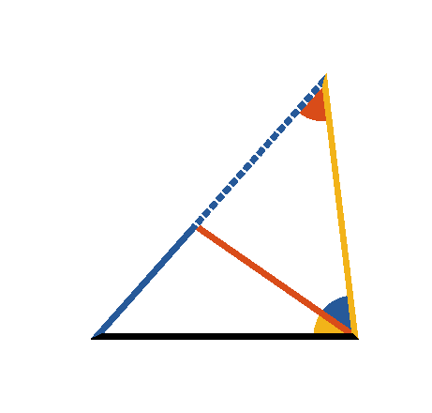

Book I. Prop. XX. Theor. Statement
Any two sides
and
of a
triangle
taken together are greater
than the third side (
).

Slide 56






Book I. Prop. XX. Theor. Proof
Produce
, and
make
(pr. I.3);
draw
.
Then
(const.),
(pr. I.5)
(ax. IX)
(pr. I.19)
and
. Q. E. D.

Slide 57
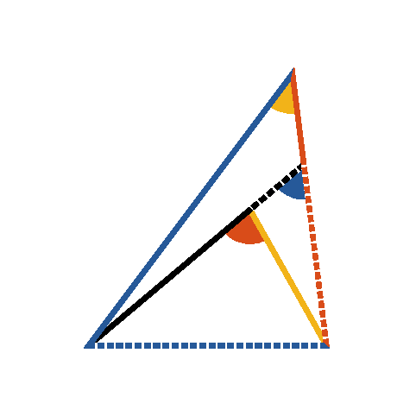


Book I. Prop. XXI. Theor. Statement
If from any point ([middle]D) within a
triangle
, straight lines be drawn to the
extremities of one side (
), these
lines must be together less than the other
two sides, but must contain a greater angle.

Slide 58








Book I. Prop. XXI. Theor. Proof
Produce
,
(pr. I.20),
add
to each,
(ax. IV)
in the same manner it may be shown that
,
,
which was to be proved.
Again
(pr. I.16),
and also
(pr. I.16),
. Q. E. D.

Slide 59
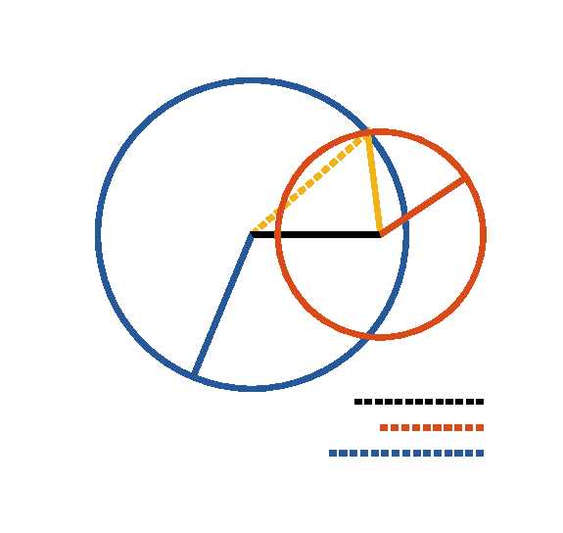

Book I. Prop. XXII. Prob. Statement
Given three right lines
the sum of
any two greater than the third, to
construct a triangle whose sides shall be
respectively equal to the given lines.

Slide 60




Book I. Prop. XXII. Prob. Proof
Assume
(pr. I.3).
With
and
as radii, describe
and
(post. III);
draw
and
,
then will
be the triangle required.
Q. E. D.

Slide 61
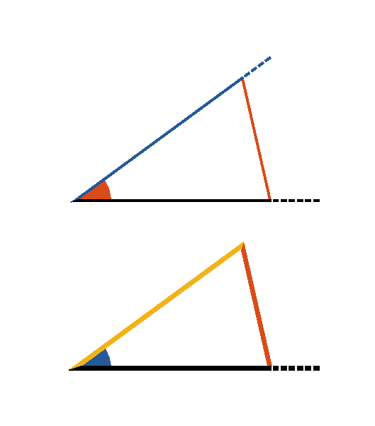


Book I. Prop. XXIII. Prob. Statement
At a given point (F) in a given straight line
(
), to make an angle equal to a
given rectilinear angle (
).

Slide 62
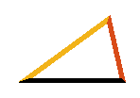


Book I. Prop. XXIII. Prob. Proof
Draw
between any two points in the legs
of the given angle.
Construct
(pr. I.22)
so that
,
and
.
Then
(pr. I.8). Q. E. D.

Slide 63
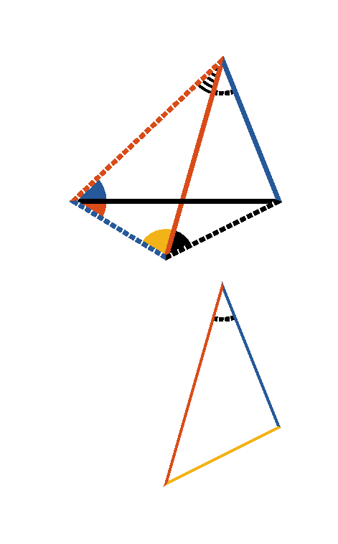



Book I. Prop. XXIV. Theor. Statement
If two triangles have two sides of the one
respectively equal to two sides of the other
(
to
and
to
), and if one of the angles (
)
contained by the equal sides be greater
than the other (
), the side (
)
which is opposite to the greater angle is
greater than the side (
) which is
opposite to the less angle.

Slide 64








Book I. Prop. XXIV. Theor. Proof
Make
(pr. I.23),
and
(pr. I.3),
draw
and
.
(ax. I, hyp., const.)
(pr. I.5)
but
,
and
,
(pr. I.19)
but
(pr. I.4)
. Q. E. D.

Slide 65
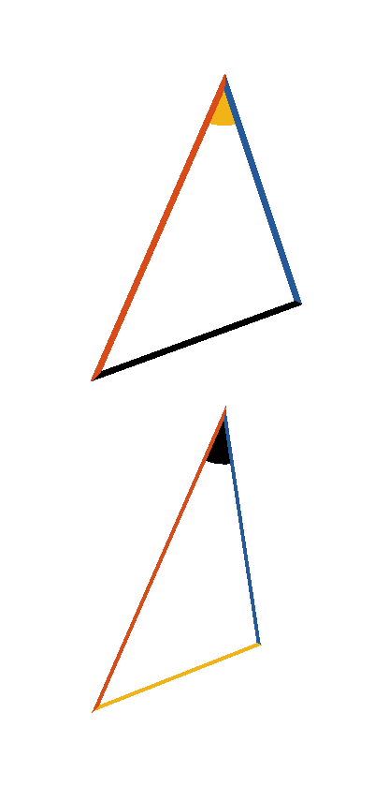
Book I. Prop. XXV. Theor. Statement
If two triangles have two sides (
and
) of the one respectively equal
to two sides (
and
) of the
other, but their bases unequal, the angle
subtended by the greater base (
) of
the one, must be greater than the angle
subtended by the less base (
) of the
other.

Slide 66








Book I. Prop. XXV. Theor. Proof
is not equal to
for if
then
(pr. I.4)
which is contrary to the hypothesis;
is not less than
for if
then
(pr. I.24),
which is also contrary to the hypothesis:
. Q. E. D.

Slide 67
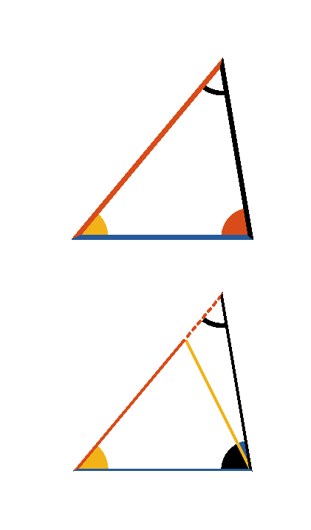


Book I. Prop. XXVI. Theor. Statement
If two triangles have two angles of the one
respectively equal to two angles of the
other (
and
), and a side
of the one equal to a side of the other
similarly placed with respect to the equal
angles, the remaining sides and angles are
respectively equal to one another.

Slide 68








Book I. Prop. XXVI. Theor. Proof — Case 1
Case I.
Let
and
which lie between the equal angles be equal,
then
.
For if it be possible, let one of them
be greater; make
, draw
.
In
and
we have
,
,
;
(pr. I.4)
but
(hyp.)
and therefore
, which is absurd;
hence neither of the sides
and
is greater than the other;
and
they are equal;
, and
(pr. I.4).

Slide 69
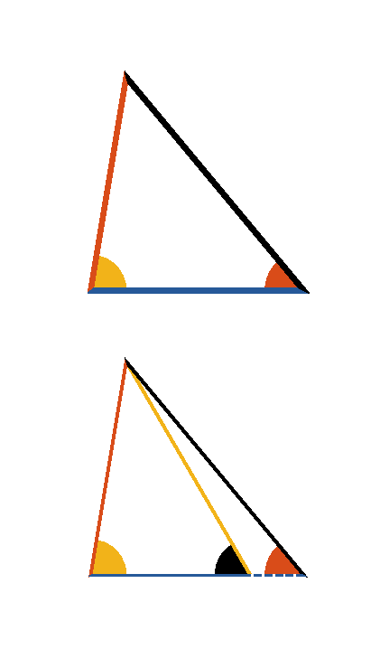










Book I. Prop. XXVI. Theor. Proof — Case 2
Case II.
Again, let
, which lie opposite the equal
angles
and
.
If it be possible, let
, then take
, draw
.
Then in
and
we have
,
and
,
(pr. I.4)
but
(hyp.)
which is absurd (pr. I.16).
Consequently, neither of the sides
or
is greater
than the other, hence they must be equal. It follows (pr. I.4) that
the triangles are equal in all respects. Q. E. D.

Slide 70
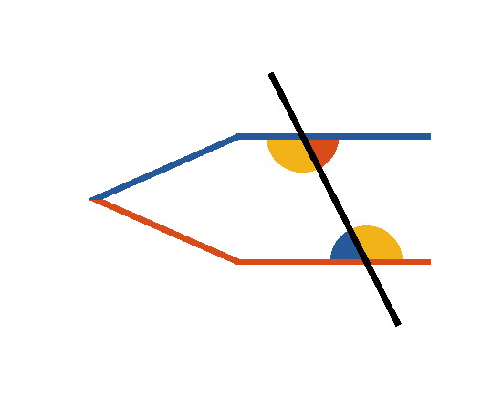




Book I. Prop. XXVII. Theor. Statement
If a straight line (
) meeting two
other straight lines (
and
)
makes with them the alternate angles (
and
;
and
) equal, these two
straight lines are parallel.

Slide 71
Book I. Prop. XXVII. Theor. Proof
If
be not parallel to
they shall meet
when produced.
If it be possible, let those lines be not parallel, but
meet when produced; then the external angle
is
greater than
(pr. I.16), but they are also equal
(hyp.), which is absurd: in the same manner it may
be shown that they cannot meet on the other side;
they are parallel. Q. E. D.

Slide 72







Book I. Prop. XXVIII. Theor. Statement
If a straight line (
), cutting two
other straight lines (
and
),
makes the external equal to the internal
and opposite angle, at the same side of the
cutting line (namely
or
),
or if it makes the two internal angles at the
same side (
and
, or
and
)
together equal to two right angles, those
two straight lines are parallel.

Slide 73






Book I. Prop. XXVIII. Theor. Proof
First, if
, then
(pr. I.15),
(pr. I.27).
Secondly, if
,
then
(pr. I.13),
(ax. III)
(pr. I.27). Q. E. D.

Slide 74
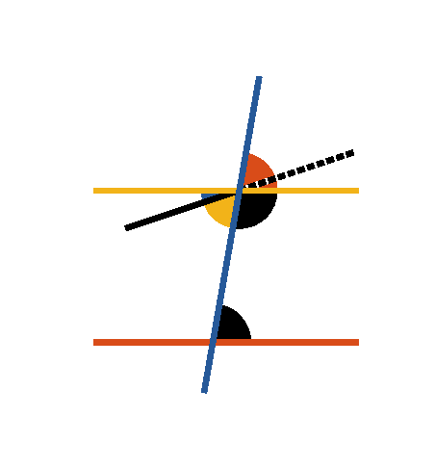
Book I. Prop. XXIX. Theor. Statement
A straight line (
) falling on two
parallel straight lines (
and
), makes the alternate angles equal to one
another; and also the external equal to the
internal and opposite angle on the same
side; and the two internal angles on the
same side together equal to two right
angles.

Slide 75








Book I. Prop. XXIX. Theor. Proof
For if the alternate angles
and
be not equal,
draw
, making
(pr. I.23).
Therefore
(pr. I.27) and therefore
two straight lines which intersect are parallel to the
same straight line, which is impossible (ax. XII).
Hence
and
are not unequal, that is, they are
equal:
(pr. I.15);
, the external angle
equal to the internal and opposite on the same side: if
be added to both, then
(pr. I.13).
That is to say, the two internal angles at the same side
of the cutting line are equal to two right angles. Q. E.
D.

Slide 76

Book I. Prop. XXX. Theor. Statement
Straight lines (
and
) which
are parallel to the same straight line (
), are parallel to one another.

Slide 77




Book I. Prop. XXX. Theor. Proof
Let
intersect
;
Then,
(pr. I.29),
(pr. I.28). Q. E. D.

Slide 78
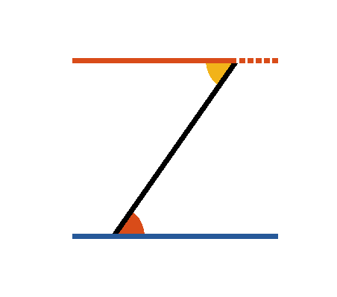
Book I. Prop. XXXI. Prob. Statement
From a given point ([middle][EB]E) to
draw a straight line parallel to a given
straight line (
).

Slide 79


Book I. Prop. XXXI. Prob. Proof
Draw
from the point [middle][EB]E to
any point [middle][CF]F in
,
make
(pr. I.23),
then
(pr. I.27). Q. E. D.

Slide 80
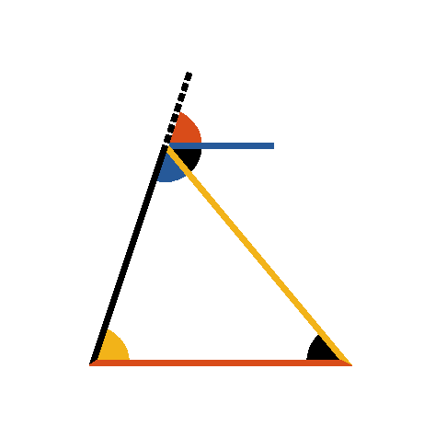



Book I. Prop. XXXII. Theor. Statement
If any side (
) of a triangle be
produced, the external angle (
) is equal
to the sum of the two internal and
opposite angles (
and
), and the
three internal angles of any triangle taken
together are equal to two right angles.

Slide 81





Book I. Prop. XXXII. Theor. Proof
Through the point [middle][AD,AE]A draw
(pr. I.31).
Then
(pr. I.29),
(ax. II),
and therefore
(pr. I.13). Q. E. D.

Slide 82
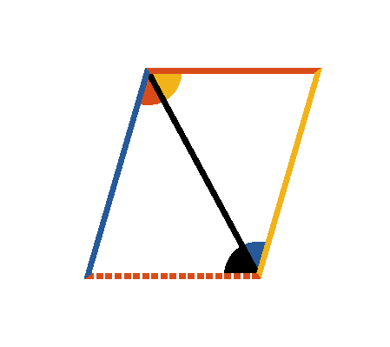
Book I. Prop. XXXIII. Theor. Statement
Straight lines (
and
) which
join the adjacent extremities of two equal
and parallel straight lines (
and
), are themselves equal and parallel.

Slide 83




Book I. Prop. XXXIII. Theor. Proof
Draw
the diagonal.
(hyp.)
(pr. I.29)
and
common to the two triangles;
, and
(pr. I.4);
and
(pr. I.27). Q. E. D.

Slide 84
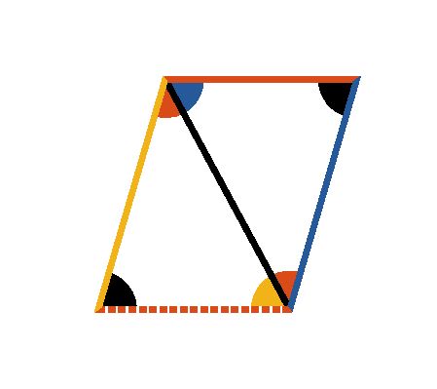
Book I. Prop. XXXIV. Theor. Statement
The opposite sides and angles of any
parallelogram are equal, and the diagonal (
) divides it into two equal parts.

Slide 85





Book I. Prop. XXXIV. Theor. Proof
(pr. I.29)
and
common to the two triangles.
(pr. I.26)
and
(ax. II).
Therefore the opposite sides and angles of the
parallelogram are equal: and as the triangles
and
are equal in every respect (pr. I.4), the diagonal
divides the parallelogram into two equal parts. Q.
E. D.

Slide 86

Book I. Prop. XXXV. Theor. Statement
Parallelograms on the same base, and
between the same parallels, are (in area)
equal.

Slide 87







Book I. Prop. XXXV. Theor. Proof
On account of the parallels,
(pr. I.29, I.34).
But
(pr. I.8)
,
and
;
. Q. E. D.

Slide 88



Book I. Prop. XXXVI. Theor. Statement
Parallelograms (
and
) on equal bases,
and between the same parallels, are equal.

Slide 89






Book I. Prop. XXXVI. Theor. Proof
Draw
and
(pr. I.34, hyp.);
;
(pr. I.33)
and therefore
is a parallelogram;
but
(pr. I.35)
(ax. I). Q. E. D.

Slide 90



Book I. Prop. XXXVII. Theor. Statement
Triangles
and
on the same base (
) and between the same parallels are
equal.

Slide 91





Book I. Prop. XXXVII. Theor. Proof
(pr. I.31)
Produce
.
and
are parallelograms on the same base and
between the same parallels, and therefore equal (pr.
I.35).
(pr. I.34)
. Q. E. D.

Slide 92
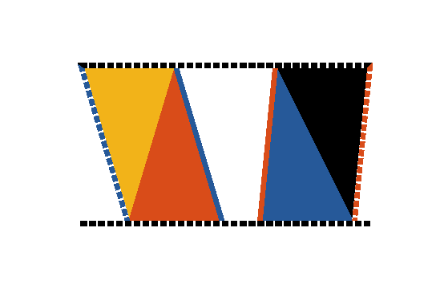


Book I. Prop. XXXVIII. Theor. Statement
Triangles (
and
) on equal bases and
between the same parallels are equal.

Slide 93





Book I. Prop. XXXVIII. Theor. Proof
(pr. I.31)
(pr. I.36);
but
(pr. I.34),
and
(pr. I.34),
(ax. VII). Q. E. D.

Slide 94



Book I. Prop. XXXIX. Theor. Statement
Equal triangles
and
on the same
base (
) and on the same side of it,
are between the same parallels.

Slide 95








Book I. Prop. XXXIX. Theor. Proof
If
, which joins the vertices of the triangles, be not
, draw
(pr. I.31), meeting
.
Draw
.
(const.)
(pr. I.37);
but
(hyp.);
,
a part equal to the whole, which is absurd.
; and in the same manner it can be
demonstrated that no other line except
is
;
. Q. E. D.

Slide 96
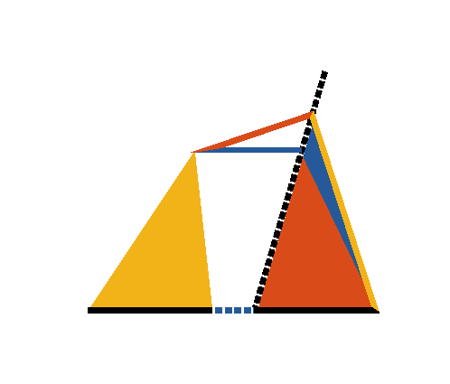


Book I. Prop. XL. Theor. Statement
Equal triangles (
and
) on equal bases,
and on the same side, are between the same
parallels.

Slide 97








Book I. Prop. XL. Theor. Proof
If
which joins the vertices of triangles be not
,
draw
(pr. I.31),
meeting
.
Draw
.
(const.)
(pr. I.38)
but
(hyp.)
,
a part equal to the whole, which is absurd.
: and in the same manner it can be demonstrated
that no other line except
is
:
.
Q. E. D.

Slide 98



Book I. Prop. XLI. Theor. Statement
If a parallelogram
and a triangle
are
upon the same base
and between
the same parallels
and
, the
parallelogram is double the triangle.

Slide 99



Book I. Prop. XLI. Theor. Proof
Draw
the diagonal.
Then
(pr. I.37)
(pr. I.34)
. Q. E. D.

Slide 100



Book I. Prop. XLII. Prob. Statement
To construct a parallelogram equal to a
given triangle
and having an angle
equal to a given rectilinear angle (
).

Slide 101





Book I. Prop. XLII. Prob. Proof
Make
(pr. I.10)
Draw
.
Make
(pr. I.23)
(pr. I.31)
(pr. I.41)
but
(pr. I.38)
. Q. E. D.

Slide 102



Book I. Prop. XLIII. Theor. Statement
The complements
and
of the
parallelograms which are about the
diagonal of a parallelogram are equal.

Slide 103
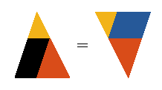


Book I. Prop. XLIII. Theor. Proof
(pr. I.34)
and
(pr. I.34)
(ax. III). Q. E. D.

Slide 104



Book I. Prop. XLIV. Prob. Statement
To a given straight line (
) to apply a
parallelogram equal to a given triangle (
), and having an angle equal to a given
rectilinear angle (
).

Slide 105







Book I. Prop. XLIV. Prob. Proof
Make
with
(pr. I.42)
and having one of its sides
conterminous with and
in continuation of
.
Produce
till it meets
;
draw
produce it till it meets
continued;
draw
meeting
produced and
produce
.
(pr. I.43)
but
(const.)
;
and
(pr. I.29, const.). Q. E. D.

Slide 106



Book I. Prop. XLV. Prob. Statement
To construct a parallelogram equal to a
given rectilinear figure (
) and having an
angle equal to a given rectilinear angle (
).

Slide 107








Book I. Prop. XLV. Prob. Proof
Draw
and
dividing the rectilinear
figure into triangles.
Construct
having
(pr. I.42)
to
apply
having
(pr. I.44)
to
apply
having
(pr. I.44)
and
is a parallelogram (pr. I.29, I.14, I.30)
having
. Q. E. D.

Slide 108

Book I. Prop. XLVI. Prob. Statement
Upon a given straight line (
) to
construct a square.

Slide 109






Book I. Prop. XLVI. Prob. Proof
Draw
(pr. I.11, I.3)
Draw
,
and meeting
drawn
.
In
(const.)
(const.)
(pr. I.29),
and the remaining sides and angles must be equal (pr.
I.34).
And
is a square (def. 30). Q. E. D.

Slide 110


Book I. Prop. XLVII. Theor. Statement
In a right angled triangle
the square
on the hypotenuse
is equal to the
sum of the squares of the sides (
and
).

Slide 111











Book I. Prop. XLVII. Theor. Proof
On
,
,
describe squares (pr. I.46)
Draw
(pr. I.31); also draw
and
.
.
To each add
:
,
and
;
(pr. I.4).
Again
(pr. I.41),
and
(pr. I.41);
.
In the same manner it may be shown that
;
hence
. Q. E. D.

Slide 112


Book I. Prop. XLVIII. Theor. Statement
If the square of one side (
) of a
triangle is equal to the squares of the other
two sides (
and
), the angle (
) subtended by that side is a right angle.

Slide 113










Book I. Prop. XLVIII. Theor. Proof
Draw
and
(pr. I.11, I.3)
and draw
also.
Since
(const.)
;
but
(pr. I.47),
and
(hyp.)
,
;
and
(pr. I.8),
consequently
is a right angle. Q. E. D.

