Slide 1
BUILDmypc

Slide 2
Objectives:
To deliver user-customised PC.
To guide user to come up with the fulfilling product .
To ensure proper usage of user’s resources.

Slide 3
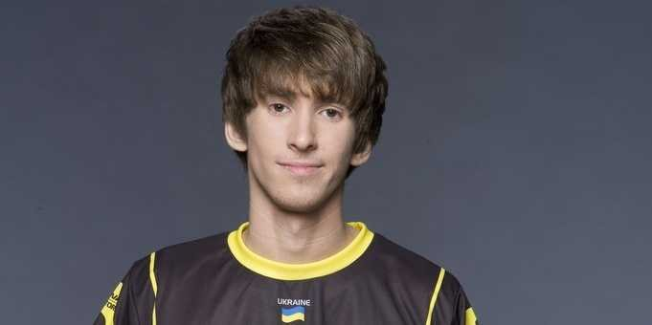






Dendi
EXPERIENCED GAMER
age:
25
title:
Pro Gamer
Gender:
Male
Industry:
Entertainment/Computer Gaming
Description:
Dendi is a 25 year old professional gamer.
He feels poorly losing a game and doesn’t like talking about it. .
Raking in more money each year through tournaments and from sponsors.
Lives with his parents , but makes enough money to live alone.
He is a homebody.
Was a state level soccer player.
Knows ethical-hacking .
needs:
A gaming rig with the most recent heavy hardware.

Slide 4





JOHNNY RAIL
SKILLED MANAGER
age:
36
title:
CEO at MSPA
gender:
Male
Industry:
Technical Support
description:
Johnny Rail is a 36 year old CEO.
He became a CEO at MSPA through his extensive skills in managing any responsibility.
Has hopes to make it big with his company.
Loves to cook. Has a blog on cooking.
Passionate driver. Loves to go on long rides.
Religious person. Attends church every week.
Puts his wife’s and children’s needs first.
He is a diabetic patient.
needs:
Large number of PCs with a specific network card for his organisation.

Slide 5
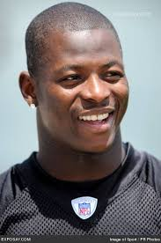

MAXWELL MACHITO
YOUTUBER
age:
28
title:
Avid YouTube
Gender:
Male
Industry:
Entertainment
Description:
Maxwell Machito is a 28 year old You Tuber.
He mostly makes videos about fitness.
He is single . And has a no marraige policy.
He is an atheist.
Does not like people who do not maintain their body fitness.
Beginner in golf.
Was a navy seal.
Short-tempered.
needs:
A budget PC just for website maintenance and uploading videos on YouTube.

