Slide 1
WELCOME

Slide 2
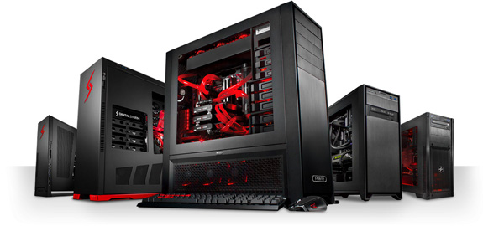
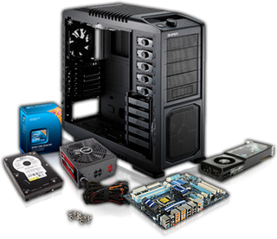
BUILDmyPC

Slide 3
Objectives :-
To deliver user-customised PC.
To guide user to come up with a fulfilling product .
To ensure proper usage of user’s resources.
BUILDmyPC

Slide 4







Dendi
EXPERIENCED GAMER
age:
25
title:
Pro Gamer
Gender:
Male
Industry:
Entertainment/Computer Gaming
Description:
Dendi is a 25 year old professional gamer.
He feels poorly losing a game and doesn’t like talking about it. .
Raking in more money each year through tournaments and from sponsors.
Lives with his parents , but makes enough money to live alone.
He is a homebody.
Was a state level soccer player.
Knows ethical-hacking .
needs:
A gaming rig with the most recent heavy hardware.

Slide 5





JOHNNY RAIL
SKILLED MANAGER
age:
36
title:
CEO at MSPA
gender:
Male
Industry:
Technical Support
description:
Johnny Rail is a 36 year old CEO.
He became a CEO at MSPA through his extensive skills in managing any responsibility.
Has hopes to make it big with his company.
Loves to cook. Has a blog on cooking.
Passionate driver. Loves to go on long rides.
Religious person. Attends church every week.
Puts his wife’s and children’s needs first.
He is a diabetic patient.
needs:
Large number of PCs with a specific network card for his organisation.

Slide 6


MAXWELL MACHITO
YOUTUBER
age:
28
title:
Avid YouTube
Gender:
Male
Industry:
Entertainment
Description:
Maxwell Machito is a 28 year old You Tuber.
He mostly makes videos about fitness.
He is single . And has a no marriage policy.
He is an atheist.
Does not like people who do not maintain their body fitness.
Beginner in golf.
Was a navy seal.
Short-tempered.
needs:
A budget PC just for website maintenance and uploading videos on YouTube.

Slide 7
STAKE HOLDERS
Customer
Parts manufacturer
Assemblers
Delivery/couriers
BUILDmyPC
BUILDmyPC

Slide 8
DESIGN UI/UX DESIGN GUIDELINES
Original and familiar UI Design patterns
Ease of use
BUILDmyPC

Slide 9
FRONTEND
It is a Cleaned and structured interface.
Responsive Design
It is a ability to display the products tailored to the individual user needs .
It provides Cross-device compatibility
BUILDmyPC

Slide 10
BACKEND
Maintain a database of
Inter-Compatibility information for all parts available for PC
All parts sorted according to performance
Have facility for accepting user input and storing it.
Process the user input by comparing with internal database.
Create a list of parts that fulfill the user requirements as well as compatibility criteria.
Make this list available to another sector that assembles the PC
Arrange for delivery.
BUILDmyPC

Slide 11
REQUIREMENTS GATHERING
Gather information from user. Information shall include details such as
Intended area of PC use (Business/Gaming/Home use etc. )
Specific requirements/Mandatory requirements
Budget
Delivery date
Ask the user for details as to how he/she intends to use the PC and in what environment. Get to know the intention for the PC and whether the PC must be inclined towards having more CPU processing, Graphical processing, Storage or Real time calculation works.
BUILDmyPC

Slide 12
PROCESS
Search database for parts as per the requirements. Prioritize the requirements as per the clause 1 of requirements.
Check for compatibility using compatibility data from database.
Find the optimal components that fall within the budget criteria.
Store end PC specification.
Make end PC specification available to PC assembler.
Deliver the Ordered product.
BUILDmyPC

Slide 13
USER DIGITAL
JOURNEY
MAP
BUILDmyPC

Slide 14

ROAMS AROUND IN THE STREET TO FIND GAMING PC
COMES OUT AS A WINNER
ADITHYA
21 YEARS OLD
COLLEGE STUDENT
NOT SATISFIED WITH THE CURRENT SYSTEM
EXPLORES MORE BUT COULDN’T FIND A RIGHT SYSTEM
PARTICIPATES AT LOCAL TOURNAMENTS
GETS GRADUATED
PLAYS DAWN TO DUSK
SEARCHES IN INTERNET
GETS INTERESTED IN GAMING
NO PLACEMENTS
QUITS JOB
FINDS BUILDmyPC
NO MONEY
NO FUN
SEARCH FOR JOBS
PLACES THE ORDER FOR PC
ONE YEAR
LATER
TWO YEARS
LATER
NO JOB
DOES A PART TIME JOB TO ACCOMMODATE PC

Slide 15
SOFTWARE MOCKUP
WORKFLOWS
BUILDmyPC

Slide 16
HOME SCREEN
CUSTOMIZED
PROCESSOR
PRE-BUILD
GPU
COMPATIBILITY
CATEGORIES
COMPONENTS
STORAGE
MOTHERBOARD
GAMING
HOME USERS
ORGANISATION
LOGIN
VARIANTS
VARIANTS
VARIANTS
CONFIRM
SUMMARY TOTAL
ACCOUNT NO
SELECTING
A
PC
ACCOUNT NO
CONFIRMATION
DESCRIPTION
ORDER ID
PIN NUMBER
ENDING TASK
CHECK-OUT
BUILDmyPC

Slide 17
UNIQUE FEATURES OF THE PRODUCT
Design, Assembly and Delivery all in a single platform
Assures compatibility of all the components
Provides PCs at cost lower than others
Full control of customizability to customers
BUILDmyPC

Slide 18


SWOT ANALYSIS

Slide 19
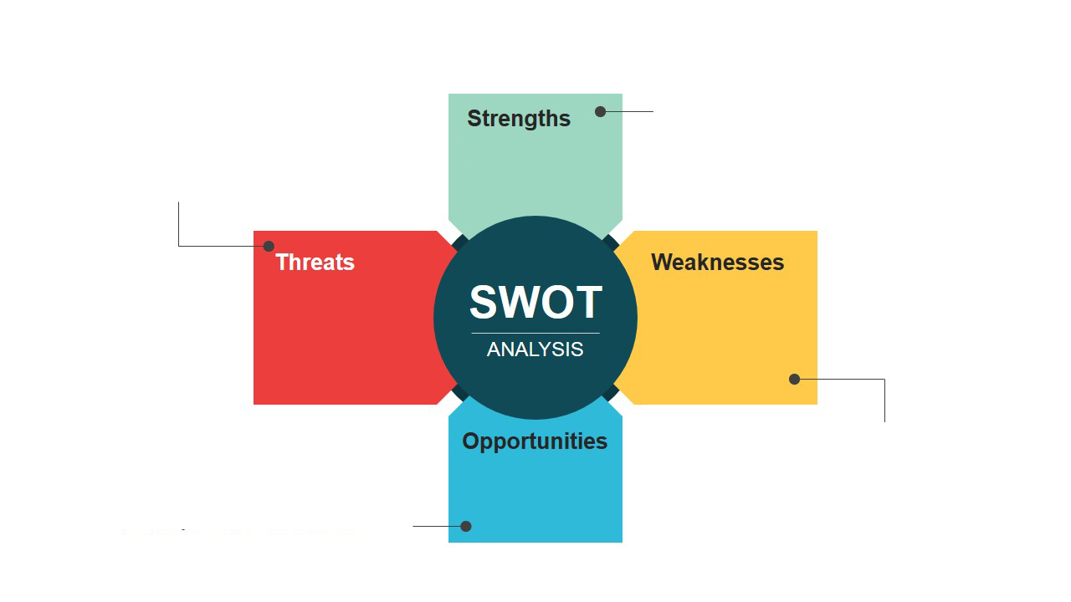
The Only website for designing, assembling and delivering PCs
Confidence of compatibility for customers
Provides a unified platform for building custom PCs
Consumers are moving towards laptops and smart phones
Similar services provided in the market
New concept may be vulnerable to issues like component failure
Delivery issues due to large size of product
Opportunity for providing even more types of PCs
Increase capacity of assembly

Slide 20
THE END
BUILDmyPC
BUILDmyPC

