Slide 1

Gemma 4 E4B
Local AI for Enterprise Innovation
On-Premise LLM Deployment via Docker + MCP Server Integration
Innovation Team — Williams-Sonoma, Inc.
May 2026

Slide 2




Executive Summary
We deployed Google's Gemma 4 E4B model locally via Docker, exposed it as an MCP server, and integrated it across Claude Desktop, VS Code, ChatGPT-compatible interfaces, and Codex alternatives — creating a hybrid AI pattern that keeps sensitive data on-premise while reducing cloud API costs.
Data Sovereignty
Cost Reduction
100% on-premise inference. Zero data leaves your machine. Air-gapped capable.
$0/token for local calls. ~2,365 tokens offloaded per analysis. Scales with volume.
Multi-Tool Integration
Production Ready
Claude Desktop, VS Code, CLI, ChatGPT interfaces, and Codex alternatives.
Docker Compose deployment. Health checks. Auto-restart. Persistent volumes.
2

Slide 3

What is Gemma 4 E4B?
Model Specifications
Why E4B for Enterprise?
Developer
Google DeepMind
Runs on any Apple Silicon Mac (M1+) — no GPU required in Docker
Architecture
Transformer (decoder-only)
Small enough for laptop deployment (9.6 GB) but capable for focused tasks
Parameters
4B effective (E4B variant)
OpenAI-compatible API — drop-in replacement for many integrations
Quantization
Q4_K_M (4-bit)
128K context window supports large document analysis
Disk Size
9.6 GB
Multimodal (text + image) enables visual analysis use cases
Context Window
128K tokens (max)
Google-backed with commercial license — enterprise safe
Modality
Text + Image input
Quantized (4-bit) for optimal memory/quality trade-off
License
Gemma License (commercial OK)
Perfect for hybrid pattern: offload structured tasks from cloud AI
Ollama Tag
gemma4:e4b
3

Slide 4
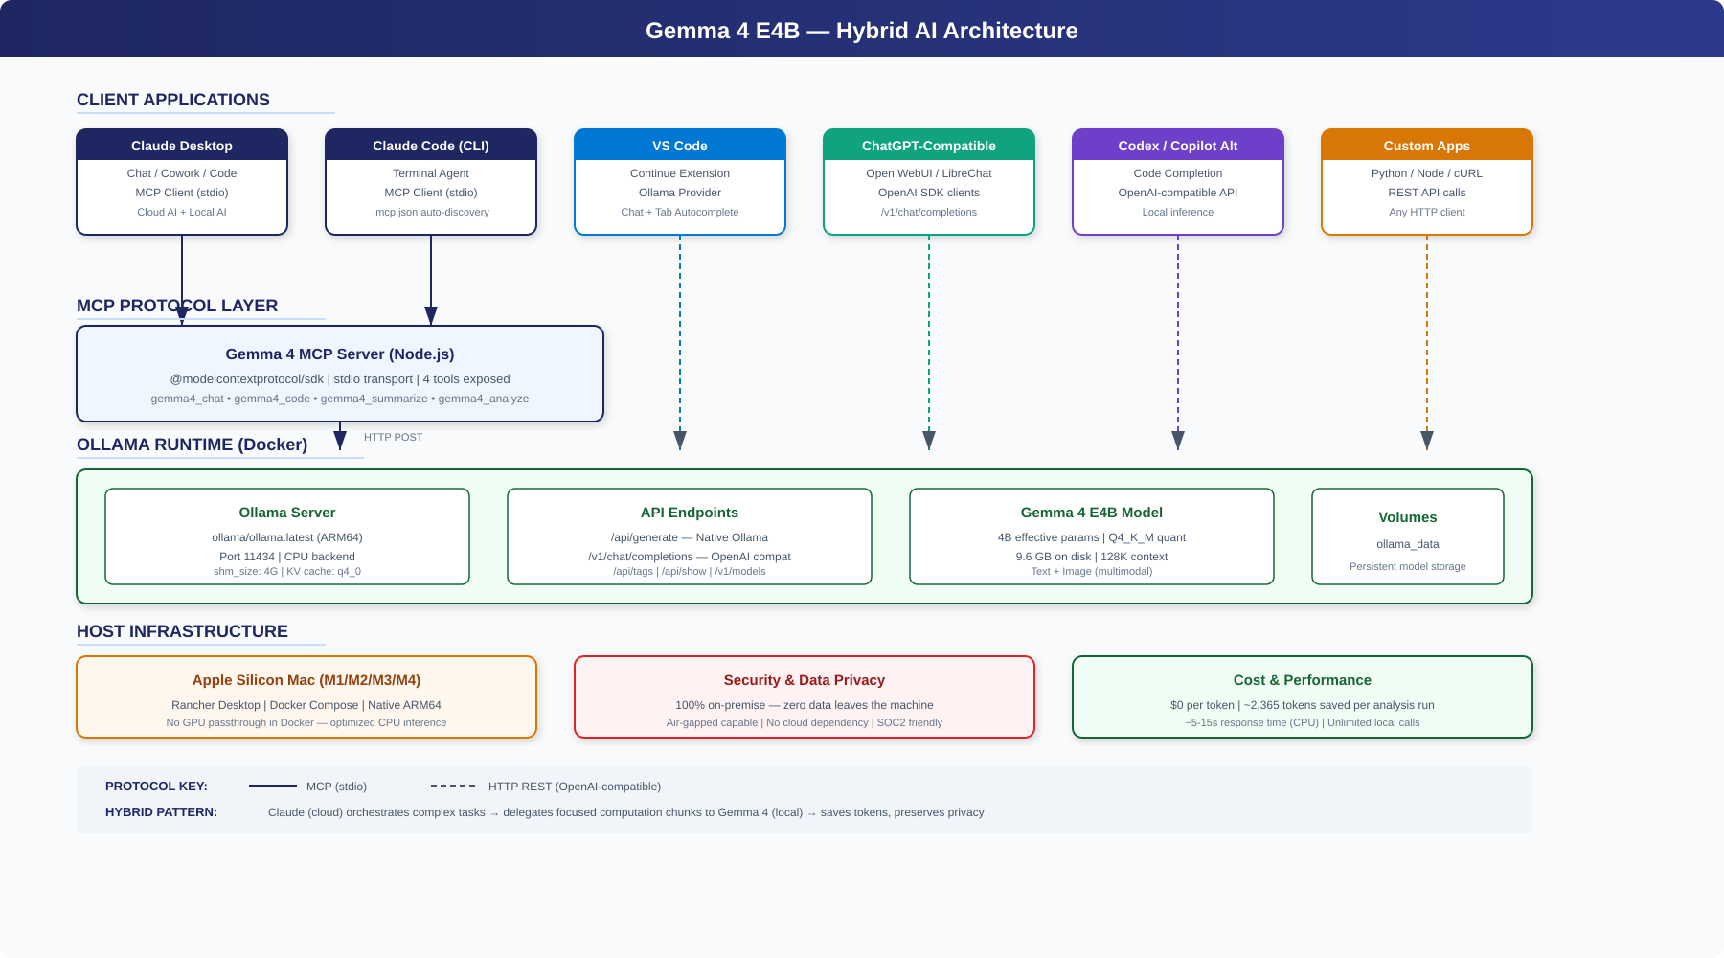
System Architecture
4

Slide 5
Docker + Ollama Deployment
docker-compose.yml
Key Configuration Decisions
services:
ollama:
image: ollama/ollama:latest
container_name: gemma4-ollama
ports: ["11434:11434"]
environment:
OLLAMA_HOST: 0.0.0.0
OLLAMA_ORIGINS: "*"
OLLAMA_NUM_PARALLEL: 1
OLLAMA_KV_CACHE_TYPE: q4_0
OLLAMA_CONTEXT_LENGTH: 4096
OLLAMA_FLASH_ATTENTION: false
OLLAMA_LLM_LIBRARY: cpu
shm_size: '4g'
restart: unless-stopped
healthcheck:
test: curl -f localhost:11434/api/tags
interval: 30s
CPU Backend
OLLAMA_LLM_LIBRARY=cpu prevents ARM64 crashes in Docker (no GPU passthrough)
Flash Attention Off
Crashes on ARM64 CPU in Docker containers — disabled for stability
KV Cache q4_0
4-bit quantized KV cache reduces memory footprint by ~40%
Context 4096
Reduced from 128K to fit in Docker container memory safely
shm_size 4G
Shared memory for model loading — prevents allocation failures
Health Checks
Automatic recovery with curl-based health monitoring every 30s
Persistent Volume
ollama_data volume preserves model across container restarts
5

Slide 6
MCP Server — Bridge to Claude Ecosystem
The MCP (Model Context Protocol) server exposes Gemma 4 as callable tools within Claude's ecosystem. Built with @modelcontextprotocol/sdk, it translates MCP tool calls into Ollama's OpenAI-compatible API requests.
gemma4_chat
gemma4_code
General chat, brainstorming, second opinions from a different AI model
Code generation, review, refactoring, debugging with language-aware prompts
Temperature: 0.7
Temperature: 0.3
gemma4_summarize
gemma4_analyze
Brief, detailed, bullet, or executive summaries with max-length control
Architecture, security, performance, readability, and bug analysis
Temperature: 0.3
Temperature: 0.4
Transport: stdio | SDK: @modelcontextprotocol/sdk | Runtime: Node.js | API: Ollama /v1/chat/completions
6

Slide 7
Integration: Claude Desktop
Chat Mode
Cowork Mode
Code Mode
Use Gemma 4 tools alongside Claude for brainstorming, Q&A, and getting second opinions. Ask Claude to delegate specific questions to the local model.
Automate file tasks and document processing. Claude orchestrates while Gemma 4 handles focused computation chunks — the hybrid AI pattern in action.
Full agentic coding with local AI assistance. Claude reads your codebase while Gemma 4 reviews individual functions, generates tests, or explains algorithms.
~/Library/Application Support/Claude/claude_desktop_config.json
{
"mcpServers": {
"gemma4-local": {
"command": "node",
"args": ["/path/to/mcp-server/index.js"],
"env": { "OLLAMA_BASE_URL": "http://localhost:11434", "GEMMA_MODEL": "gemma4:e4b" }
}
}
}
7

Slide 8
Integration: VS Code + Continue Extension
Inline Chat
Tab Autocomplete
Cmd+L opens AI chat panel. Ask Gemma 4 questions about your code directly in the editor.
Real-time code suggestions as you type. Gemma 4 provides context-aware completions locally.
Custom Commands
Edit-in-Place
/review, /explain, /refactor, /tests — pre-built commands for common development workflows.
Cmd+I for inline edits. Select code, describe changes, Gemma 4 rewrites it in place.
.continue/config.json
{
"models": [{ "title": "Gemma 4 E4B (Local)", "provider": "ollama",
"model": "gemma4:e4b", "apiBase": "http://localhost:11434" }],
"tabAutocompleteModel": { "title": "Gemma 4 Autocomplete", "provider": "ollama",
"model": "gemma4:e4b", "apiBase": "http://localhost:11434" },
"customCommands": [{ "name": "review", "prompt": "Review for bugs and improvements..." }]
}
8

Slide 9
Integration: ChatGPT-Compatible & Codex Alternatives
ChatGPT-Compatible Interfaces
Codex / Code Completion
Ollama's /v1/chat/completions endpoint is fully OpenAI-compatible, enabling drop-in connections to any ChatGPT-style UI:
Gemma 4 serves as a local alternative to cloud-based code completion services:
Open WebUI — full ChatGPT clone (included in docker-compose with --profile webui)
VS Code Continue — tab autocomplete with zero cloud dependency
LibreChat — multi-model chat with plugin support
Cody (Sourcegraph) — supports Ollama as a local provider
LobeChat — modern UI with agent marketplace
Aider — AI pair programming CLI with Ollama backend
Any OpenAI SDK client — just point BASE_URL to localhost:11434/v1
Claude Code CLI — MCP server enables gemma4_code tool for code tasks
Python/Node apps — openai.ChatCompletion.create() works directly
Cursor-like workflows — local model for completions, cloud for complex reasoning
cURL — direct REST calls for scripting and automation
CI/CD pipelines — automated code review with local inference
9

Slide 10
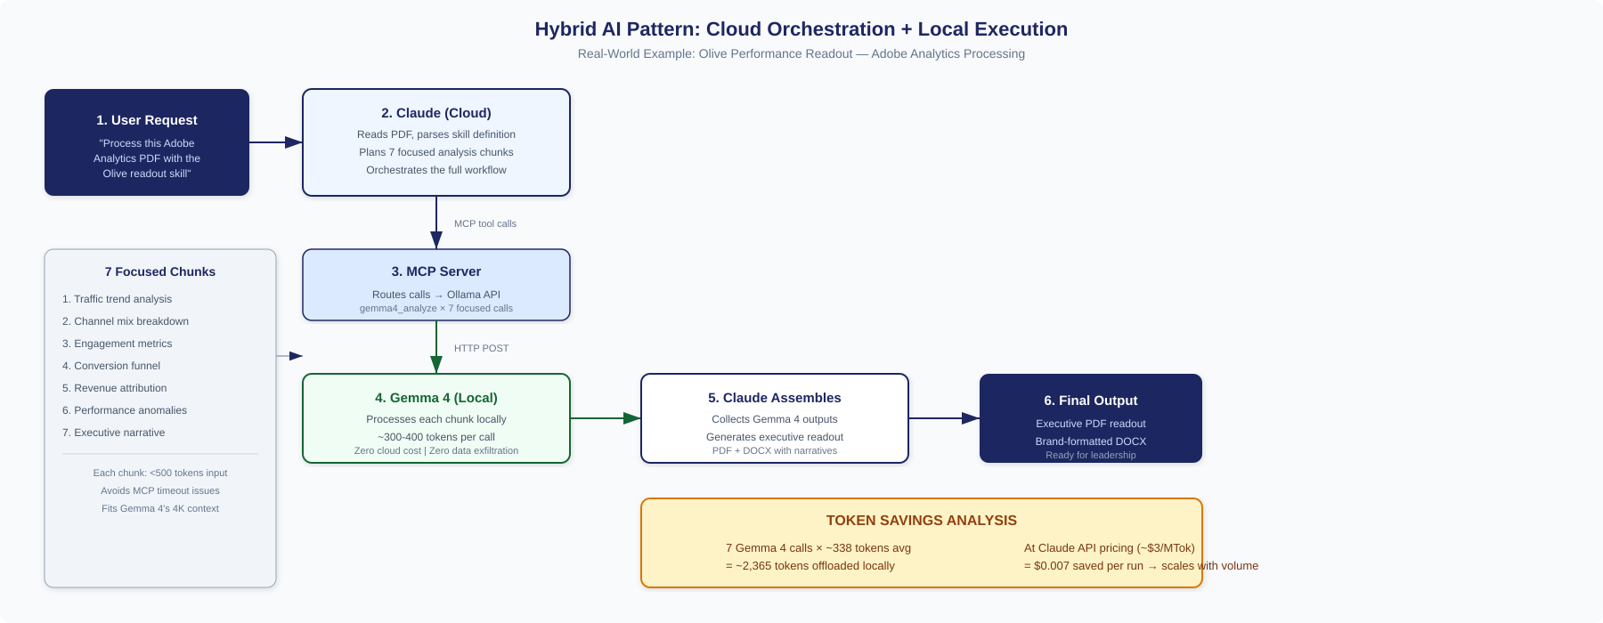
Hybrid AI Pattern — Cloud + Local
10

Slide 11
Case Study: Olive Performance Readout
Demonstrating the hybrid pattern on a real WS use case: processing Adobe Analytics data through the Olive skill to generate a brand-formatted executive readout.
1
2
3
4
5
Input
>
Claude Parses
>
Gemma 4 Analyzes
>
Claude Assembles
>
Output
Adobe Analytics PDF with Olive campaign performance data
Reads PDF + skill definition, plans 7 focused analysis chunks
7 MCP calls: traffic, channels, engagement, conversion, revenue, anomalies, narrative
Combines Gemma 4 outputs into cohesive executive narrative
Brand-formatted PDF + DOCX readout ready for leadership review
Results
7 Gemma 4 calls completed successfully
~2,365 tokens processed locally ($0 cloud cost)
Each call <500 tokens input — fits 4K context, avoids MCP timeout
Output: 2-page executive PDF + branded DOCX with participation vs. direct attribution analysis
11

Slide 12
Token Savings & ROI Analysis
$0
2,365
7
100%
Per Token
(Local)
Tokens Saved
Per Run
MCP Calls
Per Analysis
Data Stays
On-Premise
Projected Savings at Scale
Scenario | Runs/Month | Tokens Offloaded | Cloud Cost Saved | Annual Savings
Individual analyst | 50 | 118,250 | $0.35/mo | $4.26
Team of 10 | 500 | 1,182,500 | $3.55/mo | $42.55
Department (50 users) | 2,500 | 5,912,500 | $17.74/mo | $212.85
Enterprise (500 users) | 25,000 | 59,125,000 | $177.38/mo | $2,128.50
+ Additional use cases | 100,000+ | 236,500,000+ | $709.50+/mo | $8,514+
Note: Cloud cost estimated at ~$3/MTok (Claude API). Real savings multiply as more tasks are offloaded (code review, summarization, analysis).
12

Slide 13
Security & Data Privacy
Zero Data Exfiltration
Network Isolation
Compliance Ready
All Gemma 4 inference runs locally. No API keys for local calls. No data transmitted to any third-party server. Complete air-gap capability.
Ollama container only exposes localhost:11434. No external network calls during inference. Docker network policies restrict outbound traffic.
SOC2, HIPAA, PCI-DSS friendly. Sensitive data never leaves the machine boundary. Audit logs via Docker container logs. No cloud provider data retention.
Enterprise Controls
IP Protection
Access Management
Persistent volumes for model versioning. Health checks for reliability. Auto-restart on failure. Container isolation from host system. Resource limits configurable.
Proprietary code and documents processed locally. No training data leakage risk. Model weights are read-only. No fine-tuning happens without explicit setup.
Localhost-only access by default. OLLAMA_ORIGINS controls CORS. Can be fronted by enterprise auth proxy. No built-in auth = no attack surface.
13

Slide 14
Challenges & Lessons Learned
Docker Hub Registry Timeout
Created fallback pull methods: rdctl VM pull, Google mirror, manual load. Added fix-registry.sh diagnostic script.
Model Too Large for Memory
Removed Docker memory limit, added q4_0 KV cache, reduced context to 4096, tuned parallel=1. Three iterations to stabilize.
ARM64 Flash Attention Crash
Disabled flash attention + forced CPU backend (OLLAMA_LLM_LIBRARY=cpu). Root cause: no GPU passthrough in Docker on Apple Silicon.
MCP Tool Timeout on Large Prompts
Broke analysis into 7 small focused calls (<500 tokens each). Pattern: Claude chunks, Gemma 4 processes, Claude assembles.
Key takeaway: Local LLM deployment requires iterative tuning. Docker + Apple Silicon + large models = unique memory/stability challenges that are now fully solved.
14

Slide 15


Roadmap & Next Steps
Phase 1: Current (Complete)
Phase 2: Near-Term
Phase 3: Scale
Gemma 4 E4B running in Docker
Open WebUI deployment for team access
Kubernetes deployment for shared access
MCP server with 4 tools
Additional MCP tools (RAG, embeddings)
Model fine-tuning on WS domain data
Claude Desktop + CLI integration
GPU-enabled host for faster inference
Automated CI/CD code review pipeline
VS Code Continue extension
More Cowork skills using hybrid pattern
Multi-model routing (Gemma + others)
Olive readout demo validated
Team onboarding documentation
Enterprise proxy with auth + logging
15

Slide 16
Thank You
Questions & Discussion
Innovation Team — Williams-Sonoma, Inc.
Repo: gemma4-with-vscode | Ollama: localhost:11434 | MCP Server: gemma4-local

