Slide 1

LOW DROPOUT VOLTAGE Regulator
[LDO]
MENTOR- Dr. Sujata S Kotabagi

Slide 2

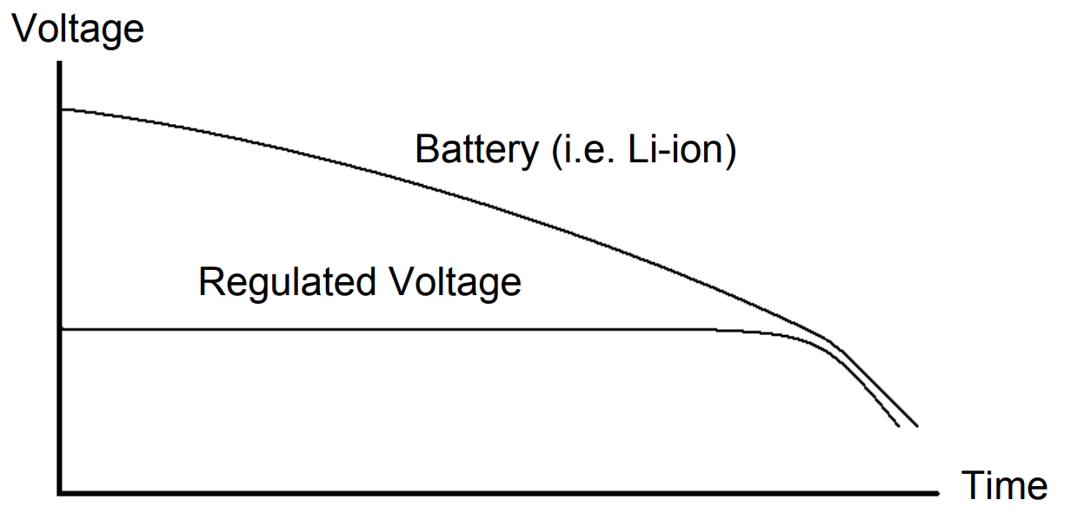
Power management
Why do we need power management?
>Batteries discharge “almost” linearly with time. – To optimize the charging of batteries to be safe and extend their life. –
>Circuits with reduced power supply that are time dependent.
>To optimize the charging of batteries to be safe and extend their life.
>Circuits with reduced power supply that are time dependent operate poorly. Optimal circuit performance can not be obtained
>Mobile applications impose saving power as much as possible. Thus, the sleep‐mode and full‐power mode must be carefully controlled
>Objective of a power converter is to provide a regulated output voltage

Slide 3
The LDO act as a variable resistor that is placed between input power source and the load in order to drop and control the voltage applied to the load.
Compared to DC‐DC switching regulators, LDOs are: –
Of continuous operation
Easier to use
Cheaper solution
But of Lower efficiency

Slide 4

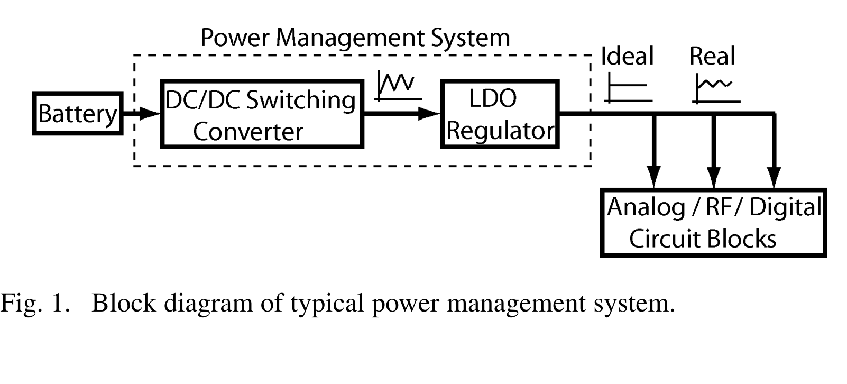
LDO-Low dropout regulator
An important building block in power management is the low drop-out (LDO) linear regulator which often follows a DC-DC switching converter, as shown in Fig. 1. It is used to regulate the supplies ripples to provide a clean voltage source for the noise-sensitive analog/RF blocks

Slide 5

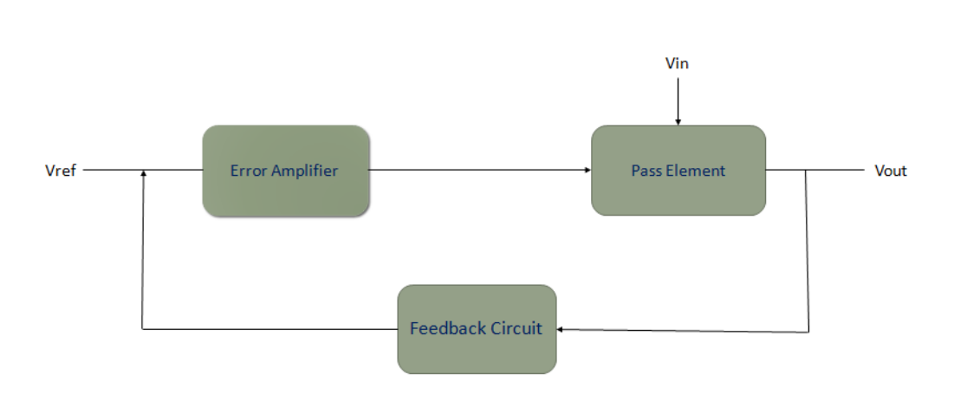
Block diagram of LDO
The feedback circuit is in capable of scaling down the output voltage so that the error amplifier may compare it to the reference value
The fundamental criterion for the error amplifier’s design is that it draw as little current as feasible. Since the pass transistor’s gate capacitance is significant, the amplifier’s output resistance must be as low as reasonable.
The feedback circuit scaled-down output voltage is one input of the error amplifier, while the reference voltage is the other.
The error amplifier then modifies the resistance of the pass element based on the correlation. Reference voltage serves as the beginning point for every regulator since it establishes the operating point of the error amplifier. A band-gap type voltage reference is typically employed since it allows for operation at low supply voltages.

Slide 6

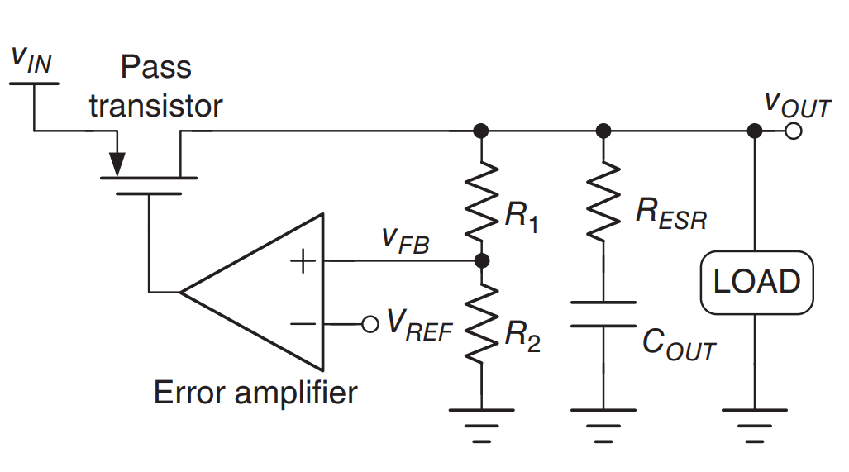
Structure of basic LDO architecture
Pass transistor
> load current will determine its size and thus layout
• Error amplifier
The accuracy required by the LDO, determines the magnitude of the open loop gain.
Single pole architectures are recommended for better and easier stability.
The amp transient requirement is dependent on the stability i.e. gain and phase margins. There is a trade‐off in making the PM high and speed of amp. This is also true for the Gain.
Should have high PSRR

Slide 7

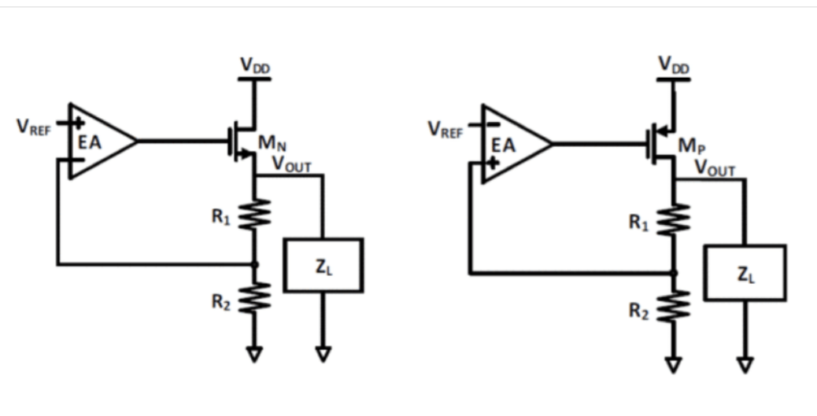
Types of LDO.
> i) N channel MOSFET LDO.
> ii) P channel MOSFET LDO.
N channel LDO
P channel LDO

Slide 8

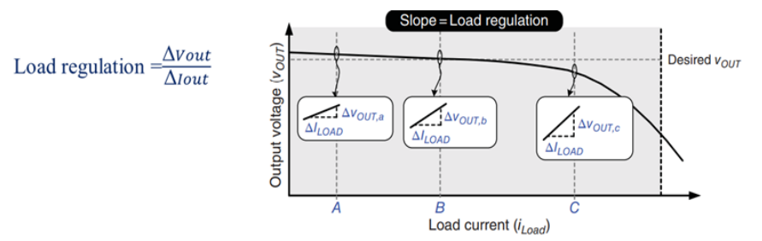
Performance parameters:-
Load regulation:-change in output voltage with respect to change in load current.

Slide 9
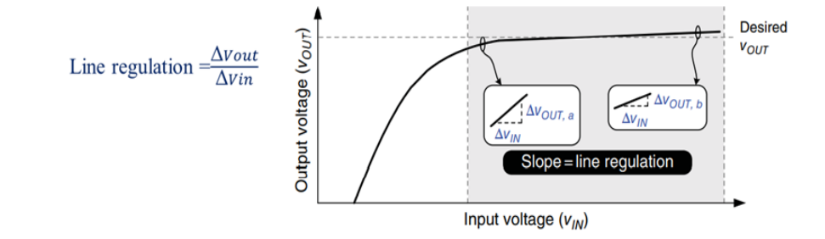
.
2.Line regulation:-change in output voltage with respect to change in input voltage.

Slide 10

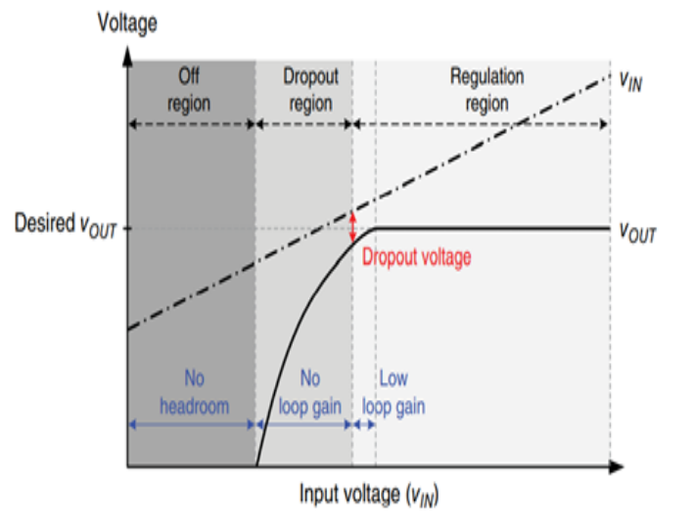
3.Dropout voltage (Vdo):
This is the difference between the minimum voltage the input DC supply can attain and the regulated output voltage.

Slide 11
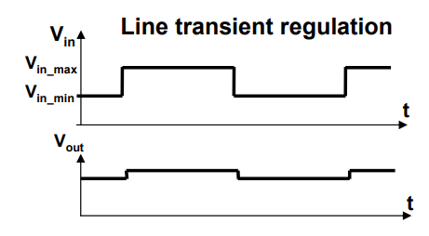
Line regulation:
This is the variation in output voltage as supply voltage is varied from min. to max.
Line regulation is a steady state parameter. increase in loop gain improves line regulation

Slide 12
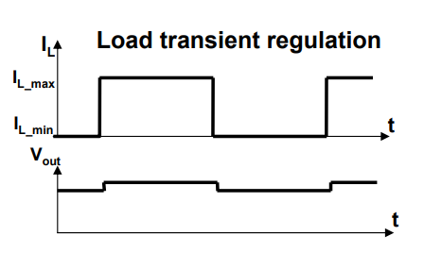
LOAD REGULATION
Load regulation: This is the variation in output voltage as current moves from min. to max . It defines the output resistance of ldo
Ideally line regulation is zero

Slide 13
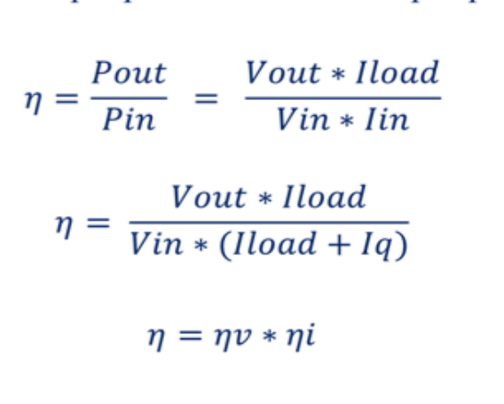
Efficiency
It is the ratio of output power Pout to the ratio of input Pin.

Slide 14
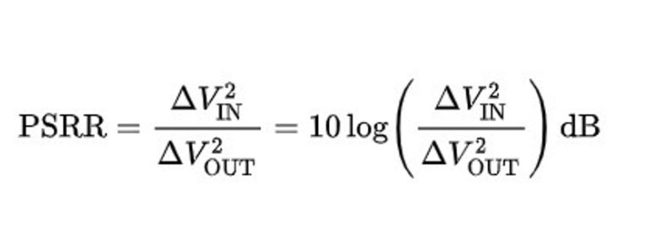
Power supply rejection ratio
Power Supply Rejection Ratio or Power Supply Ripple Rejection (PSRR) is a measure of a circuit’s power supply’s rejection expressed as a log ratio of output noise to input noise.
PSRR provides a measure of how well a circuit rejects ripple, of various frequencies, injected at its input. In the case of LDOs, PSRR is a measure of the regulated output voltage ripple compared to the input voltage ripple over a wide frequency range (10Hz to 1MHz is common) and is expressed in decibels (dB).
The PSRR is very critical parameter in many audio and RF applications.

Slide 15
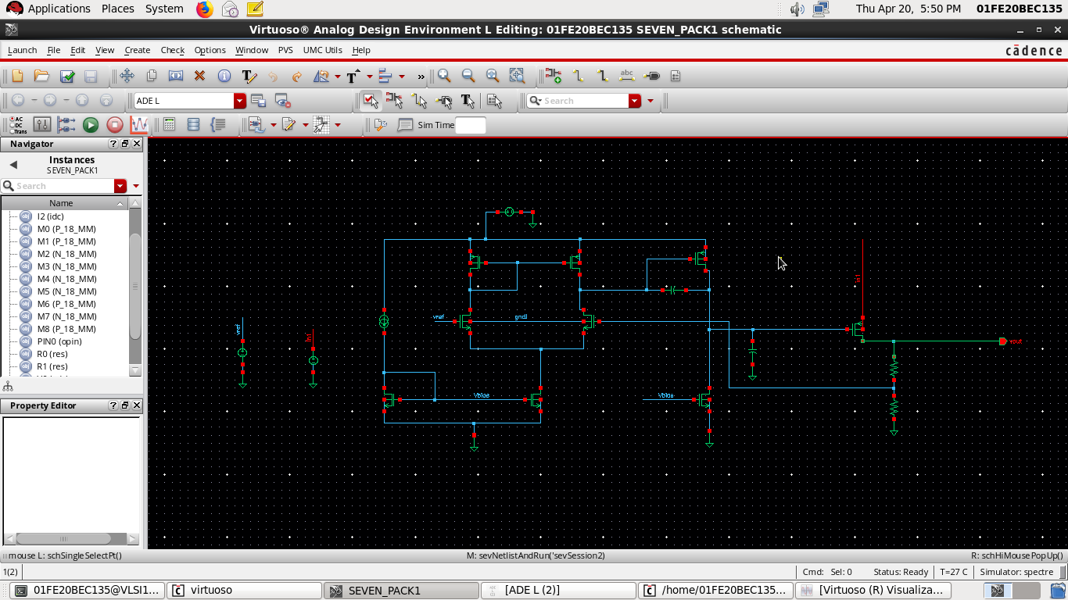
BASIC LDO

Slide 16
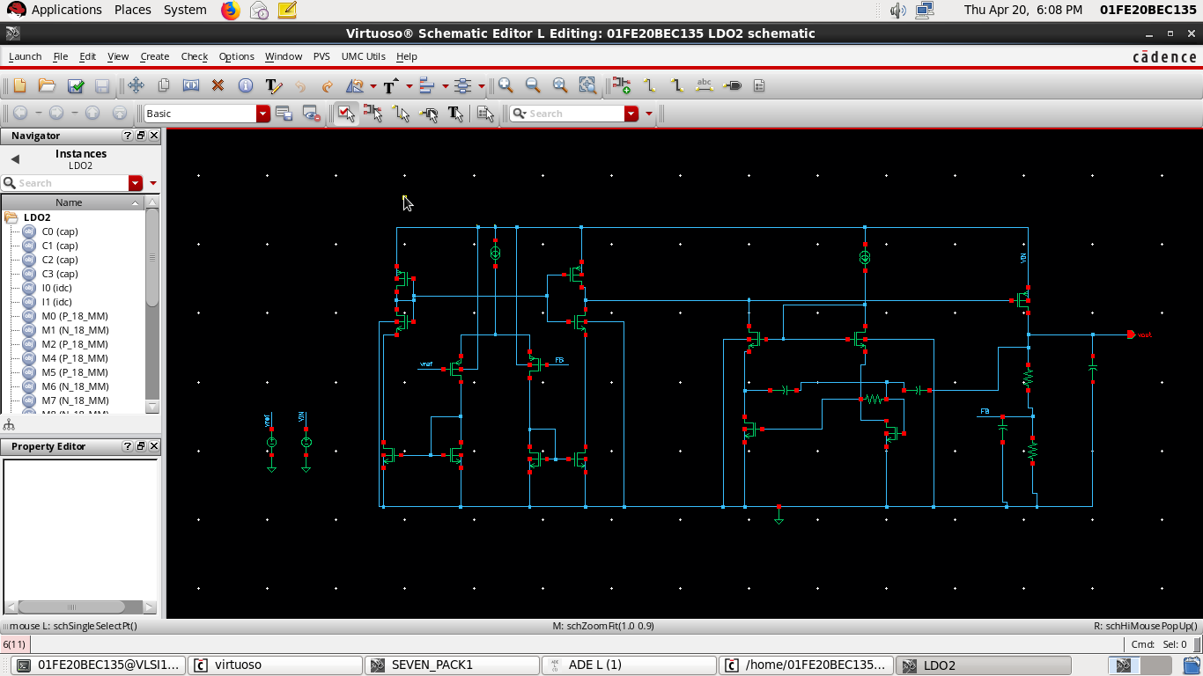
Implemented LDO

Slide 17
Changes from that IEEE paper with our LDO
Parameters | Paper LDO | Our LDO
Technology | 350nm | 180nm
Gain | 50db | 42db
Bandwidth | 18KHz | 10MHz
Phase | >45 | 54

Slide 18
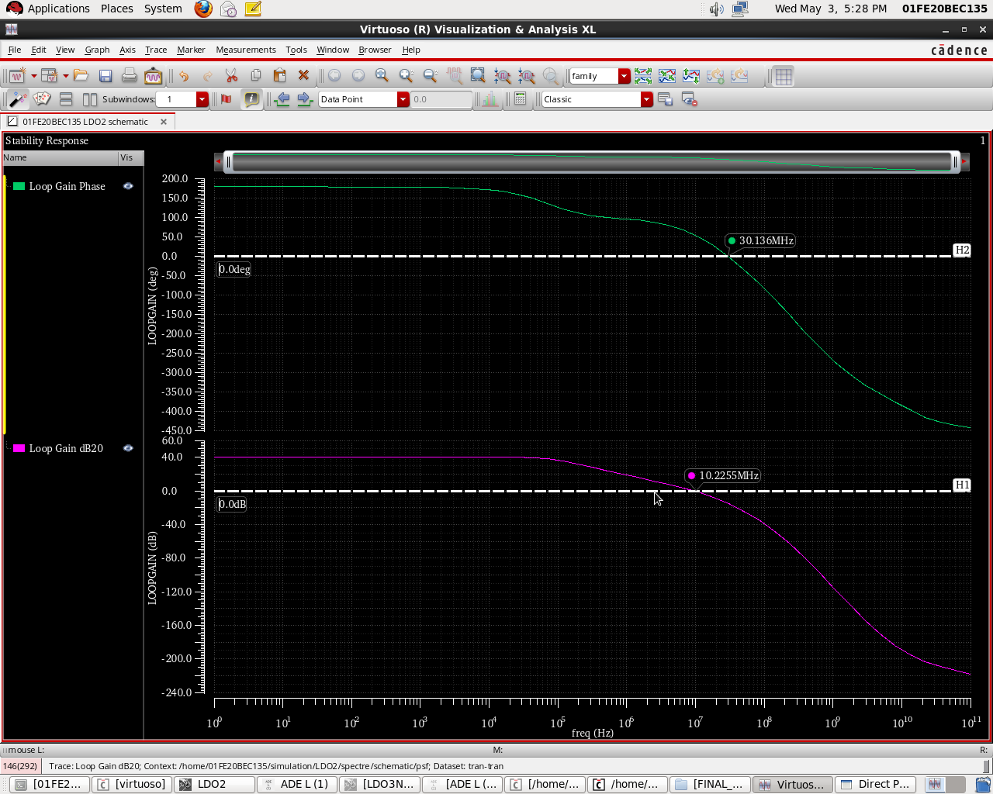
Gain and Phase

Slide 19
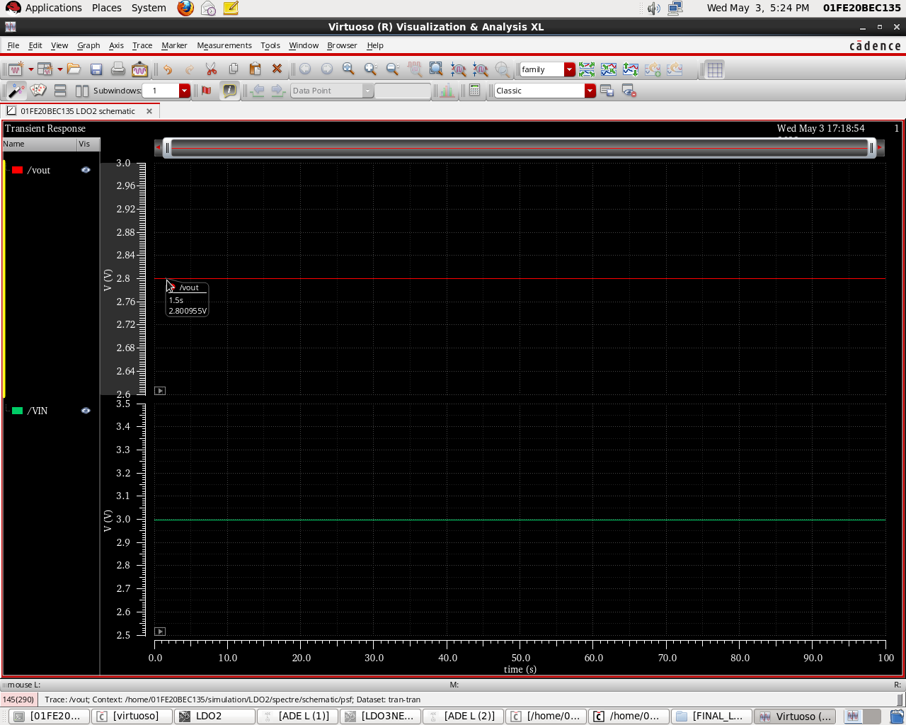
Basic Transient

Slide 20
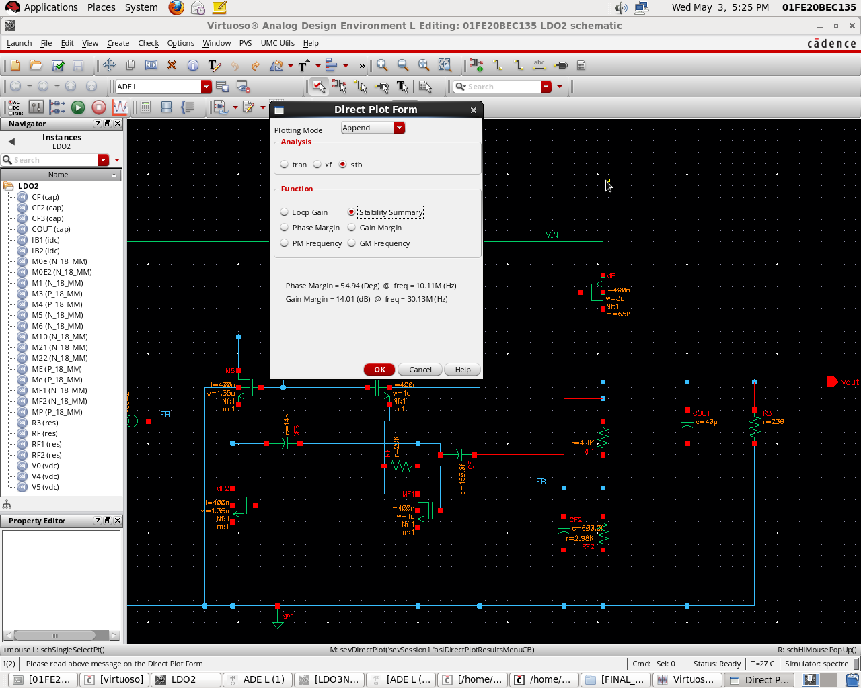
Stability summary

Slide 21
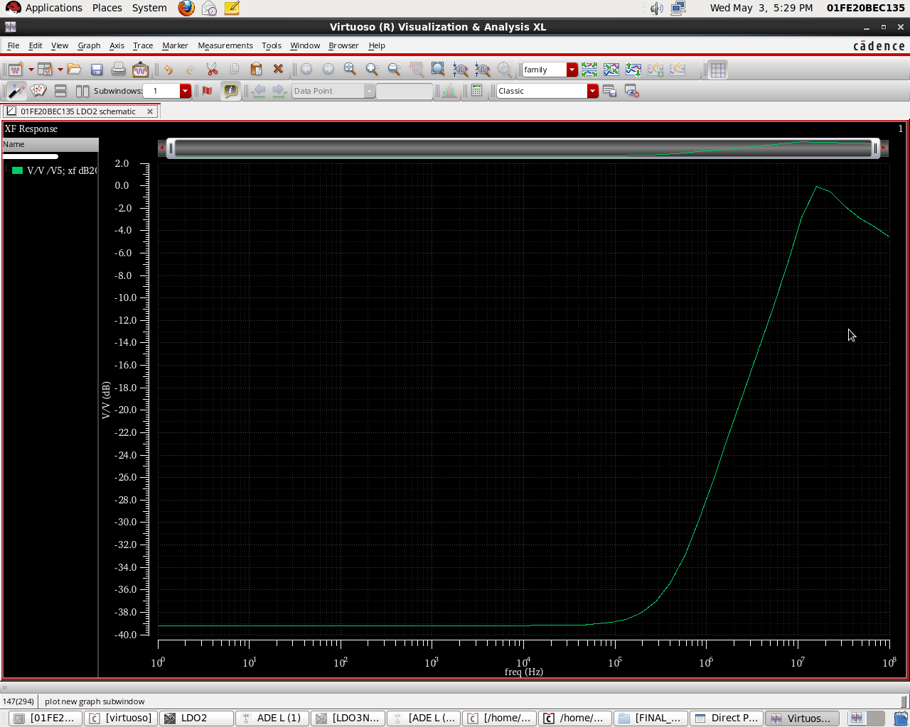
Psrr

Slide 22
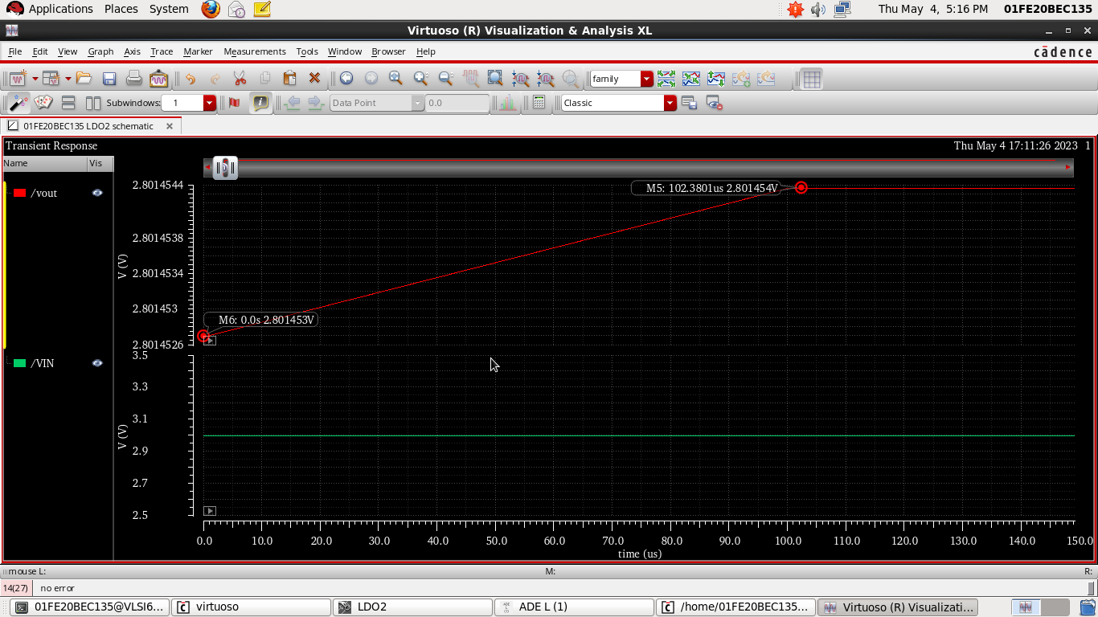
Variation at 0us

Slide 23
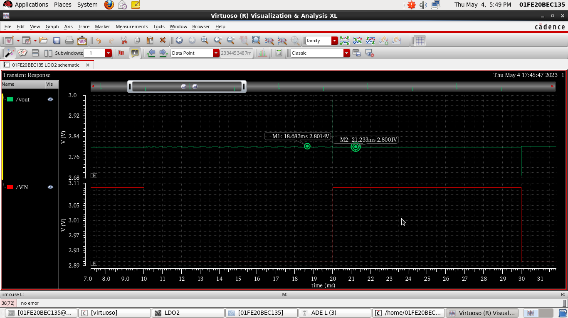
Line transient

Slide 24
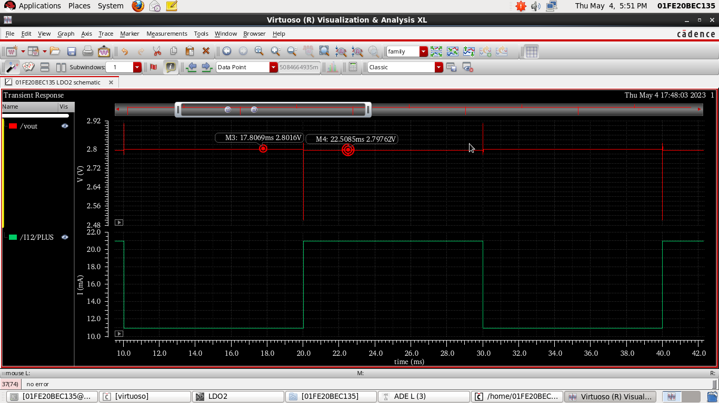
Load transient

Slide 25
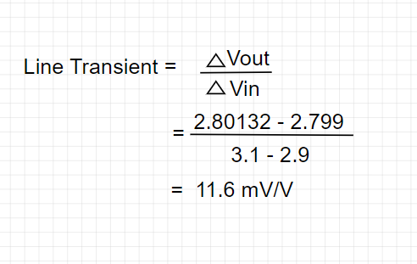
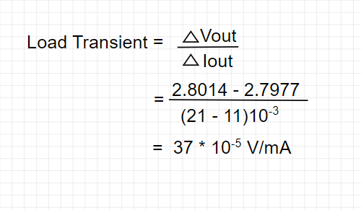
Calculations
Line transient
Load transient
For every 1v variation in input, varies Vout by 11.6mV
For every 1mA variation in Iout, varies Vout by 3.7uV

Slide 26
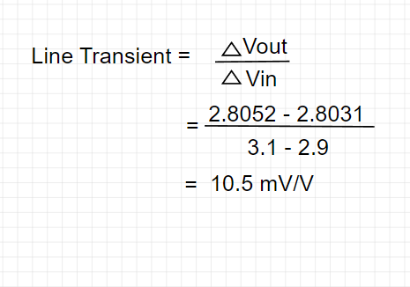
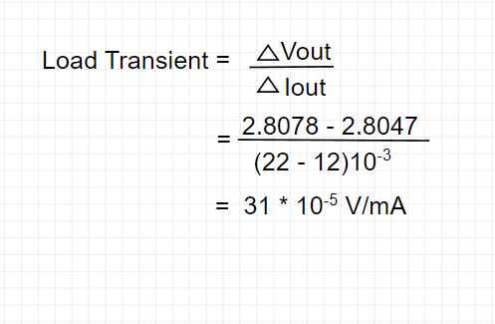
Calculations(1M)
Line transient
Load transient
For every 1v variation in input, varies Vout by 11.6mV
For every 1mA variation in Iout, varies Vout by 3.7uV

Slide 27
Specification
Parameters | Values
Input voltage | 3V
reference voltage | 1.24V
regulated output | 2.8V
Dropout | 0.2V
load current | 21mA
load capacitance | 90p
line regulation | 11.6mV/V
load regulation | 0.00037V/mA
Gain | 42db
Phase | 54
Bandwidth | 10MHz

Slide 28
Application in which our LDO can be used
Low-power microcontrollers
Battery-powered devices
Audio and video equipment
Communications equipment
Above Applications are for the LDO with low Gain and High Bandwidth.
As we have high Bandwidth which means that it will respond more quickly to changes in the input voltage. This could result in better transient response and stability.

Slide 29
THANK YOU

