Slide 1

Presentation
on
“A DEEP LEARNING-BASED ASSISTIVE SYSTEM FOR
CONVERTING SIGN LANGUAGE TO TEXT AND VOCAL OUTPUT”
(March 21, 2025)
DEPARTMENT OF COMPUTER SCIENCE & ENGINEERING
CAY 2024-2025
Presented by:
Spoorti P Hiremath 2JH21CS102
Suhasini S Hombal 2JH21CS104
Uzmaafreen Shirasangi 2JH21CS118
Vijayalaxmi S Kotagi 2JH21CS124
Guided by:
Prof. Trupti Thite
Dept of Computer Science
& Engineering

Slide 2
Contents
INTRODUCTION
LITERATURE SURVEY
MOTIVATION
OBJECTIVES
PROBLEM STATEMENT
REQUIREMENT ANALYSIS
METHODOLOGY
IMPLEMENTATION
APPLICATIONS
RESULTS AND DISCUSSION
CONCLUSION AND FUTURE WORK
REFERENCES
Dept of CSE, JCET, Hubballi 2024-2025 1

Slide 3
INTRODUCTION
Sign language is a visual language used by the deaf and mute community to communicate.
This project aims to bridge the communication gap between sign language users and non-users by converting hand gestures into text and speech.
It uses deep learning models for accurate gesture recognition, and improves accessibility and enhances communication.
Dept of CSE, JCET, Hubballi 2024-2025 2

Slide 4
🧠 Domain: Deep Learning & Assistive Technology
Utilizes deep learning algorithms (like CNN, RNN) to detect and classify sign language gestures.
Converts recognized gestures into text and vocal output for real-time communication.
Aims to improve accessibility and bridge communication gaps for the hearing and speech impaired.
Dept of CSE, JCET, Hubballi 2024-2025 3

Slide 5
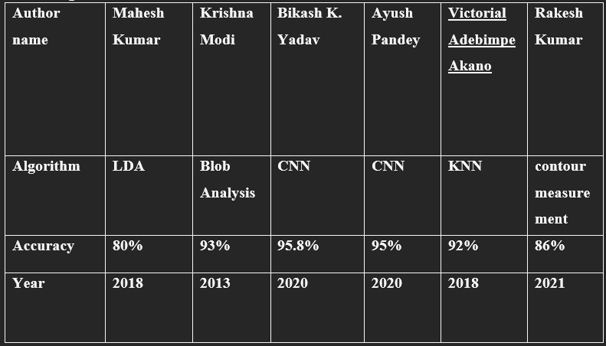
LITERATURE SURVEY
Dept of CSE, JCET, Hubballi 2024-2025 4

Slide 6
MOTIVATION
SUMMARY OF THE EXISTING SYSTEM
Communication barriers between the deaf community and non-sign language users.
Limited availability of user-friendly applications.
Need for an affordable and accessible solution.
Opportunity to leverage AI and deep learning technologies.
Dept of CSE, JCET, Hubballi 2024-2025 5

Slide 7
DRAWBACKS OF THE EXISTING SYSTEM
Existing systems primarily focus on text conversion without speech output.
They lack multi-language translation capabilities.
Most systems require high computational resources.
They fail to provide real-time gesture recognition.
Limited dataset size affects accuracy.
Dept of CSE, JCET, Hubballi 2024-2025 6

Slide 8
How Proposed System Overcomes Drawbacks
Real-time gesture recognition using CNN.
Multi-language speech output.
Lightweight system with minimal resource usage.
High accuracy on custom datasets.User-friendly interface with Tkinter.
Dept of CSE, JCET, Hubballi 2024-2025 7

Slide 9
OBJECTIVES
To develop a system that translates sign language into text.
To provide real-time speech output in multiple languages.
To ensure high accuracy using CNN.
To create a user-friendly interface using Tkinter.
To improve accessibility for the deaf and mute community.
Dept of CSE, JCET, Hubballi 2024-2025 8

Slide 10
PROBLEM STATEMENT
The project aims to convert sign language gestures into text and speech. It uses CNN for gesture recognition and integrates multi-language translation. The system provides real-time output with high accuracy. The objective is to create an accessible and user-friendly solution for the deaf and mute community.
Dept of CSE, JCET, Hubballi 2024-2025 9

Slide 11
REQUIREMENT ANALYSIS
Functional Requirements
Real-time gesture recognition.
Text and speech output.
Audio playback without saving files.
Non-Functional Requirements
User-friendly interface.
Low system resource consumption.
Dept of CSE, JCET, Hubballi 2024-2025 10

Slide 12
Software and Hardware Requirements
Python
TensorFlow
Tkinter
Googletrans
OpenCV
Webcam
Laptop/Desktop with minimum 4GB RAM

Slide 13
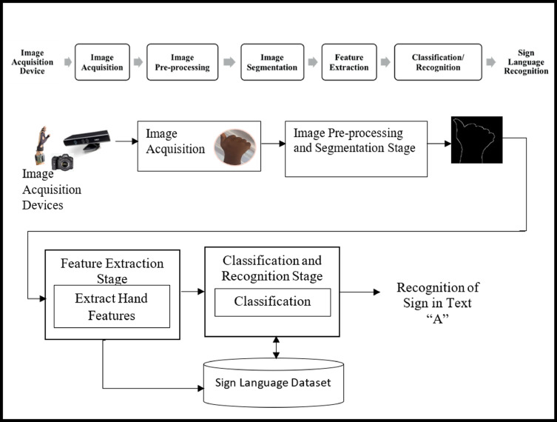
METHODOLOGY
BLOCK DIAGRAM
Dept of CSE, JCET, Hubballi 2024-2025 11

Slide 14
Image Preprocessing
CNN Model Training
Text Conversion
Language Translation
Speech Conversion
Multi-language Speech Output
Dept of CSE, JCET, Hubballi 2024-2025 12

Slide 15
IMPLEMENTATION
Grayscale image capturing using OpenCV
CNN model creation and training with Keras
Real-time gesture recognitionText to Speech conversion using gTTS
Multi-language translation using Googletrans
Tkinter GUI for user-friendly interface
Dept of CSE, JCET, Hubballi 2024-2025 9

Slide 16
APPLICATIONS
Communication tool for deaf and mute individuals
Aid in public places like banks, hospitals, and railway stations
Educational purposes for learning sign language
Customer service applications for special needs users
Dept of CSE, JCET, Hubballi 2024-2025 10

Slide 17
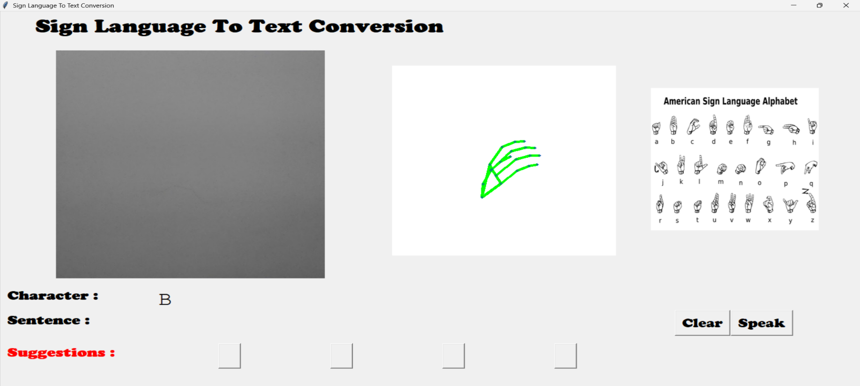
RESULTS AND DISCUSSIONS
Dept of CSE, JCET, Hubballi 2024-2025 11

Slide 18
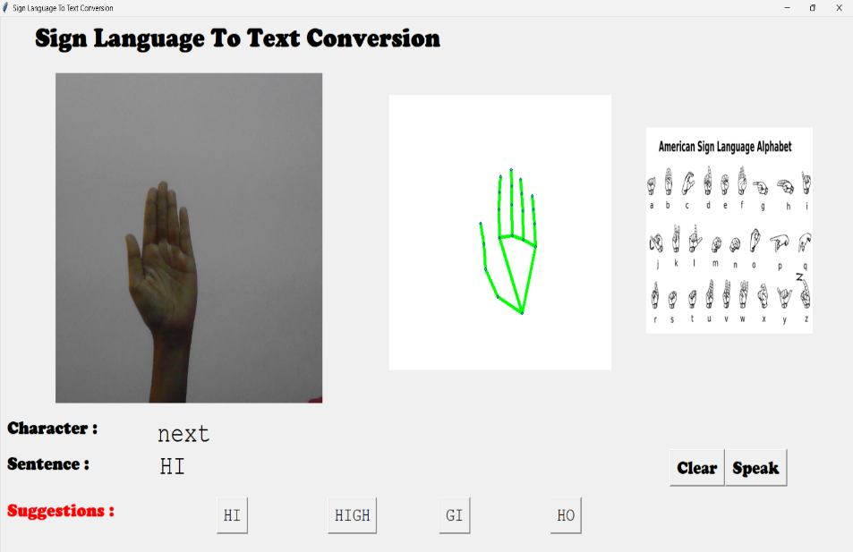
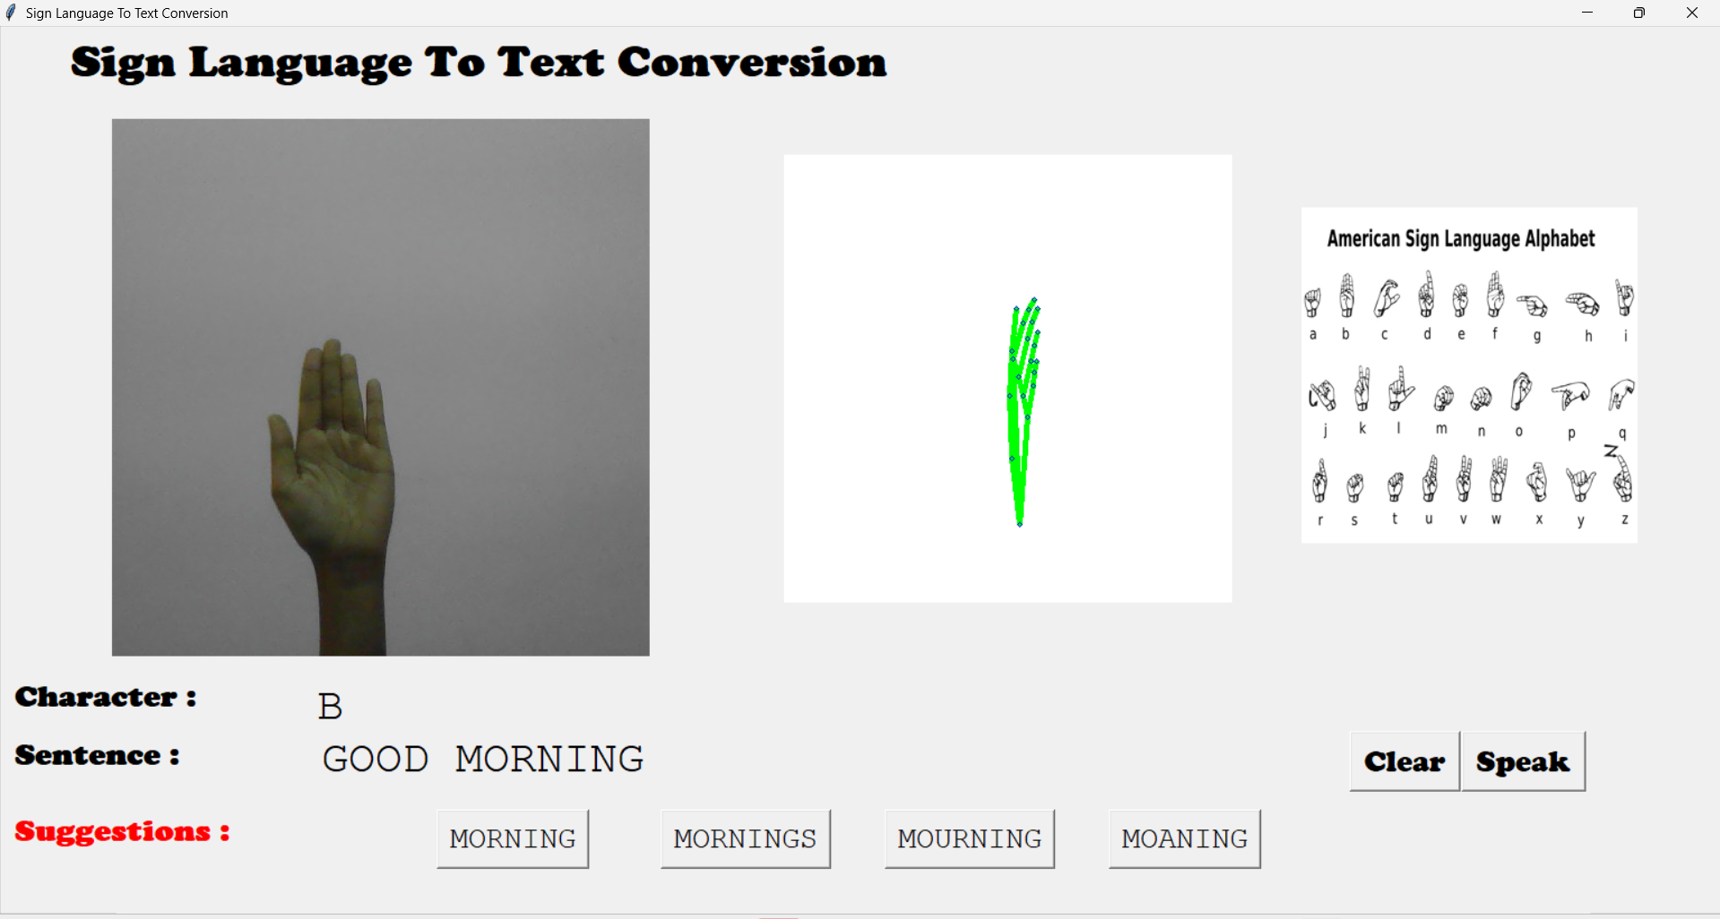

Slide 19
CONCLUSION
The project converts sign language gestures into text and speech, enhancing communication for the deaf and mute community. Future work includes developing an Android app for mobile-based gesture prediction, and expanding the system for different language and dataset for better recognition..
Dept of CSE, JCET, Hubballi 2024-2025 12

Slide 20
REFERENCES
[1] Rajat Nagarkar, "Live Sign Language Translation System," GitHub Repository, 2023.
[2] Ian Goodfellow, Yoshua Bengio, Aaron Courville, "Deep Learning," MIT Press, 2016.
[3] John D. Hunter, "Matplotlib: A 2D Graphics Environment," Computing in Science & Engineering, 2007.
[4] François Chollet, "Deep Learning with Python," Manning Publications, 2017.
Dept of CSE, JCET, Hubballi 2024-2025 13

Slide 21
Q and A

