Slide 1
Women Safety App - Sahelii
Suhasini Choudhari - 2006022
Sanika Hingalkar - 2006045
Kanchan Jaiswal - 2006053
Sai Kulkarni - 2006067

Slide 2
OVERVIEW
Today’s world is not safe for a person to travel alone at night especially for women; as she is not physically as strong as men.
Good way to avoid being a victim of violent crime (robbery, sexual assault, rape, domestic violence) is to identify and contact resources for help timely.
Sahelii provides help, assistance, moral support and condolence.

Slide 3
GOALS
1
6
To get urgent help in emergency situations with just a shake.
To reduce time consumption
2
5
To Provide Emergency Location to the helper.
To ease out the women in stress
3
4
Easier to use for all the woman.
Allow the user to provide feedback

Slide 4
FEATURES
EMERGENCY SOS
SIREN ALERT
ABOUT US
EMERGENCY HELPLINE NUMBERS
SAFETY TIPS AND VIDEOS
DATABASE CONNECTIVITY

Slide 5
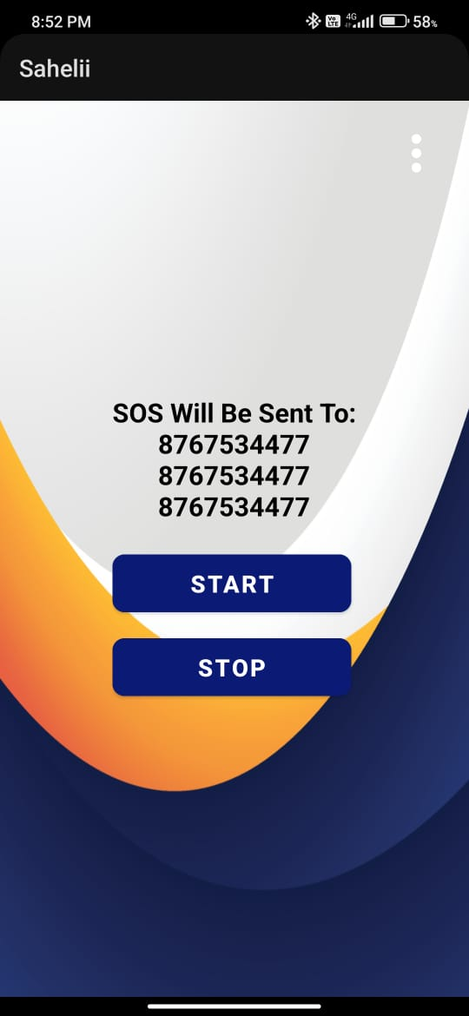
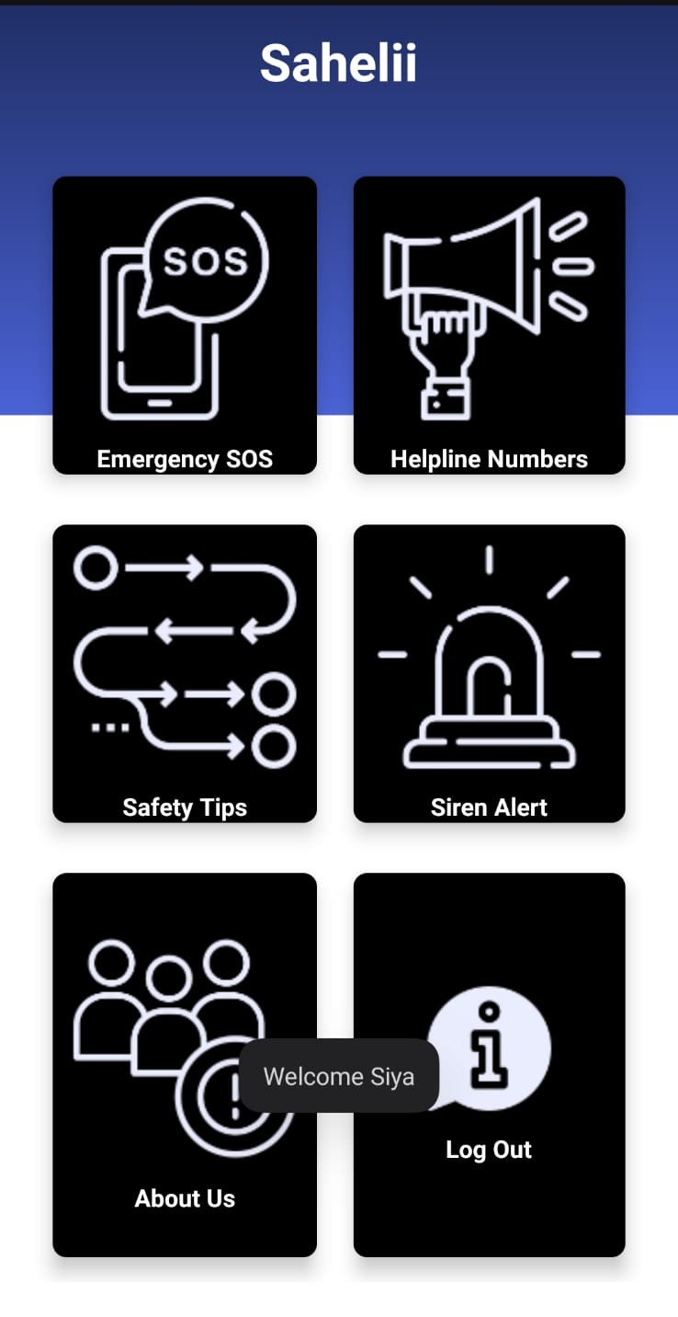
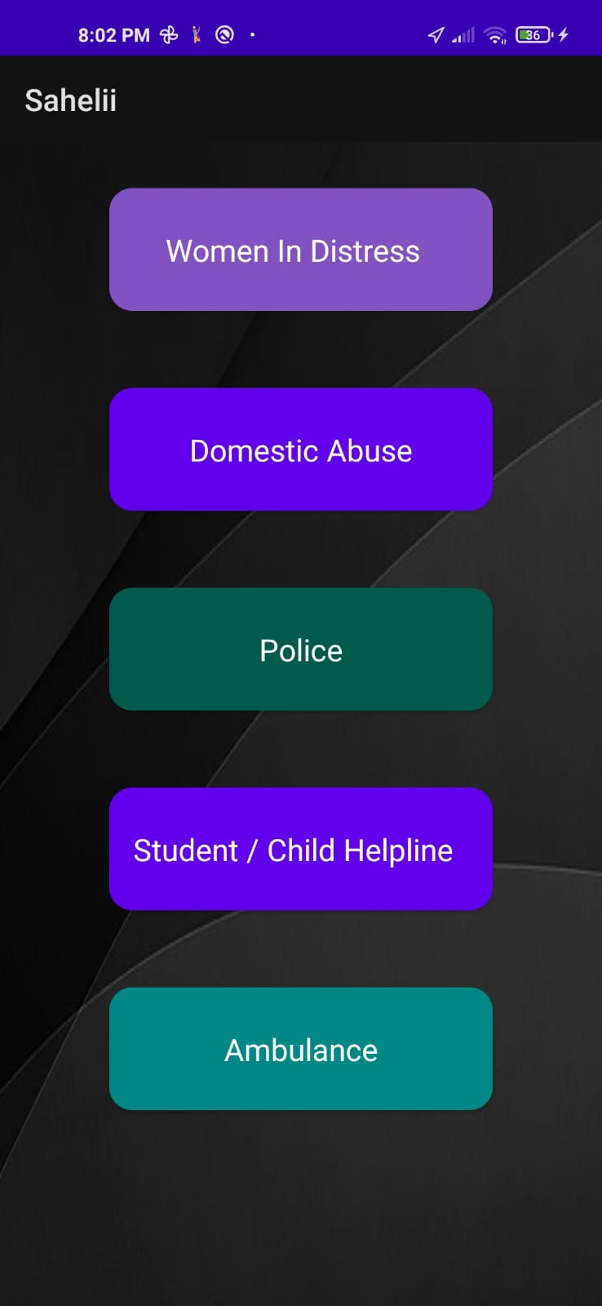
GLANCE OF UI
HOME PAGE
SMS
HELPLINE NUMBERS

Slide 6
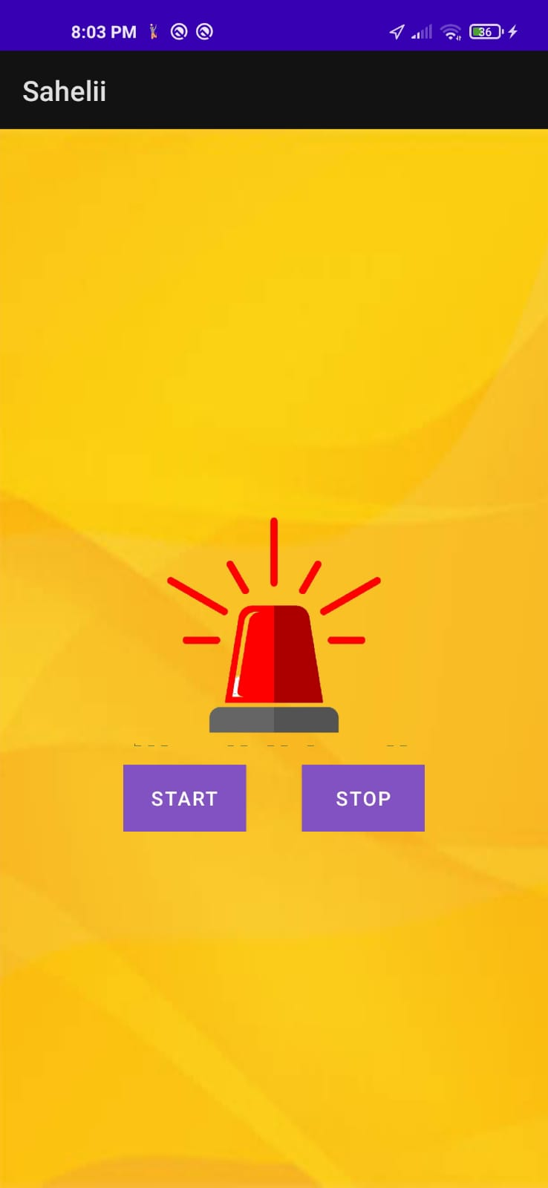

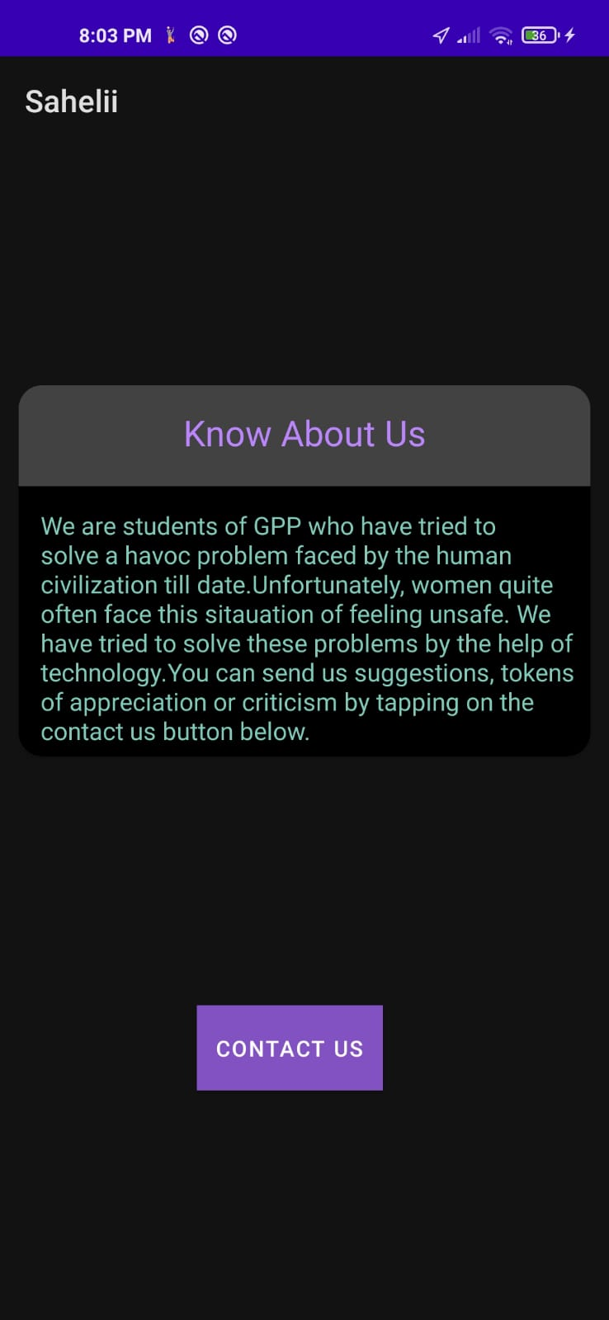
GLANCE OF UI
TIPS
SIREN
ABOUT US

Slide 7




FRONT END
For frontend development we have used XML for our layout in Android Studio.
XML stands for Extensible Markup Language
As it is lightweight language so it doesn't make our layout heavy.

Slide 8

BACK END
Backend is the core implementation or the logic.
The database used in the backend is SQLite
The core language that we have used as backend is Java.
The code for SQLite is , commercial or private transactional SQL database engine

Slide 9
SOME LIMITATIONS
User will manually have to turn on their location
SQLite is a in-memory database
Can send sms message of upto only 150 characters
Range dependency

Slide 10
FUTURE SCOPE
Vibration features for deaf users
Use AI to predict threat
Can add voice commands
Partnership with NGOs or police stations

Slide 11
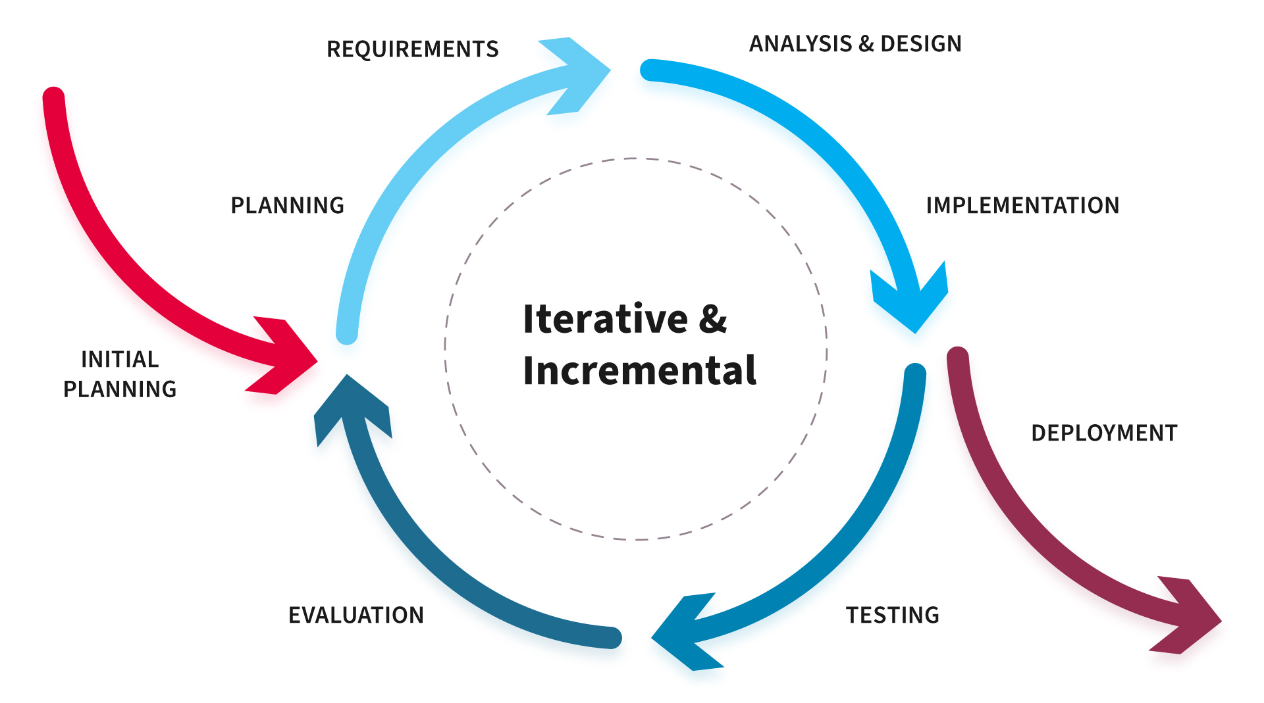
MODEL
The models specify the various stages of the process and the order in which they are carried out..
We have thought of many useful models of software engineering
When adopting the iterative approach, the philosophy of incremental development will also often be used liberally and interchangeably.
An iterative life cycle model does not attempt to start with a full specification of requirements by first focusing on an initial, simplified set user feature, which then progressively gains more complexity and a broader set of features until the targeted system is complete.

Slide 12
CONCLUSION
Sahelii is a android application for assisting women when in trouble
It gave us very good exposure to android platform and mobile app development in general
Enabled understanding of SQLite databases, Google Maps API for android and performance testing
Most importantly, it gave us the confidence of building more advanced android applications

Slide 13
THANK YOU!

