Slide 1
MZK - Data Quality Issue in Source File
Automation-driven Data Quality Solution

Slide 2
Problem Statement
Manual Data Validation: Finding schema mismatches is like finding a needle in a haystack.
Challenges: Error-Prone Detection, Scalability Issues.
Business Impact: Validating 10,000 rows takes ~5–7 hours with low precision.
Data quality issue affects retail and non-retail source files.
INGAAS tool does not provide exact match for root cause identification.

Slide 3
Expected Solution
Standard solution to compare schema file and source file for bad records.
Schema file formats:
– Copybook for positional files.
– Avro for CSV format.
Detect bad records due to:
– Record length mismatch.
– Data type mismatch.
– Null values in mandatory fields.

Slide 4
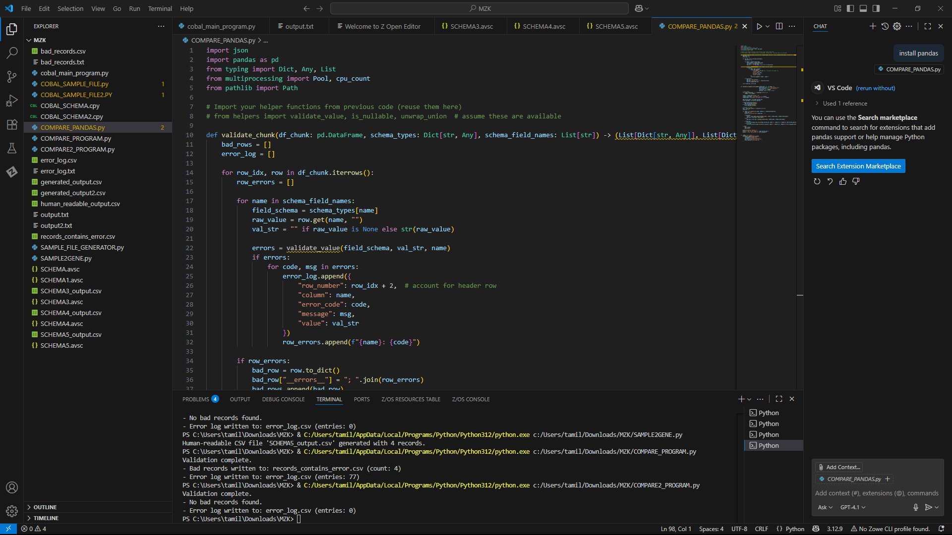
Programs Overview
AVRO Schema & CSV File:
Main program: COMPARE_PROGRAM.py
Program to check the AVRO SCHEMA and SOURCE CSV FILE.

Slide 5
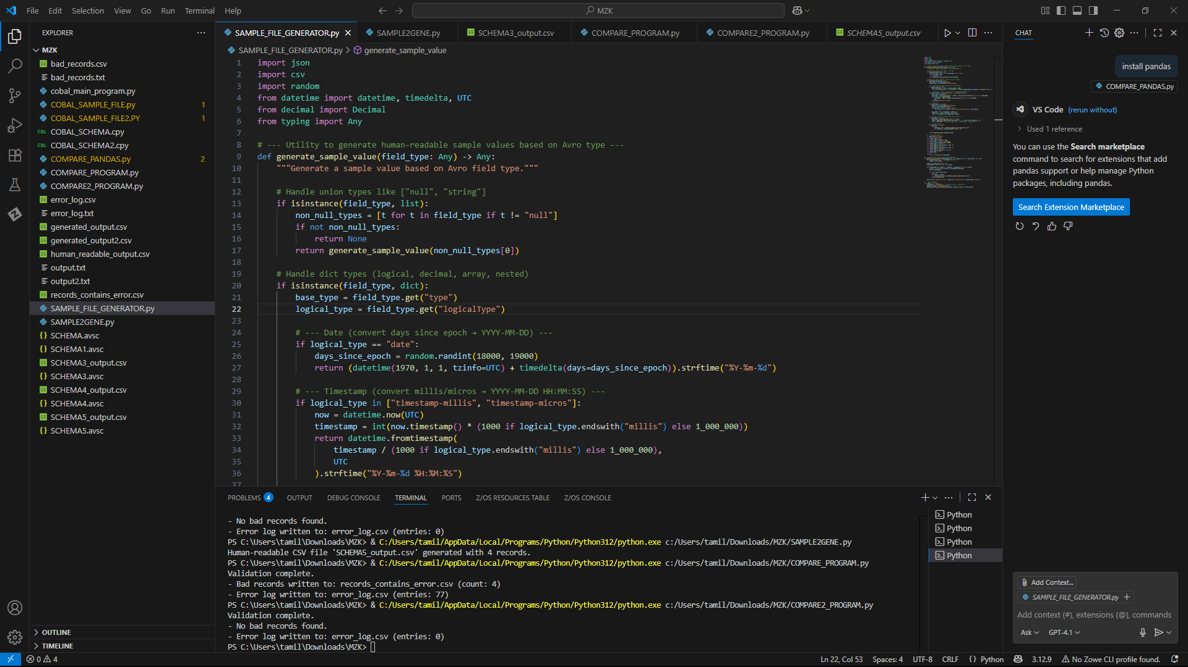
Sample file generator
SAMPLE_FILE_GENERATOR.py
To generate sample CSV file using any AVRO schema

Slide 6
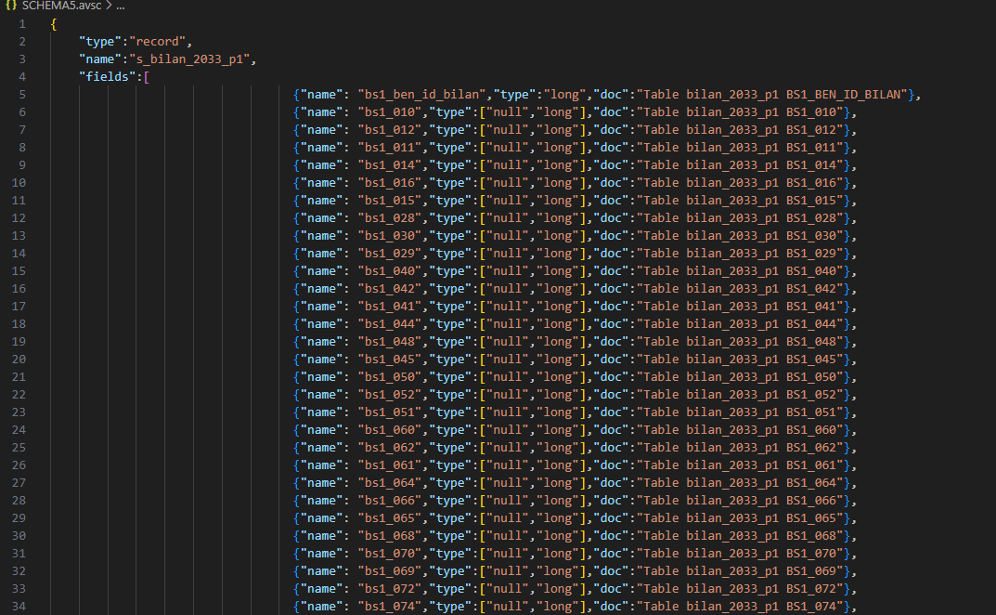
EXAMPLE SCHEMA
Example schema: SCHEMA.avsc

Slide 7
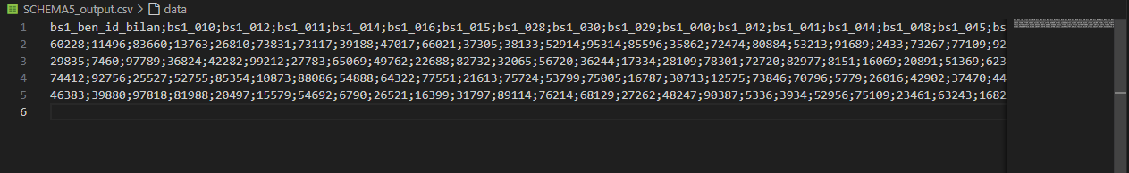
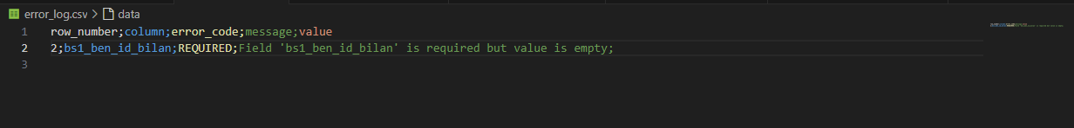
EXAMPLE OUTPUT
Output: SCHEMA5_output.csv
ERROR LOG
BAD RECORDS

Slide 8
COBOL Copybook & Text File
Main program: COBAL_PROGRAM.py
Program to check the COPYBOOK SCHEMA and TEXT FILE.

Slide 9
Benefits
Eliminates development bottlenecks with instant data generation.
Automated quality assurance reduces manual testing by up to 90%.
Ensures 100% schema compliance accuracy.

