Slide 1
RL & DQN- BASED CLUSTERING AND ROUTING FOR WEARABLE IOT ENABLED WIRELESS BODY AREA NETWORK
Presented by
Guided by
Ariganesh A (922521106008)
Ashiq M.I (922521106011)
Dhanush Kumar B (922521106030)
Hari Prasath M (922521106053)
Mr. Ashok kumar .R, M.E (PhD)
Assistant Professor
Department of ECE
V.S.B Engineering College - Karur

Slide 2
ABSTRACT
The paper proposes an energy-efficient routing technique for Wireless Sensor Networks (WSNs) using Reinforcement Learning (RL) and Deep Q-Networks (DQN).
Sensor nodes are grouped into clusters to reduce communication overhead and improve data aggregation.
Cluster Head (CH) selection is performed using DQN based on factors like residual energy, link quality, and traffic load.
The method supports multi-hop routing among CHs to minimize energy consumption and prolong network lifetime.
Simulation results show improved Packet Delivery Ratio (PDR), Cluster Lifetime, and Energy Efficiency compared to existing methods like DECR, ALOC, and MT-MAC.
The RL & DQN-based approach adapts to network changes dynamically, leading to reduced congestion and lower packet loss.

Slide 3
OBJECTIVES
1)To develop an energy-efficient and intelligent routing and clustering protocol for Wireless Sensor Networks (WSNs).
2)To implement Reinforcement Learning (RL) and Deep Q-Network (DQN) for optimal cluster head selection and route discovery.
3) To enhance packet delivery ratio and network lifetime by minimizing energy consumption and routing overhead.
4)To introduce a multi-path selection mechanism that improves reliability and fault tolerance in WSN communication.
5) To compare the proposed RL and DQN-based approach with the existing DECR protocol based on key performance metrics.
6) To simulate and validate the protocol using MATLAB and analyze the performance under different network scenarios.

Slide 4
INTRODUCTION
Communication networks require efficient and adaptive routing protocols to handle dynamic topologies.
Traditional routing methods often struggle with congestion, packet loss, and increased latency.
Reinforcement Learning (RL) enables routers to learn optimal paths by interacting with the network environment.
Deep Q-Networks (DQN) enhance RL by using neural networks for decision-making in large state spaces.
Traditional one-hop clustering fails due to node mobility, and existing two-hop clustering is mostly centralized, which is unsuitable for dynamic WBANs.
This work proposes an intelligent routing strategy that uses RL and DQN to improve packet delivery, reduce delay, and optimize network performance.

Slide 5
PROBLEM STATEMENT
Limited battery life : Continuous data transmission rapidly depletes energy, leading to frequent node failures and reduced network lifetime.
Wireless Sensor Networks (WSNs) face significant challenges such as limited energy resources, inefficient routing, and high communication overhead.
One-hop clustering : does not ensure connectivity due to node mobility, Existing two-hop clustering methods are centralized.
Traditional routing protocols often fail to adapt dynamically to network changes, resulting in reduced network lifetime and poor data delivery.
There is a critical need for an intelligent, adaptive routing and clustering mechanism that can optimize energy consumption, enhance reliability, and ensure efficient multi-path data transmission.
Inefficient Routing and High Transmission Delay: Long-distance transmissions require more energy, reducing packet delivery ratio (PDR) and increasing network instability.
Network congestion : Existing multi-hop routing protocols in WBANs generate excessive control messages.

Slide 6
LITERATURE REVIEW
S.No | Author(s) | Publication | Scope of the Project | Drawbacks
1 | Muhammad Yeasir Arafat, Sungbum Pan, EunSang Bak | IEEE Access, 2023 | Proposes a distributed energy-efficient clustering and routing protocol (DECR) for WBANs, using a two-hop neighbor-based clustering approach and grey-wolf optimization algorithm for cluster head selection and routing. | Focuses primarily on simulation results; real-world implementation and scalability in diverse environments not thoroughly addressed.
2 | Ruby Das, Manikandan Narayanan | IEEE Conference Publication, 2023 | Introduces a cluster-based routing protocol aimed at enhancing WBAN lifetime by reducing energy consumption. | Lacks detailed performance evaluations and comparisons with existing protocols, limiting its effectiveness assessment.
3 | Udyaprasad, Shreyas, Dilip kumar | IEEE Journals & Magazine, 2023 | Presents an energy-efficient routing technique integrating SDN and AI for large-scale I-IoT networks. | Primarily focused on industrial IoT networks, which may not directly apply to the specific constraints of WBANs.

Slide 7
S.N | Author(s) | Publication | Scope of the Project | Drawbacks
4 | S.Kumar, V gupta | IEEE Access, 2023 | Proposes a distributed energy-efficient routing algorithm for wireless sensor networks to balance energy consumption and extend network lifetime. | Algorithm's applicability to WBANs not clearly demonstrated; lacks comprehensive performance analysis.
5 | Y. Zheng, P. Wang | IEEE Access, 2023 | Focuses on a cluster-based energy-efficient routing protocol for WBANs to optimize energy usage and extend network lifetime. | No explicit discussion of real-world implementation challenges or hardware constraints.

Slide 8
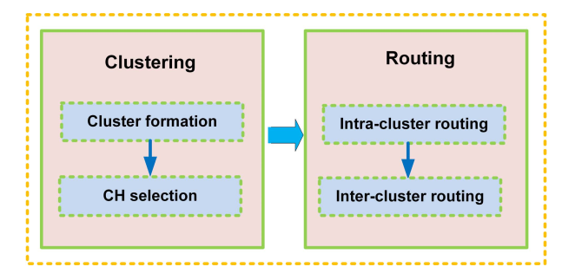
EXISTING METHOD - BLOCK DIAGRAM
Sensor nodes in the network are grouped into clusters.
Nodes within a cluster communicate with a designated Cluster Head (CH).
In routing it involves intra-cluster routing and inter-cluster routing.

Slide 9
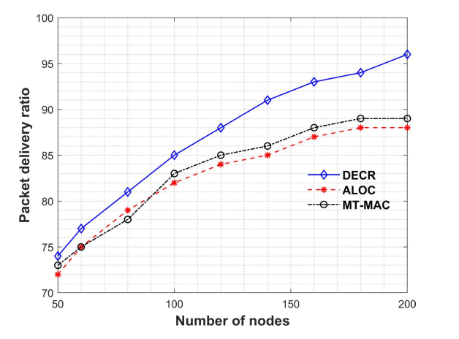
EXISTING METHOD- OUTPUT 1
The author compared the DECR clustering and routing method with the ALOC and MT-MAC clustering and routing.And the nodes range from 50 to 200.Node densities have an impact on PDR.
In this DECR they used two-hop neighbour based clustering that works better than one-hop neighbour based clustering.

Slide 10
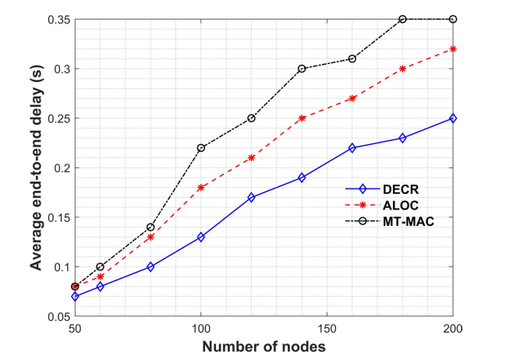
EXISTING METHOD- OUTPUT 2
The two hop neighbour scheme minimizes the node AE2E delay compared to the one-hop-based clustering and routing protocol.So the DECR has more effective than the ALOC and MT-MAC.

Slide 11
EXISTING METHOD - EXPLANATION
Cluster Formation : Sensor nodes in the network are grouped into clusters and Cluster formation is typically based on parameters like proximity, energy level, and network topology.
CH Selection :A Cluster Head is selected from within each cluster, usually based on energy level or rotation schemes to balance energy consumption.
Intra-Cluster Routing : Member nodes transmit their data to the Cluster Head. This local aggregation reduces overall communication overhead and saves energy.
Inter-Cluster Routing :Cluster Heads communicate either directly with the Base Station (BS) or with other CHs to forward the aggregated data.
The DECR is compared with other routing methods called ALOC and MT-MAC.
There is increase in the values PACKET DELIVERY RATIO,
CLUSTER LIFE TIME ,
CONROL OVER HEAD,
ENERGY CONSUMPTION in DECR method over the ALOC and MT-MAC.

Slide 12
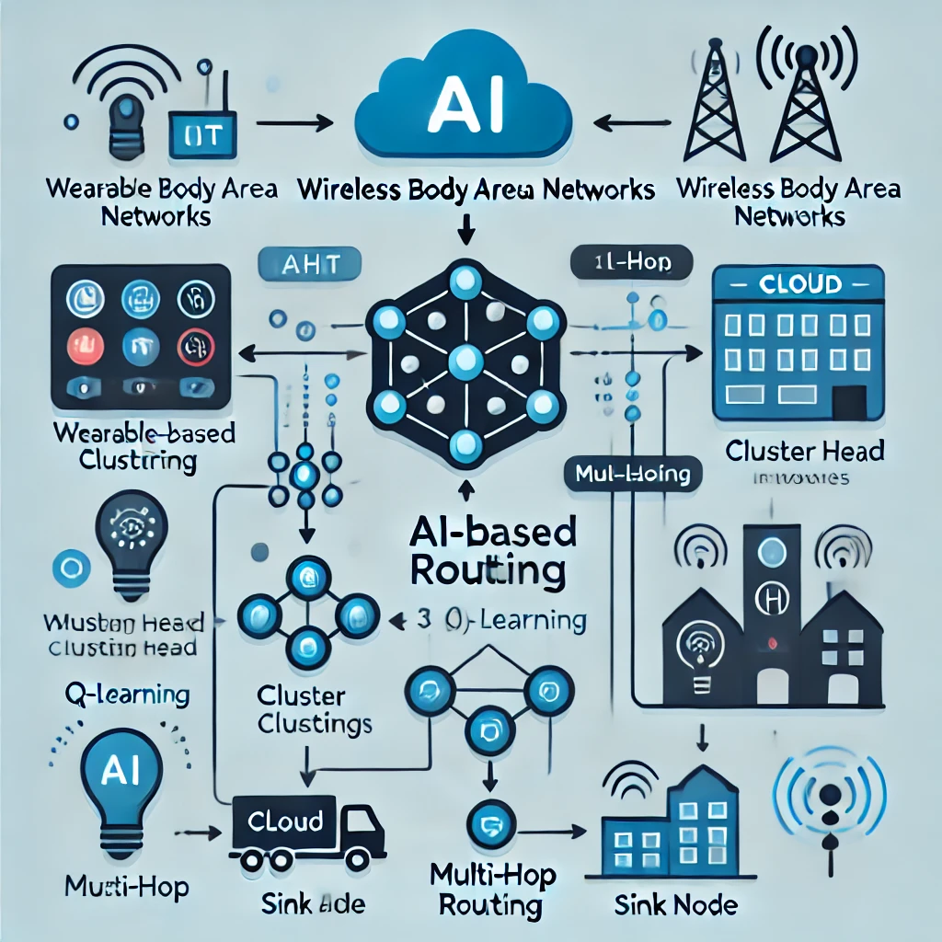
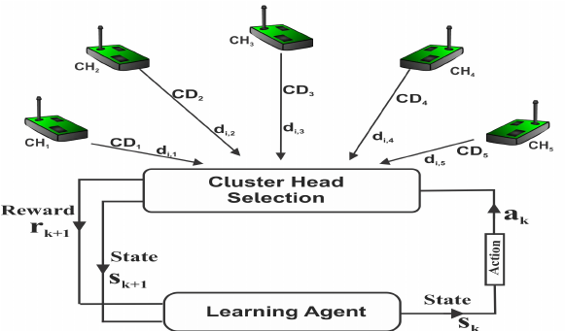
PROPOSED SYSTEM-DIAGRAM

Slide 13
PROPOSED SYSTEM- EXPLANATION
Wearable IoT Users (Sensor Nodes):
Represented as small circles or sensor icons in the diagram.
These devices continuously collect health-related data (e.g., heart rate, temperature).
Each user has multiple sensor nodes communicating with each other.
Clustering
The wearable devices form dynamic clusters based on proximity, energy levels, and communication quality.
Each cluster has one Cluster Head (CH) that gathers data from its member nodes.
Cluster Head (CH) Selection
The CH is selected using Q-learning (a Reinforcement Learning algorithm).
It considers residual energy, link quality, and traffic load to select the best CH.
CH selection is dynamic, meaning that when a CH node’s energy drops, another node is chosen automatically.

Slide 14
Multi-Hop Routing:
Selected Cluster Heads (CHs) do not transmit data directly to the Base Station (sink node) in order to minimize energy consumption.
Instead, CHs utilize a multi-hop communication approach, where data is forwarded through intermediate CHs until it reaches the sink.
This strategy reduces the transmission range required and extends the network's overall lifetime.
Sink Node (Base Station):
The sink node collects aggregated data from various CHs.
It processes the data locally or forwards it to a cloud server or healthcare monitoring system for further analysis and decision-making.

Slide 15
Reinforcement Learning (Q-Learning) for Cluster Head (CH) Selection
Each node observes its energy, link quality, and traffic.
The Q-learning model selects the best node as CH based on Q-values.
Reward System: CHs with high energy, stable links, and low congestion get higher rewards
Q-values are updated using the formula:
Q=Q(S,A)+α[R+γmaxQ(S′,A′)−Q(S,A)]
where:
α= Learning Rate
γ= Discount Factor
R= Reward
S′ = Next State
A′ = Next Action

Slide 16
Deep Q-Network (DQN) for Multi-Hop Routing
How it Works: Neural Network predicts the best next-hop based on past experiences. The routing decision is made based on Q-values learned over time. Reward System: Paths with low energy consumption & high link stability are preferred.
🔹 Outcome: Reduces transmission delay & optimizes energy-efficient paths.
CHs aggregate data from cluster members and forward it using DQN-optimized multi-hop routing.
Rewards are updated in both Q-learning (for CH selection) and DQN (for routing).

Slide 17
SOFTWARE REQUIREMENT
Matlab -For graph generation and comparision.
Python - For implementing the Re-inforcement learning and Deep-Q-Network

Slide 18
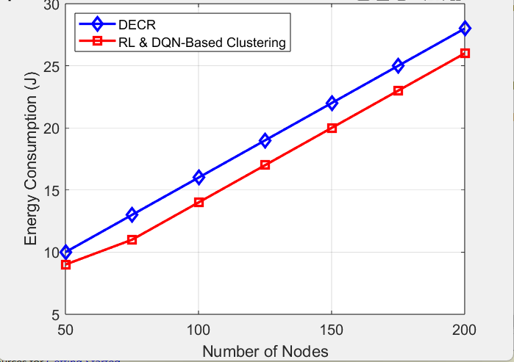
FINAL OUTPUT -1
In this it represents that both protocols' energy usage rises with network size, but the RL & DQN-based strategy continues to outperform DECR, demonstrating its efficacy in extending network lifetime and lowering power depletion.
The superiority of deep Q-networks and reinforcement learning in reducing energy consumption and guaranteeing effective data transfer is amply demonstrated by this comparison.

Slide 19
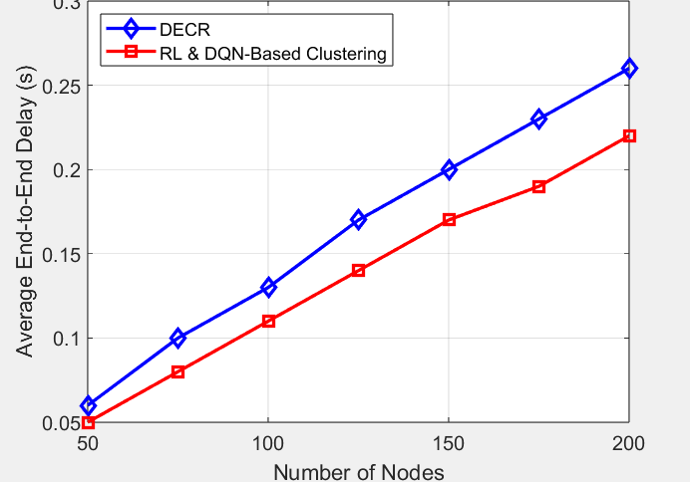
FINAL OUTPUT-2
End-to-End delay: The time it takes for a packet to travel from one end of a network to other.
However, because of its adaptive learning capabilities and intelligent multi-hop routing, which optimize packet transmission channels, the RL & DQN-based approach maintains reduced latency values.

Slide 20
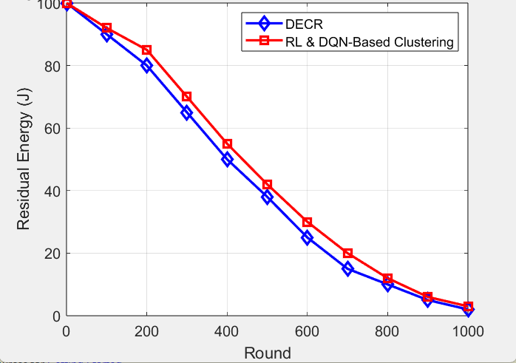
FINAL OUTPUT- 3
RESIDUAL ENERGY: The energy remaining in a system or the remaining energy in a sensor node.
At first, both protocols have the same energy levels, but as the number of rounds increases, RL & DQN retains slightly more residual energy than DECR. This is due to RL & DQN's intelligent and adaptive cluster head selection, which ensures balanced energy consumption across all nodes, preventing premature node depletion.

Slide 21
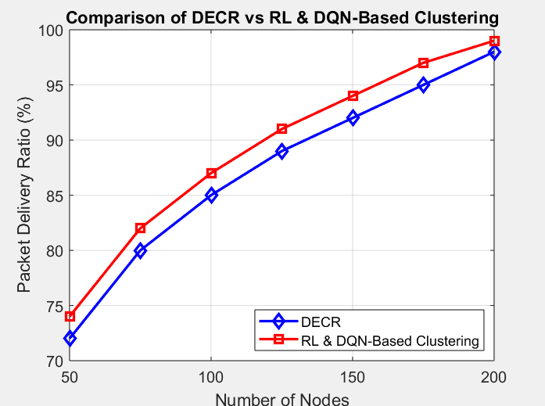
FINAL OUTPUT-4
Packet delivery ratio: It measures how many packets are successfully delivered to a destination.
RL & DQN-Based Clustering continuously performs better than DECR when compared in terms of Packet Delivery Ratio (PDR). Better packet transfer, less congestion, and less packet loss are made possible by RL & DQN's adaptive routing and intelligent CH selection.

Slide 22
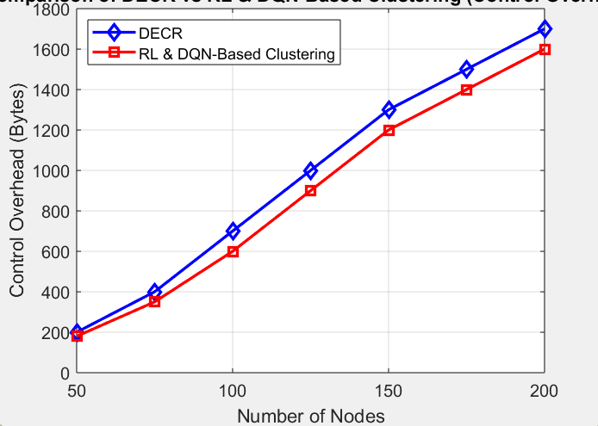
FINAL OUTPUT- 5
CONTROL OVER HEAD: The extra communication overhead required to manage the cluster formation process, including electing cluster heads, assigning cluster memberships, and coordinating data membership.
RL & DQN-based clustering and routing reduces control overhead compared to DECR.
As the number of nodes increases, control overhead decreases due to optimized CH selection and adaptive routing.
DECR has higher overhead due to excessive control messages for CH selection and routing updates.

Slide 23
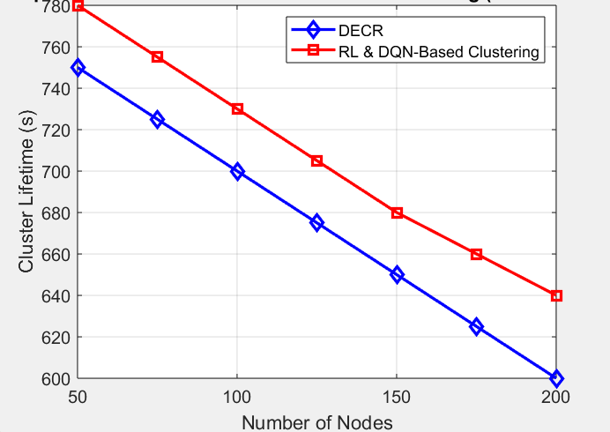
FINAL OUTPUT-6
CLUSTER LIFE TIME: The duration of the cluster life existence.
As the number of nodes increases, RL & DQN-based clustering maintains stability, whereas DECR depletes faster.
Dynamic CH selection (Q-learning) and optimized routing (DQN) improve energy efficiency, leading to longer cluster lifetime.

Slide 24
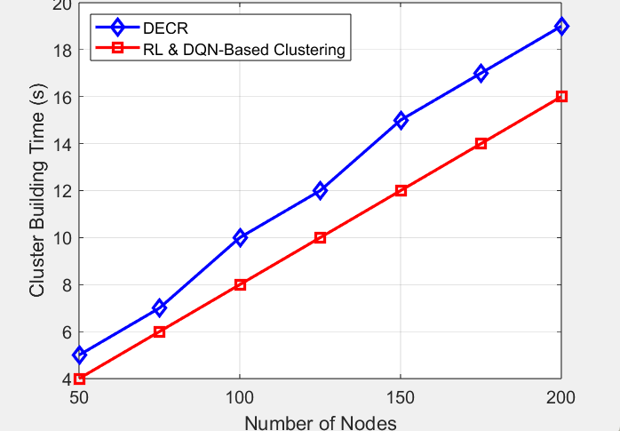
FINAL OUTPUT- 7
Cluster building Time: The time taken to build a cluster.
both protocols require more time to form clusters, but RL & DQN consistently achieves faster clustering due to its dynamic and adaptive CH selection.
The significant reduction in cluster formation time with RL & DQN highlights its efficiency in handling network scalability and reducing computational overhead, making it more suitable for large-scale networks.

Slide 25
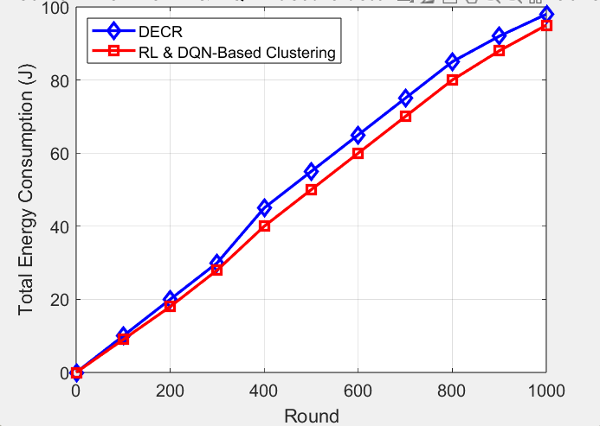
FINAL OUTPUT-8
Total Energy Consumption: The time takes to summing up the energy by each individual sensor node.
RL & DQN-based clustering and routing reduces total energy consumption compared to DECR.
DECR experiences higher consumptions.
DQN optimizes multi-hop routing dynamically, to reduce the energy consumption .
Its clever and flexible cluster head selection minimizes needless energy waste and maximizes resource use, which accounts for this efficiency.

Slide 26
APPLICATION
Healthcare Monitoring
Wearable IoT devices collect real-time health data (e.g., heart rate, temperature) from users and transmit it efficiently using RL & DQN-based routing.
Remote Patient Monitoring
Enables continuous and energy-efficient monitoring of patients in hospitals or at home without frequent battery replacement
Emergency Detection Systems
Supports fast and reliable data delivery in critical situations (e.g., abnormal vitals), enabling timely response.
Energy-Efficient IoT Networks
Applicable to any IoT-based system requiring prolonged network operation with limited power resources.

Slide 27
CONCLUSION
The method improves Cluster Head (CH) selection and multi-hop routing using intelligent decision-making.
Simulation results show enhanced performance in terms of Packet Delivery Ratio, Energy Efficiency, and Network Lifetime.
Compared to traditional methods like DECR, ALOC, and MT-MAC, the proposed model adapts better to dynamic network conditions.
The approach is suitable for real-time and energy-constrained applications like healthcare monitoring.
Future work can explore integrating mobility and real-time learning for more complex WSN environments.

Slide 28
REFERENCE
1.) R. S. Sutton and A. G. Barto, Reinforcement Learning: An Introduction, 2nd ed. Cambridge, MA, USA: MIT Press, 2018.
2.) V. Mnih, K. Kavukcuoglu, D. Silver, A. A. Rusu, J. Veness, M. G. Bellemare, A. Graves, M. Riedmiller, A. K. Fidjeland, G. Ostrovski, S. Petersen, C. Beattie, A. Sadik, I. Antonoglou, H. King, D. Kumaran, D. Wierstra, S. Legg, and D. Hassabis, "Human-level control through deep reinforcement learning," Nature, vol. 518, no. 7540, pp. 529–533, Feb. 2015.
3.) Y. Li, "Deep reinforcement learning: An overview," arXiv preprint, arXiv:1701.07274, 2017.
4.) S. Wang, C. Jiang, H. Zhang, Y. Ren, X. Chen, and L. Hanzo, "Reinforcement learning-based mobility management in space-air-ground integrated networks," IEEE Trans. Wireless Commun., vol. 19, no. 12, pp. 8195–8209, Dec. 2020.
5.) F. H. P. Fitzek, M. Reisslein, and S. Mangold, Q-Learning for Intelligent Wireless Networks: Models, Algorithms, and Applications, Hoboken, NJ, USA: Wiley, 2021.
6.) H. Van Hasselt, A. Guez, and D. Silver, "Deep reinforcement learning with double Q-learning," in Proc. AAAI Conf. Artif. Intell., vol. 30, no. 1, 2016.
7.) M. Tan, "Multi-agent reinforcement learning: Independent vs. cooperative agents," in Proc. 10th Int. Conf. Mach. Learn., 1993, pp. 330–337.
8.) S. Liu, Y. He, and X. Chu, "Federated deep reinforcement learning: Fundamentals, methods, and applications," IEEE Trans. Neural Netw. Learn. Syst., vol. 34, no. 6, pp. 3032–3052, June 2023..

