Slide 1

RCB - IPL Strategy
SuhasJ

Slide 2
About Franchise
Royal Challengers Bengaluru, a professional cricket franchise that competes in the Indian Premier League (IPL) representing Bengaluru, a city from Karnataka in India .
Royal Challengers Bengaluru is part of IPL from inaugural Year i.e. 2008.
RCB hold the record for Highest Partnership in IPL between two batsmen.
RCB holds the record for hitting the most sixes by a team in a single IPL season.
RCB commands one of the most passionate fan bases in IPL history.

Slide 3
Business problem statement
RCB team is looking for top-performing and reliable players to win tournaments, considering both on-field performance and value for money in mega player auction of 2017.
Task is to come up with strategies/suggestions regarding selecting the best-performing players and optimizing player auction investments.

Slide 4
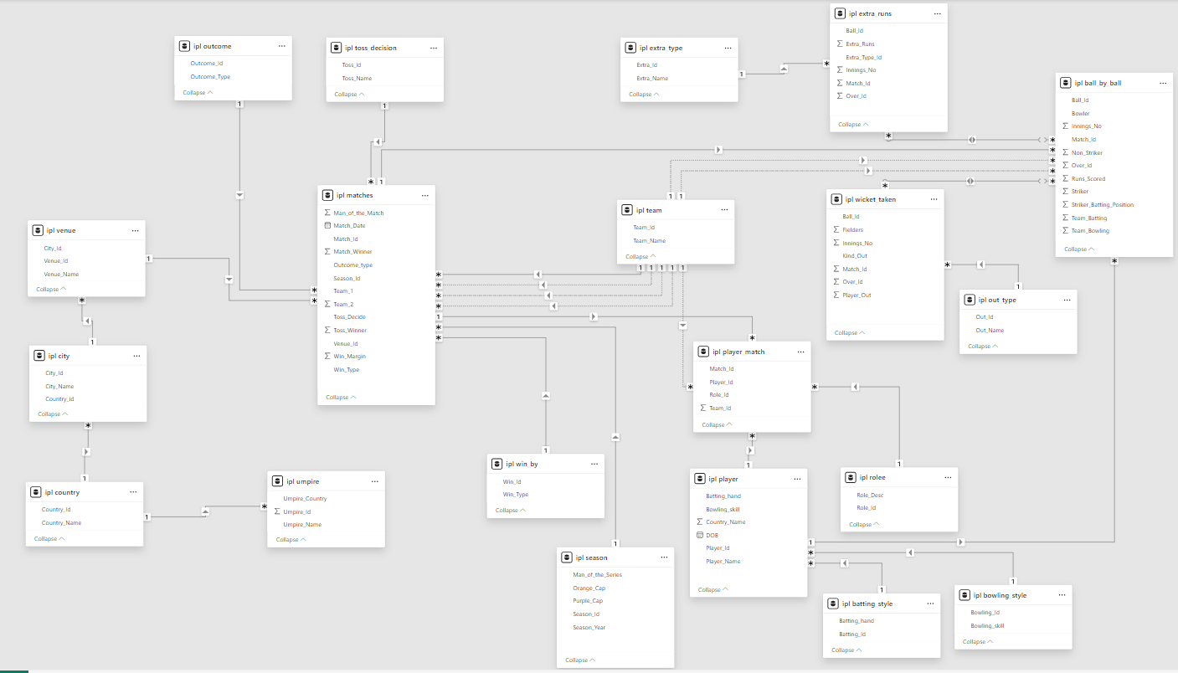
Database Schema

Slide 5
Approach
Data Cleaning
Managing missing data and resolving inconsistencies, if present.
Transformation
Merged multiple tables using joins to restructure data and enhance analytical depth.
Functions like SUM(), AVG(), and COUNT() transform raw values into summarized insights.
Analysis
Leveraged window functions like RANK(), DENSE_RANK(), and ROW_NUMBER() to efficiently evaluate and filter top-performing individuals.
Visualization
Transformed the SQL data into visual formats to facilitate deeper comprehension.

Slide 6
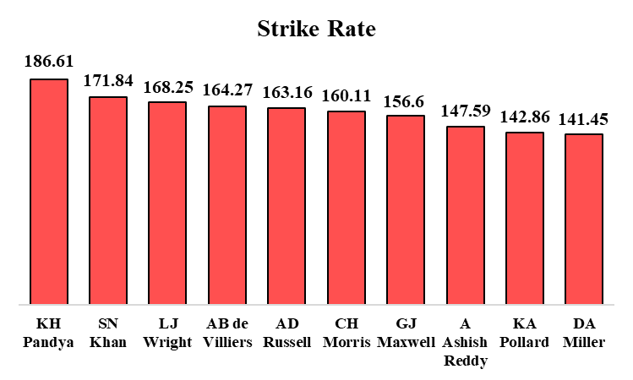
Top Strikers
This visual showcases the most dominant strikers across the previous four seasons
KH Pandya stands tall as the most explosive striker, boasting a strike rate of 186.61.

Slide 7
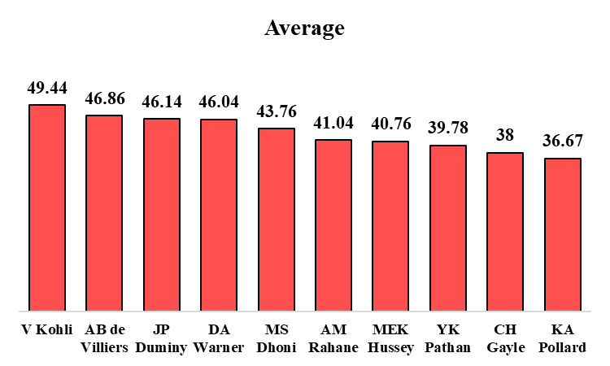
Consistent Batsmen
This chart highlights the IPL’s most consistent performers across all seasons, ranked by their batting averages.
With an impressive average of 49.44, V Kohli stands out as the most consistent run-getter in IPL history.

Slide 8
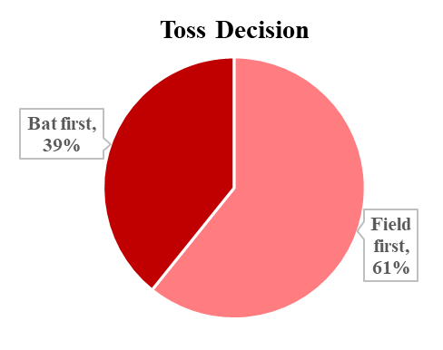
Toss Decision
This chart showcases the preferred toss decision made by winning captains.
61% chose to field first and chase, while 39% opted to bat first and defend the total.

Slide 9
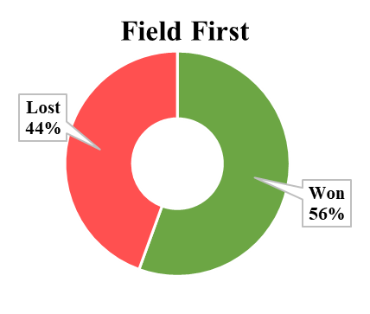
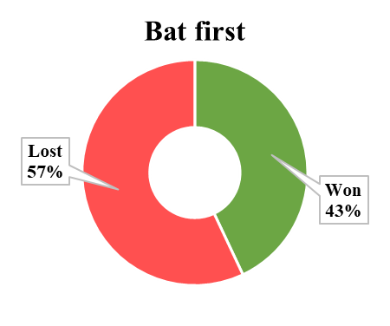
Toss Decision Outcome
This chart showcases the outcome of toss decision made.
While fielding first proved successful in 56% of games, batting first saw a 57% loss rate across matches

Slide 10
Toss Choice by Venue
Bat First suitable Venue | Bowl First Suitable Venue
M. A. Chidambaram Stadium (Chepauk) | Eden Gardens
Wankhede Stadium | Feroz Shah Kotla
Subrata Roy Sahara Stadium | JSCA International Stadium Complex
Himachal Pradesh Cricket Association Stadium | M. Chinnaswamy Stadium
Sardar Patel Stadium, Motera | Maharashtra Cricket Association Stadium
Punjab Cricket Association IS Bindra Stadium, Mohali | Rajiv Gandhi International Cricket Stadium, Uppal
This table highlights the most strategic decisions to prioritize at each venue.

Slide 11
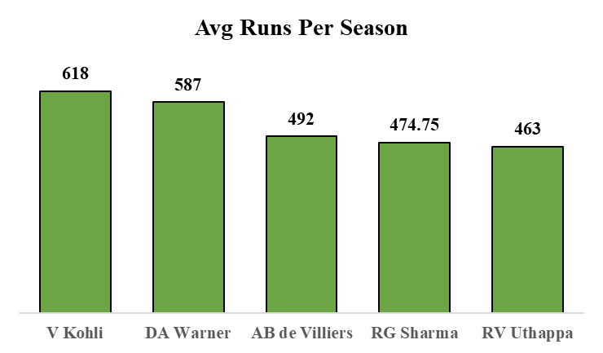
Best Batsmen
This chart highlights the performance, representing the runs scored by each per season.
V Kohli has the best average among all the players with average of 618 runs per season.

Slide 12
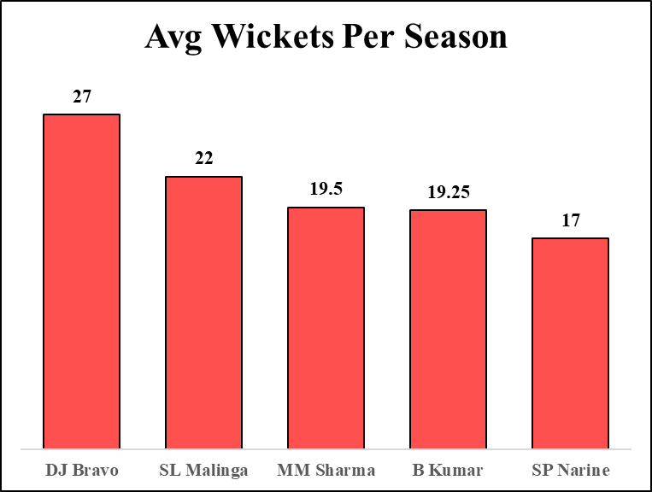
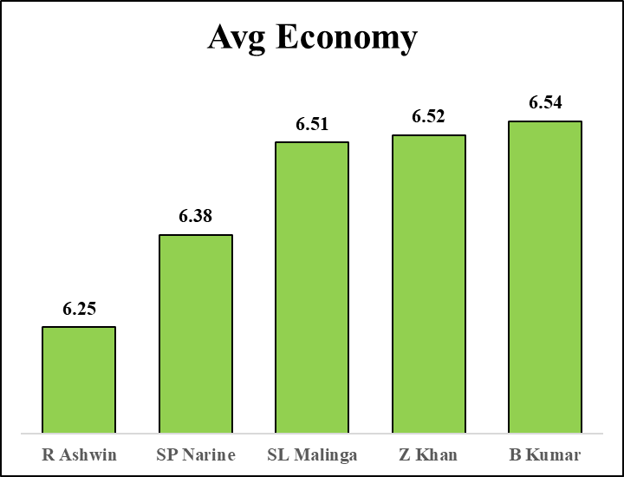
Best Bowler
A visual breakdown of players’ bowling impact tracking seasonal wicket averages and overall career economy
DJ Bravo and R Ashwin top the lists in the respective category.

Slide 13
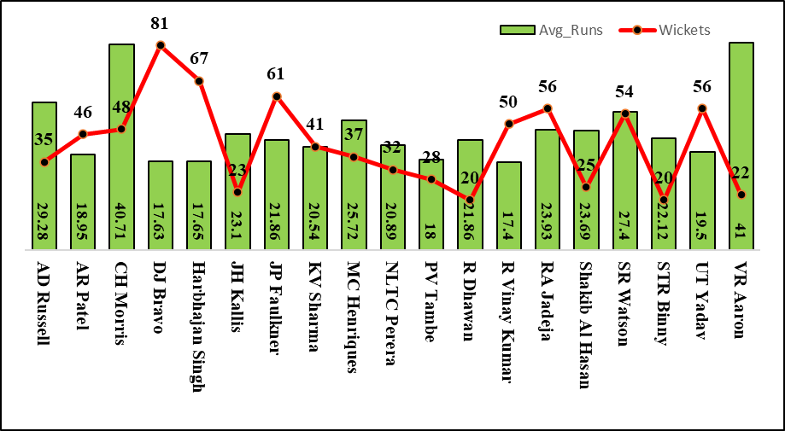
Best All Rounder
This visual presents players who’ve excelled with both bat and ball, highlighting their all-round performances.

Slide 14
RCB Performance – Match
This chart highlights Season-wise aggregates of matches won and lost, used to assess year-on-year team performance of RCB team.
2014 : Least wins and most Losses
2016 & 2013 : RCB’s top performing seasons with most wins.

Slide 15
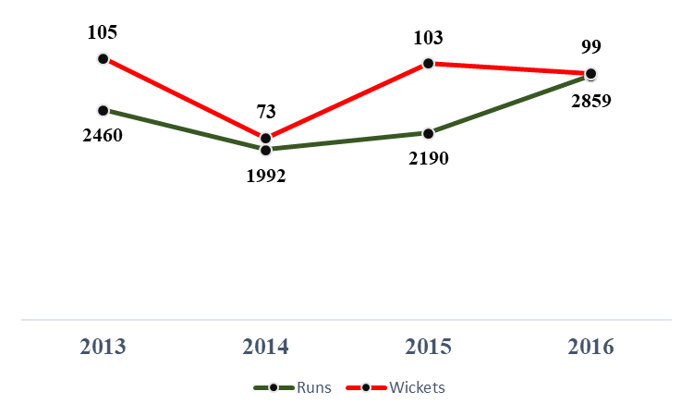
RCB Performance – Runs and Wickets
This chart highlights Season-wise aggregates of runs and wickets used to assess year-on-year team performance of RCB team.
2014 : Lowest runs scored and fewest wickets taken in RCB’s IPL history
2016 : RCB’s top run-scoring season with peak batting form
2013 : RCB’s best bowling season, with the highest wickets in a single IPL campaign

Slide 16
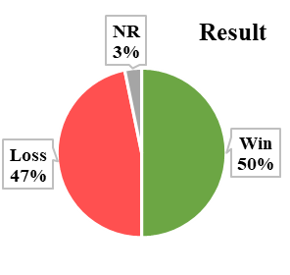
RCB Match - Win – Loss Performance
This chart highlights the RCB team performance at IPL across all seasons, representing the win and loss percentage of the matches played.
RCB has maintained a 50%-win rate across IPL seasons

Slide 17
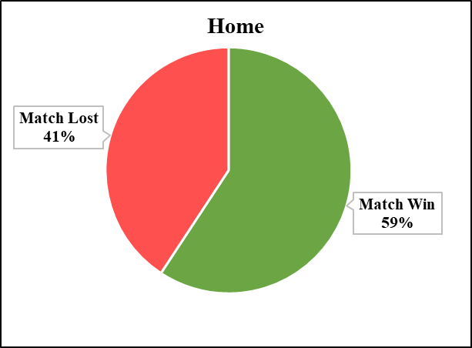
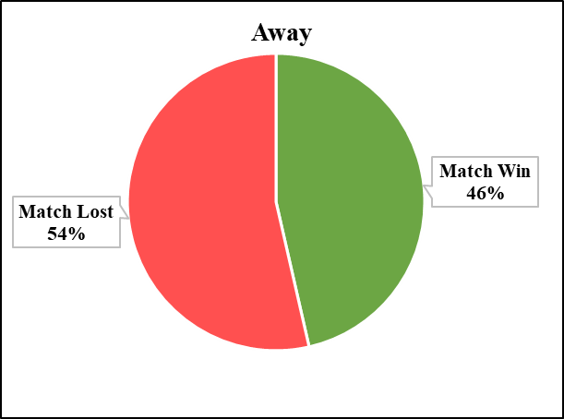
RCB Match - Win – Loss Performance
This chart highlights the RCB team performance at IPL across all seasons, representing the win and loss percentage of the matches played at home and away venue.
RCB wins 59% of their matches at home, but that number drops to 46% when playing away
The team’s performance dipped in away games, where losses stood at 54%, versus 41% on home turf.

Slide 18
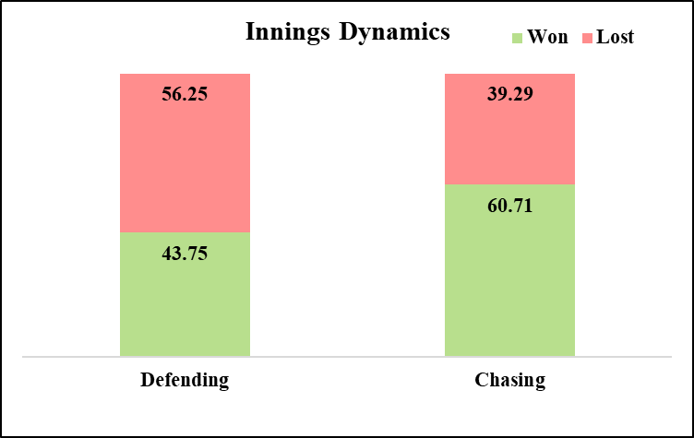
RCB Innings Dynamics
This visual explores RCB’s performance trends while defending and chasing, highlighting their success and failure rates.
RCB secured victories in 60.71% of matches while chasing, but only 43.75% when defending a total.
The team suffered defeats in 39.29% of their chases and 56.25% of their defending efforts

Slide 19
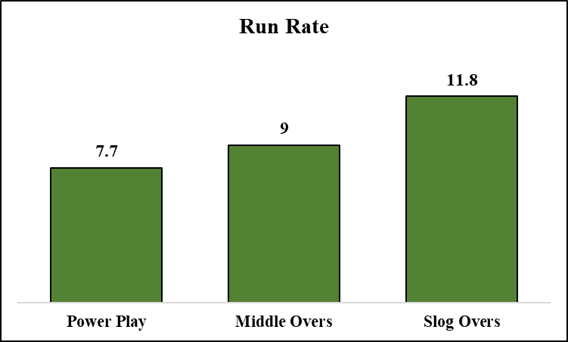
RCB 2016 Scoring Rate
The chart illustrates RCB's scoring trends across different phases of the match, showcasing the average run rate at each stage.
RCB registered their lowest scoring rate during the Powerplay, with just 7.7 runs per over, highlighting a slow start.

Slide 20
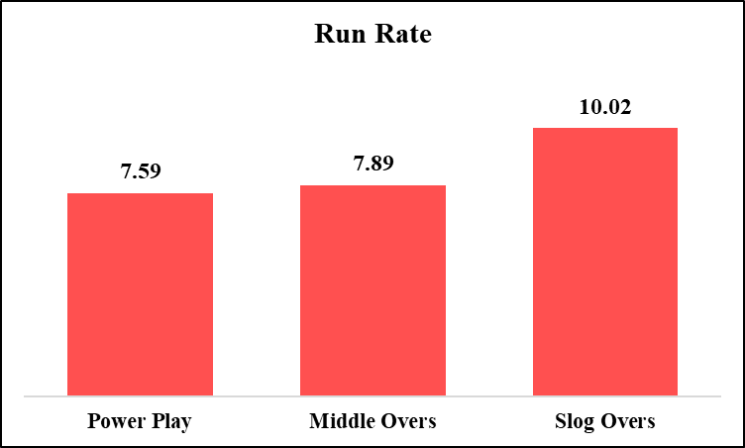
RCB 2016 Bowling Economy
The chart illustrates RCB’s bowling economy trends across different phases of the match, showcasing the average run rate conceded at each stage.
RCB registered their highest economy rate during the Slog Overs, with 10.02 runs per over, highlighting a poor death bowling.

Slide 21
Recommendations
To emerge as a strong title contender, RCB must work on boosting their overall win rate—particularly in away matches.
RCB should prioritize acquiring a quality death-over specialist, as analysis indicates frequent losses while defending totals and a high economy rate in the slog overs.
To enhance their powerplay impact, management should target players with high strike rates and proven consistency to ensure a strong start to the innings.
Investing in quality all-rounders will give RCB both firepower down the order and flexibility with the ball.
Focusing on acquiring impact players with a winning mindset is essential to boost team spirit and perform in pressure scenarios.

Slide 22


