Slide 1

Zomato Restaurant Analysis
SuhasJ

Slide 2
About company
Zomato is a leading food-tech company that connects users with restaurants for dining, delivery, and table reservations.
Initially a restaurant discovery platform, it evolved into a comprehensive service catering to both customers and restaurant partners.
The company enables users to browse menus, read reviews, order food, and even book tables, simplifying the dining experience.
Over time, Zomato expanded its operations to multiple countries, offering diverse cuisine options and supporting local food businesses.
Competing with major players in the industry, Zomato continues to innovate by improving accessibility, affordability, and food quality, making it a key player in the online food ecosystem

Slide 3
Business problem statement
Zomato's team is focused on expanding and launching new restaurant locations. Here, task is to develop strategies and recommendations for opening these restaurants.

Slide 4
Data Overview
The dataset includes two tables—RawData and Country Description—containing a total of 22 combined attributes, Those are:
Restaurant ID
Restaurant Name
CountryCode
City
Address
Locality
Locality Verbose
Longitude
Lattitude
Cuisines
Currency
Has_Table_booking
Has_Online_Delivery
Is_Delivering_now
Switch_to_order_menu
Price_Range
Votes
Average_cost_for_two
Rating
Date_key_opening

Slide 5
Approach
Data Cleaning
Handling missing values in the cuisine column, duplicate check and format check.
Removed 9 null values.
Data Transformation and column modification
Deriving month, year and quarter from DateKey_Opening.
Adding country name column from Country description to RawData using country code.
Converting different currency sources to single currency unit (INR).
Data analysis
Using excel functions like VLOOKUP, Concat, Count and Pivot tables.
Country, Year and rating wise aggregation
Check for online delivery and table booking percentages affecting rating.
Data Visualization
Conditional formatting to highlight the suggested Country and cities.
Charts created to support the analysis.
Dashboard creation for complete analysis.

Slide 6
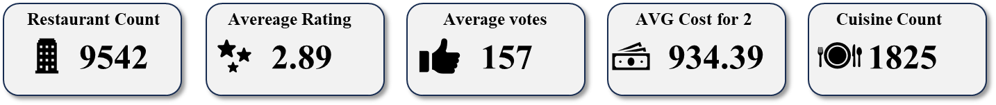
Objective Key Metrics
The dataset contains over 9500 records.
It includes data from 15 countries and 140 cities.
There are 9542 restaurants represented in the data .
These restaurants serve 1825 different cuisines.
The overall average rating across all the restaurant is 2.9.
The average number of votes received per restaurant across the dataset is 156.
The Average Cost for 2 for as per the entire dataset is Rs.934.39

Slide 7
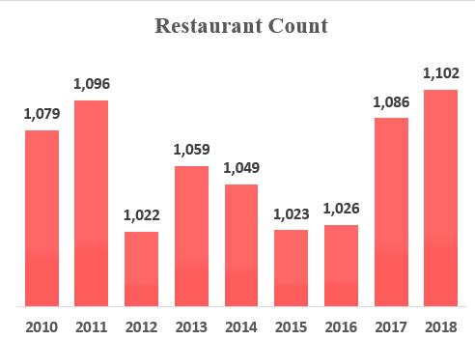
Year-wise Restaurant Count
The Following Charts shows the count of restaurants that are opened in each year.
The average number of restaurants opened per year for the last 8 years is 1061.
However, 2018 has the most restaurants opened i.e. 1102 and 2012 has the least opening of restaurants with 1022.
There is an increase of 2.13% on restaurants opened from the year 2010 to 2018.

Slide 8
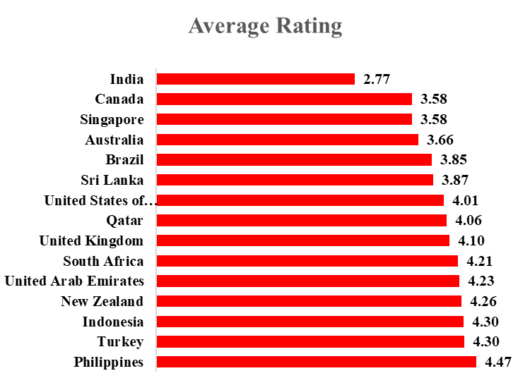
Country wise Average Raing
The Following Charts shows the average rating for each country.
The average rating for the entire data is 2.89
However, Philippines has the most average rating i.e. 4.47 and India has the least rating of 2.77.

Slide 9
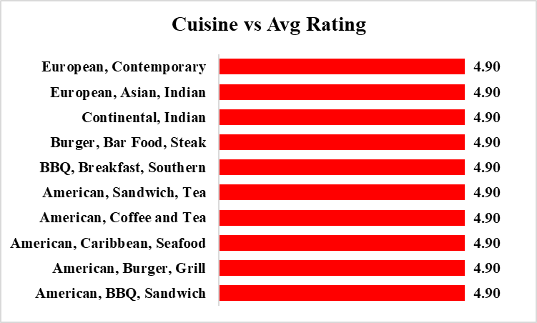
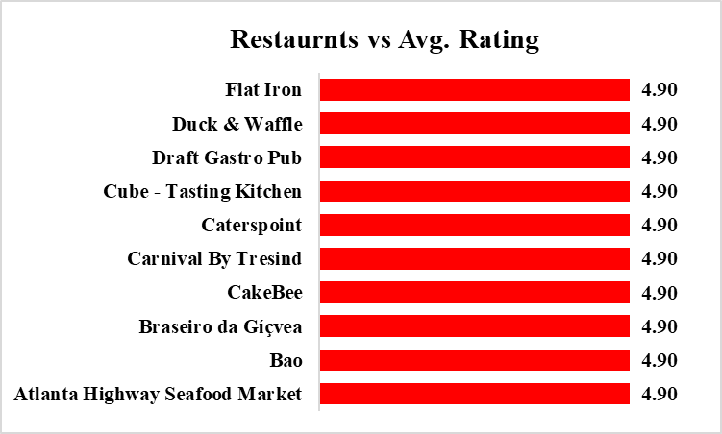
Top 10 Cuisines and Restaurants
The above chart highlights the ten cuisines with the highest average ratings
The above chart highlights the ten restaurants with the highest average ratings

Slide 10
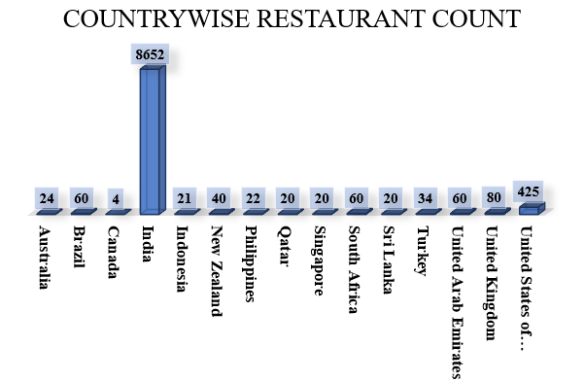
Country wise Restaurant Count
Plotted chart represents the number of number of restaurants present in each country.
India accounted for the highest number of restaurants, making up 91.5% of the total compared to other countries.
Canada has the least with only 4 restaurants.

Slide 11
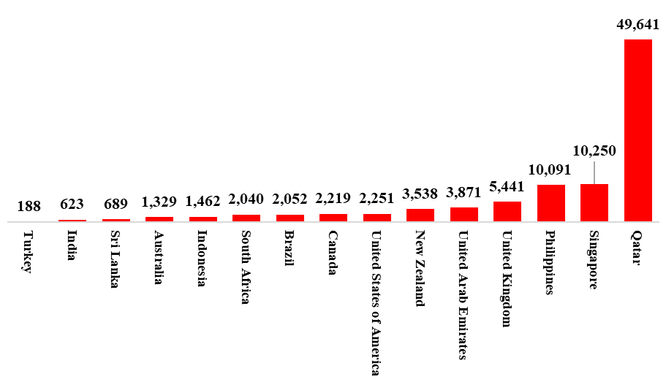
Country wise Average Cost for two
Plotted chart represents Average cost for 2 in INR for each country
Qutar accounted highest average count for two of Rs.49,641
Turkey has the least with only Rs.188.

Slide 12
Suggestion of countries for expanding
Criteria
The total number of restaurants should be fewer than 60 to minimize competition. Maintaining a limited presence allows for greater market control, ensuring higher demand and profitability within the selected locations
The number of restaurants per city should be fewer than 5 to ensure market dominance. Limiting competition within each city allows for greater control over customer preferences and enhances the ability to establish a strong presence.
The average cost for two should remain below Rs.4000, as a premium price may discourage potential customers from visiting. Keeping pricing accessible can help attract a larger customer base and improve footfall.
An average rating below 3.7 suggests a lower quality of service for customers. Expanding into such cities could provide a competitive advantage if customer satisfaction is effectively addressed
Recommended countries and Cities
Australia - Flaxton, Paynesville, Montville.
Canada – Chatham-Kent, Consort, Vineland Station, Yorkton.
Indonesia – Tangerang.

Slide 13
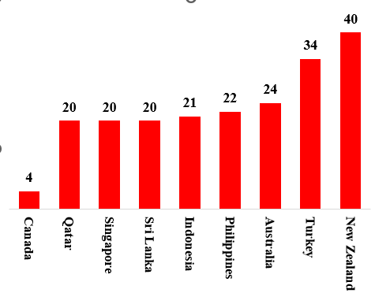
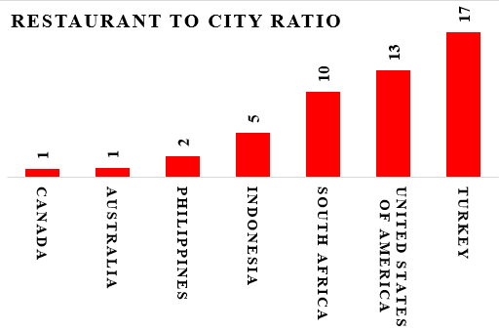
Visualization
Restaurant count
The country-wise distribution of restaurant counts has been visualized to support the selection of the ideal country for expansion. This analysis helps in identifying market opportunities, assessing competition, and making data-driven decisions for strategic growth..
The city to restaurant count ratio is visualized to support the selection of the ideal country for expansion. This analysis helps in identifying market opportunities, assessing competition, and making data-driven decisions for strategic growth..

Slide 14
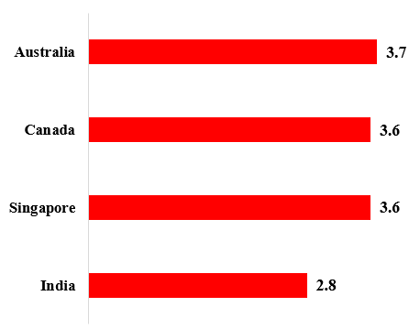
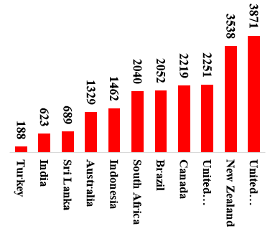
Visualization
Country vs Average rating
Country vs Avg_cost_for_2
The country-wise distribution of average rating has been visualized to support the selection of the ideal country for expansion. This analysis helps in identifying market opportunities, assessing competition, and making data-driven decisions for strategic growth..
The country-wise distribution of Average_cost_for_2 has been visualized to support the selection of the ideal country for expansion. This analysis helps in identifying market opportunities, assessing competition, and making data-driven decisions for strategic growth..

Slide 15
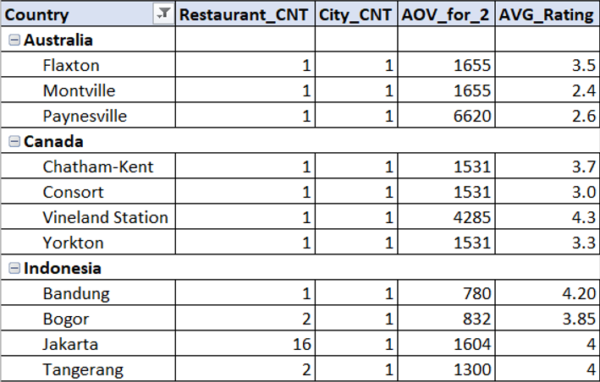
Visualization
City selection
Australia
Its average order value for 2 is around 1350, but in some places like Flaxton and Montville its over 2000 and in Paynesville its around 6500
Canada
Its average order value for 2 is over 2200, but in places like Vineyard station its over 4500 with only one restaurant Though the country average rating is 3.5, in some cities around 3 which indicates there is a huge demand for good quality and tasty food
Indonesia
Though its City to Restaurant count ratio is 5, which means there are 5 restaurants for each city, its majority of the restaurants i.e. with over 65% of the restaurants are in Jakarta rest other cities have around 2 restaurants per city. Its average order value for 2 is around 1450, but in some place like Tangerang its around 1300 with satisfactory rating of 4, which means with good quality and better food there can be increase in AOV.

Slide 16
Cuisine Selection
Considering popularity of cuisines in the recommended region while also factoring in globally favoured cuisine types for a more comprehensive perspective.
Australia | Canada | Indonesia
Pizza - Italian, American | Pizza - Italian, American, Chinese | Sushi, Japanese
Bar Food - Burger, Steak, Desserts | Mediterranean, Seafood | Indonesian, Sunda, Asian
Mediterranean, Seafood, Continental | Asian, Sushi, Tapas | Coffee, Tea
Modern Australian Breakfast |  | Italian, Desserts, Burger
Coffee, Tea
Incorporating the recommended cuisines tailored to each country will greatly enhance customer feedback and restaurant ratings, while also driving significant revenue growth since there have ratings near to 4 or above.

Slide 17
Impact of Table booking feature on rating
The graph clearly shows that countries without table booking tend to have lower ratings compared to those that offer it. This suggests that implementing a table booking system can help enhance a restaurant’s overall rating.
Since recommended countries like Australia, Canada, and Indonesia currently do not offer table booking, integrating this service could be a key strategy to enhance restaurant ratings and customer satisfaction. Providing a seamless reservation system would likely improve the dining experience, increase convenience, and establish a sense of reliability among customers, ultimately leading to higher engagement and better reviews.

Slide 18
Impact of Online Delivery feature on rating
The graph clearly shows that countries without online delivery tend to have lower ratings compared to those that offer it. This suggests that implementing online delivery system can help enhance a restaurant’s overall rating.
Average Rating
Since recommended countries like Australia, Canada, and Indonesia currently do not offer online delivery integrating this service could be a key strategy to enhance restaurant ratings and customer satisfaction. Providing a seamless delivery system would likely improve the convenience and establish a sense of reliability among customers, ultimately leading to higher engagement and better reviews.

Slide 19
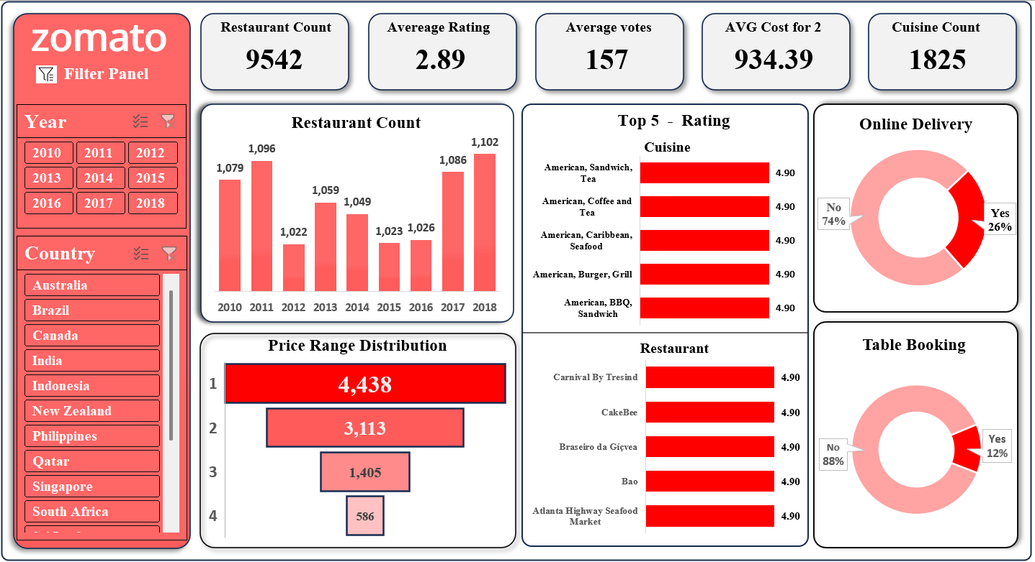
Dashboard

Slide 20
Recommendations
Our analysis of Zomato's restaurant data highlights exciting opportunities for global expansion. By focusing on high-demand regions, aligning with demographic preferences, and leveraging competitive advantages, we can confidently propose the establishment of new restaurants. This strategy not only strengthens market presence but also elevates dining experiences, fostering sustainable growth for Zomato while enriching the global culinary scene
Target underserved regions: Focus on countries with a high demand for restaurants but a limited presence, maximizing growth opportunities.
Optimize pricing strategy: Higher-priced restaurants tend to receive better ratings. Choosing a price range between 3–4 ensures financial stability while maintaining quality
Expand into untapped markets: Online delivery and table booking present significant growth potential, offering new revenue streams.
Enhance cuisine quality and pricing: Maintaining high-quality cuisine and selecting an appropriate price range can boost restaurant ratings and overall success.

Slide 21


