Slide 1
Assignment Outputs
Suhas S Kamath

Slide 2
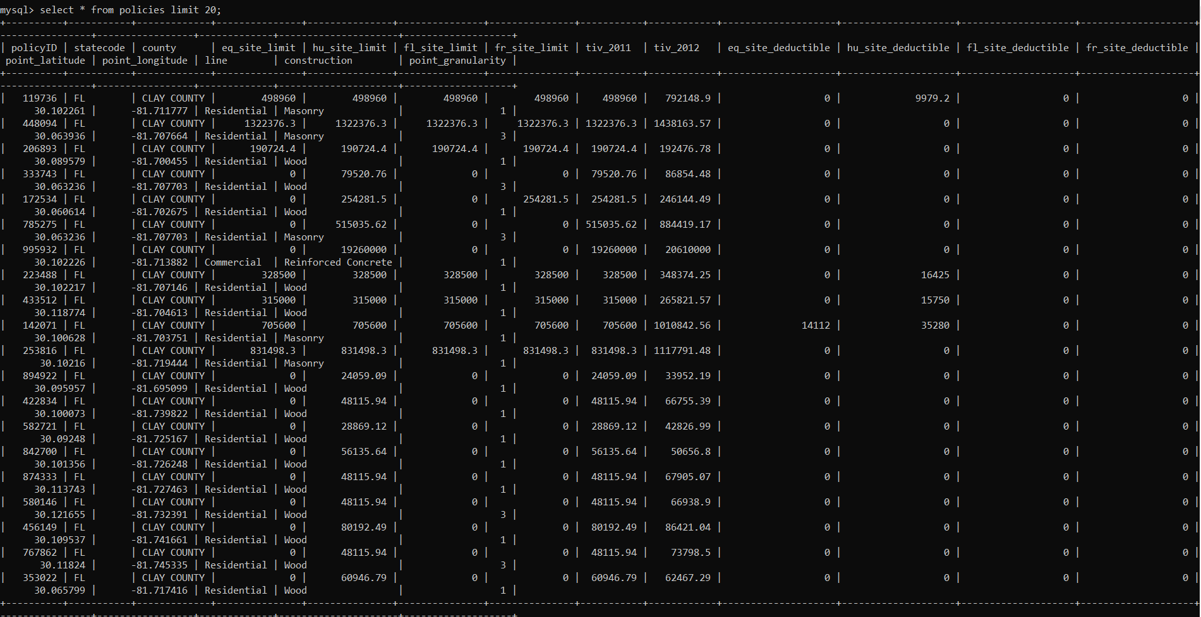
SQL write of CSV File

Slide 3
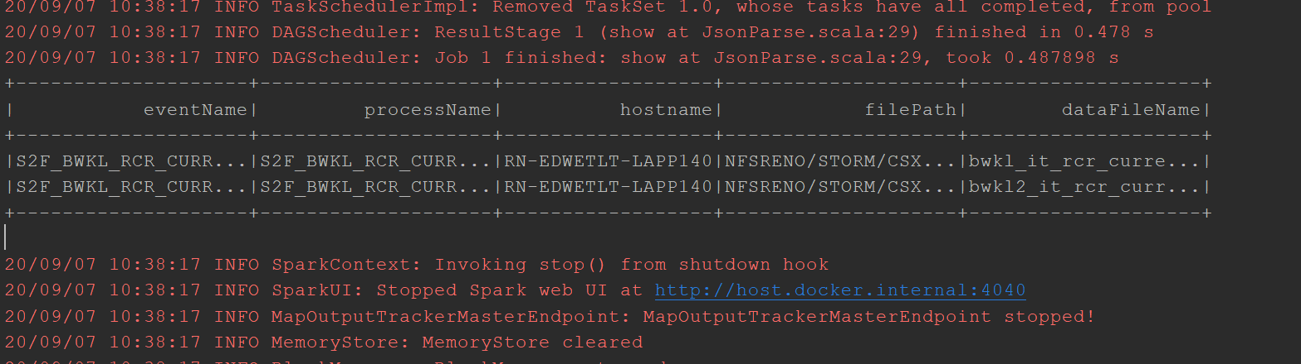
JSON Parse Output

Slide 4
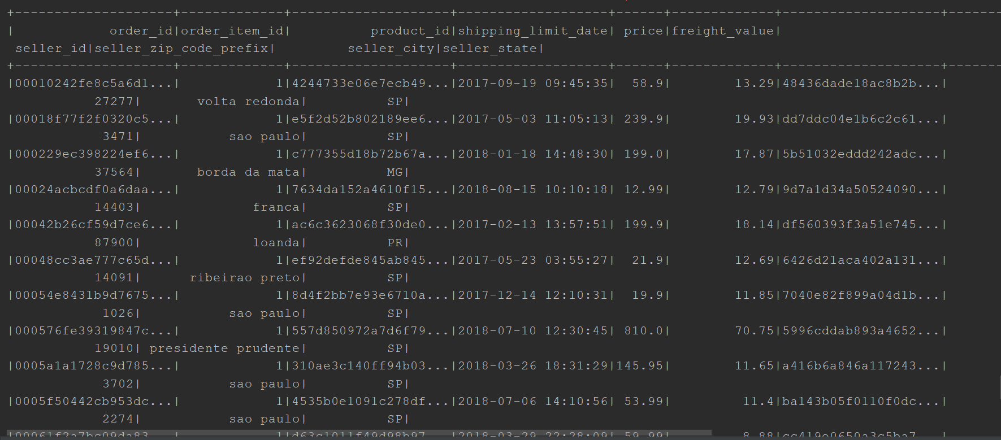
Reading of two CSV and Join

Slide 5
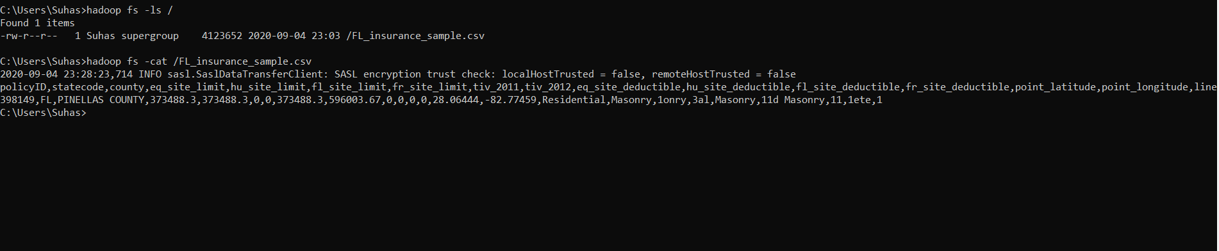
Hadoop read and write to Filesystem
Input

Slide 6
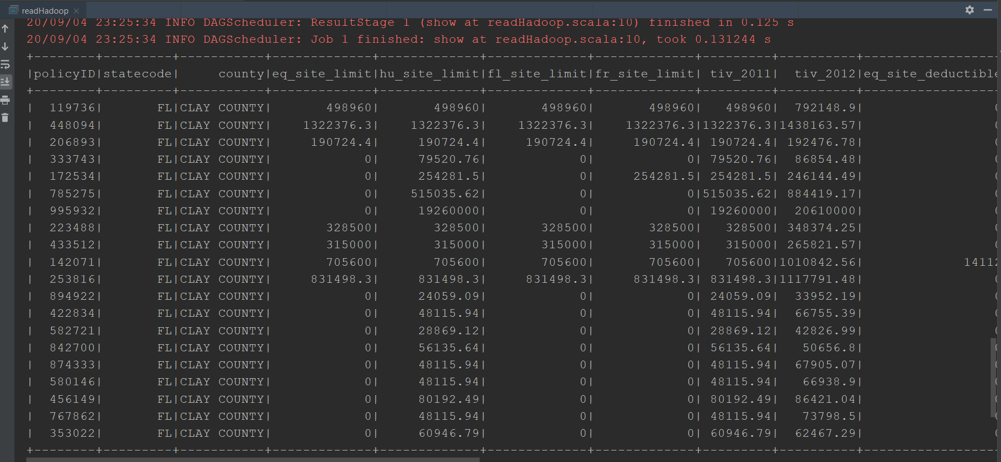
Output of Hadoop

Slide 7
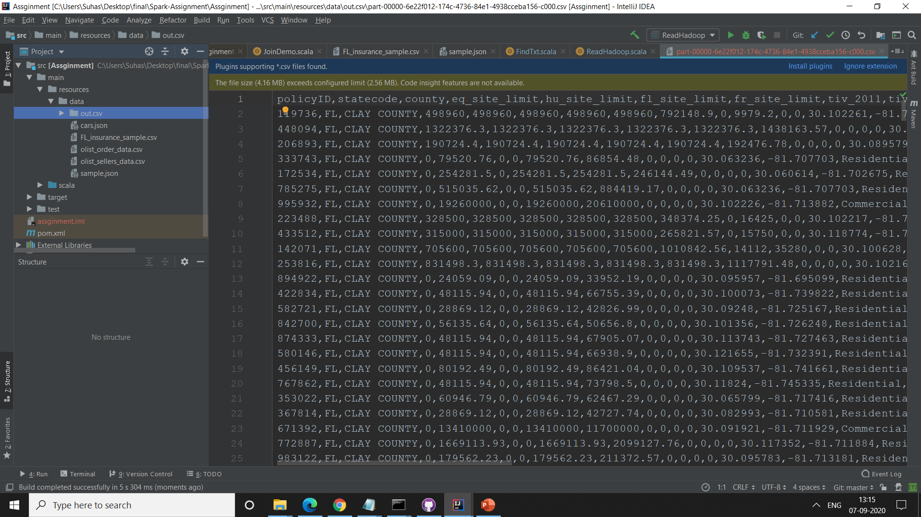
Output of Hadoop

Slide 8
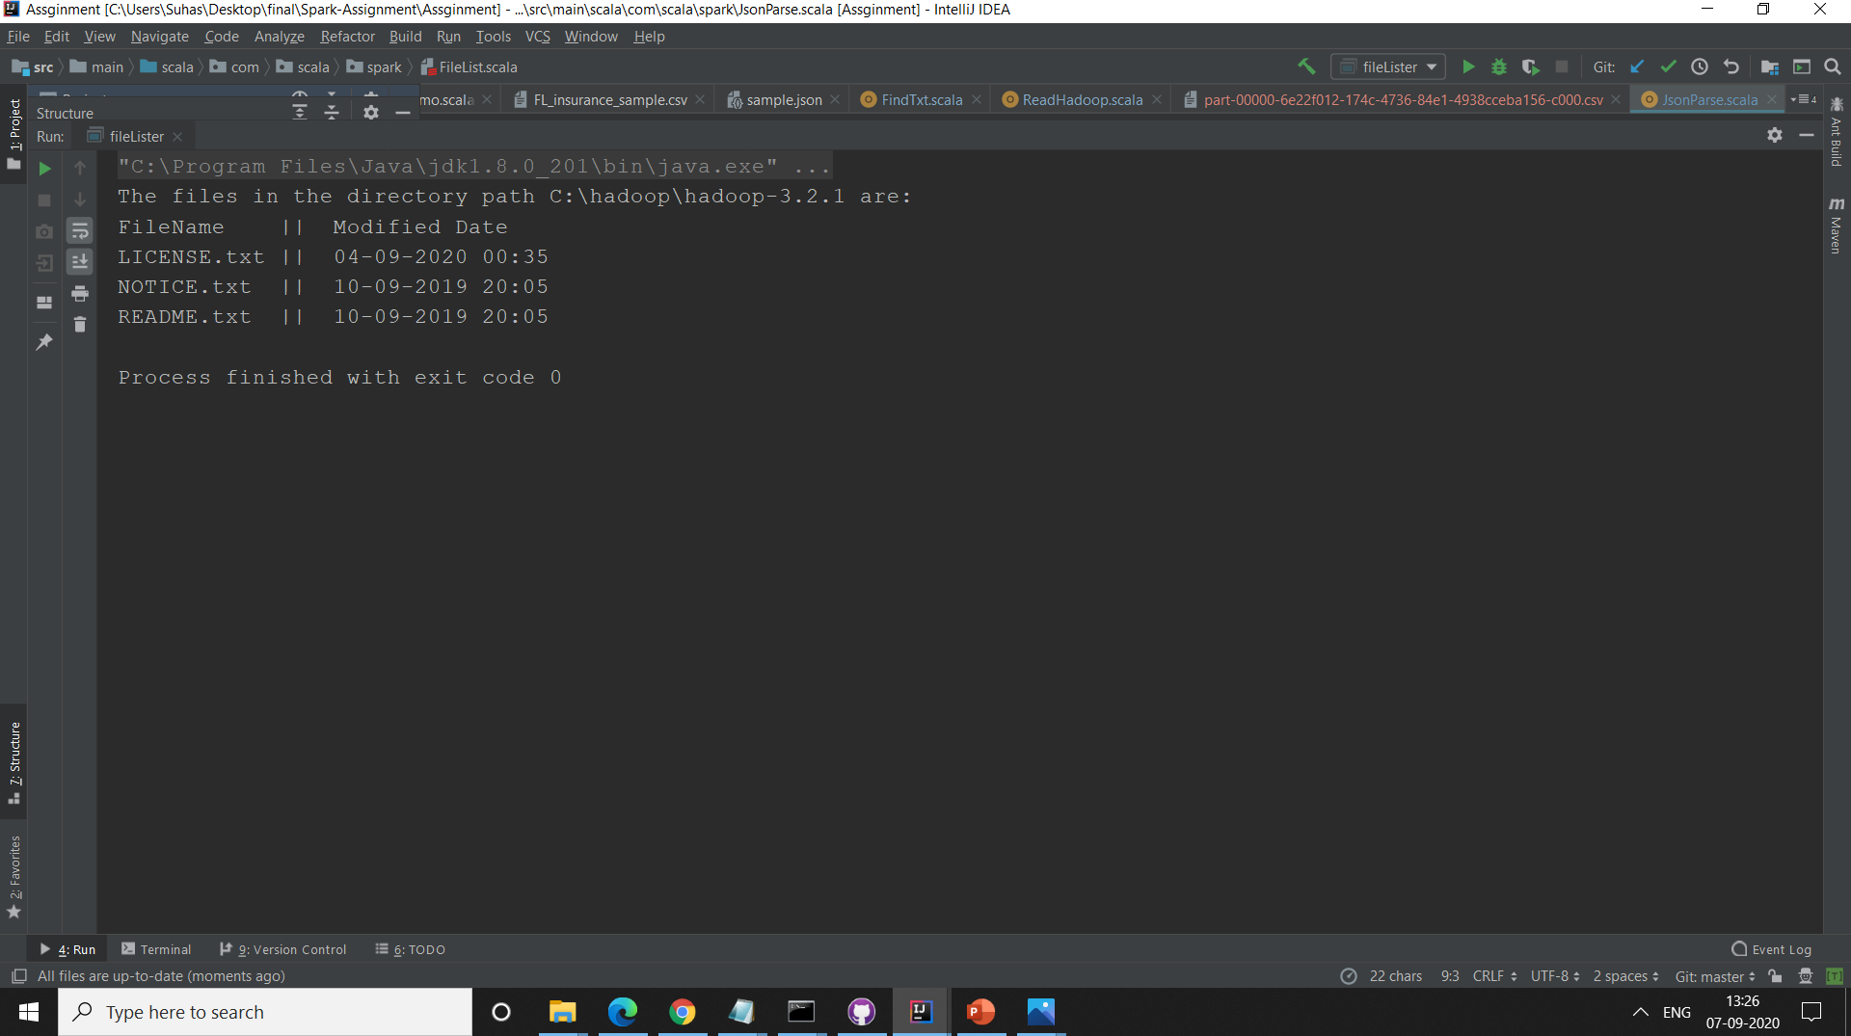
Listing of files along with Modified Dates

Slide 9
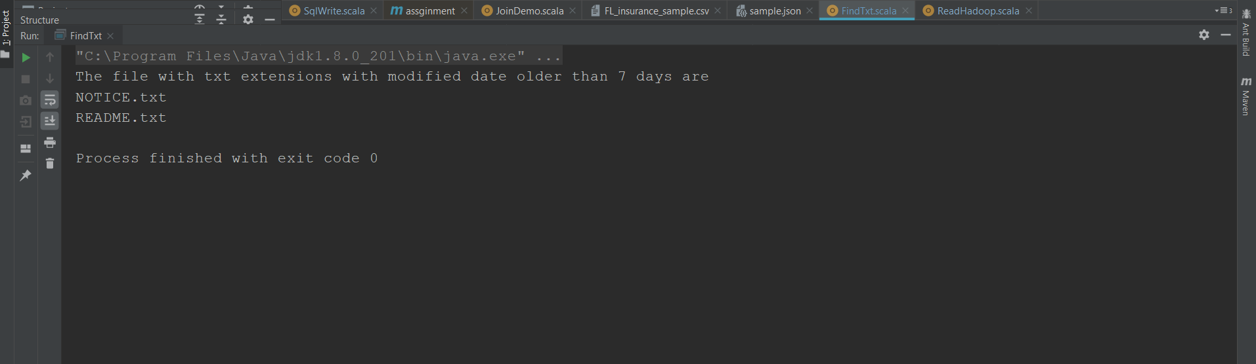
List of .txt files older than 7 days

Slide 10
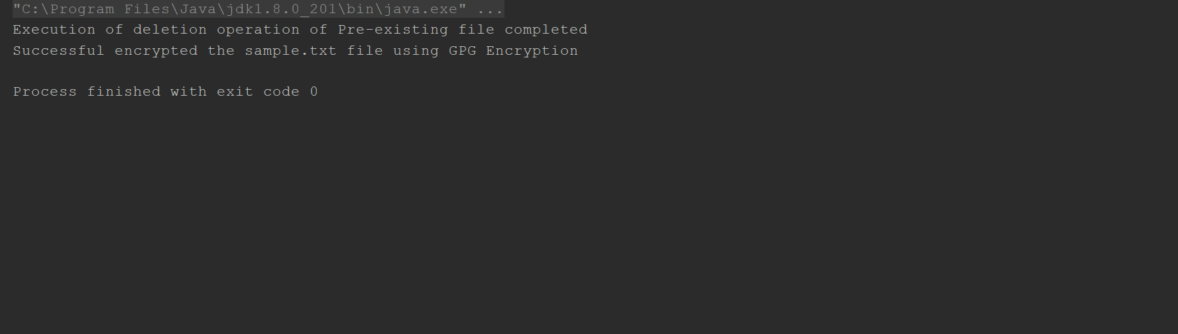
GPG Encryption-Program Output

Slide 11
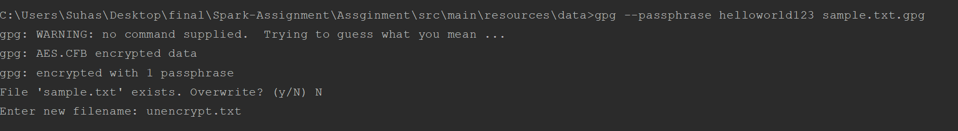
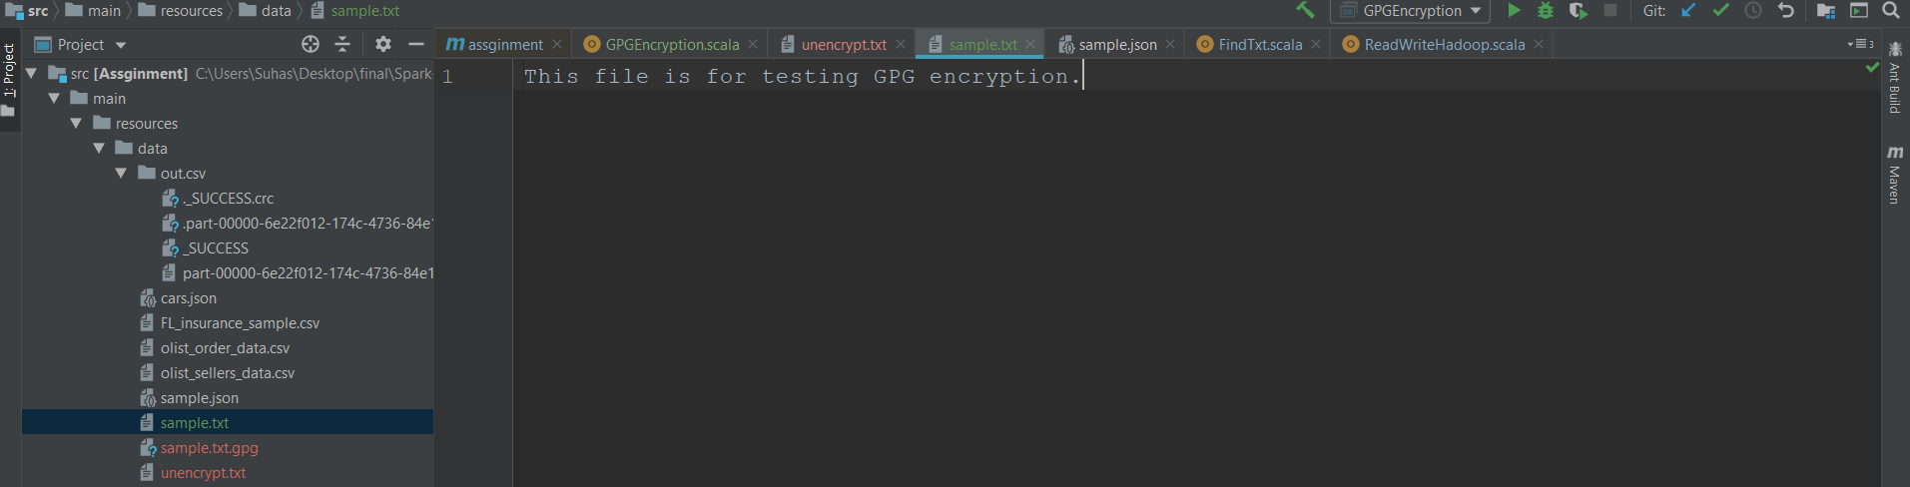
GPG Encryption-Decryption

