Slide 1

Using LLM to
Evaluate
Query Plan Equivalence
Suhas Kamath
&
Anish Tiwari

Slide 2



Motivation & Project Objectives
Query plans for the same SQL query can look different but still be equivalent.
Using LLMs to check if two query plans are equal
01
If the plans are equal, what are the transformations required to map from Plan A to Plan B?
02
Using Apache Calcite to check the LLM’s response
03
Equivalence testing is important for database optimizers, correctness testing, and detecting redundant queries.
Existing tools (like PostgreSQL’s planner) can’t easily verify plan equivalence — hence this research.

Slide 3

Step 1: Extracting query plans from PostgreSQL
We require query plans as input for the LLM.
Use EXPLAIN JSON to obtain the query plan.
We “clean” the query plan.
Given ORIGINAL_PLAN and TARGET_PLAN (both in simplified JSON plan format, see "Plan Format" below), determine whether the two plans are equivalent by producing a sequence of Apache Calcite transformations (from SUPPORTED_TRANSFORMATIONS) that maps ORIGINAL_PLAN -> TARGET_PLAN.
<Response rules (omitted)>
<Plan format (omitted)>
<Supported transformations (omitted)>
<Schema for context (omitted)>
<Example of input & output (omitted)>
Step 2: Prompt Engineering
We need the LLM to output only two things:
  Whether the query plans are equal
  If they are equivalent, what are the transformations that map from plan A to plan B.
After plenty of trials, we have found that the following prompt achieves the best results:

Slide 4

Step 3: Apache Calcite
Apache Calcite is an open-source framework for building databases and data management systems. It includes a SQL parser, an API for building expressions in relational algebra, and a query planning engine.
We use Apache Calcite to check the LLM’s answers
We can now compare two query plans with/without any transformations.

Slide 5

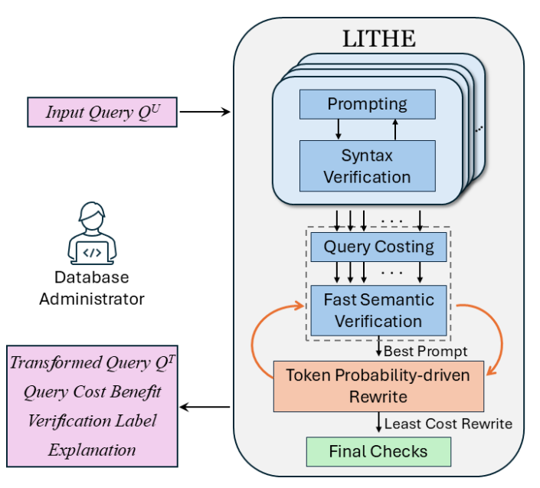




LITHE
LITHE is a software that leverages the power of LLMs to improve query performance.
Developed at Database Systems Lab (DSL), IISc
It works by rewriting a query to another equivalent query by leveraging the ability of LLMs.
We used this software to rewrite queries, so that we can test them using our program.
DHARWADA, S., DEVRANI, H., HARITSA, J., AND DORAISWAMY, H. Query Rewriting via LLMs. March 2026 (2025), ACM.

Slide 6
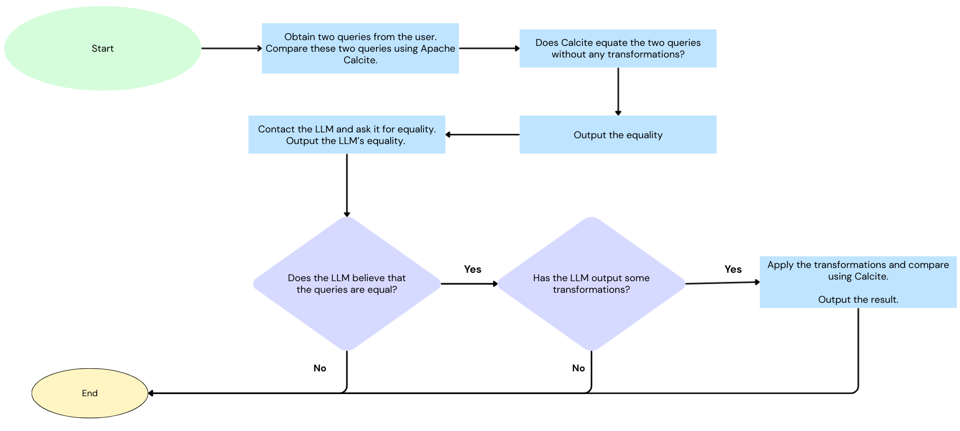
Current Program Flow

Slide 7
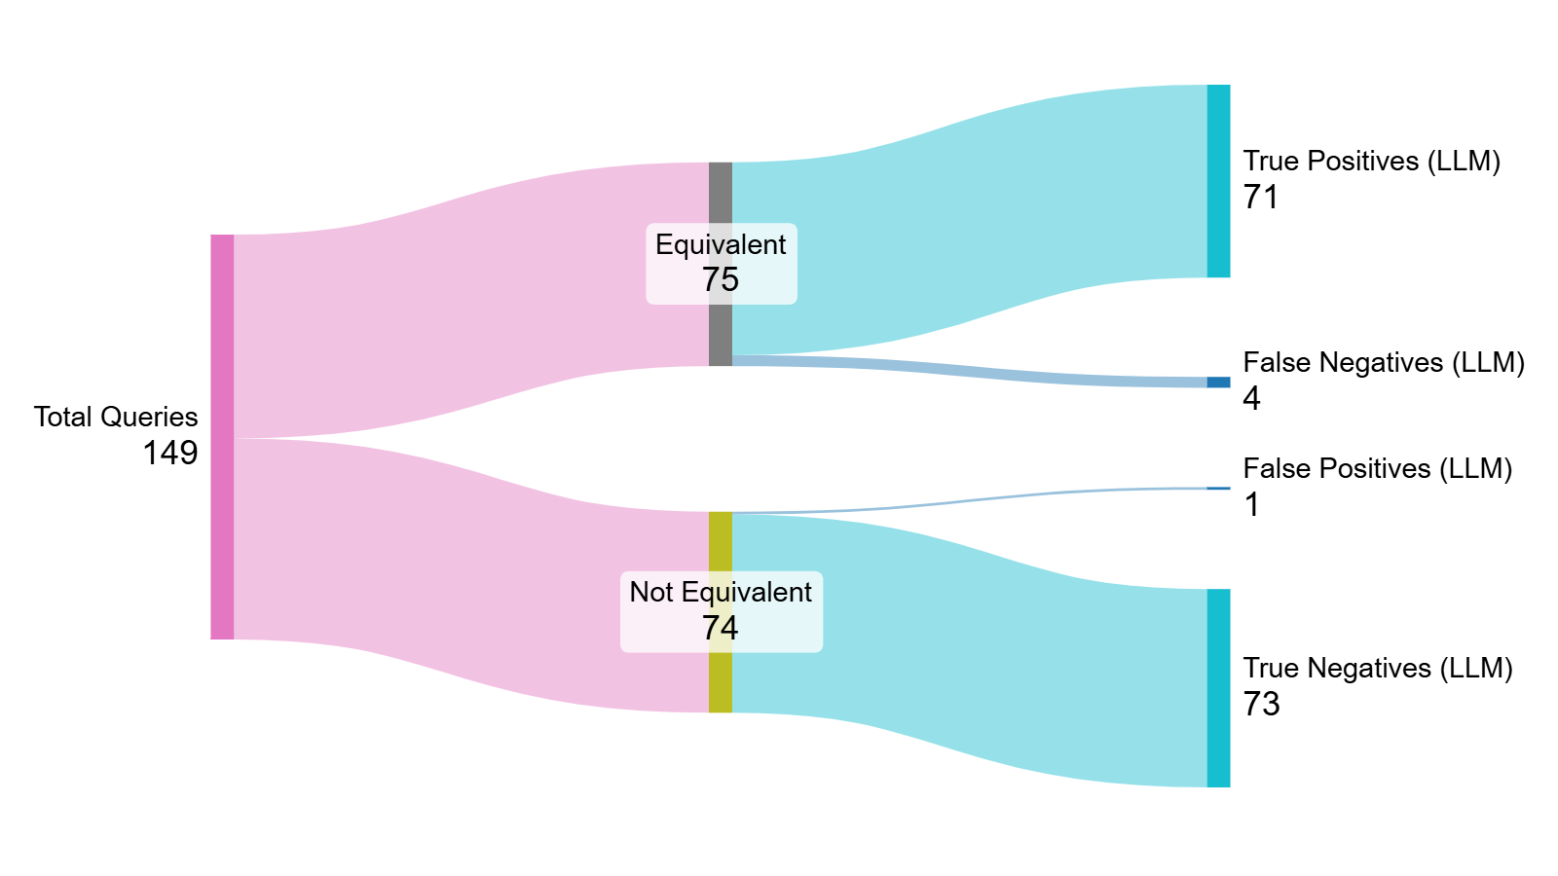
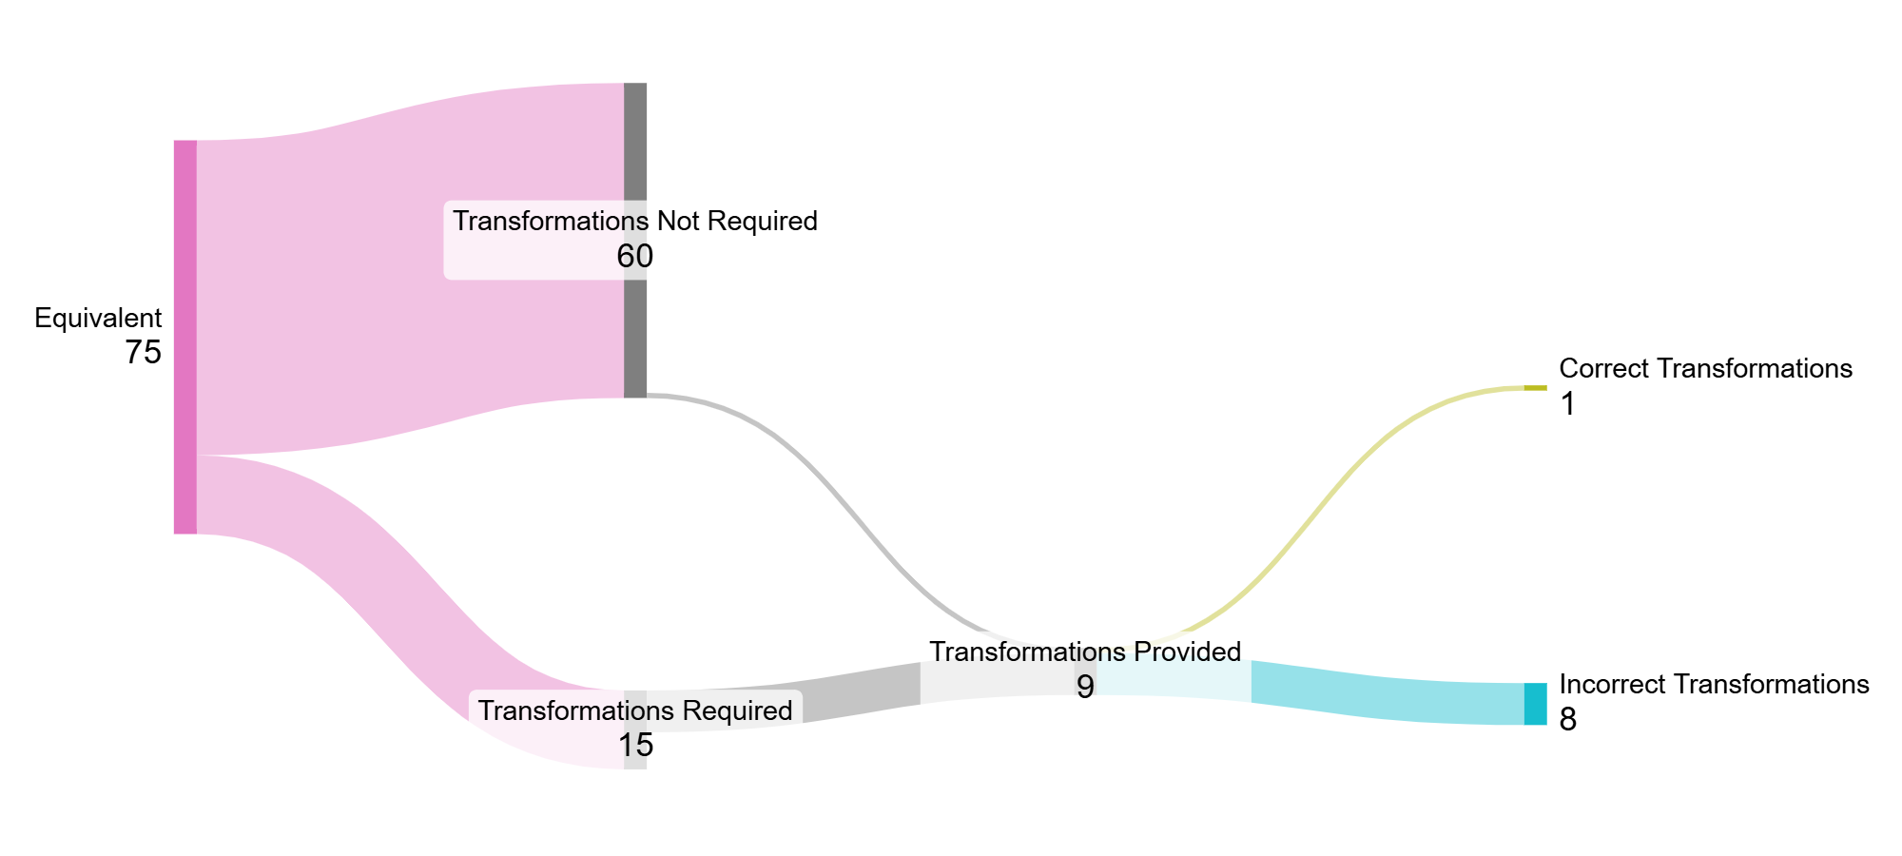
Results
Overall accuracy of 96%.
Much better results than last time!

Slide 8
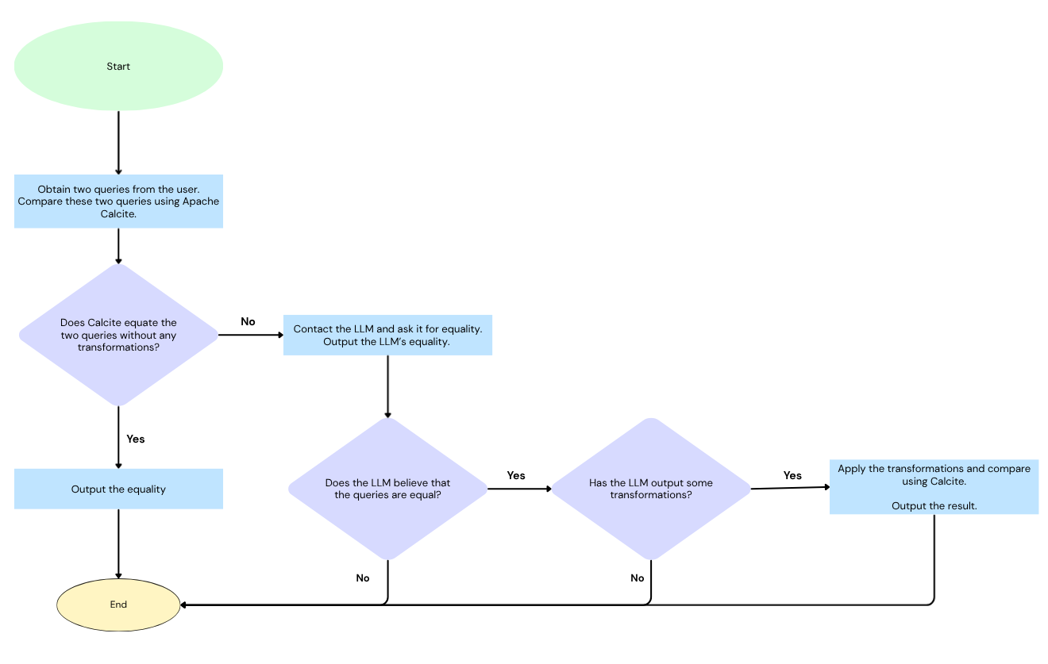
Alternate Program Flow

Slide 9
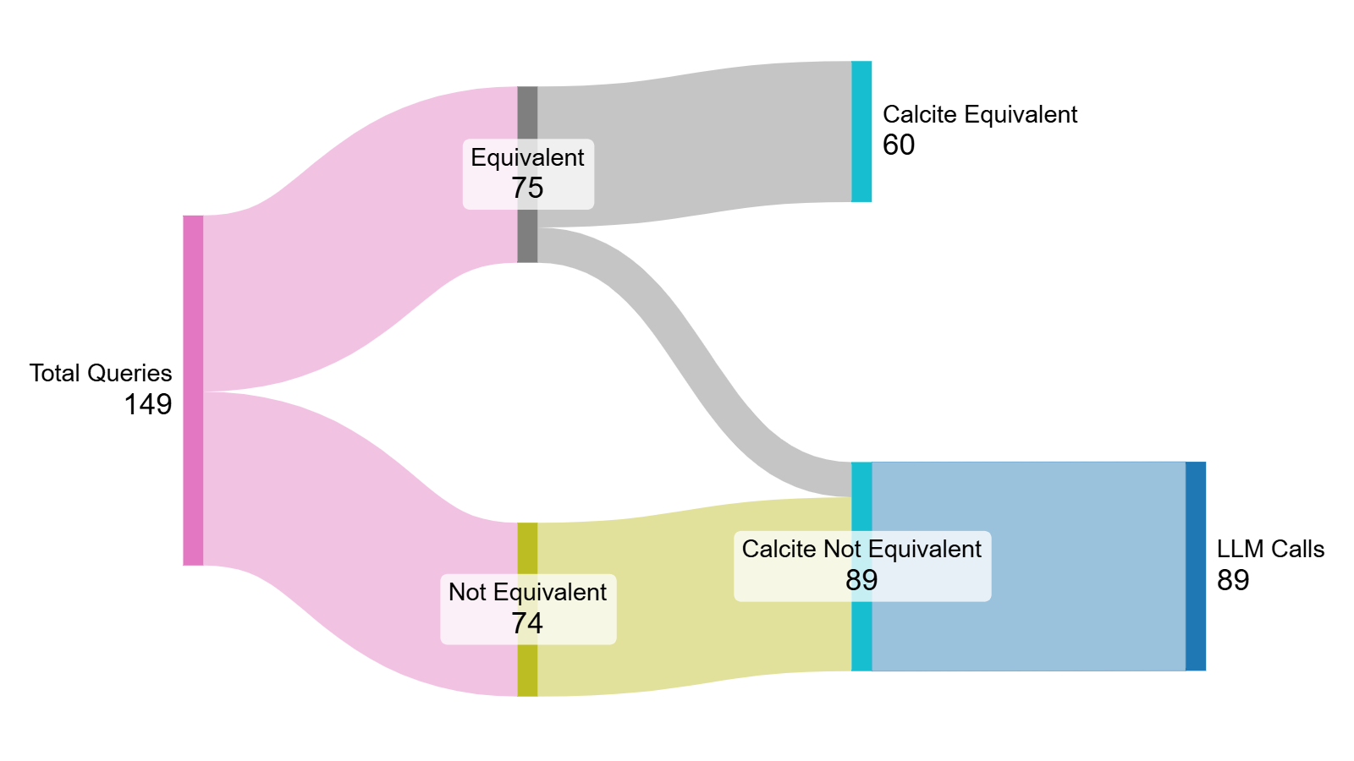
Advantages of Alternate Program Flow
Reduction in LLM calls by a factor of 40%.
Reduces cost and time.
Making an LLM API call takes upwards of 45 seconds, whereas the current Calcite-based deterministic check requires less than 5 seconds.
Lesser tokens are used.

Slide 10
Future Work

