Slide 1
ECE 516 Cloud Computing and Big Data Project Presentation
Title : Valuation and
Forecasting Stock Prices of Publicly
Traded Companies Using Spark
Framework
Department of Electrical and Computer Engineering
Prof. Maria Striki
Group 2
Joel Joseph Kinny, Jay Panchal and Suhas Kollur

Slide 2
Agenda
Introduction
Project Goals
Methodology
Experimental Observations
Analysis
Conclusion
Related Work

Slide 3
Valuation and Forecasting of Stock Prices
Notes:
Brendon

Slide 4
Introduction
In the volatile landscape of financial markets, precision in stock price forecasting and intrinsic value assessment stands as a paramount necessity.
This project endeavors to establish a resilient framework for the meticulous valuation and forecasting of publicly traded entities, harnessing the prowess of the Apache Spark framework for unparalleled efficiency in data processing and analysis.
Notes:
Brendon

Slide 5
Project Goals
Goal 1: Develop a comprehensive and sophisticated framework for the valuation and forecasting of publicly traded companies, integrating advanced analytical methodologies.
Goal 2: Apply technical and quantitative analyses to dissect and interpret intricate patterns within stock market data.
Goal 3: Implement a robust data preprocessing and feature engineering pipeline to curate historical and real-time financial data for optimal model training and analysis.

Slide 6
Project Goals
Goal 4: Harness the distributed computing capabilities of the Apache Spark framework to facilitate seamless and scalable data processing and analysis.
Goal 5: Construct a predictive model capable of forecasting stock prices and calculating intrinsic values with a high degree of accuracy.
Notes:
Brendon

Slide 7
Methodology

Slide 8
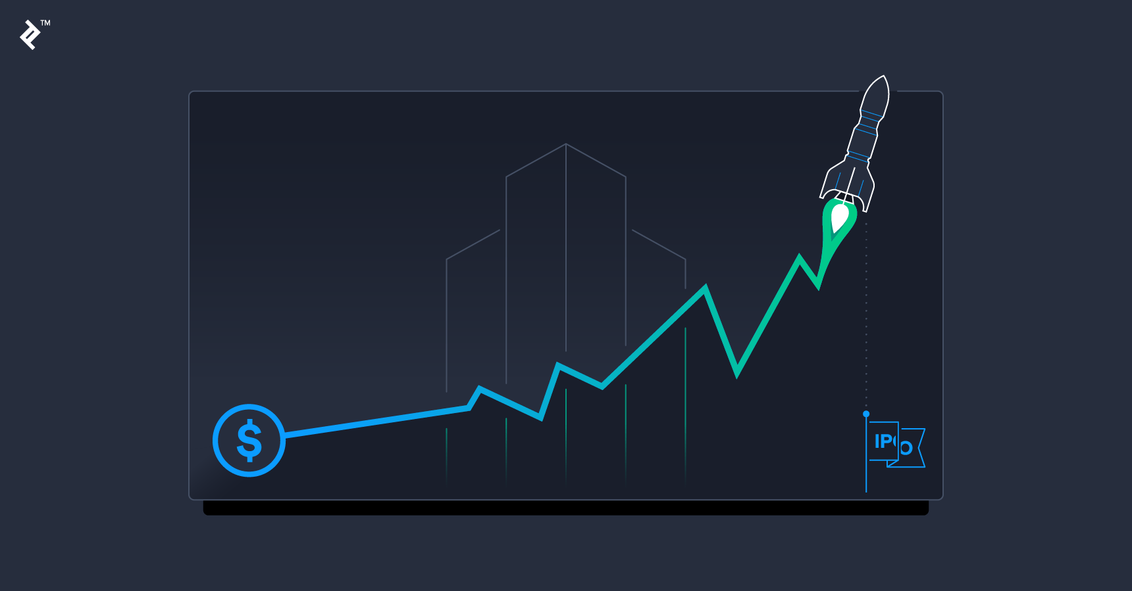
Data Collection and Processing
Acquired historical and real-time financial data from reputable sources to form the foundation of the analysis.
Executed a meticulous data preprocessing phase to rectify data quality issues and render it suitable for subsequent analysis.
Transformed the data into a format conducive to comprehensive model training and analysis.
Notes:
Brendon

Slide 9
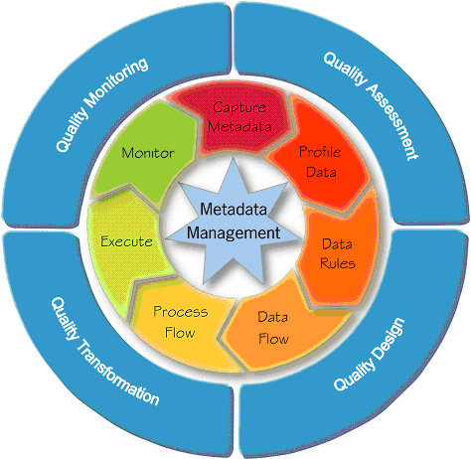
Data Quality Assurance
Ensuring Data Integrity:
Discuss strategies implemented to ensure the integrity of the acquired data, including data validation techniques and cross-verification processes.
Emphasize the importance of reliable data as the foundation for accurate financial analysis

Slide 10

Model Development
Employed technical analysis indicators and quantitative analysis techniques to establish a robust foundation for stock price forecasting and intrinsic value assessment.
Implemented sophisticated feature engineering mechanisms to capture key market dynamics and economic indicators.
Leveraged state-of-the-art machine learning approaches to construct a highly predictive forecasting model.
Notes:
Brendon

Slide 11
Apache Spark Integration
We deploy Apache Spark to enable distributed data processing, optimizing scalability and computational efficiency.
We have Implemented parallel processing methodologies to adeptly handle large financial datasets, ensuring optimal resource utilization.
Leveraged Spark Streaming and MLib for real-time analysis and machine learning, affording the project a cutting-edge analytical edge.
Notes:
Brendon

Slide 12
Apache Spark Integration -
Cluster Deployment and Parallel Processing in Apache Spark
Spark Cluster Deployment:
Overview: Set up a cluster with a master node and multiple worker nodes for Spark applications.
Components: Master node manages task distribution to worker nodes.
Resource Management:
Overview: Spark supports various cluster managers like Apache Mesos, Hadoop YARN, or its built-in manager.
Function: Manages resource allocation and execution of Spark applications.
Parallel Processing with RDDs:
Overview: Spark breaks down large datasets into partitions distributed across nodes.
Feature: RDDs (Resilient Distributed Datasets) enable fault-tolerant parallel processing.

Slide 13
Apache Spark Integration -
Optimizing Scalability and Efficiency
Data Partitioning:
Importance: Crucial for efficient parallel processing.
Strategy: Understand data characteristics and adjust partitioning accordingly.
Caching and Persistence:
Benefit: Persist intermediate data in memory, reducing recomputation needs.
Impact: Significant improvement in the performance of iterative algorithms.
Tuning Spark Configurations:
Parameters: Memory allocation, executor cores, and parallelism.
Importance: Essential for achieving optimal performance; adjust based on workload characteristics.

Slide 14
Apache Spark Integration -
Spark Streaming and MLlib for Machine Learning
Spark Streaming:
Purpose: Enables scalable, fault-tolerant stream processing of live data.
Integration: Seamless integration with batch processing for unified real-time and historical analysis.
MLlib for Machine Learning:
Functionality: Scalable machine learning library with various algorithms.
Integration: Tightly integrated with Spark Core, simplifying development and deployment of ML models at scale.

Slide 15
View Forecasts -
Real-Time Updates:
i) Enable users to view real-time forecasts generated by the model.
ii) Implement automatic refreshing or provide a manual refresh option for the latest data.
Clear Presentation:
i) Present forecasts in a clear and understandable format, such as charts, graphs, or tables.
ii) Include relevant metrics and key indicators for quick interpretation.
Notes:
The interface facilitates real-time access to model-generated forecasts, enabling users to stay updated with the latest insights vital for decision-making. Automatic data refreshing and manual refresh options ensure data accuracy and relevance. Forecasts are presented in clear, understandable formats such as interactive charts, graphs, or tables, aiding users in interpreting trends and predictions effortlessly. Alongside forecasts, relevant metrics and key indicators are included, streamlining decision-making by highlighting essential insights and enhancing overall data comprehension.

Slide 16
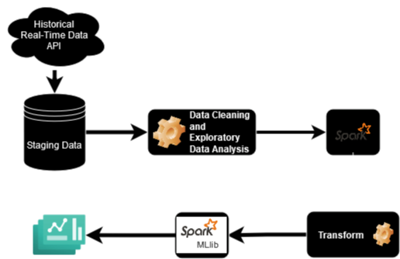
Project Architecture Overview
Main Components -
Data Sources (AlphaVantage API + Yahoo Finance)
Data Cleaning and Analysis
Apache Spark Framework for Data Processing
Transformation steps
Spark MLlib for Regression
Data Visualization
Notes:
Jingyi

Slide 17
Design - Project Architecture Overview
1. Data Collection Layer
Role:
Involves sourcing historical and real-time financial data.
Components:
Various data sources integrated for comprehensive financial information.
2. Data Processing and Analysis Layer
Role:
Utilizes Apache Spark for efficient data processing.
Houses the valuation and forecasting model.
Components:
Apache Spark for distributed computing.
Valuation and forecasting model.
3. User Interface Layer
Role:
Web-based interface for interaction, visualization, and result interpretation (Jupyter Notebook)
Components:
Web interface accessible via browsers.
Integration with visualization tools (e.g., Tableau, PowerBI).
Notes:
The project architecture comprises three main layers: the Data Collection Layer responsible for sourcing historical and real-time financial data by integrating diverse sources, the Data Processing and Analysis Layer utilizing Apache Spark for efficient data processing and housing the valuation and forecasting model, and the User Interface Layer providing a web-based interface for interaction, visualization, and result interpretation. The Data Collection Layer plays a crucial role in compiling comprehensive financial information from various sources. In the Data Processing and Analysis Layer, Apache Spark is employed for distributed computing alongside hosting the core valuation and forecasting model. The User Interface Layer offers accessibility through web browsers and integrates visualization tools like Tableau or PowerBI to enhance data representation, enabling users to interact seamlessly, visualize data effectively, and interpret results efficiently.

Slide 18
Setup and Configurations
Environment
Docker Container running PySpark on Standalone mode
Docker Container running PySpark on Single Cluster mode
Setup
Setup of Docker Engine
Gathering of relevant dependencies
Container execution for PySpark Notebook and Linux image
Jupyter or Spark Submit
Spark
Local (as many workers as threads on device)
Pseudo cluster with one Executor and Two Workers
Executor Memory -> 6GB, 8GB, 12GB, 16GB

Slide 19
Data Sources
AlphaVantage
Provides comprehensive data quotes on company fundamentals
Simple way to watch stock in real time and check historical stock
Yahoo Finance
Popular and provides stock data
Discontinued and doesn’t provide recent data
Good for historical
Polygon.io
Bloomberg

Slide 20
Data Sources (Alpha Vantage)
Daily Time Series Adjusted
Company Overview
Company Balance Sheet
Company Income Statement
Company Cash Flow

Slide 21
Data Cleaning and Analysis
Renaming and Formatting of Data columns
Restructuring the Adjusted Close price data
Addition of Split Coefficient column
Exploring Data for any cleaning or formatting

Slide 22
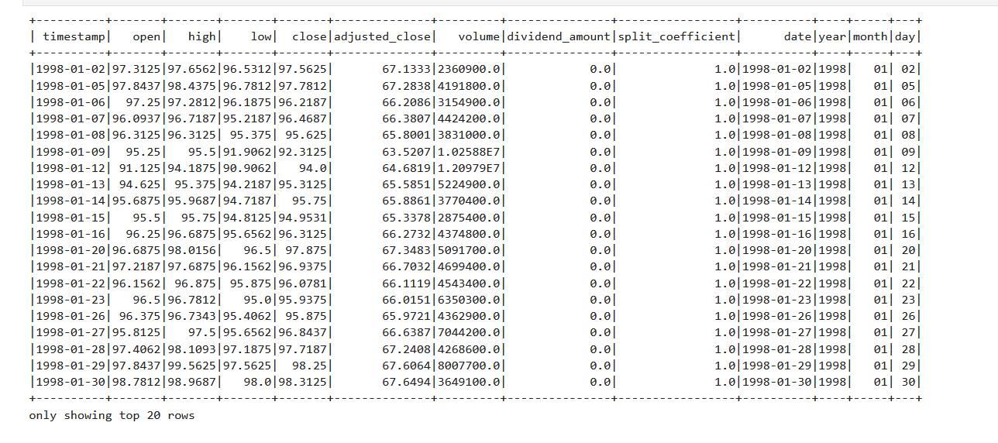
Current + Historical Stock of Apple Inc.

Slide 23
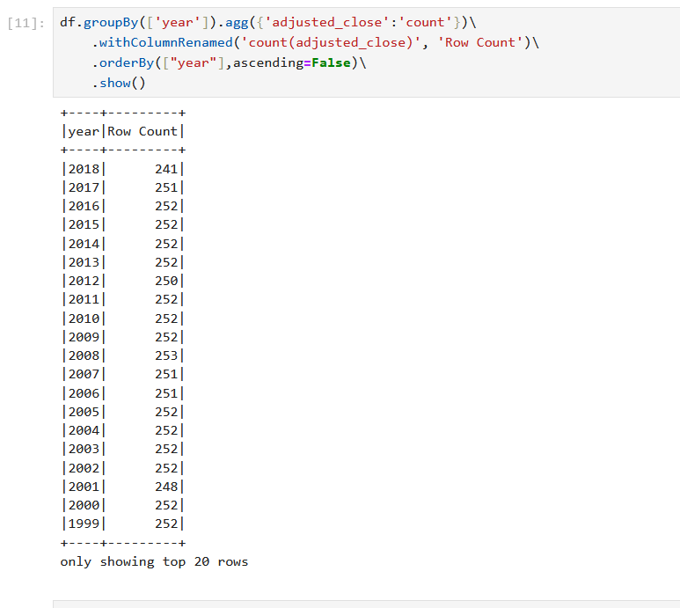
Variation and availability of Adjusted Close price

Slide 24
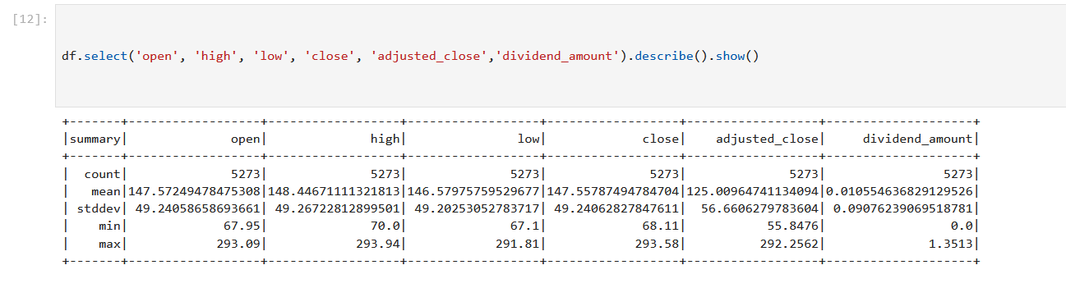
Summary Statistics of the Data for easy comparison and intuitions

Slide 25
Transformation Steps
The following steps were undertaken on the RDD and DataFrames that were used for this project
Windowing -
This creates a Window specification with no partitioning and orders the data by the "timestamp" column. The ordering is crucial for window functions that involve looking at previous or following rows
Lagged Close Price -
This adds a new column "lag_close_1" to the DataFrame, representing the close price of the previous day. The F.lag function is a window function that retrieves the value of the "close" column from the previous row within the specified window.

Slide 26
Transformation Steps
The following steps were undertaken on the RDD and DataFrames that were used for this project
Daily Return -
Computes the daily return as the percentage change from the opening to closing prices. It creates a new column "daily_return" with this calculated value.
Intra-day Volatility -
Calculates the intra-day volatility as the difference between the highest and lowest prices of the day. It adds a new column "intra_day_volatility" to the DataFrame.

Slide 27
Transformation Steps
The following steps were undertaken on the RDD and DataFrames that were used for this project
Daily Volatility -
Computes the daily volatility as the change in closing price from the previous day. It adds a new column "daily_volatility" to the DataFrame.
7-Day Moving Average -
Calculates a 7-day moving average for the closing prices. The F.avg function is a window function that computes the average over a specified window. In this case, it considers the current row and the previous 6 rows.

Slide 28
Transformation Steps
The following steps were undertaken on the RDD and DataFrames that were used for this project
Binary Indicators -
Creates a binary indicator column "is_dividend" that equals 1 if there was a dividend (dividend_amount > 0), and 0 otherwise Creates a binary indicator column "is_split" that equals 1 if there was a stock split (split_coefficient != 1), and 0 otherwise.

Slide 29
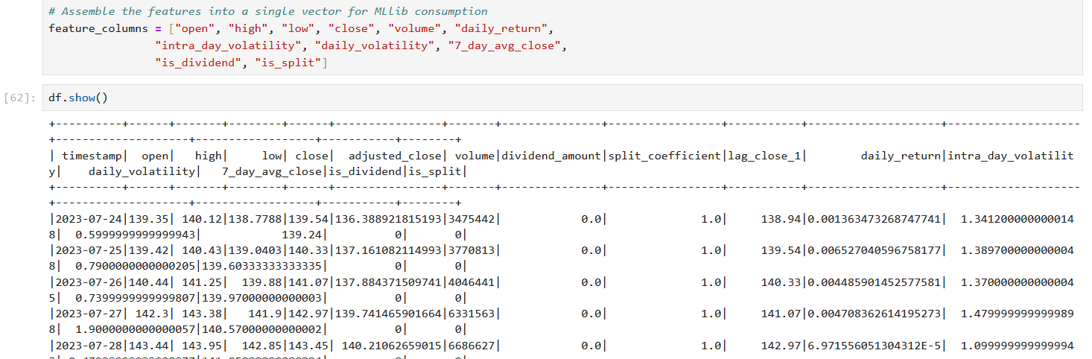
Transformation Steps
Feature Engineering -

Slide 30
Comparison with Intrinsic Value
Dividend Cash Flow Model
Residual Income Method

Slide 31
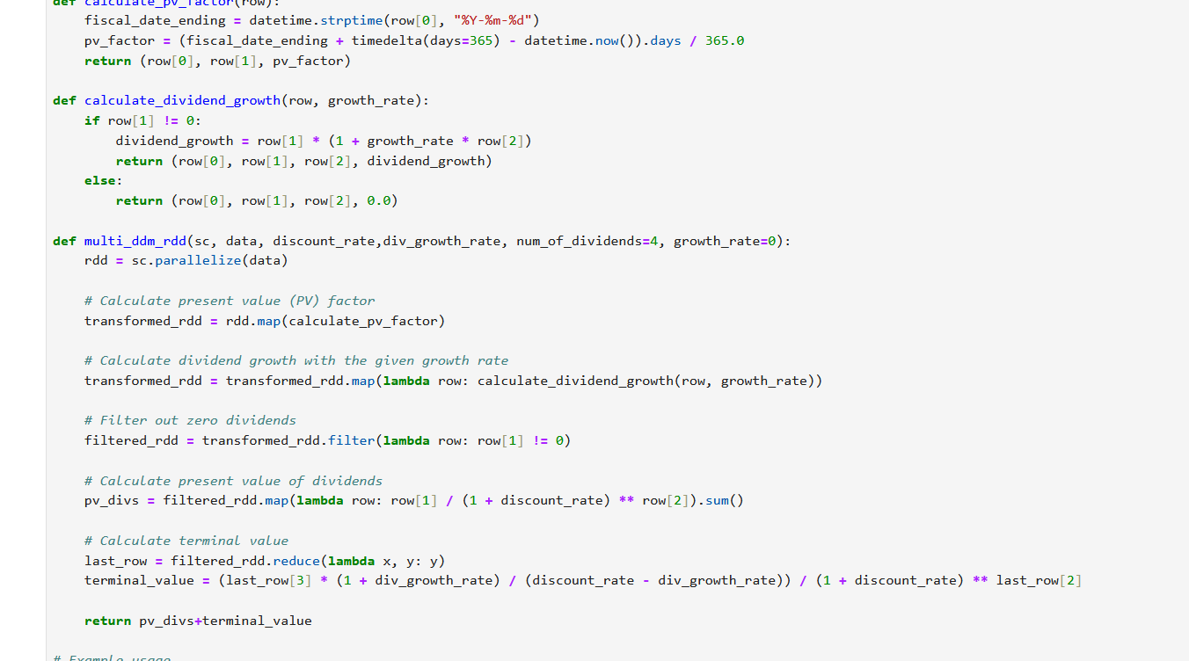
Computation of Intrinsic Values
Gives the actual value of a company versus the market price
The difference in the two prices could indicate a potential change in Stock Valuation

Slide 32
Apache Spark MLlib for Regression Tasks
VectorAssembler
GBTRegressor

Slide 33

Vector Assembler
The VectorAssembler is a feature transformer that combines a given list of columns into a single vector column. This is often used as a preparation step before feeding the data into machine learning algorithms that expect input features as a single vector column.

Slide 34

Gradient Boosted Tree Regressor
Gradient Boosted Trees (GBT) is a powerful ensemble machine learning algorithm that can be used for stock market prediction, including stock price regression. The GBTRegressor in PySpark's MLlib library is an implementation of the GBT algorithm for regression tasks.

Slide 35
Gradient Boosted Tree Regressor
Ensemble Learning:
GBT is an ensemble learning algorithm that builds a series of weak learners, typically decision trees, and combines them to create a strong predictive model.
Sequential Training:
Trees are built sequentially, and each new tree corrects the errors of the combined ensemble of the existing trees.
Gradient Descent Optimization:
GBT uses gradient descent optimization to minimize the loss function. In the context of regression, it minimizes the mean squared error (MSE) between predicted and actual values.
Robust to Overfitting:
GBT has mechanisms (like regularization parameters) to control overfitting, making it more robust to noisy data and outliers.

Slide 36
Results
Metrics for Accuracy :
Root Mean Squared Error (RMSE) on test data = 9.544595132509585
MAE: 8.734564548282654
R2: -4.40344806670358

Slide 37
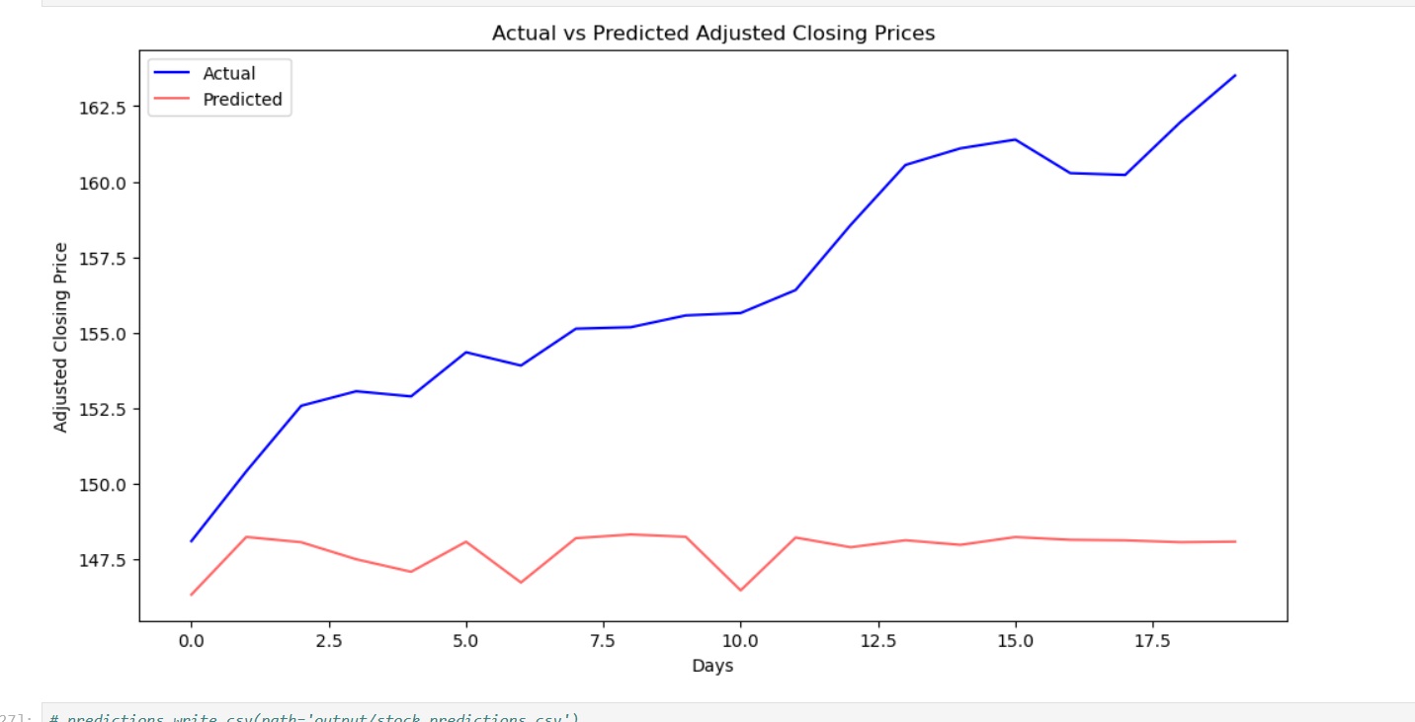
Prediction Results over Test Data
Predictions are close enough
Needs more hyperparameter tuning
Requires more epochs of training data

Slide 38
Conclusion
The model for the Stock Market prediction is capable of predicting stock prices with an MSE of only around 9
This value can be further lowered when the training data has been expanded into multiple companies training over multiple epochs
There can be finer adjustments made to the Model Training which has been deferred to future scope
The Spark Distributed framework was used to handle the data processing and coordination of parallel tasks for faster and more efficient computations

Slide 39
Future Work Opportunities
1. Integration of Additional Data Sources
Objective:
Improve accuracy through diverse data inputs.
Approach:
Incorporate news sentiment analysis.
Benefits:
Enhanced model insights with sentiment-driven data.
2. Advancing Machine Learning Techniques
Objective:
Enhance stock price forecasting capabilities.
Approach:
Implement advanced machine learning and deep learning techniques.
Benefits:
Improved accuracy and predictive power.
3. Model Coverage Expansion
Objective:
Encompass a wider range of financial instruments and markets.
Approach:
Research and integrate additional instrument data sources.
Benefits:
Increased versatility for users in diverse financial markets.
Notes:
To further augment the forecasting model, future work opportunities include the integration of additional data sources, such as incorporating news sentiment analysis. This expansion aims to enrich the model's insights by leveraging diverse data inputs, contributing to a more comprehensive understanding of financial dynamics. Additionally, advancing machine learning techniques holds promise in elevating stock price forecasting capabilities. The implementation of cutting-edge methodologies can refine accuracy and enhance predictive power, thereby bolstering the model's reliability. Lastly, model coverage expansion is crucial for providing users with increased versatility. By encompassing a broader array of financial instruments and markets through the research and integration of additional data sources, users can navigate and make informed decisions across a more expansive financial landscape. This holistic approach ensures the continuous improvement and adaptability of the forecasting model to evolving market conditions.

Slide 40
Project Impact and Future Vision
1. Project Impact
Insights Offered:
Valuable insights for investors.
Informed decision-making in the fast-paced stock market.
Current Capabilities:
Foundation for advanced financial analysis.
2. Future Vision
Potential Outcomes:
Advanced predictive capabilities.
Industry-leading financial analysis.
Role in Financial Decision-Making:
Empowering investors with data-driven decision support.
3. Closing Statement
Project Significance:
Catalyst for advancing financial analysis.
Building a future-ready platform for investors.
Notes:
The current impact of the project lies in providing valuable insights to investors and supporting informed decision-making within the dynamic stock market environment. The project has established a robust foundation for advanced financial analysis, serving as a cornerstone for users seeking comprehensive perspectives on market trends. Looking ahead, the future vision of the project includes the realization of advanced predictive capabilities, positioning itself as an industry leader in financial analysis. Its role in financial decision-making is crucial, as it aims to empower investors with data-driven decision support, fostering a more informed and strategic approach to navigating the complexities of the financial landscape. In conclusion, this project stands as a catalyst for advancing financial analysis, striving to build a future-ready platform that equips investors with the tools and insights necessary for success in an ever-evolving market.

Slide 41
Access Visualizations:
Tableau Integration:
a) Integrate Tableau for advanced data visualization capabilities.
b) Leverage Tableau's interactive dashboards and visualization features for a rich user experience.
PowerBI Integration:
a) Alternatively, integrate PowerBI for dynamic reporting and visualization.
b) Customize PowerBI dashboards to align with the specific needs and preferences of users.

Slide 42
Related Work
1. Menon, V.K., Chekravarthi Vasireddy, N., Jami, S.A., Pedamallu, V.T.N., Sureshkumar, V., Soman, K.P. (2016). Bulk Price Forecasting Using Spark over NSE Data Set. In: Tan, Y., Shi, Y. (eds) Data Mining and Big Data. DMBD 2016. Lecture Notes in Computer Science(), vol 9714. Springer, Cham. https://doi.org/10.1007/978-3-319-40973-3_13

Slide 43
Related Work
2. Seif, M.M., Ramzy Hamed, E.M., Abdel Ghfar Hegazy, A.E.F. (2018). Stock Market Real Time Recommender Model Using Apache Spark Framework. In: Hassanien, A., Tolba, M., Elhoseny, M., Mostafa, M. (eds) The International Conference on Advanced Machine Learning Technologies and Applications (AMLTA2018). AMLTA 2018. Advances in Intelligent Systems and Computing, vol 723. Springer, Cham. https://doi.org/10.1007/978-3-319-74690-6_66

Slide 44
Related Work
3. Ahmed. S. Wafi, Hassan Hassan, Adel Mabrouk, Fundamental Analysis Models in Financial Markets – Review Study, Procedia Economics and Finance, Volume 30, 2015,Pages 939-947,ISSN 2212-5671, https://doi.org/10.1016/S2212-5671(15)01344-1.

Slide 45
Related Work
4. Javed Awan, Mazhar and Mohd Rahim, Mohd Shafry and Nobanee, Haitham and Nobanee, Haitham and Munawar, Ashna and Yasin, Awais and Zain, Azlan Mohd, Social Media and Stock Market Prediction: A Big Data Approach (2021). M. J. Awan, M. Shafry, H. Nobanee, A. Munawar, A. Yasin et al., "Social media and stock market prediction: a big data approach," Computers, Materials & Continua, vol. 67, no.2, pp. 2569–2583, 2021, Available at SSRN: https://ssrn.com/abstract=3827106

Slide 46
THANK YOU
Notes:
We are now open for questions

