Slide 1
RFC 4443 - RFC 4861
By Suhas Mane
TCP/IP Protocol Suite

Slide 2
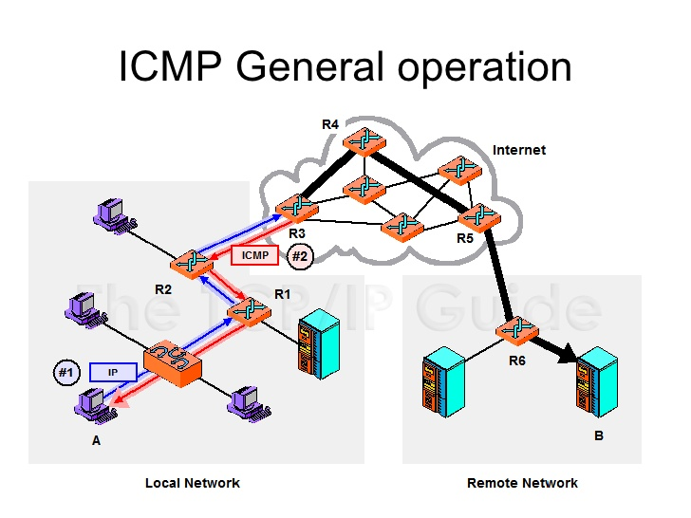
ICMPv6
TCP/IP Protocol Suite

Slide 3
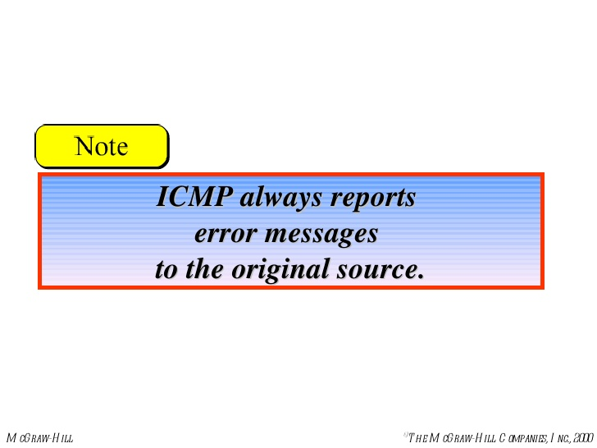
TCP/IP Protocol Suite

Slide 4
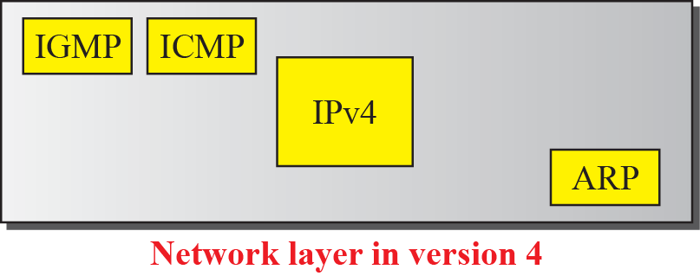
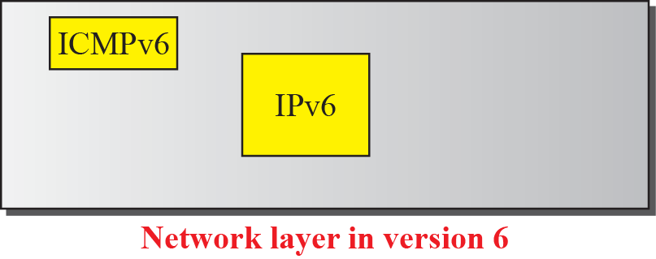
Comparison of network layers in version 4 and version 6
TCP/IP Protocol Suite

Slide 5
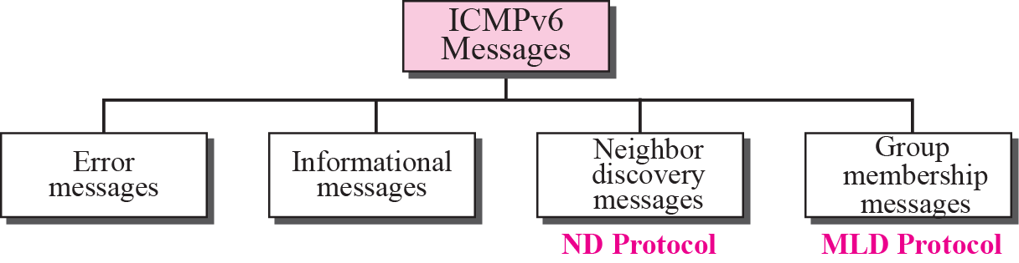
ICMPv6
Request for Comments: 4443
Next Header (Protocol Number): 58
0 1 2 3
0 1 2 3 4 5 6 7 8 9 0 1 2 3 4 5 6 7 8 9 0 1 2 3 4 5 6 7 8 9 0 1
+-+-+-+-+-+-+-+-+-+-+-+-+-+-+-+-+-+-+-+-+-+-+-+-+-+-+-+-+-+-+-+-+
| Type | Code | Checksum |
+-+-+-+-+-+-+-+-+-+-+-+-+-+-+-+-+-+-+-+-+-+-+-+-+-+-+-+-+-+-+-+-+
| |
+ Message Body +
| |
TCP/IP Protocol Suite

Slide 6
NDP Neighbor Discovery Protocol
Link Types:
Different link layers have different properties. The ones of concern to Neighbor Discovery are:
multicast capable
point-to-point
shared media
variable MTU
asymmetric reachability
Addresses:
Neighbor Discovery makes use of a number of different addresses
all-nodes multicast address
all-routers multicast address
solicited-node multicast address
link-local address
unspecified address
TCP/IP Protocol Suite

Slide 7
NDP - Neighbor Discovery Protocol
Request for Comments: 4861
NDP functions
ICMPv6 Packets
Router Discovery
Prefix Discovery
Parameter Discovery
Address Autoconfiguration
Address Resolution
Duplicate Address Detection
Neighbor Unreachability Detection
Next-hop Determination
Redirection Message
133 134
Router Solicitation + Router Advertisement
135 136
Neighbor Solicitation + Neighbor Advertisement
137
Redirect
Option Name Option Type
---------------------------------------------------------
Source Link-Layer Address 1
Target Link-Layer Address 2
Prefix Information 3
Redirected Header 4
MTU 5
TCP/IP Protocol Suite

Slide 8
NDP - Neighbor Discovery Protocol
Request for Comments: 4861
NDP functions
ICMPv6 Packets
133 134
Router Solicitation + Router Advertisement
Router Discovery
Prefix Discovery
Parameter Discovery
Address Autoconfiguration
Address Resolution
Duplicate Address Detection
Neighbor Unreachability Detection
Next-hop Determination
Redirection Message
135 136
Neighbor Solicitation + Neighbor Advertisement
137
Redirect
TCP/IP Protocol Suite

Slide 9
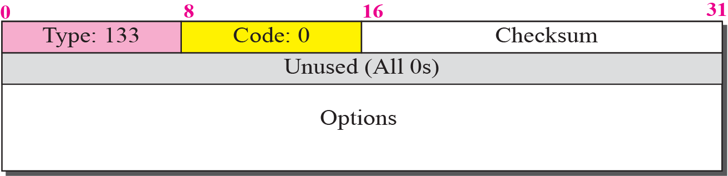
Router-solicitation message
TCP/IP Protocol Suite

Slide 10
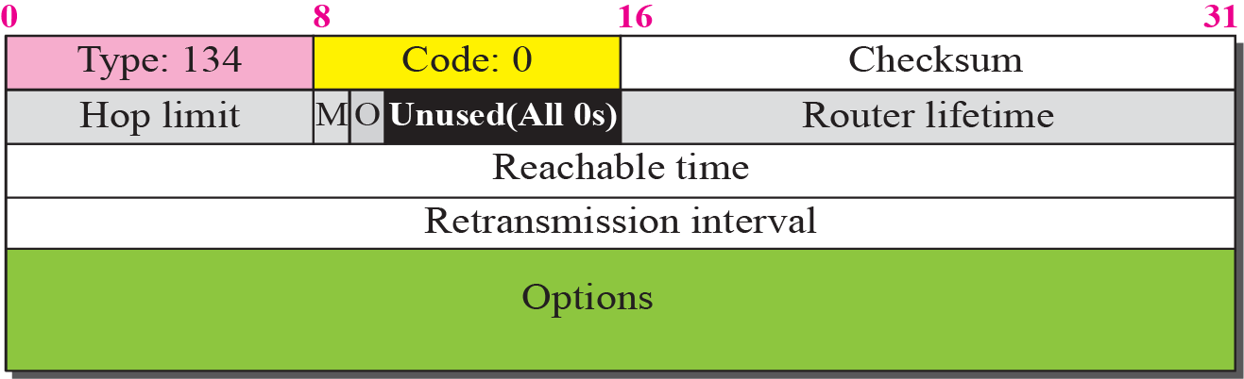
Router-advertisement message
Option Name Type
---------------------------------------------------------
Prefix Information 3
MTU 5
TCP/IP Protocol Suite

Slide 11
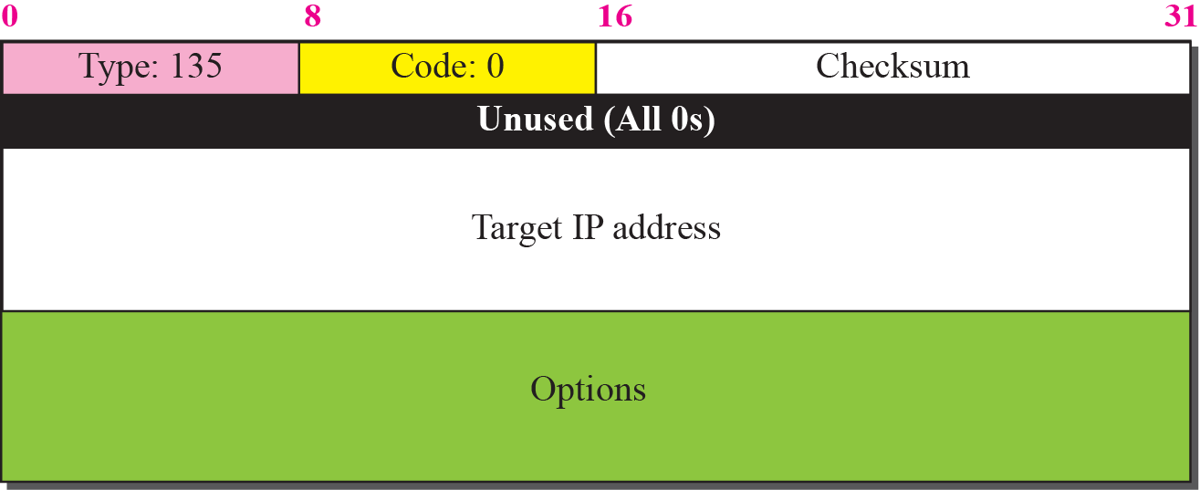
Neighbor-solicitation message Where Are You ?
Address Resolution solicited node multicast
Duplicate Address Detection solicited node multicast
Neighbor reachability confirmation - unicast
TCP/IP Protocol Suite

Slide 12
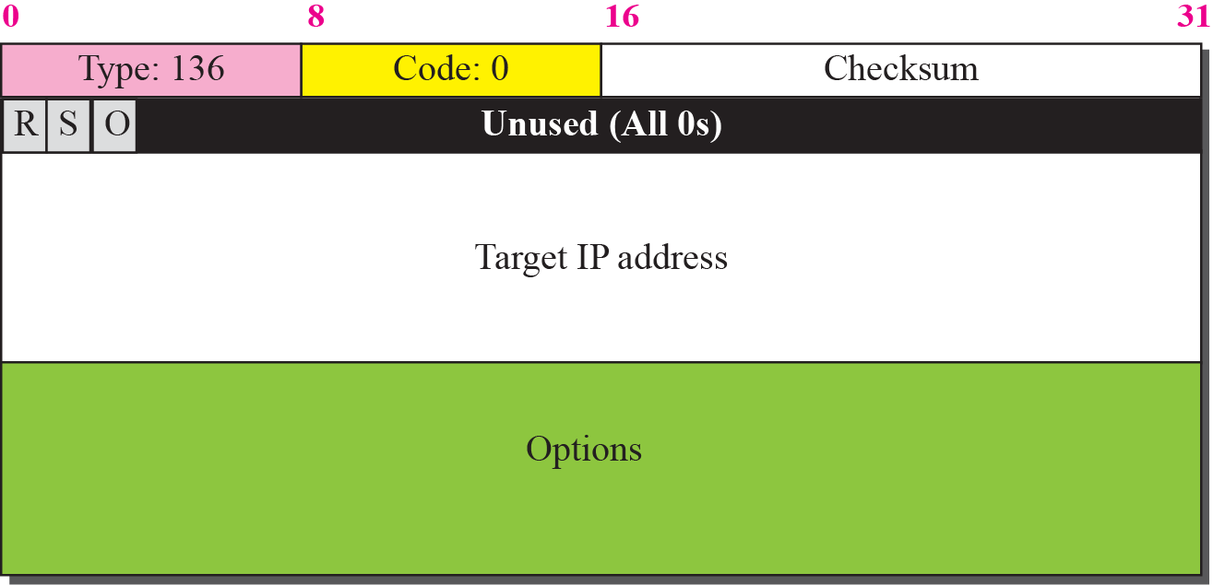
Neighbor advertisement message Here I am
TCP/IP Protocol Suite

Slide 13
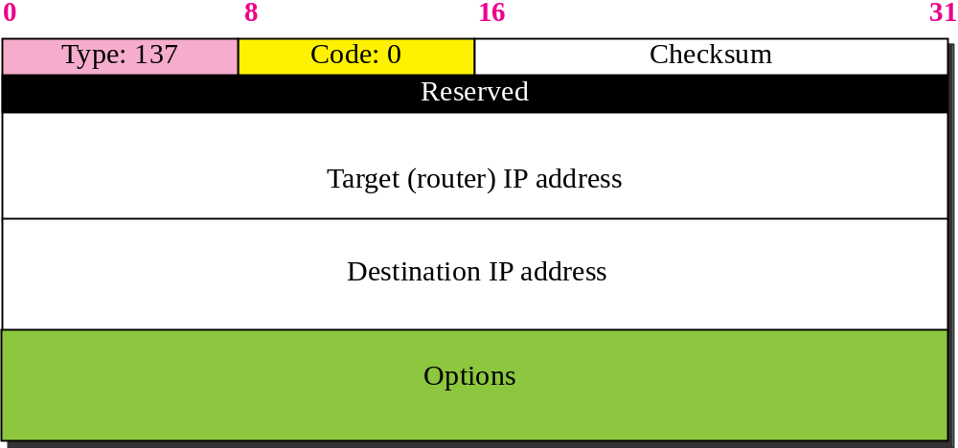
Redirection message
TCP/IP Protocol Suite

Slide 14
Thank You
TCP/IP Protocol Suite

