Slide 1
A Project On
Distributed Data over Network System
By:
Suhas Mane
Under The Guidance of
Professor T. B. Patil.

Slide 2
Introduction : Modules of ddnsProject
ddnsServerAdmin.
ddnsServer.
ddnsNode.
ddnsClient.
DDNS_CM
DDNS_NODE
DDNS_CLIENT

Slide 3
Introduction
ddnsServerAdmin :
- Add/Remove User.
- Add Node.
- Store Files on nodes and Generate xml of File System.

Slide 4
User Specific: Password Based Encryption (PBE)
ddnsServerAdmin : Add / Remove User.
+
please
Encrypt me
(PBE)
KEY :
Be cool I will encrypt you
ummmm !
I am encrypted..
username and password
master password
+
salt
username and password
Table : users
Id | Username | Password
1 | 3y3a1h=4i5 | 5o8e3a1h=I
2 | 1au4u01a3= | 8i47oe8o5u

Slide 5

Node Specific
ddnsServerAdmin : Add Node.
I wannaa add 192.168.24.24
ummmm….
Let me compute free space.
Table : Node
Node id | Node name | Node ip | Free space | IS node alive
1 | 192.168.24.24 | 192.168.24.24 | 30000 | yes
DDNS_CM
I wanna add you?
Free space : 30000 MB
DDNS_NODE_1
192.168.24.24 added successfully.

Slide 6
GenerateDB : consider an example : test.mpg
ddnsServerAdmin : compute share
I wannaa store “test.mpg”
file on DDNS_NODE
How do we solve partnership problems ?
test.mpg
Size : 69 MB
Free space : 30000 MB : investment by node 192.268.24.24
Number of splits of “test.mpg” : 50 splits : profit among all nodes.
Number of splits to be stored on 192.168.24.24 : (50 * 30000 / 50000) = 30 splits
path: D:\video\test.mpg
DDNS_CM
69 / 1.38 = 50
So we have 50 splits for test.mpg
Size of each split : 1.38 MB aprox. equals FLOPPY_SIZE
Table : Node
Node id | Node name | Node ip | Free space | IS node alive
1 | 192.168.24.24 | 192.168.24.24 | 30000 | yes
2 | 192.168.24.25 | 192.168.24.25 | 20000 | yes

Slide 7
GenerateDB : consider an example : test.mpg
ddnsServerAdmin : Distribute data & Generate XML , locations file for “test.mpg”
Store splits 1 – 30
Stored successfully
192.168.24.24 : LINUX
DDNS_CM
Store splits 31 – 50
Stored successfully
192.168.24.25 : WIN XP
DDNS_NODE creates + maintains directory structure.
Table : file_sys
Id | Name | Type | Size | File location | busyMode | Child Set | Online Users
1 | D | Drive | 0 | Null | Free | {2} | 0
2 | Video | Folder | 0 | Null | Free | {3} | 0
3 | test.mpg | Media | 69 | C:\Locations\test.mpg.loc | Free | Null | 0

Slide 8
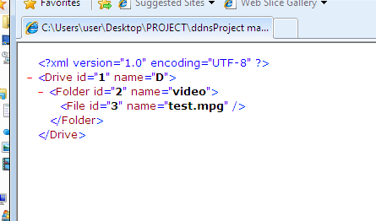
GenerateDB : consider an example : test.mpg
ddnsServerAdmin : how xml looks.

Slide 9
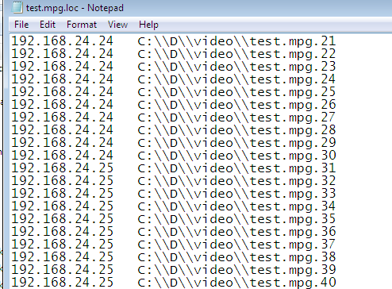
GenerateDB : consider an example : test.mpg
ddnsServerAdmin : how .loc file looks.

Slide 10
ddnsServer : xml + locations + database
Dude, you are the right one
Ummm…
Let me check
ddnsServer : Ready for receiving client requests.
DDNS_CM
I am sending encrypted user + passwd
192.168.24.24 : LINUX
E(User + passwd)
Take this xml file
192.168.24.25 : WIN XP
DDNS_CLENT
Table : users
Id | Username | Password
1 | 3y3a1h=4i5 | 5o8e3a1h=I
2 | 84i0=a5i3y | 0=ha07=11i

Slide 11
ddnsServer : xml + locations + database
ddnsServer : Ready for receiving client requests.
DDNS_CM
I am bored.
I wanna watch movie.
192.168.24.24 : LINUX
Take this xml file
192.168.24.25 : WIN XP
DDNS_CLENT

Slide 12
ddnsServer : xml + locations + database
Ummm..
U wanna watch movie
I think file is not busy. Let me get loc file for u
ddnsServer : Ready for receiving client requests.
DDNS_CM
192.168.24.24 : LINUX
Id = 3
192.168.24.25 : WIN XP
DDNS_CLENT
Table : file_sys
Id | Name | Type | Size | File location | busyMode | Child Set | Online Users
1 | D | Drive | 0 | Null | Free | {2} | 0
2 | Video | Folder | 0 | Null | Free | {3} | 0
3 | test.mpg | Media | 69 | C:\Locations\test.mpg.loc | Free | Null | 0

Slide 13
ddnsServer : xml + locations + database
Now movie is busy : somebody is enjoyng movie.
ddnsServer : Ready for receiving client requests.
DDNS_CM
192.168.24.24 : LINUX
Take this loc file
192.168.24.25 : WIN XP
DDNS_CLENT
Table : file_sys
Id | Name | Type | Size | File location | busyMode | Child Set | Online Users
1 | D | Drive | 0 | Null | Free | {2} | 0
2 | Video | Folder | 0 | Null | Free | {3} | 0
3 | test.mpg | Media | 69 | C:\Locations\test.mpg.loc | Read | Null | 1

Slide 14
ddnsServer : xml + locations + database
1-30 splits with me
I am in office. anyone can disturb me
ddnsServer : Ready for receiving client requests.
DDNS_CM
I am just downloading reqd.
split. So no space overhead at my house.
192.168.24.24 : LINUX
31-50 splits with me
DDNS_CLIENT
Table : file_sys
192.168.24.25 : WIN XP
Id | Name | Type | Size | File location | busyMode | Child Set | Online Users
1 | D | Drive | 0 | Null | Free | {2} | 0
2 | Video | Folder | 0 | Null | Free | {3} | 0
3 | test.mpg | Media | 69 | C:\Locations\test.mpg.loc | Read | Null | 1

Slide 15
ddnsServer : xml + locations + database
I am in office. anyone can disturb me
1-30 splits with me
Ok sir..
ddnsServer : Ready for receiving client requests.
DDNS_CM
Umm..
Nice movie, get 30th split
192.168.24.24 : LINUX
Send split no. 30
Ok sir..
31-50 splits with me
Take this.
Send split no. 31
DDNS_CLENT
Take this.
Table : file_sys
192.168.24.25 : WIN XP
Id | Name | Type | Size | File location | busyMode | Child Set | Online Users
1 | D | Drive | 0 | Null | Free | {2} | 0
2 | Video | Folder | 0 | Null | Free | {3} | 0
3 | test.mpg | Media | 69 | C:\Locations\test.mpg.loc | Read | Null | 1

Slide 16
ddnsServer : xml + locations + database
I am in office. anyone can disturb me
1-30 splits with me
ddnsServer : Ready for receiving client requests.
DDNS_CM
Enough movie.
192.168.24.24 : LINUX
Close the file
31-50 splits with me
File closed
DDNS_CLIENT
Table : file_sys
192.168.24.25 : WIN XP
Id | Name | Type | Size | File location | busyMode | Child Set | Online Users
1 | D | Drive | 0 | Null | Free | {2} | 0
2 | Video | Folder | 0 | Null | Free | {3} | 0
3 | test.mpg | Media | 69 | C:\Locations\test.mpg.loc | Read | Null | 1
Free
0

Slide 17
References
Google File system.
  www.google.com
PVFS – Parallel Virtual File System.
  www.pvfs.org
  www.clemson.edu

Slide 18
Thank You.

