Slide 1
A Project On
Distributed Data over Network System
By:
Suhas Mane
Under The Guidance of
Professor T. B. Patil.

Slide 2
Introduction

Slide 3
OVERALL DESCRIPTION
Product Perspective.
Product Functions.
User Characteristics.
General Constraints.
Assumptions and dependencies.

Slide 4
External Interface Diagram:
DDNS CLIENT
(DDNS_CLIENT)
DDNS CENTRAL MANAGER
(DDNS_CM)
DDNS NODE
(DDNS_NODE)

Slide 5
Assumption
Files are stored in round – robbin fashion on DDNS_NODE.
Hence,
DDNS_CLIENT perform File Merge and File Split operations.
  Merge operation : while downloading a file.
  Split operation : while uploading a file.

Slide 6




DDNS_NODE_3
DDNS_NODE_n
DDNS_NODE_1
...
DDNS_NODE_2
database / catalog
DDNS_CM
Initial Stage
Authentication Stage
If valid user..
To valid user
DDNS_CLIENT
Sending File System Hierarchy..

Slide 7
DDNS_NODE_3
DDNS_NODE_n
DDNS_NODE_1
...
DDNS_NODE_2
database / catalog
DDNS_CM
Select a file to read / write
Sending locations and remote names of requested file to client
CM is getting the locations
and remote names of requested file
DDNS_CLIENT

Slide 8
DDNS_NODE_3
DDNS_NODE_n
DDNS_NODE_1
...
DDNS_NODE_2
database / catalog
DDNS_CM
Consider file is stored on 3 nodes
Nodes unmark the file busy
Now client is requesting node to get the files
Consider, client has chosen read operation
Client completes read operation and closes the file.
DDNS_CLIENT
If file is accessible for read operation,
nodes sends it to client and marks file busy..

Slide 9
DDNS_NODE_3
DDNS_NODE_n
DDNS_NODE_1
...
DDNS_NODE_2
write denied
read granted
DDNS_CLIENT_2
DDNS_CLIENT_3
DDNS_CLIENT_1
wish to read
wish to write
reading a file
Now consider 3 clients and read – write operation

Slide 10
DDNS_NODE_3
DDNS_NODE_4
DDNS_NODE_1
DDNS_NODE_2
WRITE OPERATION
Consider client has completed write operation partially.
(i.e.uploading operation is remained)
database / catalog
DDNS_CM
- Client requests CM, locations and remote,
filenames.
- Consequence of write operation by client :
- File size has increased..
DDNS_CLIENT

Slide 11
DDNS_NODE_3
DDNS_NODE_4
DDNS_NODE_1
DDNS_NODE_2
DDNS_CM
database / catalog
DDNS_CLIENT

Slide 12
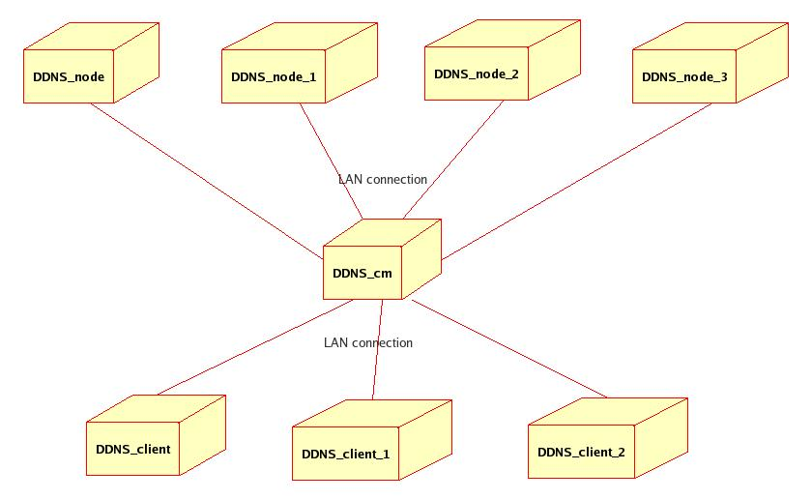
Deployment Diagram:

Slide 13
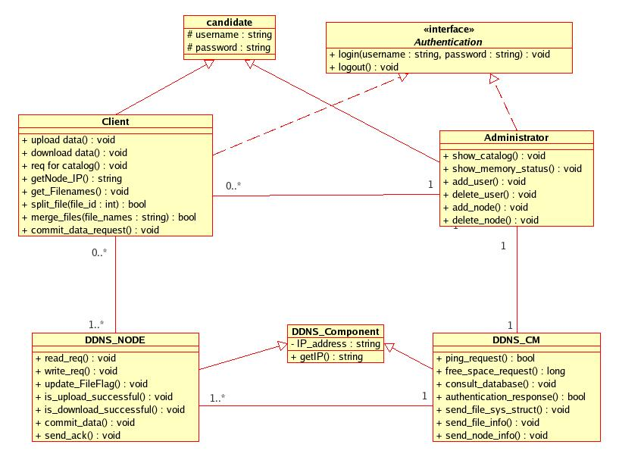
Design Diagrams : Class Diagram

Slide 14
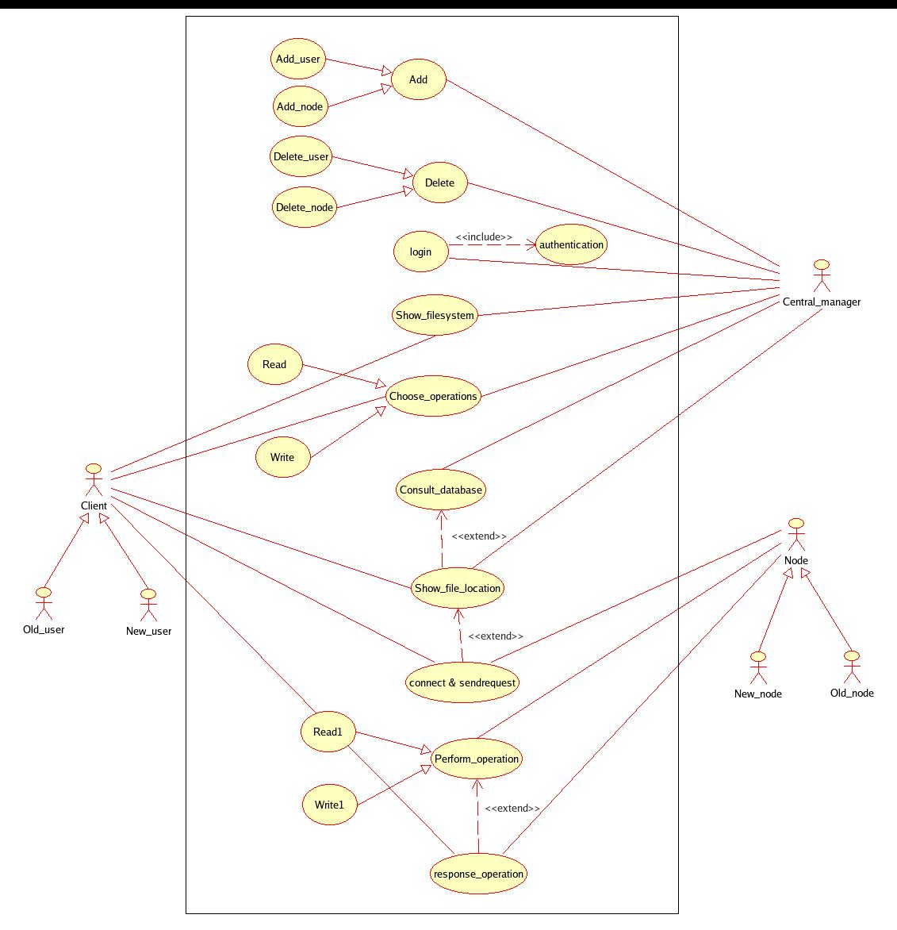
Use Case Diagram

Slide 15
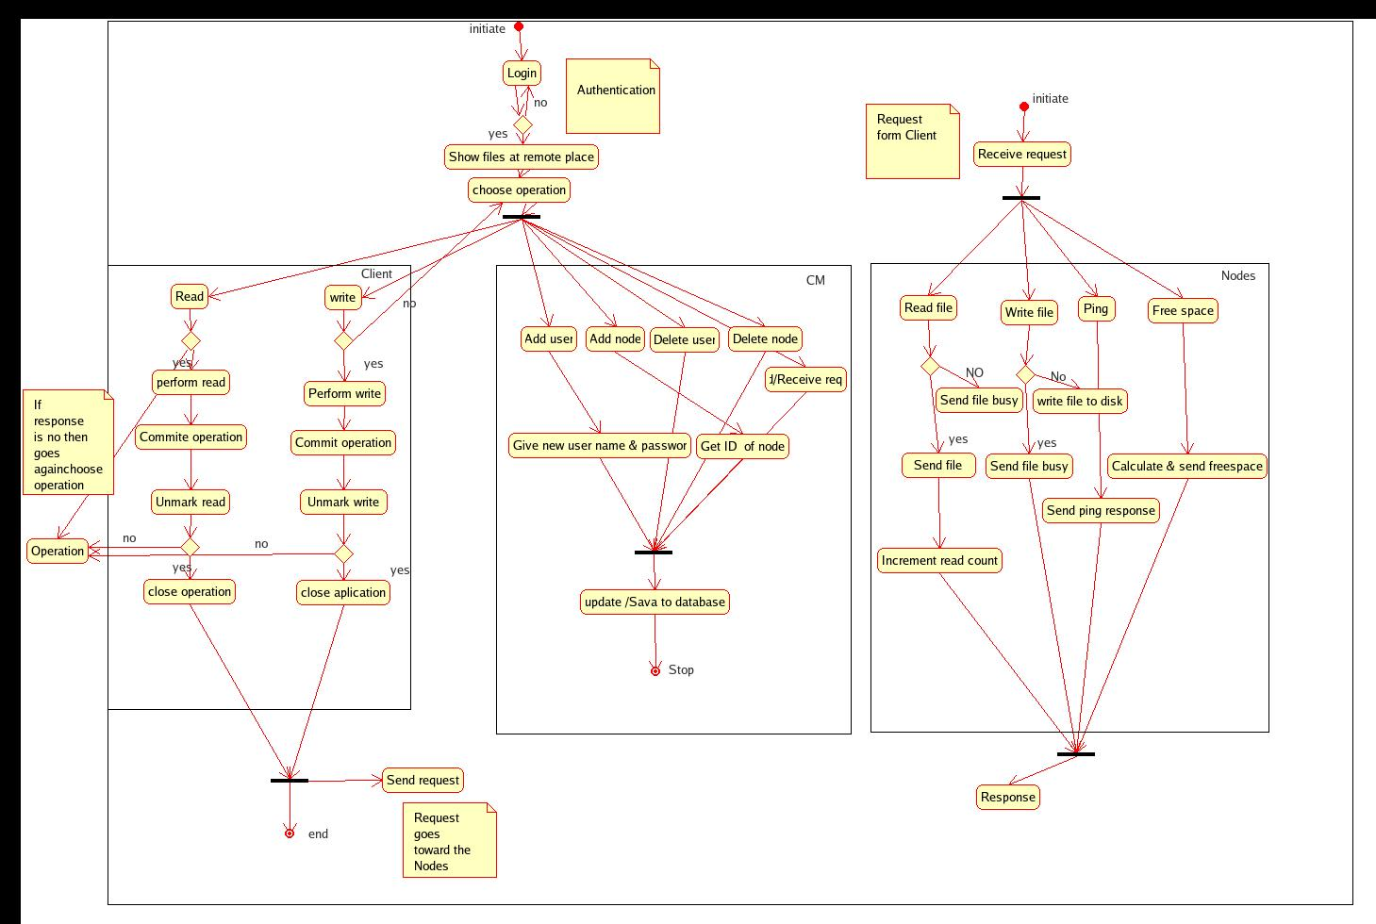
Activity Diagram

Slide 16
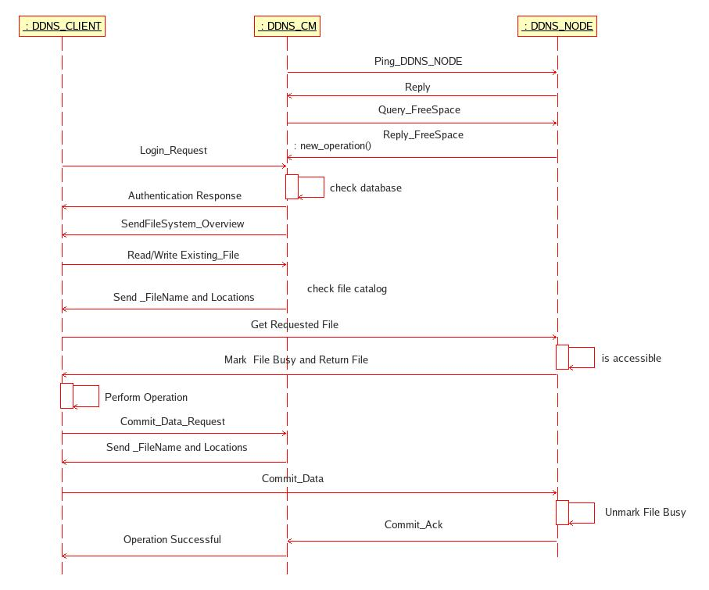
Sequence Diagram:

Slide 17
Thank You.

