Slide 1

SAI VIDYA INSTITUTE OF TECHNOLOGY
Department of Computer Science and Engineering
Accredited by NBA, New Delhi
Rajanukunte, Bengaluru - 560064
Internship (18CSI85) Presentation on
“Overview of Software – Automated PDF Report Generation with MongoDB”
Internal Guide
Prof. Anitha C S
Assistant Professor
Dept. CSE, SVIT
Presented By
Prashanth Reddy P S
1VA18CS033
External Guide
Mr. Madhvesh
Deputy Engineer
BEL, Bengaluru

Slide 2
INDEX
About the Organization.
About Department.
Task Performed.
References.
Dept. of ISE, SVIT

Slide 3

ABOUT ORGANISATION
Bharat Electronics Limited (BEL) is an Indian Government-owned aerospace and defence electronics company.
It primarily manufactures advanced electronic products for ground and aerospace applications.
BEL is one of nine PSUs under the Ministry of Defence of India. It has been granted Navratna status by the Government of India.
Bharat Electronics Limited has its units across India like Bengaluru, Visakhapatanam, chennai etc.
The Bharat Electronics Limited (BEL) has achieved a turnover of about RS 15,000 crore during FY 2021-22.
BEL designs, develops and manufactures a range of products in the following fields:
Electronic voting machines.
Voter-verified paper audit trail.
Traffic signals.
Radars.
BEL Weapon Locating Radar.
Missiles, etc

Slide 4
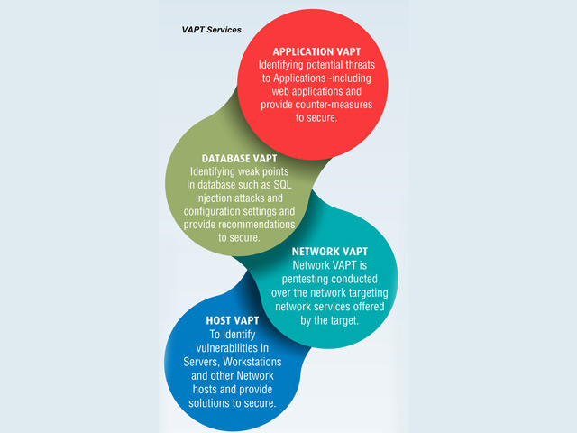
ABOUT DEPARTMENT
BEL‟s Software Division was established in Bengaluru in 1996.
The division applies State-of the-art technology and industry standard process to achieve compliance. The key customers include the Indian Defence Forces, Para-Military Forces, Election Commission of India, DRDO and other PSUs (Public sector Undertakings).

Slide 5
TASK PERFORMED
From the exsting Studentinfo database in MongoDB task is to create a report in the pdf file format.
Used mongodb java library to connect to the mongodb server and to retreive the data stored in the database.
Using the itextpdf java library the retreived data is used to create report in the pdf file format.

Slide 6
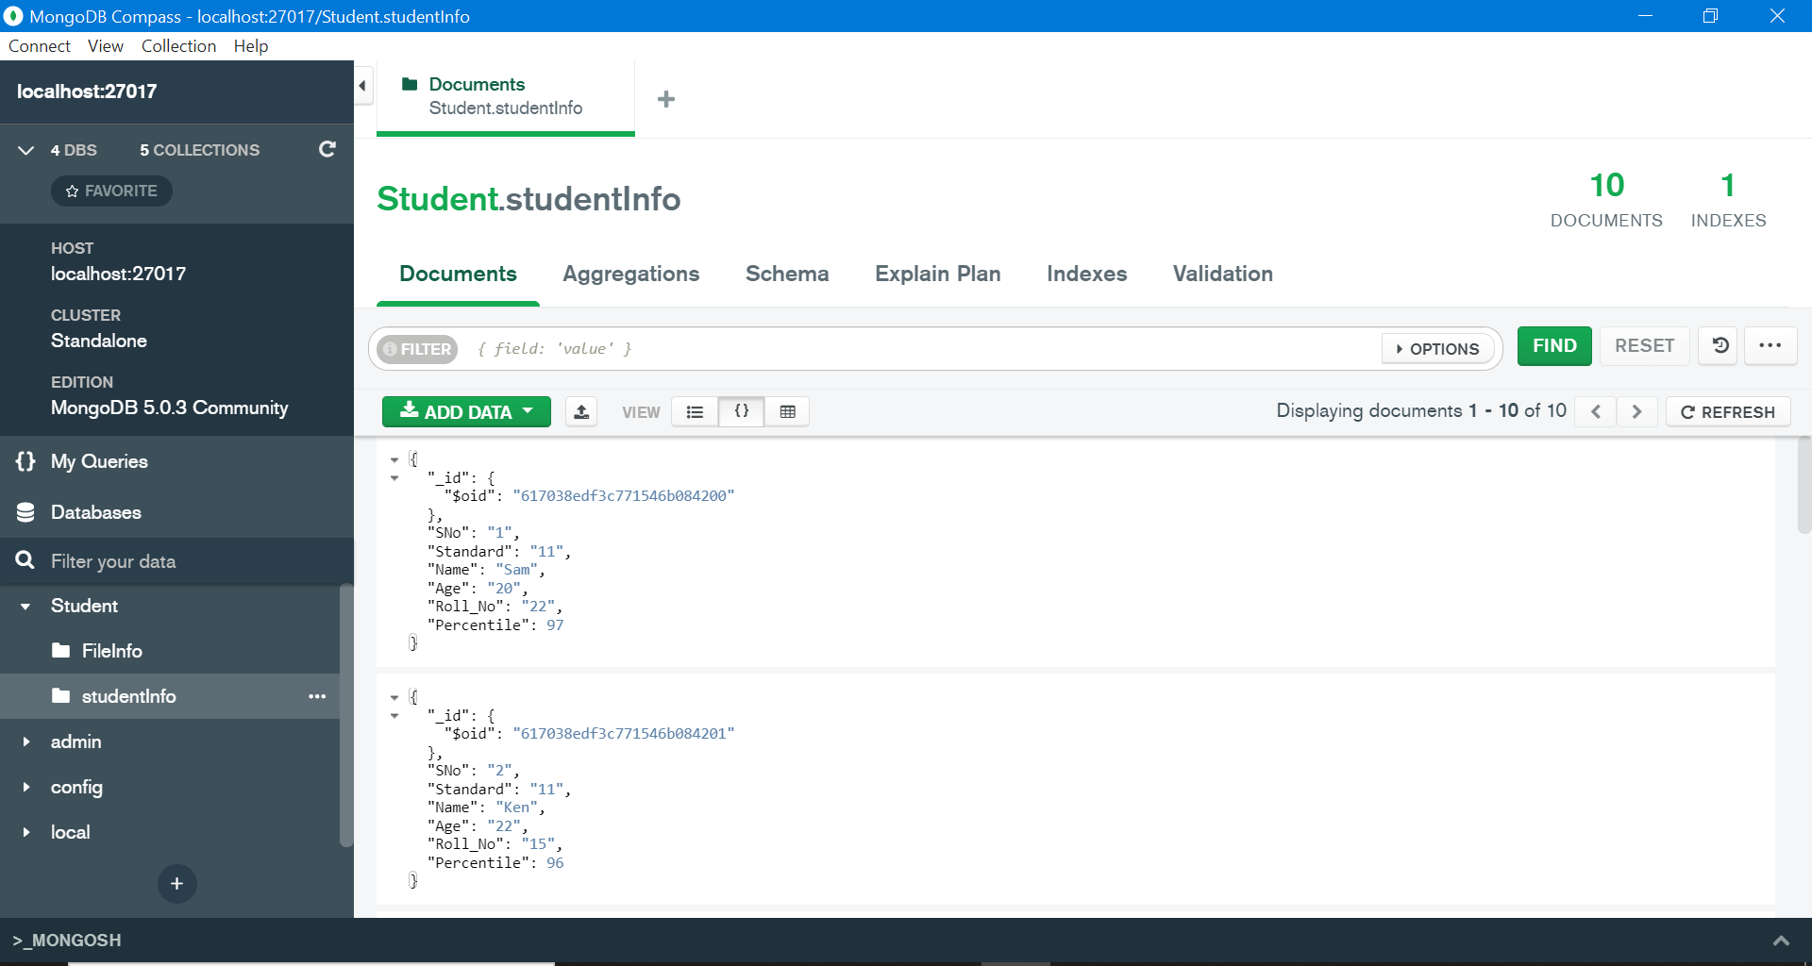
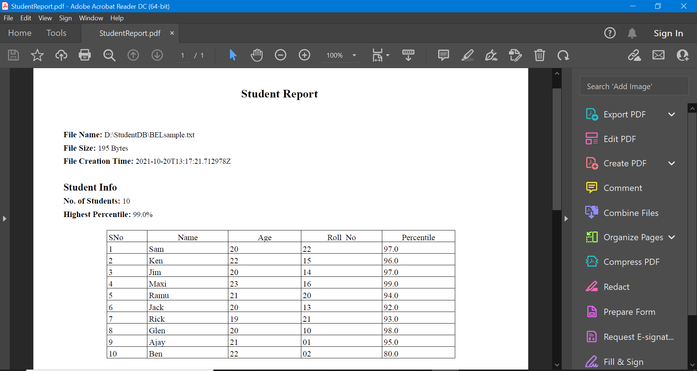
Snapshots

Slide 7
References
https://www.mongodb.com/docs/
https://mongodb.github.io/mongo-java-driver/3.4/javadoc/com/mongodb/MongoClient.html

