Slide 1


PROBLEM STATEMENT: 3
DESIGN AN INTELLIGENT TRAFFIC SIGNAL OPTIMIZATION ALGORITHM THAT USES MACHINE LEARNING TECHNIQUES TO DYNAMICALLY ADJUST SIGNAL TIMINGS BASED ON TRAFFIC FLOW PATTERNS, CONGESTION LEVELS, AND TIME OF DAY, WITH THE GOAL OF REDUCING WAIT TIMES AND IMPROVING OVERALL TRAFFIC FLOW.

Slide 2

ADJUST SIGNAL TIMINGS BASED ON TRAFFIC FLOW PATTERNS
Real-Time Traffic Monitoring:
Data Collection via Sensors/Cameras: Machine learning algorithms continuously monitor traffic flow and vehicle density at intersections using sensors, cameras, or GPS data. This real-time data allows the system to understand current traffic conditions and vehicle volumes.
Dynamic Signal Timing Adjustments:
Traffic Flow-Based Timing: Signal timings are adjusted dynamically based on traffic flow and density in each lane. For example:
High Traffic Density: When the system detects higher vehicle density in one direction, green light duration is extended to allow more vehicles to pass through and reduce the queue.
Low Traffic Density: During off-peak hours or low-density periods, signal durations are shortened to minimize unnecessary wait times for vehicles in less congested directions.
Identification of Peak and Off-Peak Hours:
Pattern Recognition: Machine learning models analyze historical traffic data to identify regular peak hours (e.g., morning and evening rush) and off-peak times (late nights, early mornings).
Proactive Adjustments: During identified peak hours, the system automatically shifts to more aggressive green light durations in the busiest lanes. Conversely, during off-peak hours, it optimizes signals for quicker clearance with shorter green phases.

Slide 3
TRAFFIC LIGHT OPTIMIZATION WITH REINFORCEMENT LEARNING
Objective: Efficiently manage traffic at a 4-way intersection using a Deep Q-Learning agent.
Key Functions: Simultaneous Lane Operation:
Allows two lanes to proceed at the same time, reducing congestion and enhancing traffic flow.
Priority Handling:
Automatically prioritizes emergency vehicles like ambulances, ensuring they are served first, regardless of normal traffic patterns.
System Overview:
State: Monitors oncoming lanes by detecting vehicles in specific cells.
Action: Selects optimal traffic light phases from a set of options, each lasting 10 seconds.
Reward: Focuses on minimizing cumulative vehicle wait times.
Learning Mechanism:
Updates state-action values using a deep neural network, aiming to continuously improve decision-making for traffic light phases based on real-time traffic conditions.

Slide 4
ADJUST SIGNAL TIMINGS BASED ON CONGESTION LEVELS
Problem:
Fixed signal timings cause longer wait times during high congestion, worsening bottlenecks.
Solution:
Implement congestion detection through real-time data from GPS, traffic cameras, or IoT devices.
Adapt signal timings to prioritize clearing congested roads faster.
Incorporate feedback from previous signal cycles to improve congestion management.

Slide 5
ADJUST SIGNAL TIMINGS BASED ON CONGESTION LEVELS
Problem: Fixed signal timings lead to longer wait times during high congestion, creating bottlenecks.
Proposed Solution:
GPS-Based Vehicle Detection:
Tracks vehicles and preemptively adjusts traffic light phases using AI/ML.
Dynamic Traffic Alerts:
Notifies passengers within a 2 km radius of current congestion levels via Twilio.
Allows passengers to monitor traffic conditions on specific roads and nearby areas in real time.
Pre-Determinative Probability Assumption Models
Early Traffic Adjustment: The model enables pre-emptive changes to signal timings before traffic congestion happens, preventing buildup and keeping traffic flow smooth.:

Slide 6
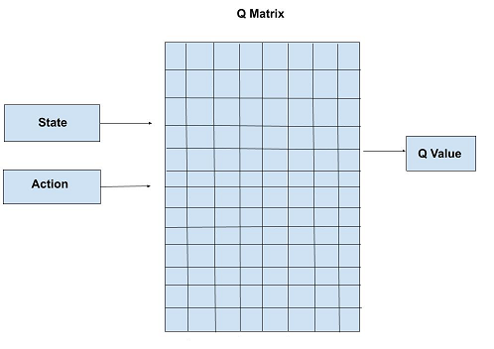
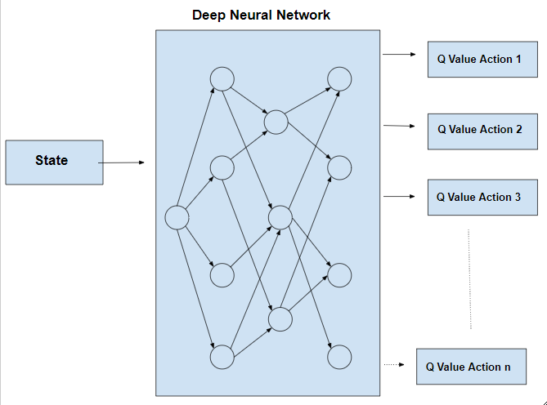
Q-LEARNING ALGORITHM
Q-LEARNING IS A REINFORCEMENT LEARNING METHOD USED TO OPTIMIZE TRAFFIC CONGESTION BY ENABLING TRAFFIC SIGNALS TO LEARN THE BEST CONTROL STRATEGIES OVER TIME. EACH INTERSECTION ACTS AS AN AGENT THAT OBSERVES ITS CURRENT TRAFFIC STATE AND SELECTS ACTIONS (LIKE CHANGING LIGHT PHASES) BASED ON POTENTIAL REWARDS, SUCH AS REDUCED WAIT TIMES. AS THE AGENT INTERACTS WITH ITS ENVIRONMENT, IT UPDATES ITS Q-VALUES, CONTINUOUSLY IMPROVING ITS DECISION-MAKING TO ENHANCE OVERALL TRAFFIC FLOW. THIS DYNAMIC ADJUSTMENT HELPS ALLEVIATE CONGESTION AND ADAPT TO REAL-TIME TRAFFIC CONDITIONS EFFECTIVELY.

Slide 7
ADJUST SIGNAL TIMINGS BASED ON TIME OF DAY
Problem:
Traffic signal settings often fail to reflect traffic volume variations throughout the day (e.g., rush hours vs. late night).
Solution:
Traffic Volume Variation Recognition:
Adaptive Traffic Flow Management: The system identifies high-volume periods like morning and evening rush hours and low-volume periods like late-night hours, and optimizes signal timings to suit the conditions. For example:
Rush Hours: Longer green light durations on major lanes to reduce congestion.
Late Night: Shorter green lights for quick clearance when fewer vehicles are on the road.
Dynamic Traffic Signal Optimization with Machine Learning:
Deep Q-Learning Agent: Learns traffic patterns in real time and adjusts traffic light phases accordingly.
Time-of-Day Adjustments: The system uses machine learning models to recognize daily traffic patterns, such as heavier traffic during rush hours and lighter traffic at night. By learning from these variations, the system adjusts traffic light settings dynamically throughout the day.
GPS-Based Vehicle Detection and Prediction:
Real-Time Adjustments: By detecting vehicle positions using GPS and pre-determined vehicle detection methods, the system adjusts signal timings based on actual traffic density. This ensures that traffic lights reflect current conditions rather than following a static schedule.

Slide 8
IMPROVING OVERALL TRAFFIC FLOW
PROBLEM:
TRAFFIC SIGNAL TIMINGS ARE OFTEN STATIC AND DON’T RESPOND TO REAL-TIME TRAFFIC FLUCTUATIONS.
SOLUTION:
USE MACHINE LEARNING ALGORITHMS TO MONITOR AND ANALYZE TRAFFIC FLOW THROUGH SENSORS OR CAMERA DATA.
IDENTIFY PEAK AND OFF-PEAK HOURS.
ADJUST TIMINGS DYNAMICALLY IN RESPONSE TO REAL-TIME TRAFFIC DATA.
ALGORITHMS CAN PREDICT TRAFFIC BUILDUP AND ADJUST SIGNALS PREEMPTIVELY.

Slide 9
IMPROVING OVERALL TRAFFIC FLOW
1. Multi-Intersection Coordination
Innovation: Traffic signals at multiple intersections communicate and adjust timings together to optimize traffic flow over a network.
Benefit: Creates "green waves" for smoother flow across multiple intersections, reducing stops and delays on main roads.
2. Dynamic Lane Optimization
Innovation: Machine learning adjusts signal timings for individual lanes based on vehicle density and type (e.g., buses, trucks).
Benefit: Lanes with more traffic receive longer green times, improving flow for heavy traffic areas while minimizing wait times for others.
3. Predictive Traffic Rerouting
Innovation: Real-time data and predictive algorithms reroute vehicles before congestion occurs, sending alerts to drivers through GPS and Twilio.
Benefit: Proactively reduces traffic build-up and directs vehicles to less congested roads, minimizing bottlenecks.
4. Vehicle-to-Infrastructure (V2I) Communication
Innovation: Connected vehicles share real-time data with traffic signals, allowing them to prioritize certain vehicles (e.g., ambulances, buses) and optimize traffic flow.
Benefit: Improves traffic efficiency by giving priority to critical vehicles, reducing congestion and enhancing mobility for all.

Slide 10


THANK YOU

