Slide 1


Fraud Detection System
Presented by Suhas S
Mentor: Muvendiran M

Slide 2
Problem Statement
Financial fraud poses a significant and growing threat in today's digital landscape. Its sophisticated methods result in substantial financial losses for individuals and organizations alike. Accurately identifying fraudulent activities presents considerable challenges. The complex and ever-evolving nature of fraudulent patterns, coupled with limitations in data availability, makes building robust detection systems difficult. Maintaining a high degree of accuracy and efficiency in fraud detection remains a significant hurdle.

Slide 3
Dataset Overview
Source
Kaggle Credit Card Fraud Detection Dataset
Size
284,807 entries
Features
31 columns, including:
- 30 numerical features (V1 to V28)
- Time
- Amount
- Class (Fraud: 1, Non-fraud: 0)
Class Distribution
Non-Fraud: 284315
Fraud: 492

Slide 4
Methodology
1
Data Preprocessing
2
Feature Engineering
3
Model Training
Cleaned data, handled missing values, scaled transactions, and encoded categorical variables.
Selected key features, removed redundant ones, and analyzed correlations to enhance performance.
Used Logistic Regression, Random Forest, Decision Tree, SVM, XGBoost.

Slide 5
Models and Accuracies
Logistic Regression
Decision Tree
Random Forest
Accuracy: ~99.91%
Accuracy: ~99.87%
Accuracy: ~99.96%
XGBoost
SVM
Accuracy: ~99.94%
Accuracy: ~99.90%

Slide 6
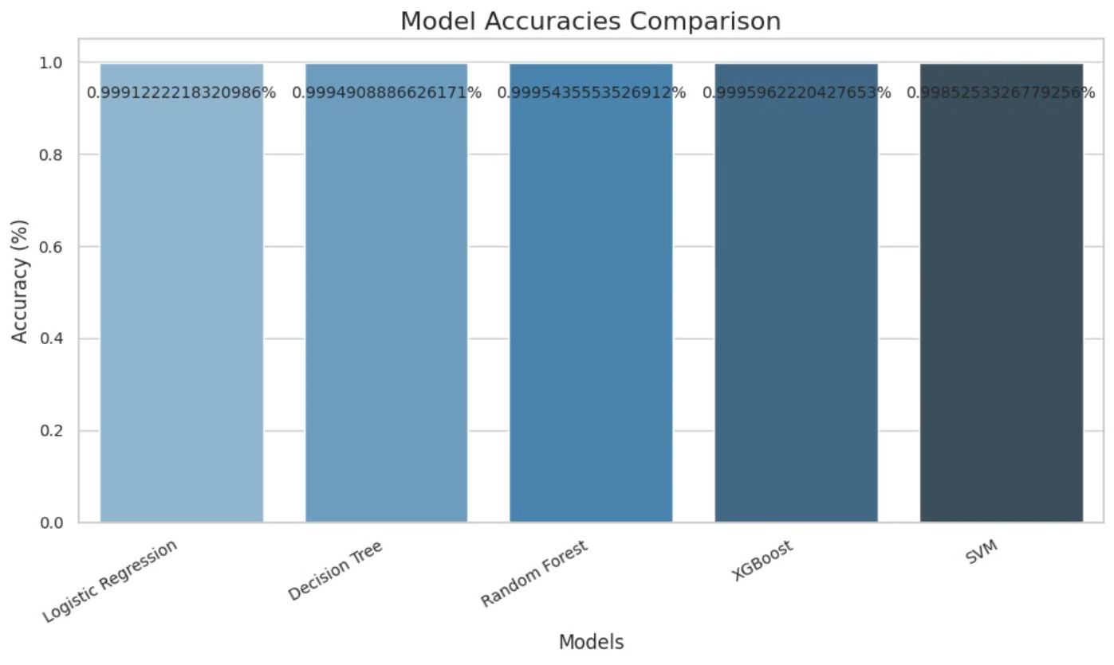
Comparison Graph

Slide 7
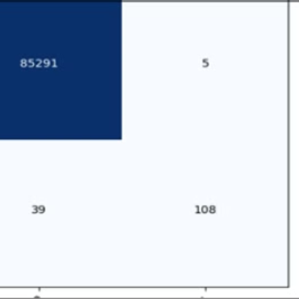
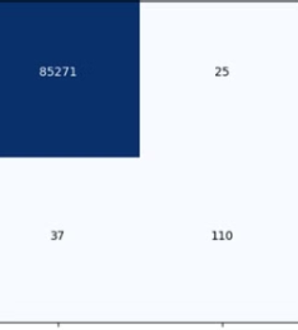
Confusion Matrix
Logistic Regression
Random forest

Slide 8
Challenges Faced & Resolutions
Data Imbalance
Solution
Feature Scaling
Solution
The dataset had a significant class imbalance (fraudulent transactions were far fewer than non-fraudulent ones).
Oversampling techniques (SMOTE) were employed to balance the dataset and improve model performance on the minority class.
The dataset contained features with varying scales, which could affect the performance of some algorithms.
StandardScaler was used to standardize features and ensure that they contribute equally to the models. This helps algorithms avoid overemphasizing certain features due to scale differences.

Slide 9
Conclusion
Achieved ~99.96% accuracy, exceeding expectations.
Robust models (Random Forest, XGBoost) and effective data preprocessing key to success.
Future potential: expand to other fraud types and real-time monitoring.
High accuracy across multiple models demonstrates effective fraud detection.
Models applicable to real-world systems for enhanced security.
Further feature engineering could improve performance.
Deployment and system integration are crucial for practical application.

Slide 10
Acknowledgments
We extend our sincere gratitude to our mentor, Muvendiran M, for their invaluable guidance and support throughout this project. We also acknowledge the contributions of all team members whose hard work and dedication made this project possible. Finally, we thank Infosys Springboard for providing this valuable opportunity.

