Slide 1
React

Slide 2
What is React
ReactJS is an open-source, component based front end library
responsible only for the view layer of the application.
It is maintained by Facebook.

Slide 3
Framework or Library ?
Differences between Library and Framework?
Ref: https://medium.com/swlh/the-difference-between-a-framework-and-a-library-aae062eb4a28

Slide 4
Library Why?
Framework have every single thing that you'll need to make a complete, large-scale app.
built-in tools for common tasks like creating forms, running automated, tests, making network requests, routing, and much more.
some framwork built based on React: Next.js, Gatsby, and Redwood.js
Ref: https://www.freecodecamp.org/news/is-react-a-library-or-a-framework/

Slide 5
Single Page Application (SPA)
Client-Side Rendering VS Server-Side Rendering

Slide 6
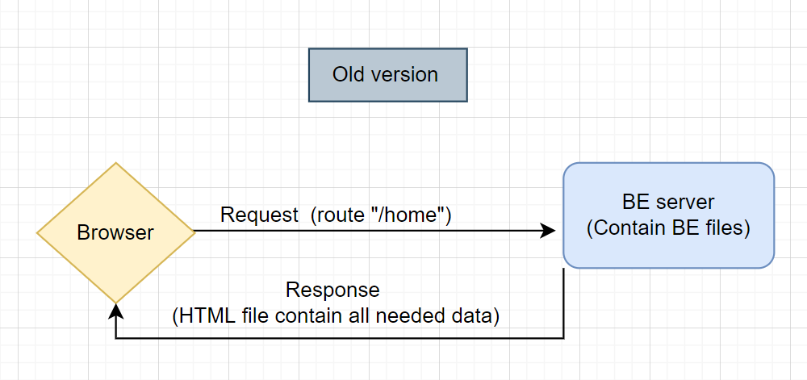
Server-Side Rendering

Slide 7
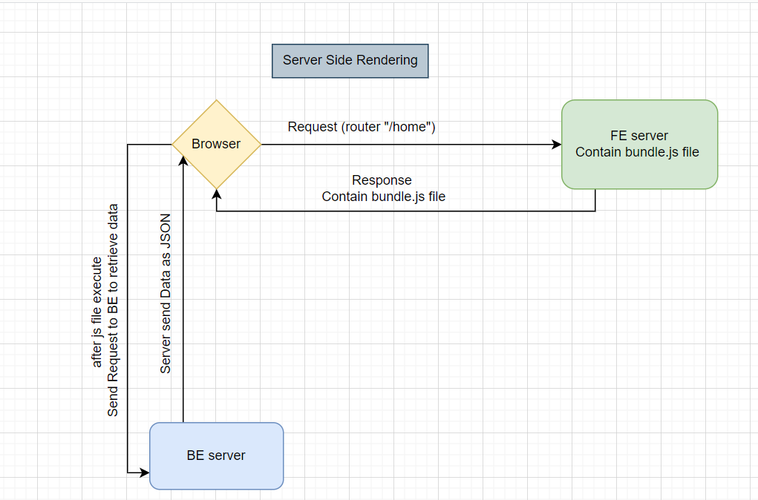
Client-Side Rendering

Slide 8
NodeJS and npm
it is an online repository for the publishing of open-source Node.js projects
Practical example:

Slide 9
Transpiler (Babel)
It’s like a tool that convert Javscript ES6 code to ES5.
Why?

Slide 10
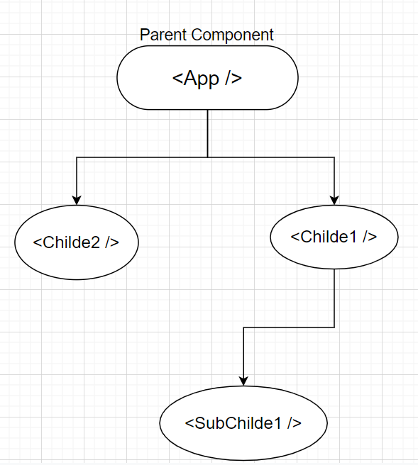
React Components

Slide 11
Virtual Dom
Virtual Dom in React as a Copy of the DOM in browser stored in memory
The interaction between real DOM with JS is expensive
The Goal of Virtual DOM is to minimize the interaction between Javscript and Real DOM

Slide 12
Create React app
npx create-react-app “app name”

Slide 13
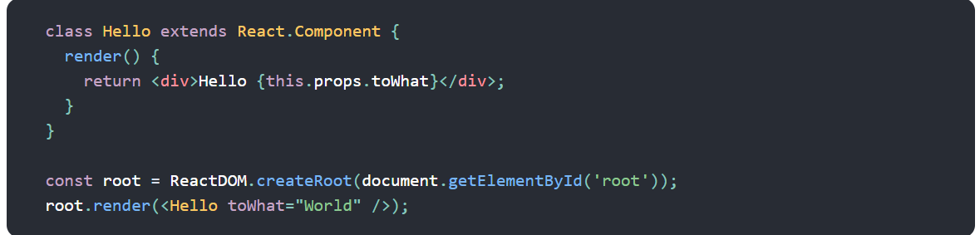
JSX
Used with React to describe what the UI should look like.

Slide 14
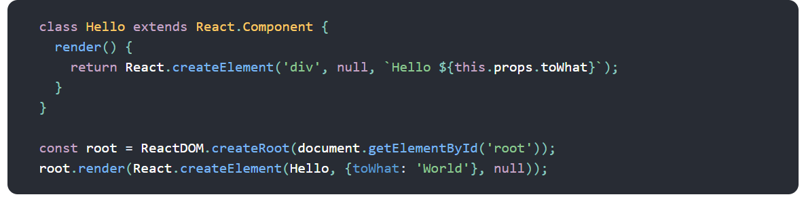
JSX

Slide 15
JSX feature
Embedding Expressions in JSX
JSX is an Expression Too using inside (if , loop, variable)
Specifying Attributes with JSX
Specifying Children with JSX

Slide 16
Build and Webpack
Webpack is a bundler (tool that make a bundle)
The Bundle is a wrap up for your project

