Slide 1
React

Slide 2
What is React
ReactJS is an open-source, component based front end library
responsible only for the view layer of the application.
It is maintained by Facebook.

Slide 3
Framework or Library ?
Differences between Library and Framework?
Ref: https://medium.com/swlh/the-difference-between-a-framework-and-a-library-aae062eb4a28

Slide 4
Library Why?
Framework have every single thing that you'll need to make a complete, large-scale app.
built-in tools for common tasks like creating forms, running automated, tests, making network requests, routing, and much more.
some framwork built based on React: Next.js, Gatsby, and Redwood.js
Ref: https://www.freecodecamp.org/news/is-react-a-library-or-a-framework/

Slide 5
Single Page Application (SPA)
Client-Side Rendering VS Server-Side Rendering

Slide 6
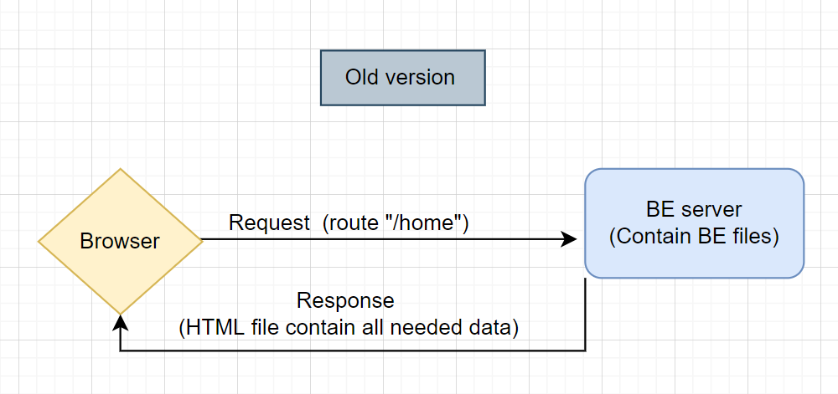
Server-Side Rendering

Slide 7
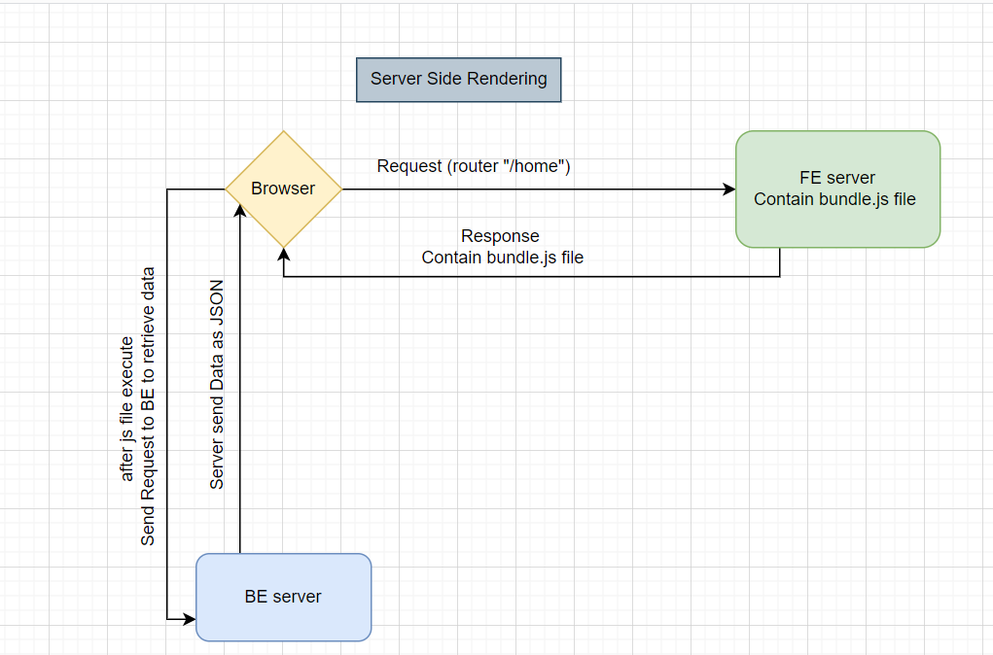
Client-Side Rendering

Slide 8
NodeJS and npm
it is an online repository for the publishing of open-source Node.js projects
Practical example:

Slide 9
Transpiler (Babel)
It’s like a tool that convert Javscript ES6 code to ES5.
Why?

Slide 10
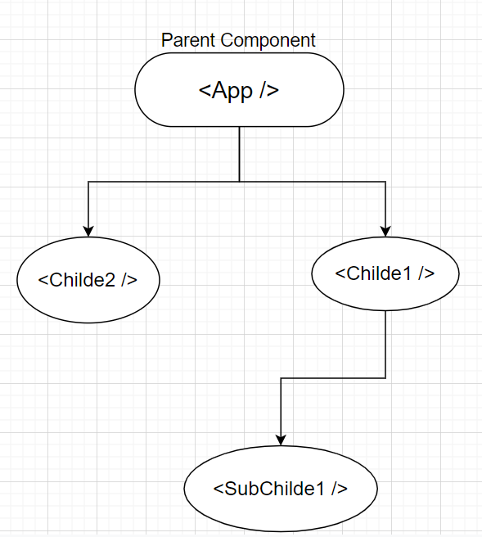
React Components

Slide 11
Virtual Dom
Virtual Dom in React as a Copy of the DOM in browser stored in memory
The interaction between real DOM with JS is expensive
The Goal of Virtual DOM is to minimize the interaction between Javscript and Real DOM

Slide 12
Create React app
npx create-react-app “app name”
Explain files and directory

Slide 13
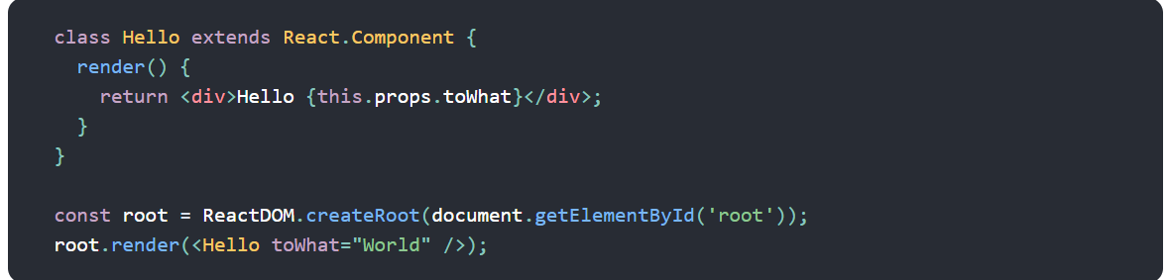
JSX
Used with React to describe what the UI should look like.

Slide 14
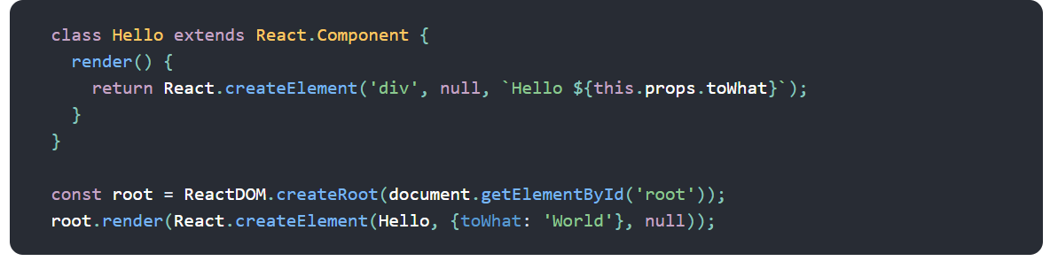
JSX

Slide 15
JSX feature
Embedding Expressions in JSX
JSX is an Expression Too using inside (loop, variable)
Specifying Attributes with JSX
Specifying Children with JSX

Slide 16
React Component in Practice
Functional component Vs Class Component
Props are the interface for the outer world
Props are read only
Pure and Impure functions
React should treated as pure function with respect to their props

Slide 17
React life cycle
Mounting,
Updating
Unmounting
Ref: https://reactjs.org/docs/react-component.html

Slide 18
Mounting
when an instance of a component is being created and inserted into the DOM
Functions will be fire in Mounting: 1. Constructor used for binding method, and initialize state should call super 2. render contain all jsx that should be rendered do not change the state inside it 3. ComponentDidMount will be called after element mounted and inserted to the real Dom update state it will make render execute twice
Practical Exampple:

Slide 19
Updating Phase
ConponeentDidUpdate: called when the component updated (state has been changed, or Re-rendered) do not change the state inside it without condion
componentWillReceiveProps (Deprecated)
Render

Slide 20
setState
setState() is executed within this
setState() is executed async
setState with call back
It makes shallow merge

Slide 21
Build and Webpack
Webpack is a bundler (tool that make a bundle)
The Bundle is a wrap up for your project

