Slide 1

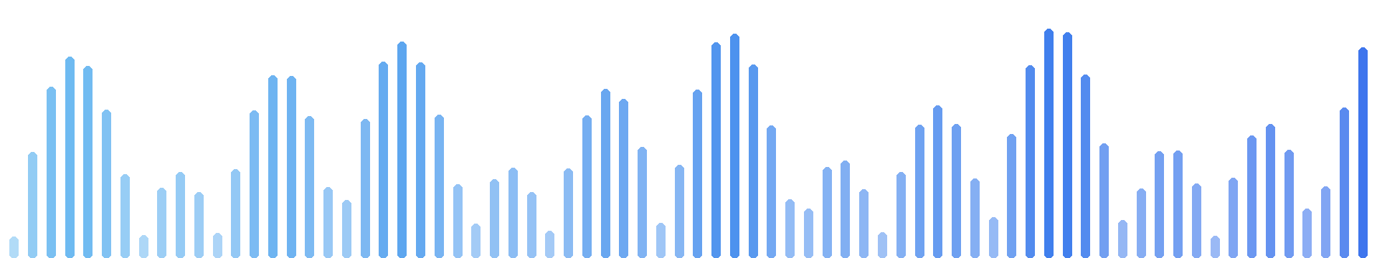
Voice Signal Analysis Using Machine Learning for Early Detection of Parkinson's Disease
Suhail Mohamed Alhammali
ID 2200208522 Supervisor: Dr. Adel Adyaf
Control and Instrumentation Division • Department of Biomedical Engineering
Faculty of Engineering, University of Tripoli • Spring 2026
Notes:
Good morning. My name is Suhail. This is my graduation project. It asks one question: can the voice help us notice Parkinson's disease earlier?

Slide 2

A movement disease reaches the voice
dopamine
loss
impaired
motor control
hypokinetic
dysarthria
measurable
acoustic change
every muscle — breathing, larynx, articulation
The weakness that shakes a hand also moves the voice.
2
Notes:
Parkinson's disease reduces dopamine. That impairs motor control. Every muscle is affected. Also the small muscles of speech. The result is a speech disorder we can measure. The weakness that shakes a hand also moves the voice.

Slide 3



The voice is a cheap, early window
~90%
5 yr
$
of patients show
speech changes
before diagnosis,
in one documented case
a microphone:
non-invasive, repeatable
Not a diagnosis — a reason to see a doctor earlier.
3
Notes:
About ninety percent of patients show speech changes. In one documented case, changes appeared five years before diagnosis. A microphone is cheap and non-invasive. This is not a diagnosis. It is a reason to see a doctor earlier.

Slide 4
Can a computer measure a voice recording and tell whether its pattern resembles Parkinson's patients — or healthy speakers?
4
Notes:
This is the research question. Read it slowly. Can a computer tell if a voice pattern resembles patients, or healthy speakers?

Slide 5
Six stages, one shared implementation
raw WAV
audio
clean-up
5 steps
10-second
chunks
74 measure-
ments / chunk
model
(Random Forest)
cautious
indication
The same code runs in training, testing, and prediction — enforced, not promised.
5
Notes:
The system has six stages. Audio comes in. We clean it. We cut it into ten-second chunks. We take seventy-four measurements per chunk. A model judges. The output is cautious. One key point: the same code runs everywhere. The program checks this before every prediction.

Slide 6
Every measurement points at physiology
raw audio
›
clean-up
›
10-s chunks
›
74 measures
›
model
›
indication
monotone speech
pitch variation
unstable vocal-fold control
jitter, shimmer
incomplete glottal closure
HNR, CPPS
disturbed timing
pause statistics
imprecise articulation
MFCC dynamics
All 74 measurements implemented in this project — none downloaded.
6
Notes:
Each measurement family points at physiology. Monotone speech shows in pitch variation. Unstable vocal folds show in jitter and shimmer. Incomplete closure shows in HNR and CPPS. Timing problems show in pauses. Imprecise articulation shows in MFCC dynamics. We implemented all seventy-four measurements ourselves.

Slide 7

We chose not to clean the sound
raw audio
›
clean-up
›
10-s chunks
›
74 measures
›
model
›
indication
Denoising suppresses irregularity. Irregularity is the evidence.
Cleaning would make a disordered voice look artificially healthy.
7
Notes:
One decision matters here. We did not remove noise. Denoising software removes irregularity. But irregularity is the medical evidence. Cleaning the sound would make a sick voice look healthy.

Slide 8
A student with the exam questions proves nothing
one person
training
the model can win by
recognising the
person
recording 1
recording 2
test
This is data leakage. Our program halts if it ever happens.
8
Notes:
Here is the danger. Each person gave two recordings. Put one in training and one in test. The model can then win by recognising the person. Not the disease. This is data leakage. Our program stops itself if it ever happens.

Slide 9
Validation design decides the number
0.909
balanced accuracy
an impressive result?
9
Notes:
Look at this number. 0.909. It looks like an excellent result. [Pause. Next slide.]

Slide 10
Validation design decides the number
0.909
0.909
0.775
deliberately wrong split — demonstration only
0.775
correct split, same model
correct split
grouped by subject
wrong split
chunks cross sides
The difference is memorisation, not detection — and it is why 95%+ results exist.
10
Notes:
Now the truth. That number came from a deliberately wrong split. Chunks of the same recording were on both sides. The honest split gives 0.775. Same data. Same model. Only the split changed. The difference is memorisation, not detection. This is why many papers report ninety-five percent or more. Orange means inflated. Blue means honest. Remember these two colours.

Slide 11




The rules were fixed before the experiments
identical splits for every variant
adoption margin: +0.02
any result ≥ 0.95: stop, investigate
all 19 configurations reported
Best score 0.840 — rejected. It won by 0.018: less than the noise.
11
Notes:
We fixed the rules before running anything. Same splits for every variant. A complex variant must win by more than 0.02. Anything above 0.95 stops the study. All nineteen configurations are reported. The best score was 0.840. We rejected it. It won by only 0.018. That is smaller than the noise.

Slide 12
Nineteen configurations — the winner chosen by rule
adoption margin +0.02
baseline phase — SVM (V0)
0.780
chunk features — SVM (V1)
0.816
chunk features — tuned RF (V4)
0.814
mean+std features — SVM (V6)
0.824
tuned SVM+RF ensemble (V5)
0.840
rejected (+0.018)
chunk features — Random Forest (V1)
0.822
selected
0.75
0.80
0.85
subject-level balanced accuracy, 3-seed mean — six of the 19 configurations shown; all are reported
12
Notes:
Nineteen configurations were compared under identical splits. Here are the leaders. The ensemble scored highest, 0.840. But it beat the Random Forest by only 0.018, inside the pre-declared margin and inside the noise. So the rule rejected it. The Random Forest at 0.822 was selected. The rule chose the winner, not our preference.

Slide 13
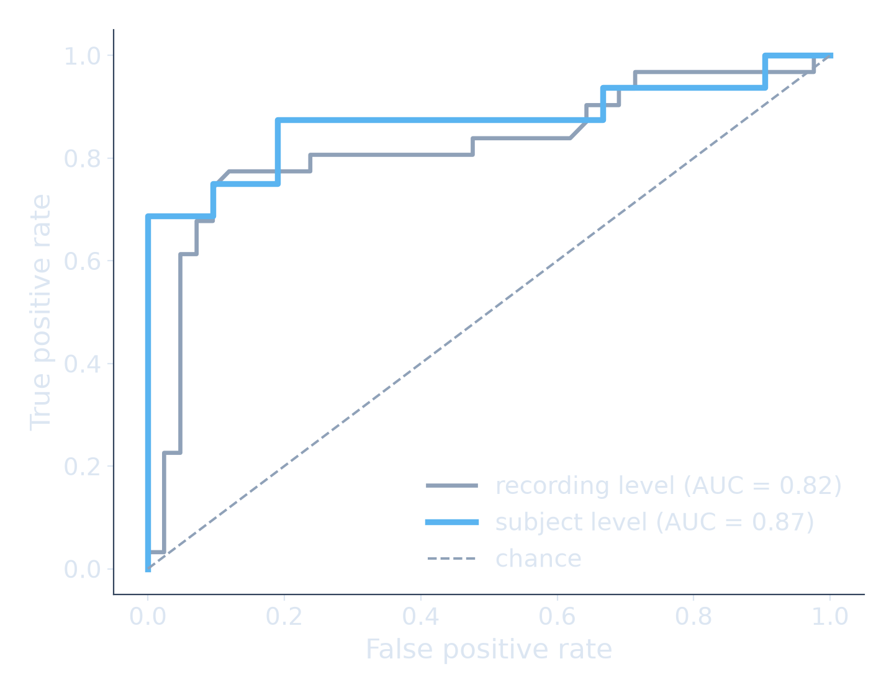
Judged on people it has never heard
raw audio
›
clean-up
›
10-s chunks
›
74 measures
›
model
›
indication
0.822 ± 0.032
balanced accuracy, per subject
0.771
0.873
0.864
sensitivity
specificity
AUC
“always healthy” scores 0.575 accuracy, finds nobody — balanced accuracy 0.500.
13
Notes:
The final model is a Random Forest on the seventy-four measurements. Balanced accuracy 0.822, plus or minus 0.032. Sensitivity 0.771. Specificity 0.873. AUC 0.864. All measured on people the model never heard. Why balanced accuracy? A model that always says healthy gets 0.575 accuracy and finds nobody. Balanced accuracy gives it 0.5 and exposes it.

Slide 14
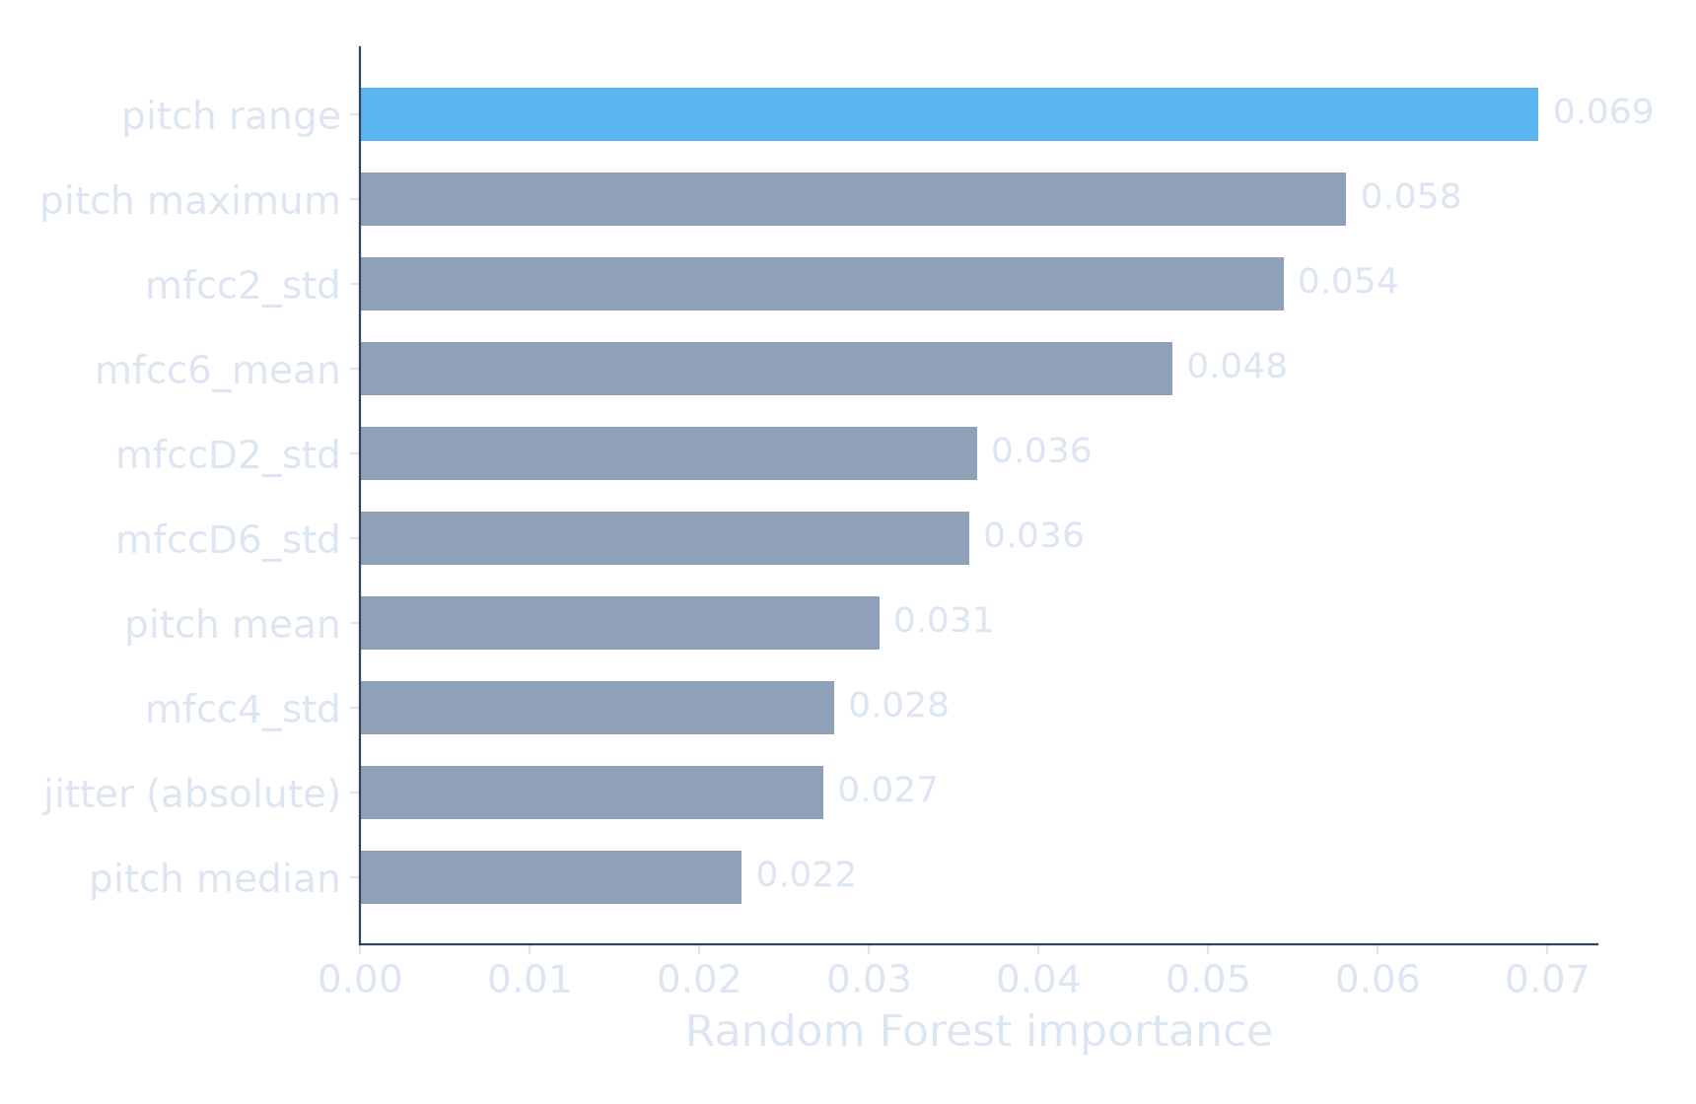
It rediscovered a known clinical sign
raw audio
›
clean-up
›
10-s chunks
›
74 measures
›
model
›
indication
Top measurement: pitch range the acoustic correlate of monotone speech — described by clinicians for decades.
14
Notes:
We asked the model which measurement mattered most. The answer: pitch range. That is monotone speech. Clinicians have described it for decades. A system with no medical knowledge rediscovered a known clinical sign.

Slide 15
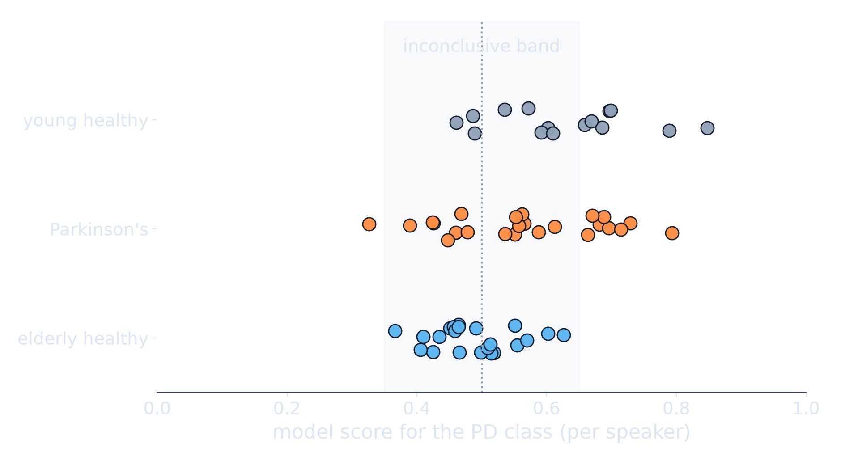
Italy: a frozen model, a trap, and a puzzle
raw audio
›
clean-up
›
10-s chunks
›
74 measures
›
model
›
indication
Trap caught: every 44.1 kHz file was a patient. Band-limited all audio to 16 kHz.
Result: AUC 0.701, balanced accuracy 0.629.
Puzzle: healthy young 0.626 > patients 0.566. Why?
15
Notes:
We froze the model and tested it on an Italian corpus. Sixty-one speakers. Another language. First, a trap: every 44.1 kilohertz file was a patient. The model could have detected microphones, not disease. We band-limited everything to 16 kilohertz. Result: AUC 0.701. Now the puzzle. Healthy young speakers scored higher than patients. Why? [Pause. Let them think.] It is medically impossible. So it proves the score follows the recording channel out of domain. That is exactly why our interface is cautious.

Slide 16
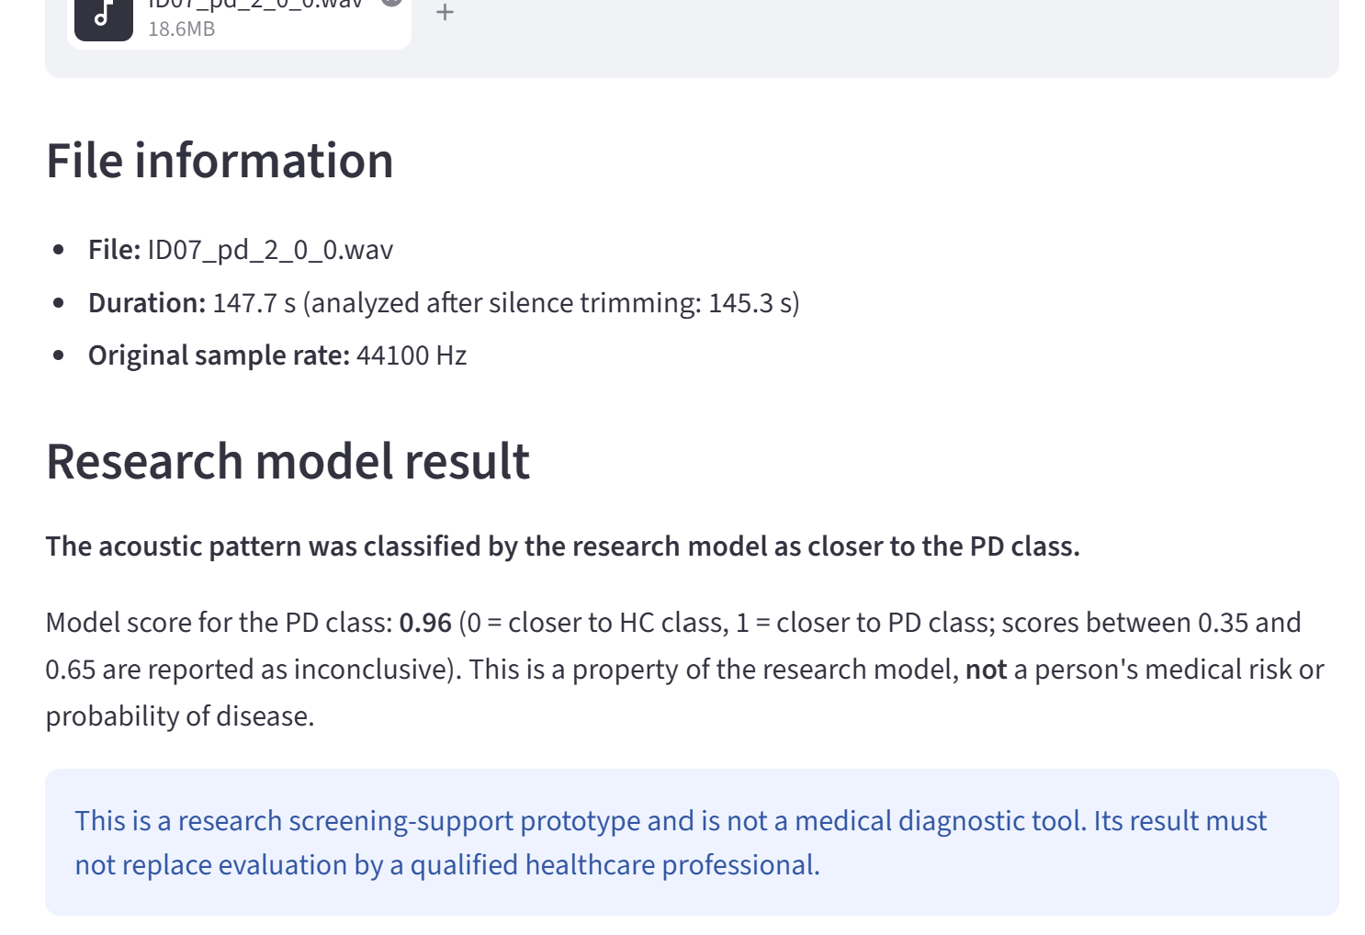
A system that refuses to guess
▪ scores 0.35–0.65 ⇒ “inconclusive”
▪ 100% of elderly healthy Italian speakers landed there
▪ declining to answer is a feature
16
Notes:
The prototype never guesses near the boundary. Scores between 0.35 and 0.65 are reported as inconclusive. In the Italian test, all elderly healthy speakers landed there. The system refused to mislabel them. Declining to answer is a feature.

Slide 17
Optional: live demonstration
$ python scripts/predict_file.py ID07_pd_2_0_0.wav RESEARCH MODEL RESULT (non-diagnostic) Duration: 147.7 s, original sample rate 44100 Hz The acoustic pattern was classified by the research model as closer to the PD class. Model score for the PD class: 0.96
▪ safest demo: a corpus recording, command line
▪ analysis takes about one minute
▪ fallback: the screenshots on the previous slide carry the same content
skip this slide if time is short
17
Notes:
If time allows, run the live demo now. Start the analysis, then keep talking. If anything misbehaves, the previous slide shows the same content.

Slide 18



The limits, stated plainly
37 subjects — one device, one language
vowel-defined measures on continuous speech
the dominant limitation; every result is reported with its spread
jitter, shimmer and HNR are noisier here; CPPS compensates only partly
scores are not calibrated probabilities
one external corpus — one data point
0.7 does not mean a 70% chance of disease — the wording enforces this
0.701 AUC measures generalisation once; it does not characterise it
Every limitation above is stated in the report itself — none is left for an examiner to discover.
18
Notes:
Before I close: the limits, stated plainly. Thirty-seven subjects, one device, one language. The classic voice measures were designed for vowels, not continuous speech. The scores are not probabilities. And one external corpus is one data point about generalisation. All of this is written in the report itself.

Slide 19
What this is — and is not
▪ not a diagnostic tool; many conditions change a voice
▪ 37 subjects, one language, one device
Validation design moves the number
more than model engineering does.
An honest 0.822 is worth more than an inflated one.
19
Notes:
To close. This is not a diagnostic tool. Thirty-seven subjects is small. But the central lesson is this. Validation design moves the number more than model engineering does. An honest 0.822 is worth more than an inflated one.

Slide 20
Thank you
Questions welcome.
Notes:
Thank you. I welcome your questions.

Slide 21
Backup Why 82% and not 95%?
▪ published 95%+ figures usually split recordings or windows, not people
▪ our own pipeline: 0.909 leaky vs 0.775 honest — same model
▪ 0.822 is measured on people the model never heard
21

Slide 22
Backup Why not deep learning?
▪ 37 subjects is far below what deep networks need
▪ examiners can ask this model which measurements it used
▪ our small neural network collapsed in the confounder test (0.671 → 0.526)
22

Slide 23
Backup Why balanced accuracy?
▪ classes are imbalanced: 42 HC vs 31 PD recordings
▪ “always healthy” scores 0.575 accuracy and finds zero patients
▪ balanced accuracy gives that model 0.500 — correctly exposing it
23

Slide 24
Backup Why reject the 0.840 ensemble?
▪ the +0.02 adoption margin was fixed before the experiments
▪ 0.018 is smaller than the seed-to-seed noise (~0.03): a statistical tie
▪ we report 0.840 openly — we just did not let it drive the decision
24

Slide 25
Backup Can it diagnose Parkinson's?
▪ no — and it is not designed to
▪ colds, laryngitis, ageing, smoking also change the voice
▪ a non-diagnostic disclaimer appears before and after every result
25

Slide 26
Backup Is 37 subjects too few?
▪ yes — it is the main limitation, stated in every report
▪ we report variability, repeat with 3 seeds, use grouped validation
▪ and we tested externally on a second corpus of 61 speakers
26

Slide 27
Backup Is it just detecting male vs female voices?
▪ we tested it: removed all absolute-pitch features and re-ran everything
▪ the selected model held: 0.768 → 0.780
▪ the small neural network collapsed — and was excluded
27

Slide 28
Backup Hardest technical problem?
▪ in the Italian corpus, every 44.1 kHz file belonged to the patient group
▪ a model could “detect Parkinson's” by detecting microphone bandwidth
▪ caught at inspection; all audio band-limited to 16 kHz before evaluation
28

