Slide 1

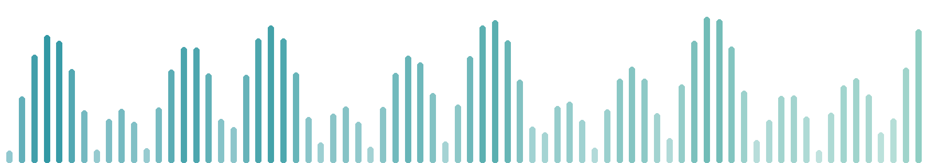
Voice Signal Analysis Using Machine Learning
for Early Detection of Parkinson's Disease
Suhail Mohamed Alhammali
ID 2200208522 Supervisor: Dr. Adel Adyaf
Department of Biomedical Engineering • Faculty of Engineering
University of Tripoli • Spring 2026
Notes:
Good morning. My name is Suhail. This is my graduation project about the voice and Parkinson's disease.

Slide 2




What is this project?
A computer program that listens to a voice recording
and answers one question:
does this voice pattern look more like
Parkinson's patients — or like healthy people?
37 people
74 measurements
not a diagnosis
in the study data
from every recording
a research screening idea
2
Notes:
In one sentence: the program listens to a recording. It answers one question. Does this voice pattern look more like patients, or like healthy people? It is not a diagnosis. It is a research screening idea.

Slide 3



Why the voice?
~90%
early
easy
of patients get
voice changes
changes can start years
before diagnosis
a microphone is cheap
and painless
Parkinson's weakens every muscle — also the small muscles of speech.
3
Notes:
Why the voice? Ninety percent of patients get voice changes. The changes can start early. And a microphone is cheap and painless. Parkinson's weakens every muscle. Also the small muscles of speech.

Slide 4


How the voice is made — three stages
1. Lungs
2. Vocal folds
3. Mouth & tongue
push the air
vibrate very fast
shape the sound
the power
the sound (pitch)
the letters
Like a musical instrument: air, a vibrating part, and a shape around it.
4
Notes:
The voice is made in three stages. The lungs push the air. The vocal folds vibrate very fast. That vibration is the pitch. The mouth and tongue shape the sound into letters. Like a musical instrument.

Slide 5
What we measure — 74 numbers per recording
Is the pitch flat or lively?
pitch range
monotone speech is a classic sign
Is the vibration steady?
jitter & shimmer
shaky muscle control makes it uneven
Is the voice clear or breathy?
noise ratio (HNR)
weak folds let air leak through
Are there many pauses?
pause statistics
starting speech becomes harder
How fast does the mouth move?
spectrum (MFCC)
slow, small movements blur the letters
5
Notes:
We turn every recording into seventy-four numbers. Each number answers a simple question. Is the pitch flat or lively? Is the vibration steady? Is the voice clear or breathy? Are there many pauses? How fast does the mouth move? Every number has a medical reason.

Slide 6


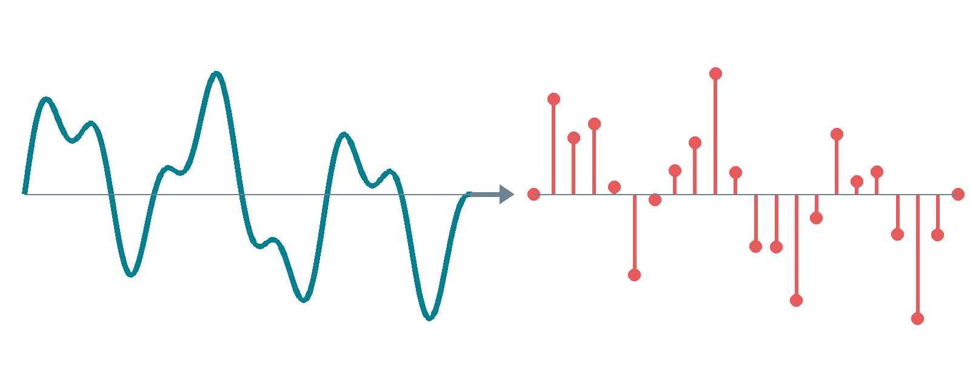
How sound becomes numbers
microphone
electricity
ADC
sound wave hits it
the wave becomes a signal
measures it 44,100 times
every second
analog wave → samples: one number each
6
Notes:
How does sound become numbers? The sound wave hits the microphone. It becomes an electrical signal. Then a converter called ADC measures this signal 44,100 times every second. Each measurement is one number, called a sample. A two-minute recording is about five million numbers.

Slide 7


One channel, no compression
Mono
WAV file
one channel = one list of numbers.
We study one voice, so one list is enough.
keeps every number exactly as recorded.
Nothing is deleted, nothing is lost.
MP3 deletes small details to save space — and small details are exactly what we measure.
7
Notes:
Two small technical points. Mono means one channel. One list of numbers. That is enough for one voice. And we use WAV files. WAV keeps every number. MP3 deletes small details to save space. But small details are exactly what we measure. So no MP3.

Slide 8

The data: real voices, checked first
37
21 / 16
73
~2 min
people
healthy / Parkinson's
recordings
each, on a phone
MDVR-KCL — a public research dataset recorded at King's College London.
Every file was checked before training: labels, speaker identity, no duplicates, no damage.
Each person reads a text and has a free conversation — normal speech, not sounds.
8
Notes:
Our data is called MDVR-KCL. It is a public research dataset from King's College London. Thirty-seven people. Twenty-one healthy, sixteen with Parkinson's. Seventy-three recordings, about two minutes each, on a phone. We checked every file before training. Labels, speaker identity, no duplicates.

Slide 9





Cleaning up — five careful steps
mono
44.1 kHz
remove offset
trim silence
same loudness
one channel
same clock
for all
center the wave
only at the edges
fair comparison
One thing we did NOT do: remove noise. Noise-removal software smooths away irregularities — and the irregularities are the medical evidence.
9
Notes:
Before measuring, we clean up. Five careful steps. One channel. One fixed clock, 44.1 kilohertz. Center the wave. Trim the silence at the edges. Same loudness for all. And one thing we did not do: remove noise. Noise removal smooths away irregularities. But the irregularities are the medical evidence.

Slide 10
How the computer learns
TRAINING
TESTING
show the computer many recordings
WITH the answers
→ it finds the pattern
new recordings, NO answers,
from people it has never heard
→ can it still tell?
Golden rule: never test on a person the computer trained on —
like a student who saw the exam questions before the exam.
10
Notes:
How does the computer learn? Two phases. Training: we show it many recordings with the answers. It finds the pattern. Testing: new recordings, no answers, from people it never heard. Can it still tell? One golden rule. Never test on a person the computer trained on. Like a student who saw the exam questions before the exam.

Slide 11

Our model: a forest of 300 small decisions
Random Forest
300 small decision trees, each looking at the numbers differently — then they vote.
Why this one? We can ask it which
measurements it used — it is explainable.
Its favourite measurement? Pitch range —
the monotone-speech sign doctors know.
We compared four models under the same fair test — this one won.
11
Notes:
Our model is called Random Forest. Three hundred small decision trees. Each looks at the numbers differently. Then they vote. Why this model? Because we can ask it which measurements it used. Its favourite is pitch range. That is the monotone speech sign doctors already know. We compared four models. This one won.

Slide 12
How good is it? — in plain words
0.822
77%
87%
balanced accuracy
sensitivity
specificity
the overall fair score
(on people it never heard)
of all true patients,
how many did we catch?
of all healthy people,
how many did we clear?
Why not plain accuracy? A lazy model that always says “healthy” scores 57.5% —
and finds
zero patients.
12
Notes:
How good is it? Balanced accuracy 0.822 on people it never heard. Sensitivity 77 percent. Of all true patients, how many did we catch? Specificity 87 percent. Of all healthy people, how many did we clear? Why not plain accuracy? A lazy model that always says healthy scores 57.5 percent and finds zero patients. That is why we use the fair score.

Slide 13
The confusion matrix — every recording, counted
model says:
healthy
model says:
Parkinson's
really
healthy
36
6
Out of 73 recordings: 60 correct • 13 mistakes — and we say so openly.
correct
false alarm
really
Parkinson's
7
24
missed
caught
13
Notes:
This table counts every recording. Really healthy, and the model says healthy: 36 correct. Six false alarms. Seven missed patients. Twenty-four caught. Out of 73 recordings, 60 correct, 13 mistakes. And we say so openly. Every screening system makes mistakes. Honest systems count them.

Slide 14
Three things to remember
The voice carries a real, measurable signal of Parkinson's.
1
We tested honestly — only on people the computer never heard.
2
It is a screening helper, not a diagnosis — a doctor decides.
3
14
Notes:
Three things to remember. One: the voice carries a real, measurable signal. Two: we tested honestly, only on people the computer never heard. Three: it is a screening helper, not a diagnosis. A doctor decides.

Slide 15
Thank you
Questions are welcome.
Notes:
Thank you. I welcome your questions.

