Slide 1


Voice Signal Analysis Using Machine Learning
for Early Detection of Parkinson's Disease
Suhail Mohamed Alhammali
ID 2200208522 Supervisor: Dr. Adel Adyaf
Department of Biomedical Engineering · Faculty of Engineering · University of Tripoli · Spring 2026
Notes:
Good morning. My name is Suhail. This is my graduation project about the voice and Parkinson's disease.

Slide 2




01 · THE QUESTION
One program, one question
Listen to a voice recording. Does its pattern look more like Parkinson's patients — or like healthy people?
37 people
74 numbers
not a diagnosis
real study data
measured from every voice
a screening helper
2
Notes:
One program, one question. Listen to a recording. Does its pattern look more like patients, or like healthy people? Thirty-seven people. Seventy-four numbers per voice. And it is not a diagnosis. It is a screening helper.

Slide 3
02 · THE VOICE
Parkinson's reaches the voice
brain
muscles
speech
less dopamine
weaker control
quieter, flatter,
less steady
~90% of patients get voice changes — and they can start early.
The weakness that shakes a hand also moves the voice.
3
Notes:
Parkinson's starts in the brain. Less dopamine. The muscles lose fine control. All muscles. Also the small muscles of speech. The voice becomes quieter, flatter, less steady. Ninety percent of patients get voice changes. And they can start early. The weakness that shakes a hand also moves the voice.

Slide 4


02 · THE VOICE
How a voice is made — three stages
1 · Lungs
2 · Vocal folds
3 · Mouth & tongue
push the air
vibrate very fast
shape the sound
the power
the sound (pitch)
the letters
Like a musical instrument: air, a vibrating part, and a shape around it.
4
Notes:
A voice is made in three stages. The lungs push the air. The vocal folds vibrate very fast. That vibration is the pitch. The mouth and tongue shape the sound into letters. Like a musical instrument. Parkinson's can disturb every one of these stages.

Slide 5



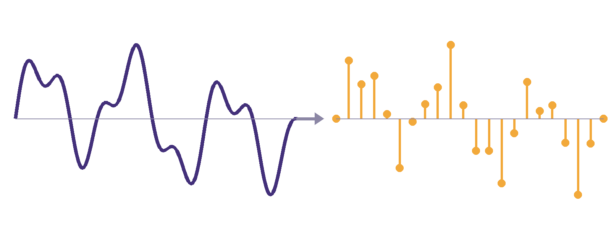
03 · SOUND BECOMES NUMBERS
From air to electricity to numbers
microphone
electricity
ADC
the sound wave hits it
the wave becomes a signal
measures it 44,100 times
every second
one smooth wave → 44,100 numbers every second
5
Notes:
How does a computer hear? The sound wave hits the microphone. It becomes an electrical signal. Then the ADC, the analog to digital converter, measures the signal 44,100 times every second. Each measurement is one number. A two-minute recording becomes about five million numbers.

Slide 6


03 · SOUND BECOMES NUMBERS
One channel, nothing lost
Mono
WAV file
one channel = one list of numbers.
One voice needs only one list.
keeps every number exactly as recorded.
Nothing deleted, nothing lost.
Why not MP3? MP3 deletes small details to save space — and the small details are exactly what we measure.
6
Notes:
Two small choices. Mono: one channel, one list of numbers. Enough for one voice. And WAV files. WAV keeps every number exactly as recorded. Why not MP3? MP3 deletes small details to save space. But the small details are exactly what we measure.

Slide 7

04 · THE DATA
Real voices, checked before use
37
21 / 16
73
~2 min
people
healthy / Parkinson's
recordings
each, on a phone
MDVR-KCL — a public research dataset from King's College London.
Everyone reads a text and has a free conversation — normal speech.
Checked before training: labels, speaker identity, no duplicates, no damaged files.
7
Notes:
Our data is called MDVR-KCL. A public research dataset from King's College London. Thirty-seven people. Twenty-one healthy, sixteen with Parkinson's. Seventy-three recordings, about two minutes each, on a phone. Everyone reads a text and has a conversation. Normal speech. And we checked every file before training.

Slide 8



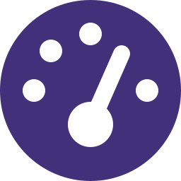

05 · GETTING READY
Five careful cleaning steps — and one refusal
mono
44.1 kHz
remove offset
trim silence
same loudness
one channel
same clock
for all
center the wave
edges only
fair comparison
We did NOT remove noise. Noise removal smooths away the small irregularities — and those irregularities are the medical evidence.
8
Notes:
Before measuring, five careful cleaning steps. One channel. One clock for all recordings. Center the wave. Trim the silence at the edges only. Same loudness for everyone. And one refusal: we did not remove noise. Noise removal smooths away the small irregularities. But those irregularities are the medical evidence.

Slide 9
06 · MEASURING
74 numbers — each answers a simple question
Is the pitch flat or lively?
pitch range
monotone speech is a classic sign
Is the vibration steady?
jitter & shimmer
shaky control makes it uneven
Is the voice clear or breathy?
noise ratio (HNR)
weak folds let air leak
Are there many pauses?
pause statistics
starting speech becomes harder
How fast does the mouth move?
spectrum (MFCC)
small slow movements blur letters
9
Notes:
From every recording we compute seventy-four numbers. Each answers a simple question. Is the pitch flat or lively? Is the vibration steady? Is the voice clear or breathy? Are there many pauses? How fast does the mouth move? Every number has a medical reason behind it.

Slide 10
07 · TEACHING THE COMPUTER
Training, testing — and one golden rule
TRAINING
TESTING
show many recordings WITH answers
→ the computer finds the pattern
new people, NO answers
→ can it still tell?
Golden rule: never test on a person the computer trained on.
A student who saw the exam questions proves nothing.
10
Notes:
How does the computer learn? Training: we show it many recordings with the answers. It finds the pattern. Testing: new people, no answers. Can it still tell? And one golden rule. Never test on a person the computer trained on. A student who saw the exam questions proves nothing. This rule is the heart of our project. The next slide shows why.

Slide 11
The most important slide in this project
Same data. Same model. Only the split changed.
0.909
0.775
the WRONG way: test on voices
the computer partly heard before
the HONEST way: test only on people
the computer never heard
The difference is memorising people, not detecting disease. This is why many published 95%+ results are not what they seem — our number is honest.
11
Notes:
This is the most important slide. Same data. Same model. Only the split changed. Tested the wrong way, on voices it partly heard before: 0.909. Looks amazing. [Click.] Tested the honest way, only on people it never heard: 0.775. The difference is memorising people. Not detecting disease. This is why many published 95 percent results are not what they seem. Our number is honest.

Slide 12

08 · OUR MODEL
A forest of 300 small decisions
Random Forest
300 small decision trees look at the 74 numbers — then they vote.
Why this model? we can ask it which numbers it used — explainable
Its favourite number? pitch range — the monotone sign doctors know
Four models competed under the same honest test — this one won.
12
Notes:
Our model is a Random Forest. Three hundred small decision trees look at the seventy-four numbers. Then they vote. Why this model? We can ask it which numbers it used. It is explainable. Its favourite number is pitch range. The monotone sign doctors already know. Four models competed. This one won.

Slide 13
09 · RESULTS
How good is it — in plain words
0.822
77%
87%
balanced accuracy
sensitivity
specificity
the fair overall score, on
people it never heard
of all true patients,
how many did we catch?
of all healthy people,
how many did we clear?
Why not plain accuracy? a lazy model that always says “healthy” scores 57.5% — and finds zero patients.
13
Notes:
How good is it? Balanced accuracy 0.822, on people it never heard. Sensitivity 77 percent: of all true patients, how many did we catch? Specificity 87 percent: of all healthy people, how many did we clear? Why not plain accuracy? A lazy model that always says healthy scores 57.5 percent and finds zero patients.

Slide 14
09 · RESULTS
Every recording, counted honestly
model says:
healthy
model says:
Parkinson's
really
healthy
36
6
Out of 73 recordings: 60 correct · 13 mistakes
Every screening tool makes mistakes.
Honest tools count them.
correct
false alarm
really
Parkinson's
7
24
missed
caught
14
Notes:
This table counts every recording. Thirty-six healthy correctly cleared. Six false alarms. Seven patients missed. Twenty-four caught. Out of 73 recordings, 60 correct and 13 mistakes. Every screening tool makes mistakes. Honest tools count them.

Slide 15
10 · THE HARD TEST
A different country, a frozen model
61 Italian speakers
different language, microphones, rooms — and the model was frozen: no re-training at all
AUC 0.701
given one patient and one healthy person, it still ranks the patient higher 70% of the time
it refused to guess
every elderly healthy speaker got “cannot tell” instead of a wrong confident answer
Knowing when to say “I don't know” is part of being honest.
15
Notes:
Then the hardest test. Sixty-one Italian speakers. Different language, microphones, rooms. And the model was frozen. No retraining. It still ranks a patient above a healthy person 70 percent of the time. And for every elderly healthy speaker, it said: cannot tell. It refused to guess. Knowing when to say I don't know is part of being honest.

Slide 16
Three things to remember
The voice carries a real, measurable signal of Parkinson's.
1
We tested honestly — only on people the computer never heard.
2
It is a screening helper, not a diagnosis — a doctor decides.
3
An honest 0.822 is worth more than an inflated number.
16
Notes:
Three things to remember. One: the voice carries a real, measurable signal. Two: we tested honestly. Only on people the computer never heard. Three: it is a screening helper, not a diagnosis. A doctor decides. An honest 0.822 is worth more than an inflated number.

Slide 17
Thank you
Questions are welcome.
Notes:
Thank you. I welcome your questions.

