Slide 1



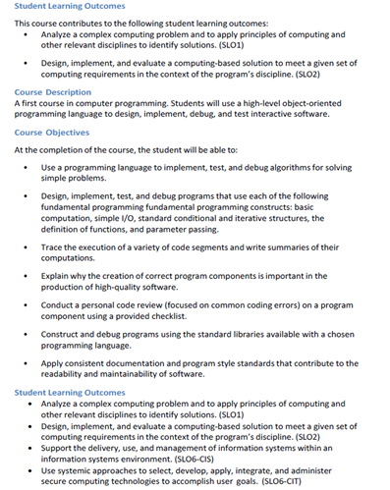
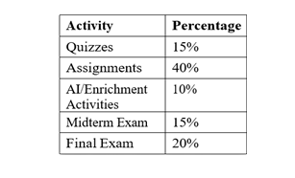
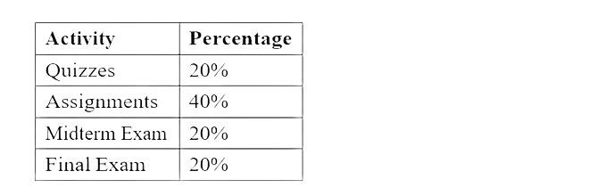






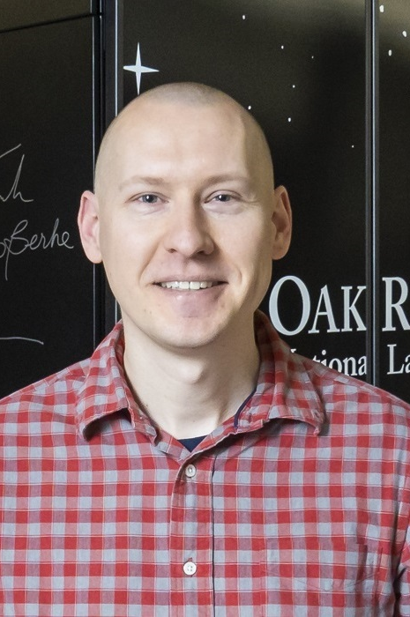







Java Concurrency in Practice" by Brian Goetz
Integrating HPC and AI Literacy into Introductory Java Programming w/Science Gateways
SGX3 is funded by the National Science Foundation under award number 2231406.
Introduction
Current Syllabus Snippet
Mentor Suggestions/Resources
This project enhances CSCI 1010/1011: Introduction to Programming I & Lab by incorporating High-Performance Computing (HPC) and Generative AI concepts into the first-year Java programming curriculum. Students will learn not only core programming skills but also how programs behave at scale, how parallelism is used in modern computing, and how Science Gateway resources make advanced computing accessible.
Consider Incorporating threads
Consider evaluating modules and textbooks for the course
Consider incorporating real-world examples to motivate HPC
Consider adding gateways that can be useful for teaching Java
Links
https://cvw.cac.cornell.edu/parallel/efficiency/scaling
https://www.olcf.ornl.gov/2024/02/29/planning-for-a-smooth-landing-on-mars/
Textbook Considerations
Java Concurrency in Practice (Brian Goetz)
The Art of Multiprocessor Programming (Herlihy & Shavit)
Target Course Description
Revised Syllabus Snippets
Course Name: | Introduction to Programming I
Course Number: | CSCI1010/CSCI1011
Department: | Computer Science and Information Technology
Anticipated Enrollment: | 35-40 freshman
Prerequisites: | None (Lab co-requisite)
Key Content: | Java programming fundamentals, loops, conditionals, arrays, methods, objects, debugging
Description: | A first course in computer programming, improved with activities introducing scalability, HPC, and AI literacy.
Project Repo: | [https://github.com/suhbrina-perry/FacultyHackHPC25]
Course Description Addition: In addition to programming fundamentals, students will gain early exposure to concepts of computational efficiency, scalability, and high-performance computing (HPC). Through hands-on labs and enrichment activities, students will explore how programs behave as input size increases, how parallelism can improve performance, and how supercomputing resources are applied to solve real-world problems
Course Objectives:
Recognize how computational problems scale with input size and system resources.
Demonstrate introductory knowledge of HPC concepts, including parallel execution and supercomputing applications
Grading Weights
SLOs Addition:
Explain the difference between sequential and parallel execution in a computing context.
Identify real-world applications of supercomputing and how programming fundamentals contribute to solving large-scale problems.
Current Grading Scale
Revised Grading Scale
Project Goals
Authors
Science Gateway Goal 1: Improve Intro to Programming with HPC Perspectives
Science Gateway Goal 2: Incorporate Generative AI for Learning Support
Science Gateway Goal 3: Introduce Parallelism Concepts
Science Gateway Goal 4: Connect to Science Gateways
Science Gateway Goal 5: Use classroom-friendly Gateway resources: Jetstream2, Cornell Virtual workshop, HPC Carpentry, or Zenodo to experience computing beyond the desktop.
Course-Level Expansions
References
HPC &Cloud Integration: Add a mini-Cloud Lab or Intro to Parallelism module using Jetstream2
AI Literacy: Introduce a Responsible AI lab where students analyze AI-generated code snippets for errors.
HPC Literacy Badge: Create a digital badge for completing modules.
Faculty Participant: Dr. Sabrina Perry
Austin Peay State University
perrys1@apsu.edu
Textbooks: Savitch, W. J. Java: An Introduction to Problem Solving and Programming. 10th ed., Pearson, 2022.Goetz, B. Java Concurrency in Practice. Addison-Wesley, 2006.Herlihy, M., & Shavit, N. The Art of Multiprocessor Programming. Morgan Kaufmann, 2020.
HPC & Science Gateways Resources:
Cornell Virtual Workshop (CVW): Roadmaps for Parallel Programming & Supercomputing.Cornell Center for Advanced Computing. https://cvw.cac.cornell.edu
HPC Carpentry: Introduction to High-Performance Computing Modules.https://hpc-carpentry.org Jetstream2 / ACCESS Cloud Computing Resource.Indiana University, 2023. https://jetstream-cloud.org Science Gateways Community Institute (SGX3).https://sciencegateways.org
Student-Level Expansions
Faculty Mentor: Dr. Izzat Alsmadi
Texas A&M University, San Antonio
ialsmadi@tamusa.edu
Undergraduate Research: Connect interested students to Science Gateways Research Projects.
AI/HPC Portfolio: Have students maintain a GitHub documenting AI-assisted code and reflections.
Faculty Mentor: Dr. John Holmen
Oak Ridge National Laboratory
holmenjk@ornl.gov
Event Site: https://hackhpc.github.io/facultyhack-gateways25

