Slide 1
B.TECH PROJECT • 2025–26
Blockchain-Federated Deep Neural Network
for Privacy-Preserving Healthcare Anomaly Detection
with Immutable Audit Trail
SUBMITTED BY
Mohd Suheb Siddique
Aman Chauhan
Roll No: 22SCSE1300012
Roll No: 22SCSE1300003
PROJECT GUIDE
Dr. Dhirendra Kumar Shukla
Professor, Department of Computer Science and Engineering
School of Computing Science and Engineering • Galgotias University, Greater Noida, India • June 2026

Slide 2
01 • PROJECT OVERVIEW
What is this project?
A privacy-preserving healthcare AI system where multiple hospitals collaboratively train a deep learning model for ECG anomaly detection — without ever sharing raw patient data — and every model update is recorded on a tamper-evident blockchain ledger.
THE PROBLEM
OUR SOLUTION
THE TRUST LAYER
Healthcare Data Silos
Federated Learning
Blockchain Audit Trail
Patient data (ECG signals) is sensitive & regulated. Centralizing it for AI training risks privacy breaches and violates HIPAA/GDPR.
Hospitals train a shared 1D-CNN model locally on their own data. Only model weights — never raw records — are exchanged with the aggregator.
Every client update and aggregation is hashed with SHA-256 and appended to an immutable ledger, ensuring full auditability and tamper-evidence.
The result: 99.24% accuracy, full privacy preservation, and 100 immutable audit log entries
BF-DNN | Galgotias University | 2 / 11

Slide 3
02 • OBJECTIVES
Project Objectives
Four guiding goals that shaped the design of BF-DNN.
01
High-Accuracy Detection
02
Privacy Preservation
Train a deep learning anomaly detector that matches centralized accuracy across multiple distributed clients.
Eliminate raw patient data sharing — keep all sensitive ECG records on the institution that owns them.
03
Tamper-Evident Audit
04
Quantified Trade-offs
Provide blockchain-style immutable logging with SHA-256 hashing for every model update and aggregation.
Measure communication overhead, training time, and accuracy gap vs centralized — prove practical viability.
BF-DNN | Galgotias University | 3 / 11

Slide 4
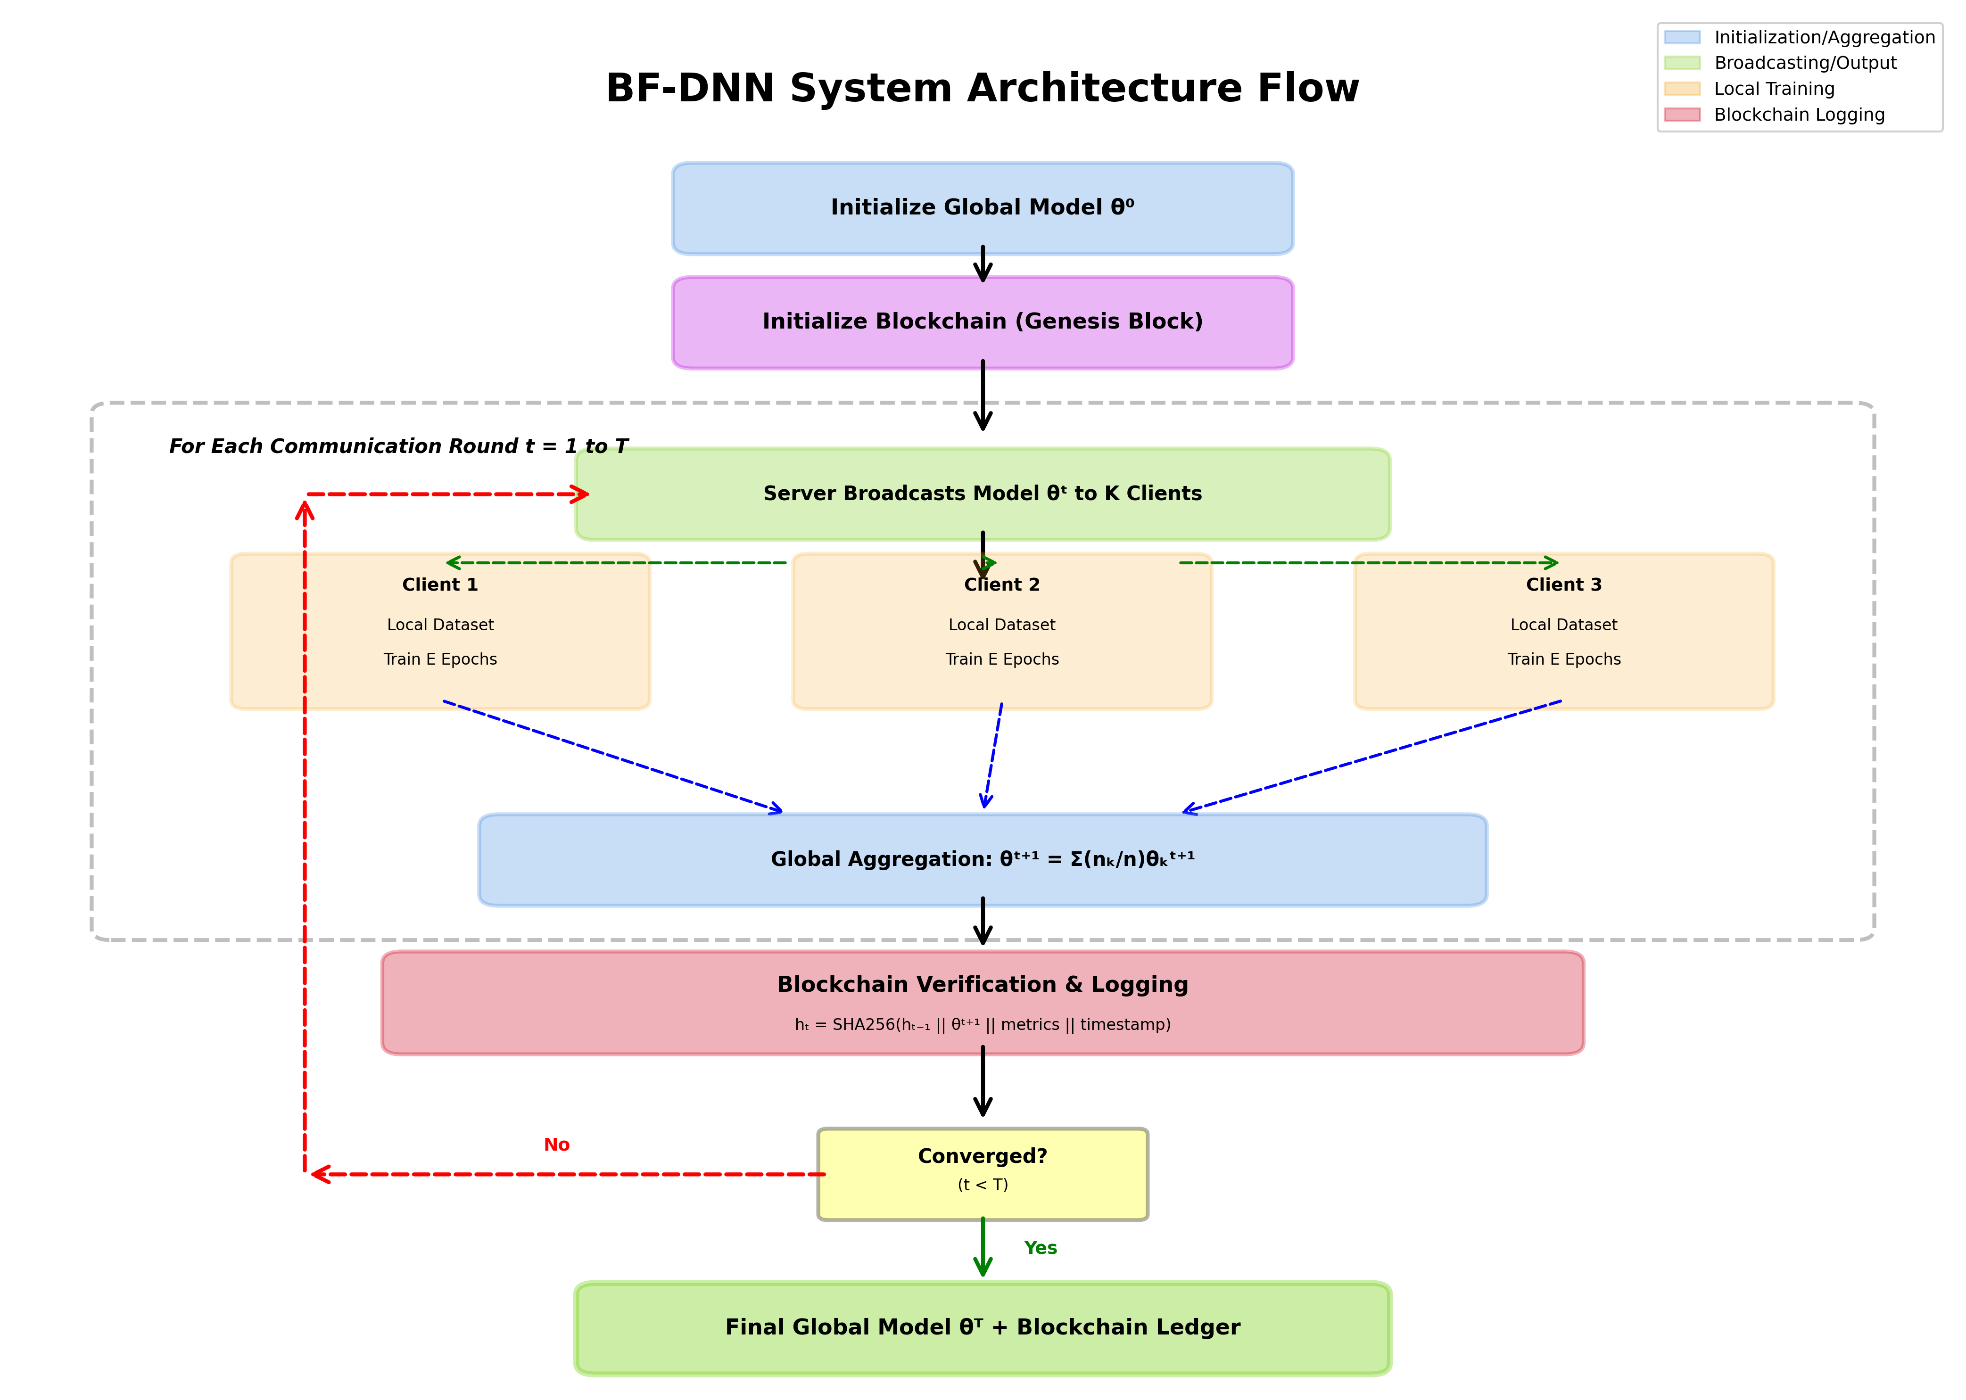
03 • SYSTEM WORKFLOW
How BF-DNN Works
THE 5-STEP CYCLE
1
Initialize
Global model θ⁰ + genesis block created
2
Broadcast
Server sends current weights to all K clients
3
Train Locally
Each hospital trains on its own data (E epochs)
4
Aggregate
FedAvg combines client updates into θ⁽ᵗ⁺¹⁾
5
Log on Chain
SHA-256 hash + timestamp appended to ledger
Repeats T = 5 rounds
BF-DNN | Galgotias University | 4 / 11

Slide 5
04 • METHODOLOGY
Methodology & Math
FEDERATED AVERAGING (FedAvg)
BLOCKCHAIN-STYLE LOGGING
Weighted aggregation of client updates
SHA-256 hash of every weight update
w^{(t+1)} = Σ ( n_{k} / N ) · w_{k}^{(t+1)}
hash^{(t)} = H ( w^{(t)} )
Each client's contribution is weighted by its number of training samples — larger hospitals carry proportionally more weight in the global model.
Each entry stores round, node, timestamp, sample count, and a 256-bit cryptographic fingerprint — creating tamper-evident provenance.
EXPERIMENTAL CONFIGURATION
K = 3
T = 5
E = 3
η = 0.001
Batch 32
SHA-256
Hospitals / Clients
Federated Rounds
Local Epochs
Learning Rate
Mini-batch Size
Hash Algorithm
BF-DNN | Galgotias University | 5 / 11

Slide 6
05 • MODEL & DATASET
Model Architecture & Dataset
1D-CNN ARCHITECTURE
DATASET
Built for time-series ECG signals
MIT-BIH
Arrhythmia Database
Input
Conv1D
Conv1D
Conv1D
Dense
Dense
Sigmoid
187 × 1
32 filters
64 filters
128 filters
128 units
64 units
Binary class
21,663
heartbeats distributed across 3 institutions
Three convolutional blocks extract waveform patterns; dense layers classify each heartbeat as normal or anomalous.
Standard cardiac arrhythmia benchmark
Binary task: Normal vs Anomaly
BatchNorm
Dropout 0.3
Adam
Sequence length: 187 time-steps
+ MaxPool
Regularization
Optimizer
Anomaly ratio: ~10% of test set
BF-DNN | Galgotias University | 6 / 11

Slide 7
06 • PROJECT PROGRESS
How far has the project come?
OVERALL COMPLETION
Aug 2025
✓
Literature Survey & Design
100%
Nov 2025
✓
Codebase Implementation
Nov 2025
✓
Blockchain Logger + SHA-256
Dec 2025
✓
Federated Training & Evaluation
All planned milestones completed
Dec 2025
✓
Comparison Study (vs Centralized & Baselines)
Implementation, evaluation, comparison study, paper communication, and report submission have all been finished.
Jan 2026
✓
Paper Acceptance — ICSDS-2025
Apr 2026
✓
Final Report & Submission
BF-DNN | Galgotias University | 7 / 11

Slide 8
07 • RESULTS
Key Performance Metrics
Final results from the BF-DNN experiment with K=3 clients over T=5 federated rounds.
99.24%
99.79%
98.50%
0.0321
Accuracy
Precision
Recall
Loss
Final test accuracy
Anomaly precision
True positive rate
Final binary CE loss
Convergence over Federated Rounds
BLOCKCHAIN AUDIT TRAIL
100
immutable log entries • 4 unique nodes • 5 rounds
SAMPLE BLOCK HASH
fe51cba13f385e87b08c2a9e9ab97f942e339b82…
BF-DNN | Galgotias University | 8 / 11

Slide 9
08 • BENCHMARK
How does BF-DNN compare?
Benchmarked against centralized training and standard federated/ML baselines.
Accuracy Comparison Across Methods
BF-DNN vs Centralized
BF-DNN matches centralized accuracy and outperforms all federated baselines.
Feature
BF-DNN
Centralized
Privacy preserved
✓
✗
Raw data shared
✗
✓
Audit trail
✓
✗
SHA-256 hashing
✓
✗
Tamper protection
✓
✗
HIPAA / GDPR fit
✓
✗
+0.19% accuracy with full privacy & audit
BF-DNN | Galgotias University | 9 / 11

Slide 10
09 • OUTCOME
Project Outcomes
What this project delivered, beyond just the code.
⚙
TECHNICAL
✓
PERFORMANCE
Working BF-DNN Prototype
99.24% Accuracy + 100 Logs
Complete federated training pipeline with 1D-CNN, FedAvg aggregation, SHA-256 logger, and reproducible experimental framework.
Matches centralized accuracy (+0.19%) while keeping all patient data local and producing a complete immutable audit trail.
★
RESEARCH
♥
IMPACT
Paper Accepted — ICSDS-2025
Privacy-First Healthcare AI
Paper ID 1068 accepted for presentation/publication at the International Conference on Sustainable Data Science.
Demonstrates that hospitals can collaborate on AI without surrendering data sovereignty — directly aligned with HIPAA & GDPR.
Future Work: Secure aggregation • Differential Privacy • Hyperledger / Ethereum deployment • Larger non-IID multi-site studies

Slide 11
Thank You
Questions & Discussion
Mohd Suheb Siddique • Aman Chauhan
22SCSE1300012 • 22SCSE1300003
Guided by Dr. Dhirendra Kumar Shukla
School of Computing Science and Engineering • Galgotias University
Paper accepted at ICSDS-2025 • Paper ID: 1068

