Slide 1
INTERNSHIP EXAM
Cognizant
Software Developer Engineering in Testing
Mohd Suheb Siddique
Admission No. 22SCSE1300012 | B.Tech CSE
Specialization: IoT, Blockchain & Cybersecurity
Galgotias University

Slide 2
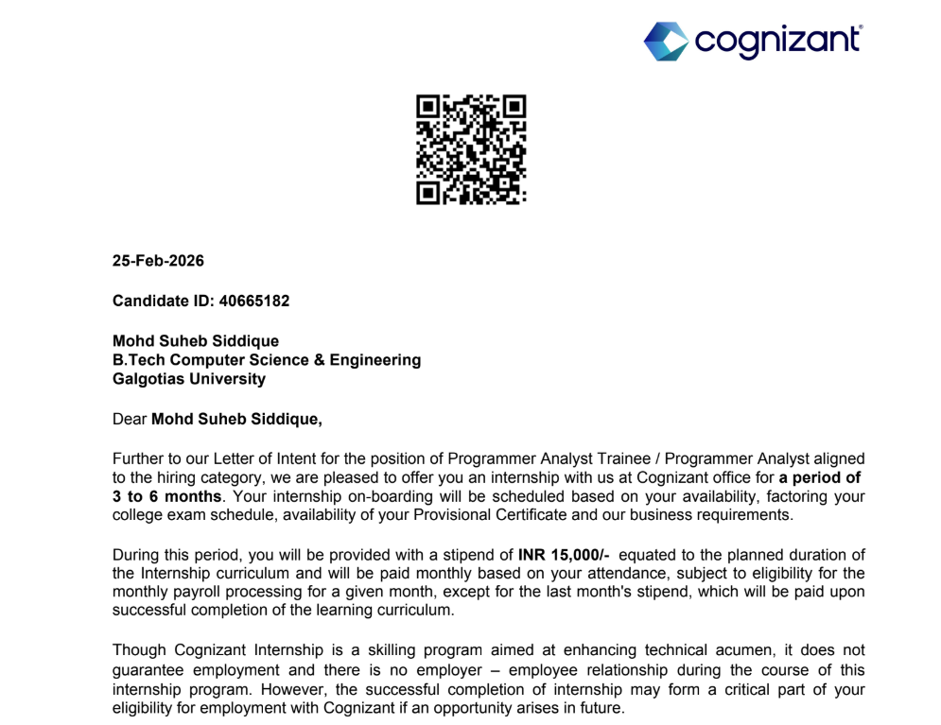
Offer Letter

Slide 3
The Internship Path
Five stages from onboarding to project completion
Stage 1 Behavioural Training
Stage 2 Testing Phases
Stage 3 Framework Development
Stage 4 Project Development
Stage 5 Final Test & Interview
01
02
03
04
05

Slide 4
STAGE 1
Behavioural Training
Self-Presentation
How to present yourself confidently in projects and team meetings
Team Collaboration
How to accept and value diverse opinions and viewpoints
Leadership & Ownership
How to lead and take strong ownership of your assigned work
P
T
L
✓ Stage 1 Assessment Completed

Slide 5
STAGE 2 – INTRODUCTION TO TESTING PHASES
Manual vs Automation Testing
STAGE 2
Aspect | Manual Testing | Automation Testing
Executor | Human tester runs tests step-by-step | Tools/scripts run tests programmatically
Speed | Slow; limited by human pace | Fast; runs many tests in parallel
Accuracy | Prone to human error & fatigue | Highly consistent and repeatable
Cost | Low setup, high long-term cost | High setup, low long-term cost
Best For | Exploratory, usability, UI/UX checks | Regression, load, repetitive tests
Coverage | Limited by time and resources | Broad coverage across devices/browsers

Slide 6
AUTOMATION TESTING DEEP DIVE
Test Automation Frameworks
A test automation framework is a structured set of guidelines, libraries, and tools that streamline the creation, execution, and maintenance of automated test scripts.
Linear
Record-and-playback. Simple, sequential scripts; quick to set up.
Modular
App split into reusable modules. Easier to maintain & scale.
Data-Driven
Test logic separated from data sources (Excel, CSV, database).
Keyword-Driven
Predefined keywords for actions. Low-code friendly for testers.
Hybrid
Combines data-driven + keyword-driven. Most popular in industry.
BDD
Behaviour-Driven. Tests in plain language using Gherkin syntax.

Slide 7
STAGE 3 – STARTS 25 MAY
Testing Framework Development
01
Hands-on Tooling
Selenium, TestNG, JUnit & Java for real automation projects
02
Build Frameworks
Design Hybrid frameworks combining data + keyword-driven approaches
03
Page Object Model
Industry-standard POM design pattern for maintainable test code
04
CI/CD Integration
Plug automated tests into Jenkins pipelines for continuous testing
Duration: 25 May – 15 June • Outcome: A working hybrid automation framework

Slide 8
INTERNSHIP TIMELINE
Stage Completion Dates
Behavioural Training
Framework Development
Final Test & Interview
9 March
1 June
10 July
1
2
3
4
5
1 May
25 June
Testing Phases
Project Development

Slide 9
Thank You
Mohd Suheb Siddique
Programmer Analyst Trainee | Cognizant

