Slide 1



AMAZON SALES DASHBOARD
Internship Task 3 - Sheik Mohammed Suhel | Data Analytics Internship

Slide 2


OBJECTIVE
To analyze product-level Amazon sales data
Design an interactive dashboard using Power BI
Enable business insights through visual KPIs
$ 758K

Slide 3


DATASET OVERVIEW
1,465 records with columns like:
product_name, category, discounted_price, rating, rating_count, etc.
Sourced from Kaggle (Amazon Sales Reviews Dataset)
Cleaned in Excel: removed ₹, %, commas, and invalid entries
Final file: amazon_cleaned.xlsx

Slide 4

KPIs Tracked
Total Sales (Card)
Total Profit Estimate (Card with DAX)
Top 5 Products by Sales (Bar Chart)
Sales by Category (Donut Chart)
Sales vs Rating (Scatter Plot)
Slicers: Category, Rating, Discount %
Success Rate
Key Performance Indicators (KPIs)

Slide 5
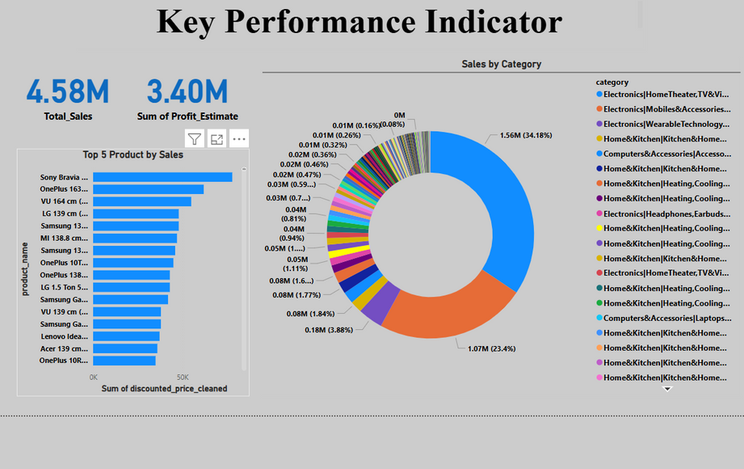
Dashboard Screenshots
Total Sales (Card)
Total Profit Estimate (Card with DAX)
Top 5 Products by Sales (Bar Chart)
Sales by Category (Donut Chart)
4.8M
3.40M
Total Sales
Total Profits

Slide 6

Insights Derived
Business Insights
Accessories category dominated total sales
Products with higher discounts had higher ratings
Estimated profit reveals margin gaps on some items
Top-rated products often had higher rating_count

Slide 7
Hands-on experience with real-world dataset cleaning
Designed insightful and stakeholder-ready dashboard
Understood KPI selection and visual storytelling
Tools & Learnings
Tool 01
Tool 02
Tool 03
Microsoft Excel (Cleaning)
Power BI power query (cleaning)
Power BI (Dashboarding)
GitHub (Submission)

Slide 8
THANK YOU
For Your Attention

