Slide 1
Coursera Capstone – The Battles of Neighborhoods

Slide 2
Introduction
Toronto is the capital city of the Canadian province of Ontario.
With a recorded population of 2,731,571 in 2016, it is the most populous city in Canada and the fourth most populous city in North America.

Slide 3
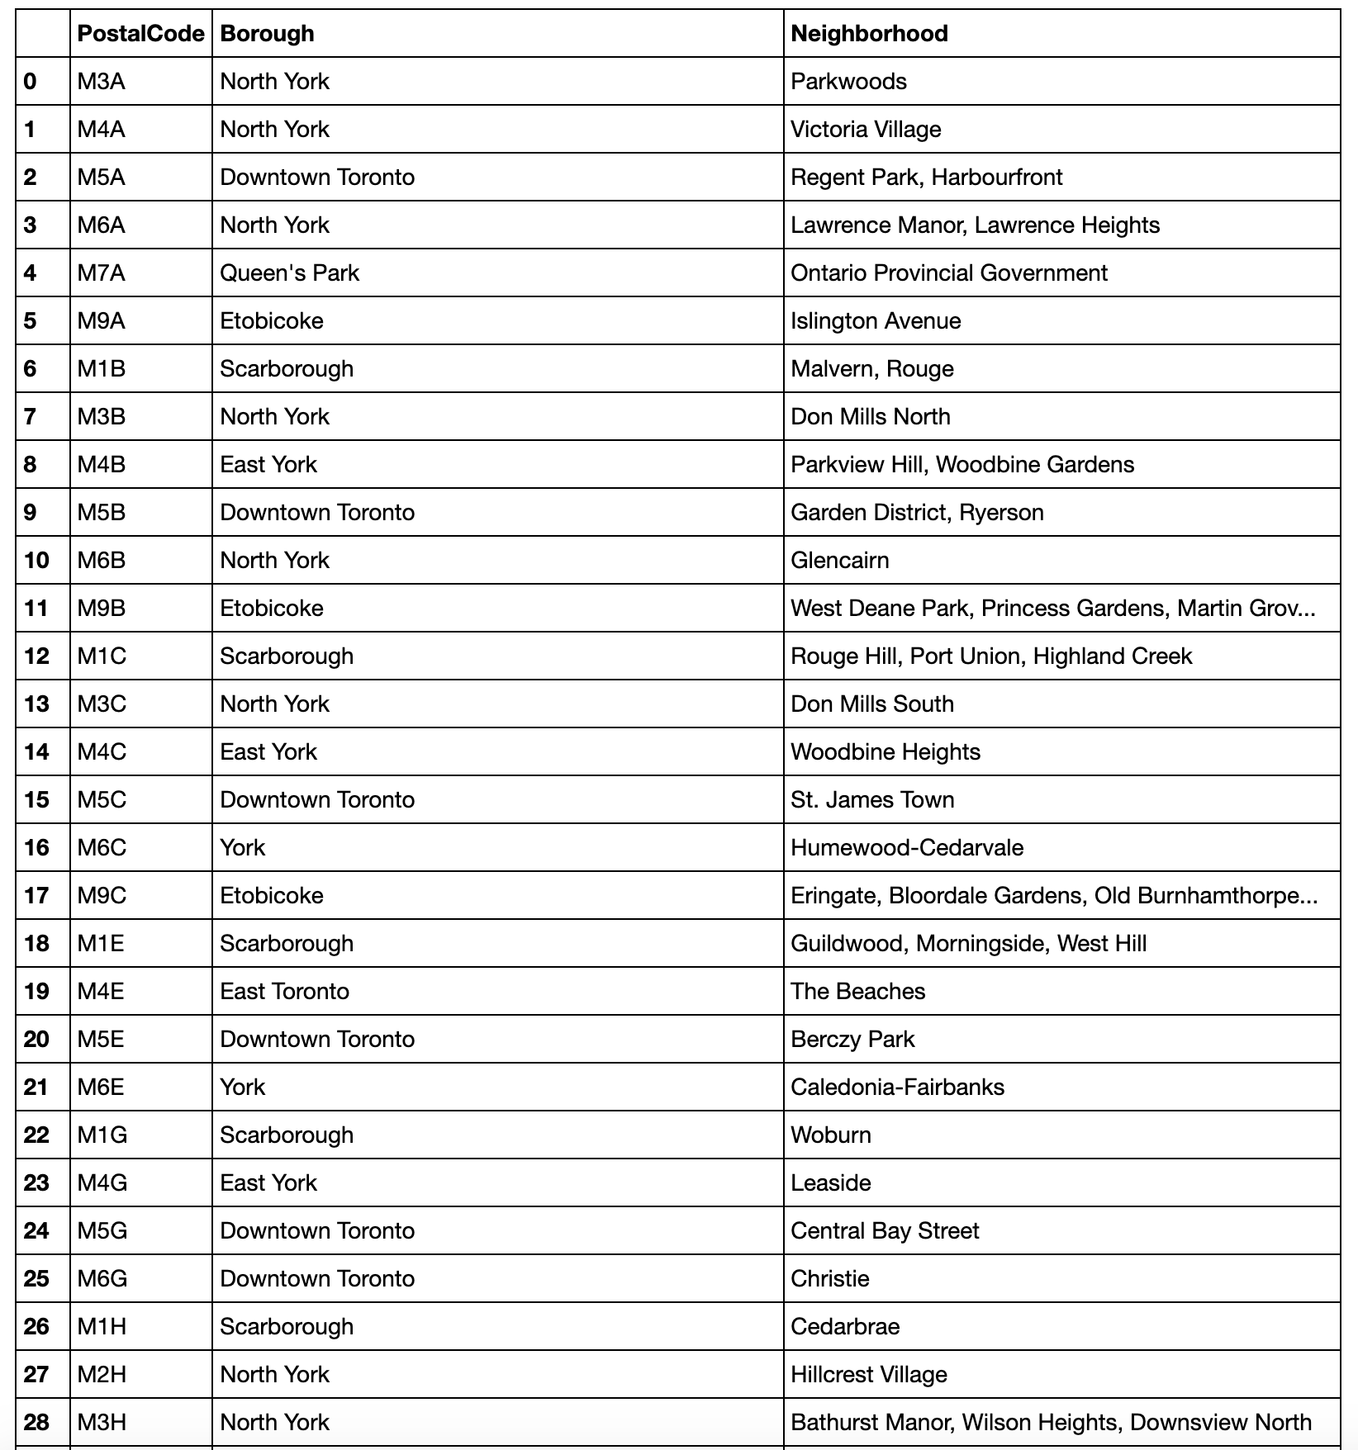
The Neighborhoods in Toronto

Slide 4
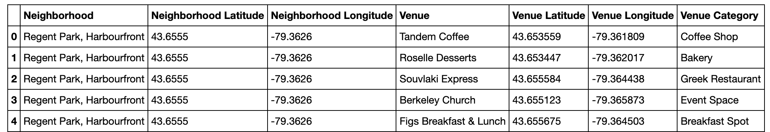
Add Venue Category

Slide 5
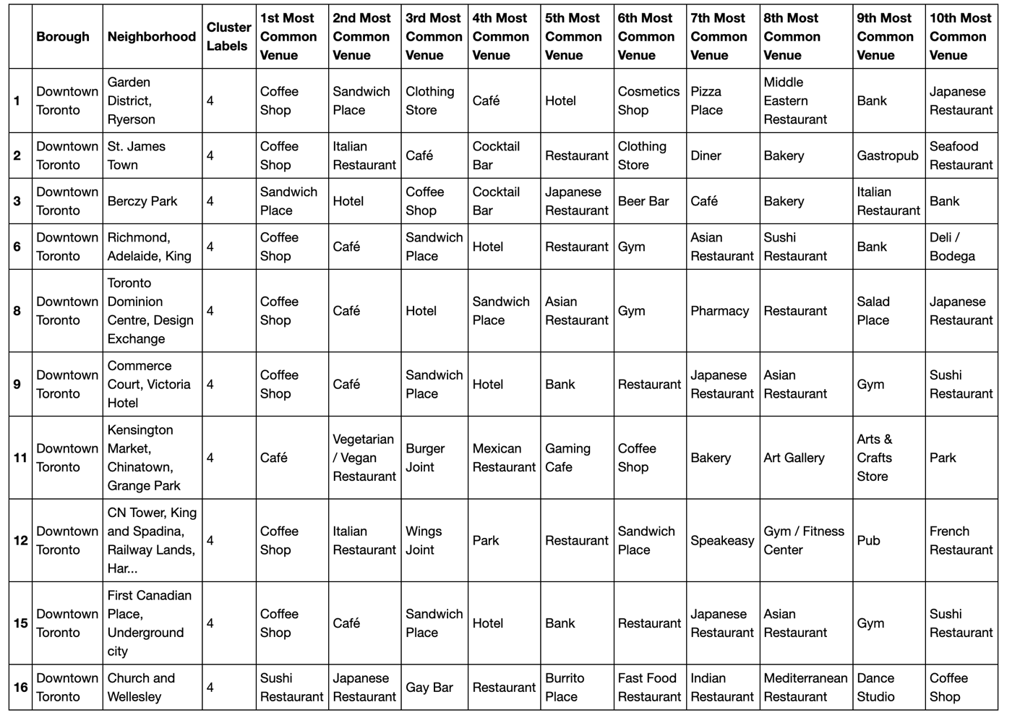
Explore

