Slide 1
Hordhac
Inta badan faallooyinka aan diiradda saarnay ee qaldan waa sawirrada aan hoos kusoo bandhignay
gaar ahaan midabbada (colors) iyo astaamaha (icons) oo si qaldan loo adeegsaday mid walbanna
si gaar ah ayaan ugu xusnay. maadaama aan u soo bandhigayno bulsho kala duwan, waxa aan
bulshada la wadaageyno waa inay noqdaan kuwo si xirfad leh loo habeeyey. Sidaa darteed waxaan
rajaynayaa inaad si degdeg ah uga jawaabtaan faallooyinkan muhiimka ah.

Slide 2

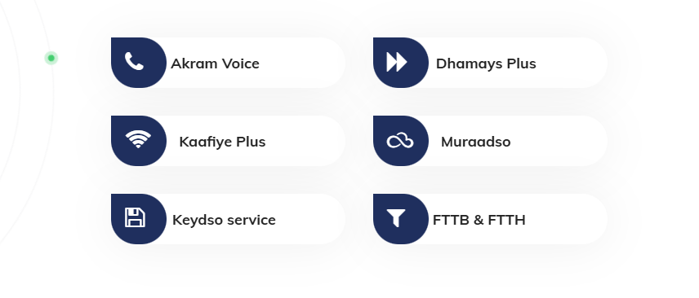
1- Labdan sawir waxaa ka qaldan icons-ka la adeegsaday.

Slide 3

2 – Sawirkaan waxaa kaqaldan colorka jaalaha waa hal-xabo wan ognahay way isbadbadalayaan laakin waxaan rabnaa haddii ay isbadalayan xate in uusan blue-dark kaliya noqon jaalaha iyo cadaanka iyagana loo kala qeybiyo.

Slide 4

3 – sawirkaan waxaa kaqaldan dhowr page oo kamid ah in aysan isku mid ahayn colors-ka oo cadaanka in dhexda lageliyo blue-darka geeska midig jaalahana bidixdiisa lagu daayo.

Slide 5
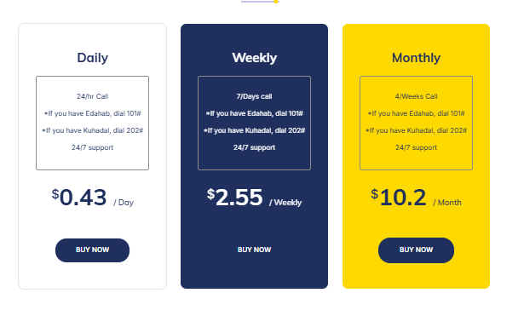
4 - Kanna waa lamid commentiga sedaxaad ayuu lamid yahay xagga color-ka.

Slide 6
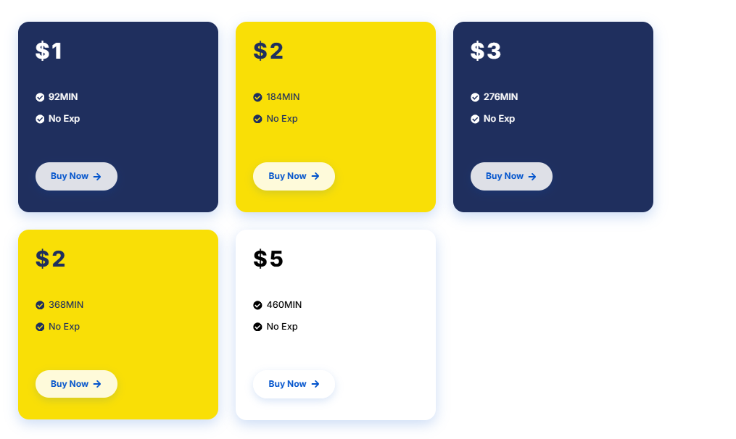
5 - sawirka kore in lagu badelo kan hoose oo in laga dhigo saf coloradana aan sidaas kadhigno dhexda caddaan ugu jirto inta Kalena sidaas noqdaan.

Slide 7

6- Sawirkaan in lawayneeyo sababtoo ah space wayn ayaa banaan.

Slide 8
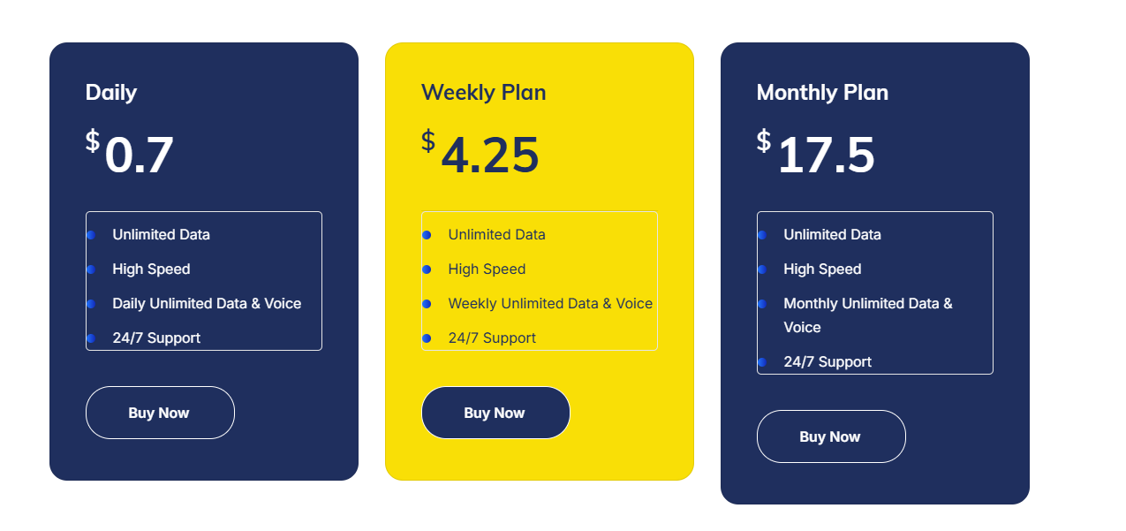
7- In laga dhigo
Unlimitted Data & voice Daily/ weekly / monthly
High Speed
Nashaad IPTV . Sidoo kale in laga saaro 24/7 support gabigiisaba.

Slide 9
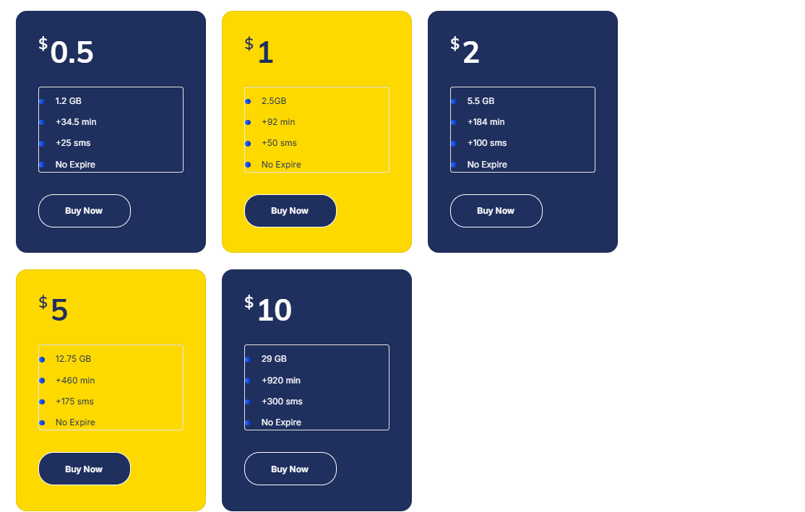
8 – In laga dhigo One line

Slide 10

9 – Sawirkaan colors-ka in laga baddelo jaalaha iyo cadaanka iyo blue-dark loo kala qeybiyo.

Slide 11
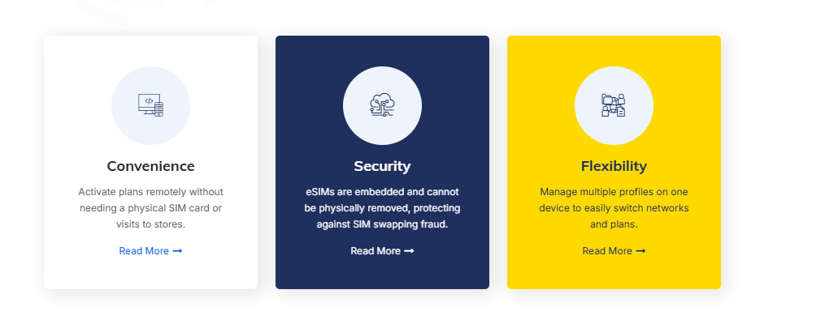

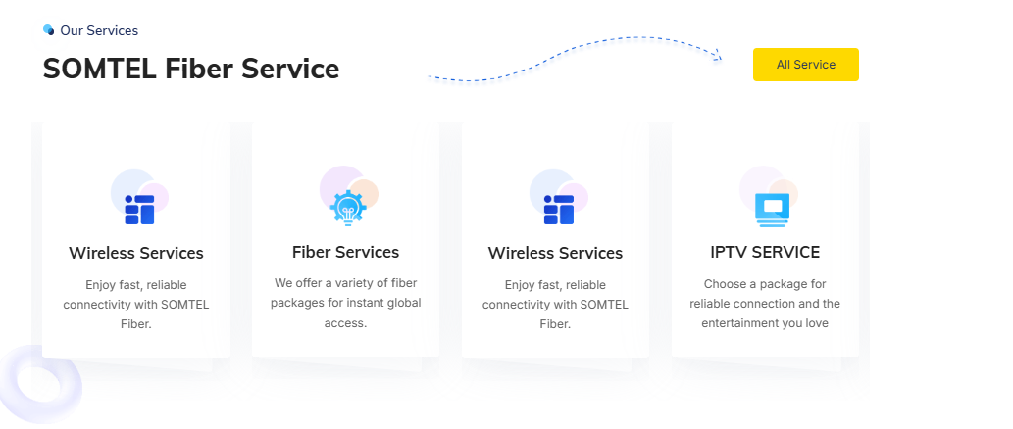
10 – sawirka kore in colorka cadaan-ka ah dhexda lageliyo sawirka xiga iyo kan hoosenna loosameyo colorska midka kore okale iskudhafan.

Slide 12
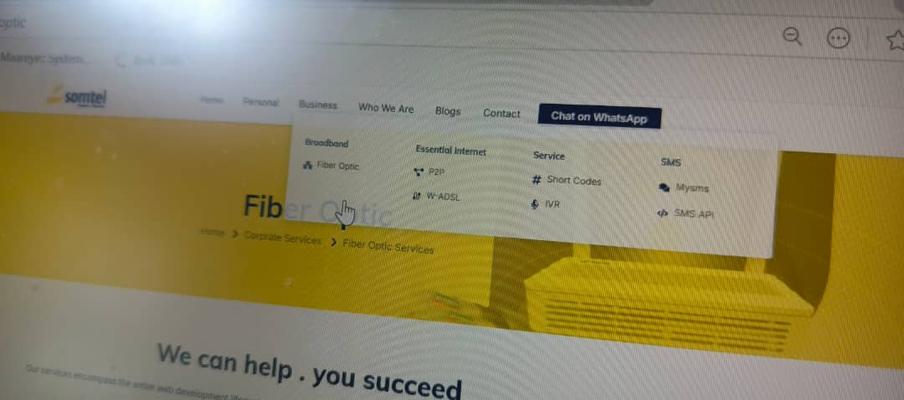
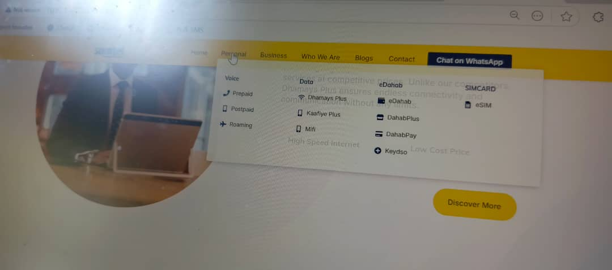
11 – labadan sawir iyaganna sido kale icons-ka ay leeyihiin adeegyada in loo sameeyo.

Slide 13

12 - icons-ka vision iyo mission ee aad isticmasheen isagana wuu qaldan yahay in aad badeshan midka saxda ah aad kusoo badeshaan.

Slide 14
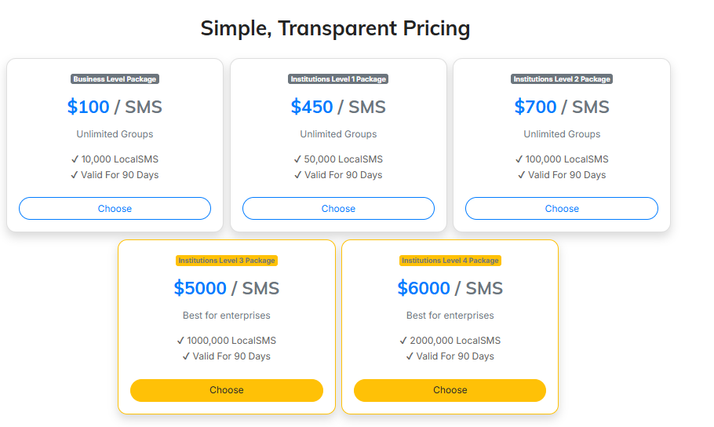

13 - labadan sawir iyagana loosameeyo colorska iskudhafan ee cadaanka iyo jaallaha iyo blue-dark.

Slide 15

14 – Sawir-kaan isagana sido kale in loosameeyo colorska iskudhafan ee cadaanka iyo jaallaha iyo blue-dark.

Slide 16
Mahadsanidiin

