Slide 1
A Startup Company
Test Strategy

Slide 2
Agenda
Brief about Company
QA Mission and Vision
Test Strategy
References

Slide 3
Brief about Company
The company is an end-to-end services provider platform.
Company located in Berlin.

Slide 4
Brief about Company cont.
Roles:
Product Owner
SDET (QA)
Developers
Team leaders
Methodology: Scrum
ALM tool: JIRA
Technology:
Backend: PHP, SQL, Microservices
Frontend: Reactjs, Android, Swift
Testing: JS/Nodejs, Java
CI Server: Jenkins
SCM: Github

Slide 5
QA Mission
Our mission is to work together as a cross functional team to develop and deliver high quality products.
We do that by applying lean software development principles and practices such as fault-proofing and Zero Quality Control.

Slide 6
QA Vision
To become an industry leader in Software QA
To provide innovative services by building the best QA practices across technology domains

Slide 7

Test Strategy

Slide 8
People
Product Owner: - Involved with QA in writing/reviewing feature files during sprint planning and backlog grooming.
- Maintains Product Backlog. - Attending Sprint planning. - Walkthrough delivered product on either blue-green environment. - Attend and actively participate retrospectives. - Share continuous feedback on products in sprint retro and sprint review meetings.
Scrum Master: - Facilitate sprint events. - Enforce company culture. - Teach and enforce Scrum. - Teach and enforce Agile practices such as TDD and BDD. - Actively participate in Scrum events. - Handle impediments. - Protect the team during sprints (to prevent long working hours and team fatigue).

Slide 9

People
Dev team (Developers, SDETs)
Take part in writing features files during sprint planning and backlog grooming with PO.
Size stories.
Decide the sprint’s backlog based on their velocity and based on PO priorities.
Develop stories TDD, BDD mode based on user stories and feature files.
Solve defects reported on JIRA and/or MS teams.
Attend and actively participate in sprint reviews and retros.
Take part in dailies with SM and PO.

Slide 10
People
SDETs
Automate E2E tests using feature files
Automate performance and security tests from User Stories
Automate E2E mobile tests
Implement tests in BDD and TDD mode.
Developers
Write unit and integration test in TDD mode.
Develop production code as per feature files and user stories.

Slide 11
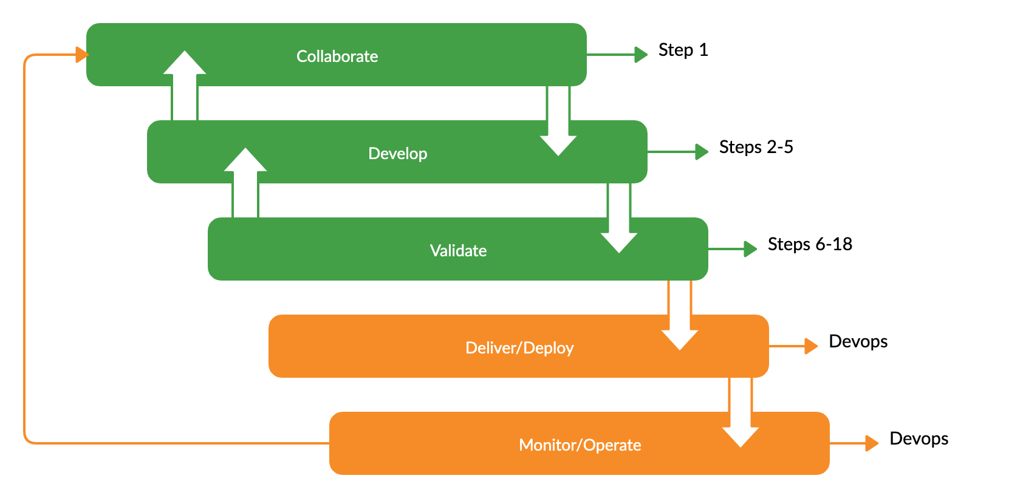
Process

Slide 12
Working Contract
Development process will be based on Agile and lean methodologies/practices. Main Agile methodology will be Scrum. Main Agile/lean practices will be BDD and TDD. Test- first approaches will be applied mainly.
During feature file writing, the following techniques must be applied by all team members
Requirements elicitation techniques (such as surveys, interviews, etc.) with PO.
Test analysis techniques for deriving scenarios and step definitions (such as test conditions).
Black box test design techniques for deriving scenarios, step definitions and examples.

Slide 13
Working Contract
Once feature files are written, story will be considered ready for development.
Feature files will be used by:
SDETs to automate web E2E tests in TDD mode.
SDETs to automate mobile E2E tests in TDD mode.
SDETs will also automate performance and security tests.
Developers to automate Frontend tests and API tests.
Developers will write unit/integration tests for their components in TDD mode.
When coding is done and code is pushed to GitHub.
Code is reviewed by peer review or by technical team leader.
If everything is ok, TL approves push to staging branch.

Slide 14
Working Contract
CI server pulls code and executes the following sequence:
Compile.
Run static code analysis After running static code analysis, report is reviewed by TL. Any issues are reported on JIRA and fixed.
Run unit/integration tests.
Any issues that arise should be automatically reported on MS teams, email and JIRA as a bug.
If unit/integration tests are successful, build should be promoted to API testing.
API tests are executed in a run by a separate job on CI server.
Any issues that arise should be automatically reported on email and JIRA as a bug.
If successfully, build should be promoted to E2E testing
E2E tests are executed in a run by separate job on CI server.

Slide 15
Working Contract
Any issues that arise from E2E tests should be automatically reported on email and JIRA as a bug.
If successfully, non functional tests should run.
Any issues that arise from non functional tests should be automatically reported on email and JIRA as a bug.
If successful, then build is ready to be deployed to blue-environment.
Smoke/Sanity test automation suite should run against blue-environment, along with any necessary exploratory testing by PO and SDET.
If successful, a notification will be sent by CI server to DevOps team to convert blue version to green version and keep a copy of green version as blue version for any hotfixes.

Slide 16
Tools
Tool | Test Level | Test Type
Junit | Backend Unit test | Unit/Functional test
Mockito | Backend Unit test | Unit/Functional test
MockMvc | Backend Integration test | API test
TestCafe | Frontend Integration test | UI test
JEST/Enzyme | Frontend Unit test | Unit/Functional test
Appium/ Espresso | Mobile Frontend Integration test | E2E/Functional test
CucumberJs | System/UAT test | E2E/Functional test
Jmeter | Integration | Load testing
Zap | System test | Security test

Slide 17
Other tools
Static Code Analysis: SonarQube and ESLint
ALM : JIRA
CI : Jenkins
SCM: GitHub

Slide 18
Testing Environment
Machine for running cucumberJS E2E tests.
Mobile devices to run E2E Appium tests.
Machine for running security tests.
Machine for running performance tests.
Machine for system under test - Staging environment.
Blue environment on production for smoke/sanity tests.

Slide 19

References
Agile Manifesto
Scrum Guide Book from Scrum Alliance
Subway Map to Agile Practices from Agile Alliance
User Stories Applied book by Mike Cohn
BDD in Action book
Test Driven Development by Example by Kent Beck
Extreme Programming Explained: Embrace change book by Kent Beck
Lean Software Development book
Zero Quality Control: Source Inspection and the Poka-Yoke System by Shigeo Shingo
Software Testing Foundations book
The Business Analysts Handbook by Howard Podeswa.

