Slide 1

Sinhgad Institute of Technology & Science, Pune
Department of Electronics &Telecommunication Engineering
1
B.E. PROJECT
Presented by
Name of Student | Roll No.
Mr. Nitin Khanka Mr. Mohit Jangid Mr. Surajpratapsingh Sayar Ms. Suhita Vaidya | A-4401052 A-4401043 B-4402040 B-4402038
Under Guidance of Prof. Mahesh Deshpande | Project Coordinator Prof. Tanisha Londhe | Head of Department Dr.V.M.Rohokale
Sinhgad Institute of Technology & Science, Narhe
Department of Electronics & Telecommunication Engg.
Notes:
1
1

Slide 2
Title Of The Project
Sinhgad Institute of Technology & Science, Pune
Department of Electronics &Telecommunication Engineering
2
PV system fault detection using
AI/ML
Notes:
2
2

Slide 3
Outline of Presentation
Sinhgad Institute of Technology & Science, Pune
Department of Electronics &Telecommunication Engineering
3
Title of the Project
Problem statement
Objectives & associated activities
Literature Review
The budget of project
Proposed Block Diagrams
Results
References
Notes:
3
3

Slide 4
PROBLEM STATEMENT
Sinhgad Institute of Technology & Science, Pune
Department of Electronics &Telecommunication Engineering
4
PV systems are subject to various faults and failures, and early fault detection of those faults and failures is very important for the efficiency and safety of the PV systems
Notes:
4
4

Slide 5
MOTIVATION
India stands third in Asia and fourth in the world in terms of solar power production across its plants. This currently accounts for about 38% of its total capacity of renewable energy.
Claimed to be the largest solar power plant in the world, the Bhadla Solar Park is located in Bhadla village, in Rajasthan’s Jodhpur district. Spanning 14,000 acres, the fully operational power plant has been installed with a capacity of nearly 2,250 megawatts (MW). Such projects on this large scale require a smart and scientific approach to handle the faulty problems arriving at minute scale that can turn out difficult to detect and identify and hence, the main reason for our topic of project.

Slide 6
OBJECTIVES
Sinhgad Institute of Technology & Science, Pune
Department of Electronics &Telecommunication Engineering
6
To analyze data and predict electrical faults
To identify and classify fault types
To improve maximum efficiency Power Point Tracking (MPPT) as well as power productivity of SPP.
Notes:
6
6

Slide 7
ASSOCIATED ACTIVITIES
Sinhgad Institute of Technology & Science, Pune
Department of Electronics &Telecommunication Engineering
7
To design circuit network for data Acquisition
Activity 1.1:- Design of data acquisition Circuit
Activity 1.2:- Selection of components for the circuit
Activity 1.3:- Assembly of Circuit
Activity 1.4:- Programming for collecting and transmission of raw data
Notes:
7
7

Slide 8
ASSOCIATED ACTIVITIES
Sinhgad Institute of Technology & Science, Pune
Department of Electronics &Telecommunication Engineering
8
Selection of requisite Cloud server
Activity 2.1:- Deciding server platform
Activity 2.2:- Developing interface
Activity 2.3:- Programming
Developing a model for pre-processing data
Activity 3.1:- Removing of unwanted observations
Activity 3.2:- Fixing structural errors
Activity 3.3:- Managing unwanted outliers
Activity 3.4:- Handling Missing data
Notes:
8
8

Slide 9
ASSOCIATED ACTIVITIES
Sinhgad Institute of Technology & Science, Pune
Department of Electronics &Telecommunication Engineering
9
Subjecting the data to Model
Activity 4.1:- Loading the parameters in various models
Activity 4.2:- Finding the model with the highest performance matrix
Notes:
9
9

Slide 10
LITERATURE REVIEW
Sinhgad Institute of Technology & Science, Pune
Department of Electronics &Telecommunication Engineering
10
Sr.no. | Paper Title | Author’s name | Methodology | Relevance
1. | Detection and Prediction of Faults in Photovoltaic Arrays: A Review | Kais AbdulMawjood; Shady S. Refaat; Walid G. Morsi | The solar industry has rapidly grown over the past several years and photovoltaic (PV) systems in particular have significantly expanded. Detection and prediction of various faults in the PV system is a key factor to increase the efficiency, reliability, and lifetime of the PV system. In previous studies, several techniques of fault detection were presented. These detection methods depend on sensing different faults at different locations of the PV system. Some solutions identify the faults on the DC side, while others detect faults on the AC side of the system | This paper describes and explains all the types of faults that a PV array can encounter in its functioning. One has to know the faults first in order to detect, predict and rectify them in a proper way, with that point in mind this paper is explains and classifies the faults in an easy way.
Notes:
10
10

Slide 11
Sinhgad Institute of Technology & Science, Pune
Department of Electronics &Telecommunication Engineering
11
2. | Identifying PV module mismatch faults by a thermography-based temperature distribution analysis | Yihua Hu; Wenping Cao; Jien Ma; Stephen J. Finney; David Li | When developing a parameter-based PV model, the electrical and thermal characteristics of the PV module should be included as they play an important role in the overall performance of PV systems. Fortunately, the electrical and thermal characteristics are interlinked through an energy balance that all receiving solar energy must be converted into electrical or heat energy. The electrical characteristic of a PV cell is influenced by both illumination and environmental temperature. | Mismatch faults reduce the power output and cause potential damage to PV cells. This paper defines three fault categories in terms of fault levels, which lead to different terminal characteristics of the PV module.
Notes:
11
11

Slide 12
Sinhgad Institute of Technology & Science, Pune
Department of Electronics &Telecommunication Engineering
12
Sr.no. | Paper Title | Author’s name | Methodology | Relevance
3. | Solar Array Fault Detection using Neural Networks | Sunil Rao, Andreas Spanias and Cihan Tepedelenlioglu | Work is subdivided into 3 stages In the first step, we will discuss the operating principle of a photovoltaic panel, its mathematical modeling and its characteristics. The second step will represent a study and analyze the healthy state and in the presence of four defects in a photovoltaic string. In fourth step, we present the diagnosis of the photovoltaic system, applying the method of artificial neural networks (ANN). | While using unsupervised machine learning algorithms, a fault could be detected but not identified and unsupervised algorithms could not classify the type of fault. Neural networks allows not only detection but also identification or classification of the fault type with a high accuracy.
Notes:
12
12

Slide 13
Sinhgad Institute of Technology & Science, Pune
Department of Electronics &Telecommunication Engineering
13
Sr.no. | Paper Title | Author’s name | Methodology | Relevance
4. | Experimental studies of failure detection methods in PV module strings | Takumi Takashima; Junji Yamaguchi; Kenji Otani; Kazuhiko Kato | In TDR method, the inputted signal into transmission line and the reflected signal caused by the impedance mismatches in the line are compared. The signal delay and the change of waveform are translated into the failure position in the line and the type of failure. In this research, PV module string is regarded as the transmission line on which PV cells and other devices are distributed. If some impedance mismatches exist on the PV transmission line, the position and type of the mismatch will be identified by TDR. Function Generator used for producing the signal. The graph for the detection of fault and location can be done using the graph of V vs T. The waveforms were observed by an oscilloscope. | This paper tells us the application of TDR in a PV Module String.
Notes:
13
13

Slide 14
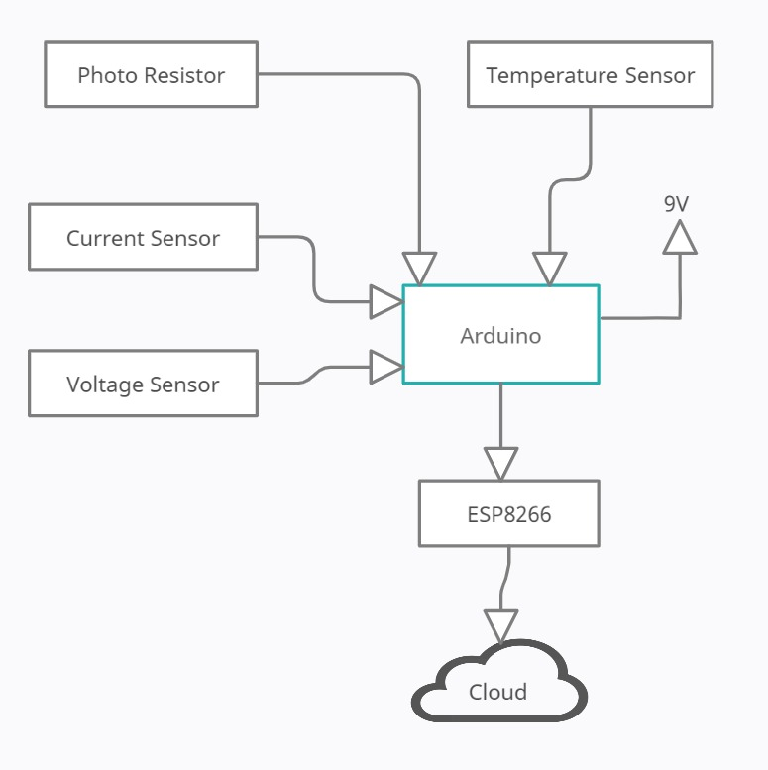
Proposed Hardware Block Diagram
Sinhgad Institute of Technology & Science, Pune
Department of Electronics &Telecommunication Engineering
14
Notes:
14
14

Slide 15
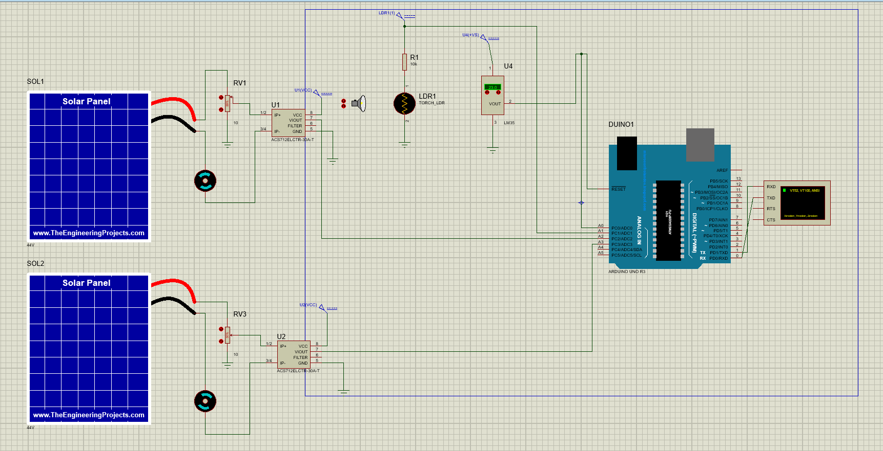

Slide 16
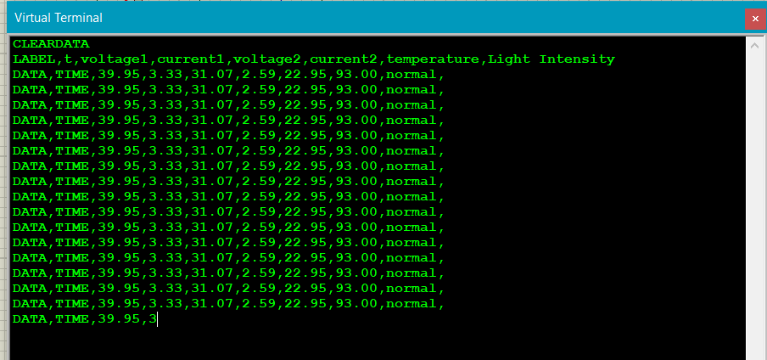

Slide 17
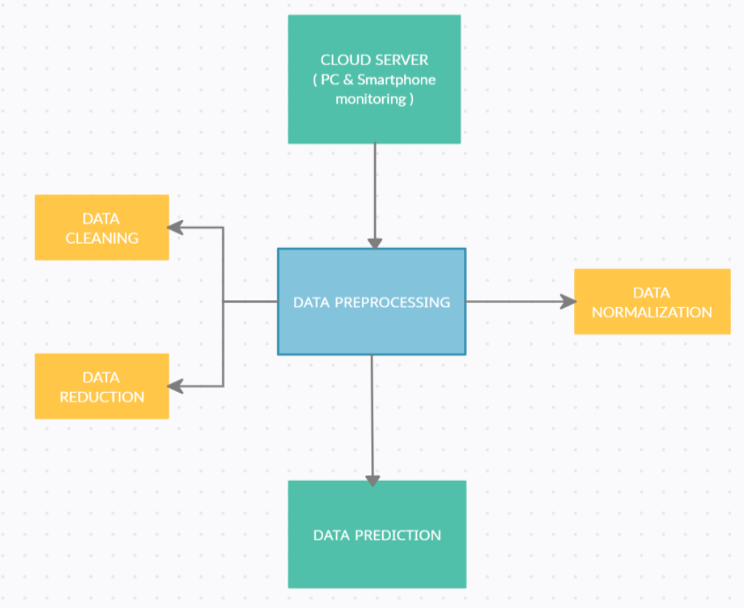
Proposed software Block diagram

Slide 18
Hardware Platform
Sinhgad Institute of Technology & Science, Pune
Department of Electronics &Telecommunication Engineering
18
Arduino
NodeMCU
Solar Panel
Battery
Sensors
Software Platform
Arduino IDE
Proteus
Jupyter Notebook
Notes:
18
18

Slide 19

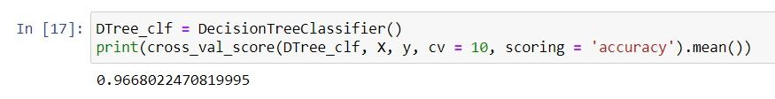
Accuracy among models with cv=10
Random Forest Classifier
Decision Tree

Slide 20
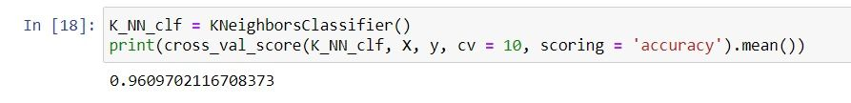
KNN

Slide 21
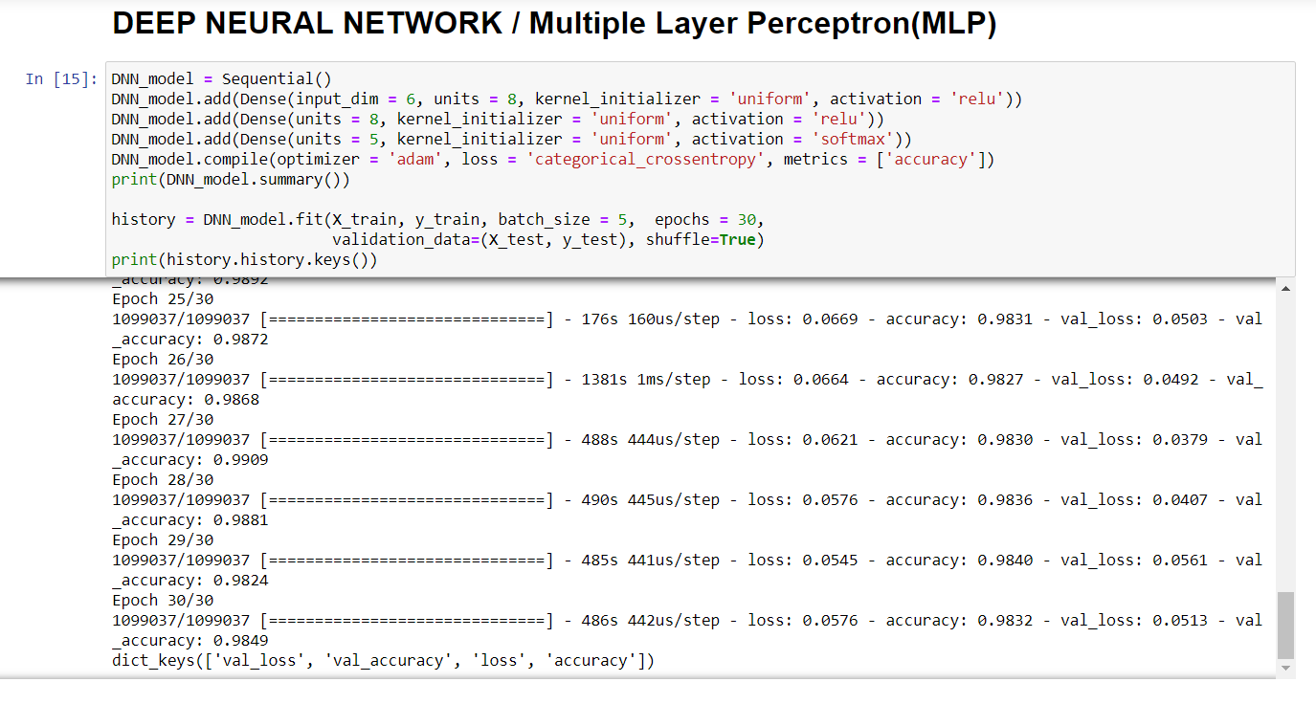

Slide 22
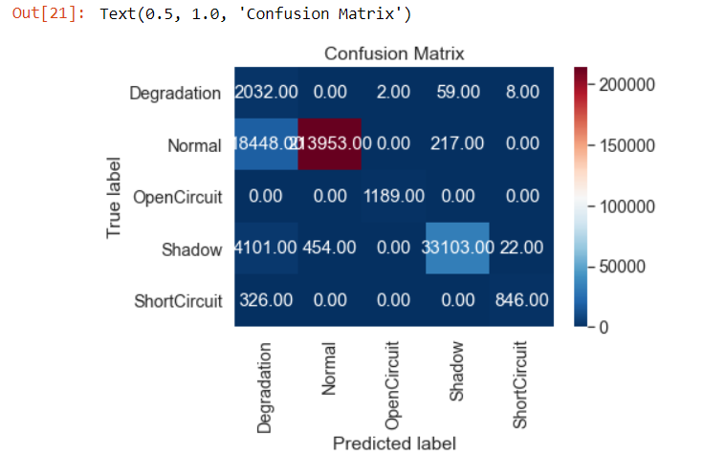
Confusion Matrix of True Label vs Predicted Label

Slide 23
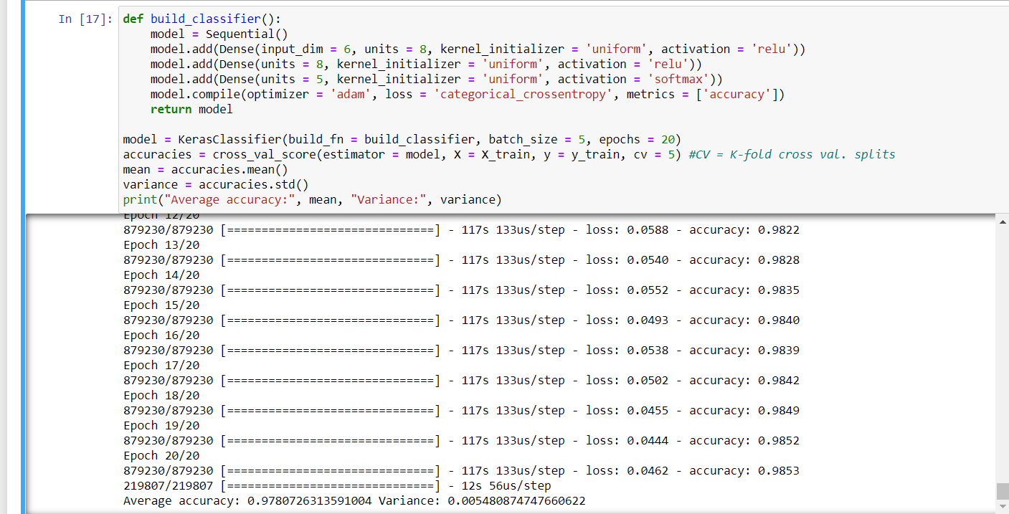
Result of MLP of 20 epochs with cv=5

Slide 24
Sinhgad Institute of Technology & Science, Pune
Department of Electronics &Telecommunication Engineering
24
BUDGET OF THE PROJECT
Components | Cost
Arduino | Rs.400
Temperature Sensor | Rs.157
Wires | Rs.175
ESP8266 | Rs.280
Digital light intensity sensor | Rs.260
Solar Panel | Rs.4800
Voltage Detection Sensor module | Rs.200
Current Detection Sensor module | Rs.849
Total | Rs.7121
Notes:
24
24

Slide 25
REFERENCES
[1] M. Sabbaghpur Arani and M. A. Hejazi, “The comprehensive study of electrical faults in PV arrays,” Journal of Electrical and Computer Engineering, vol. 2016, Article ID 8712960, 10pages, 2016.
[2] A. Triki-Lahiani, A. Bennani-Ben Abdelghani, and I. SlamaBelkhodja,“Fault detection and monitoring systems for photovoltaic installations: a review,” Renewable and Sustainable Energy Reviews, vol. 82, pp. 2680–2692, 2018.
[3] Y. Hu and W. Cao, Theoretical analysis and implementation of photovoltaic fault diagnosis, Intech, 2016.
[4] A. Y. Appiah, X. Zhang, B. B. K. Ayawli, and F. Kyeremeh,“Review and performance evaluation of photovoltaic array fault detection and diagnosis techniques,” International Journal of Photoenergy, vol. 2019, Article ID 6953530, 19 pages,2019
[5] Y. Hu, W. Cao, J. Ma, S. Finney, and D. Li, “Identifying PVmodule mismatch faults by a thermography-based temperature distribution analysis,” IEEE Transactions on Device andMaterials Reliability, vol. 14, no. 4, pp. 951–960, 2014.

Slide 26
THANK YOU!
Sinhgad Institute of Technology & Science, Pune
Department of Electronics &Telecommunication Engineering
26
Notes:
26
26

