Slide 1
Auto Insurance Case Study
Suhita Acharya

Slide 2
Marketing Group Deck

Slide 3
Current 2017 Policies Study
Study conducted on 60,392 policies, out of which 10,030 policies had at least one claim.
Policy holder information studied:
Gender
Age Categories
Area of residence
Number of claims
Total claim amounts
Vehicle age, value, and body type
Credit Score
Cost-per-claim

Slide 4
Current 2017 Policies Study (cont..)
Goal: Identifying low-risk policy/group characteristics.
2017 Policy Data studied to identify low and high-risk groups and apply the same to 2018 Potential Policy data.
EDA (Exploratory Data Analysis) study aided by certain data groupings:
Claim Risk Groups
Low Risk: 0 claims
High Risk: >0 claims
Credit Risk Groups
Based on credit scores: Excellent, Good, Fair, etc.
Study is also accompanied by data modeling to add risk categories for 2018 potential data.

Slide 5
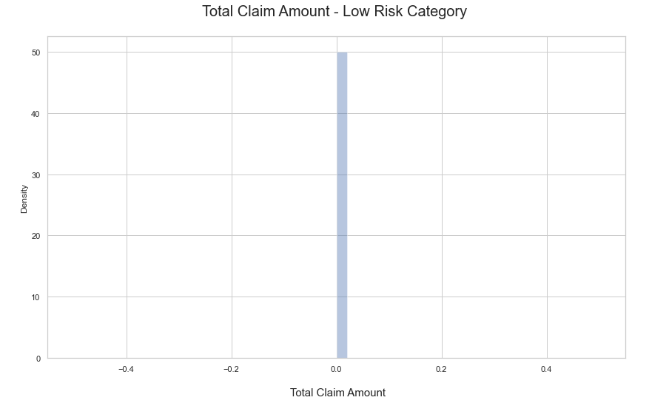
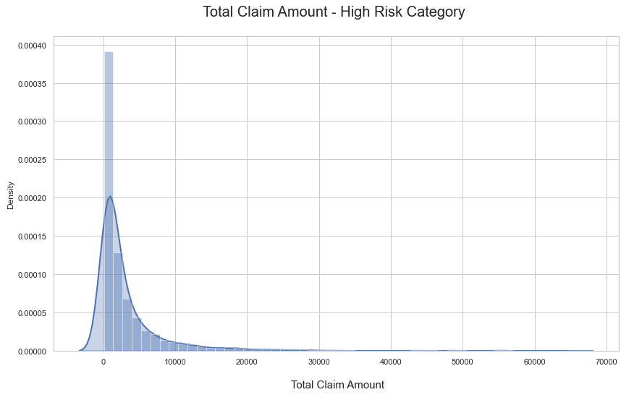
2017 Policy Data EDA:
Total Claim Amount

Slide 6
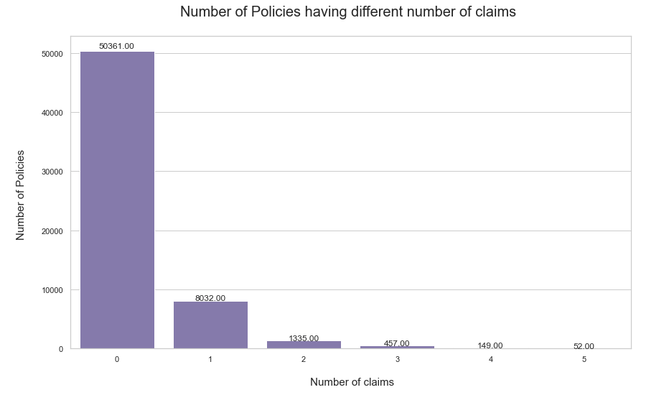
2017 Policy Data EDA:
Number of Claims (Info used to create risk categories):

Slide 7
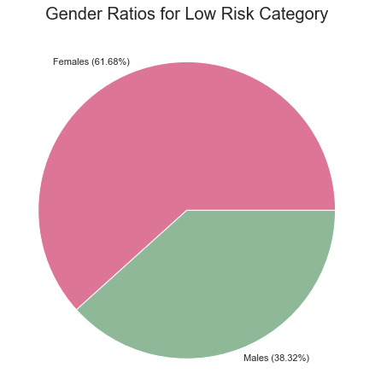
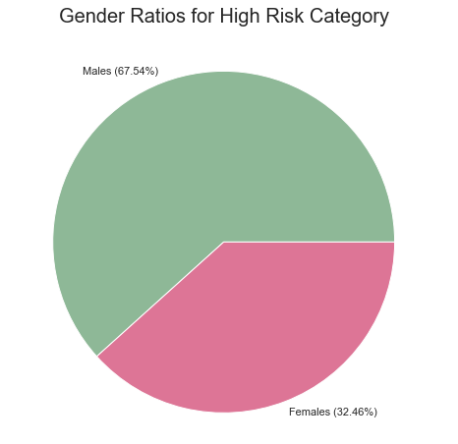
Gender Evaluation

Slide 8
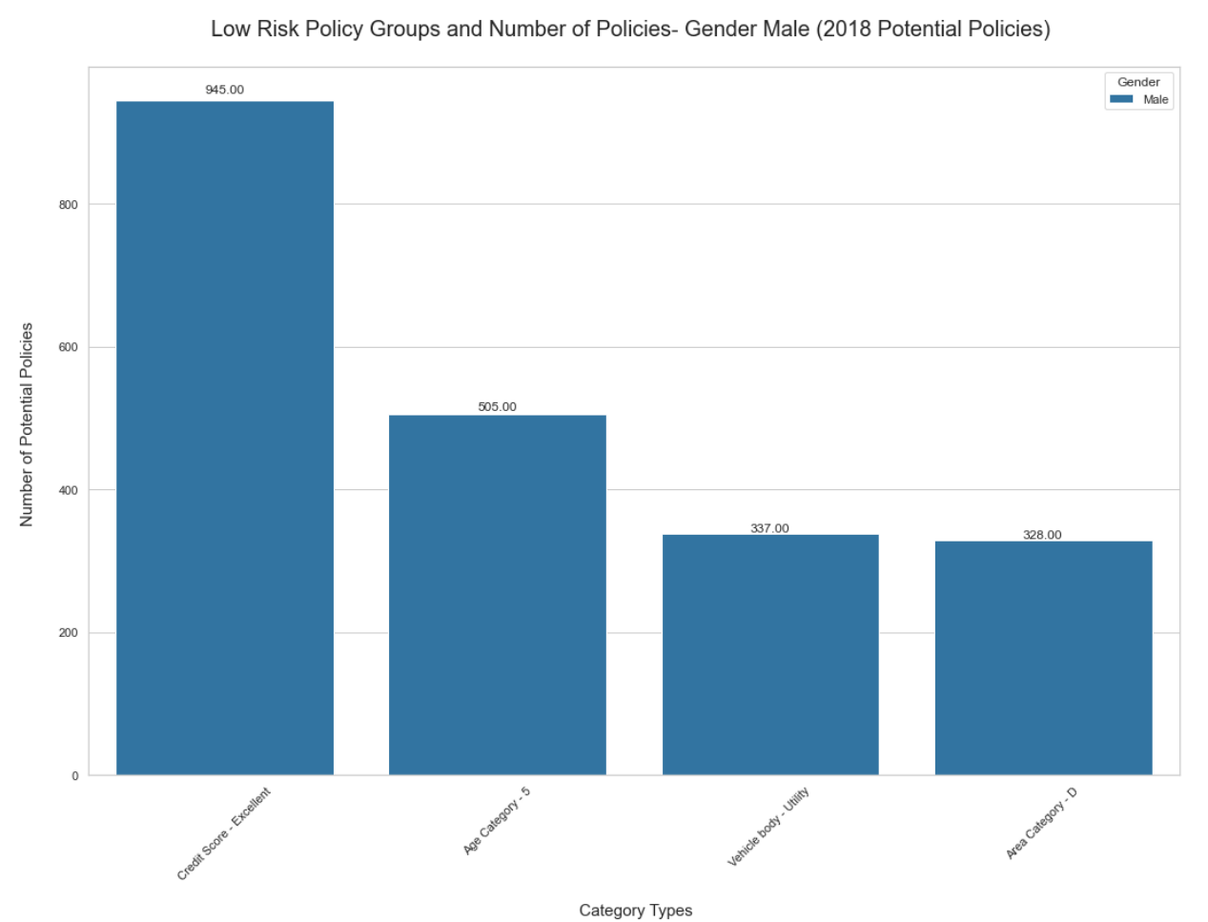
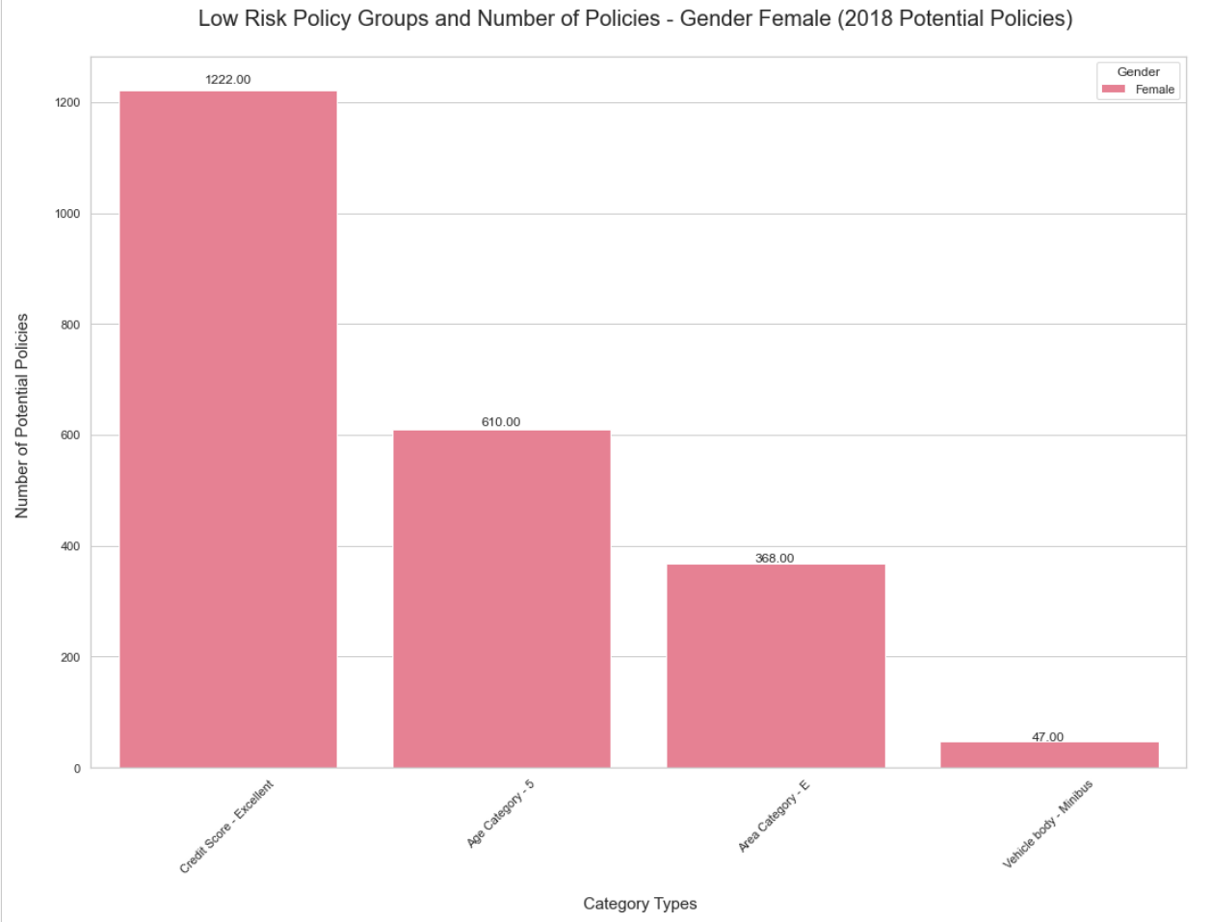
2018 Data Evaluation: Groups Identification

Slide 9
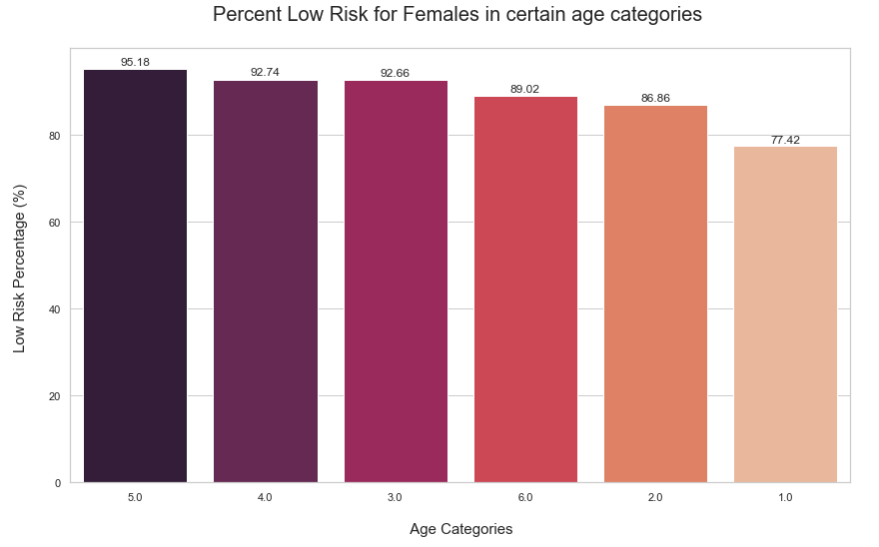
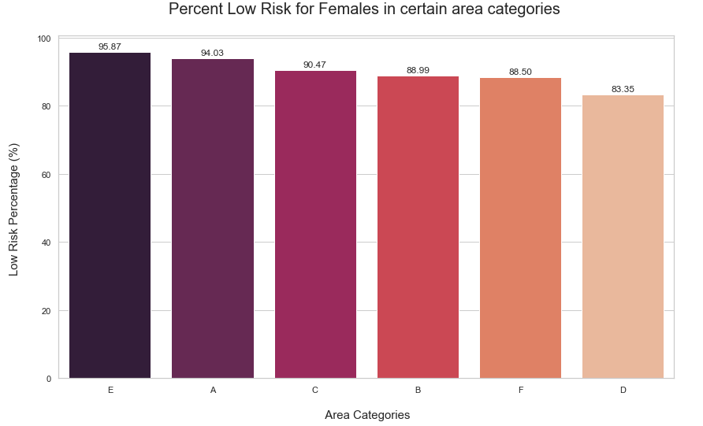
Focusing on females (majority) - Low Risk

Slide 10
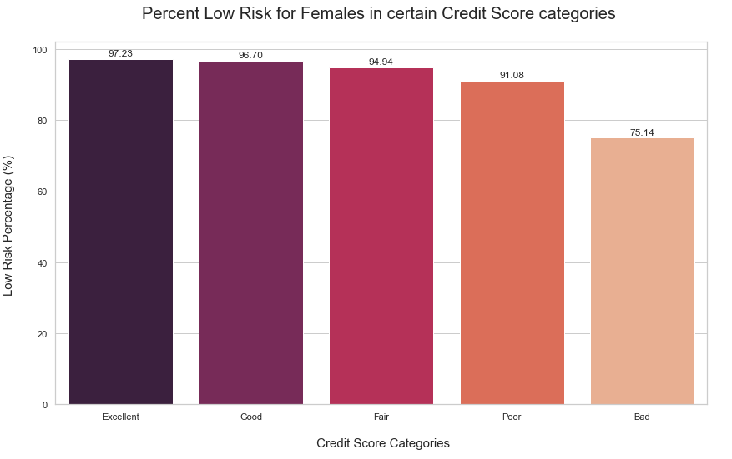
Focusing on females (majority) - Low Risk

Slide 11
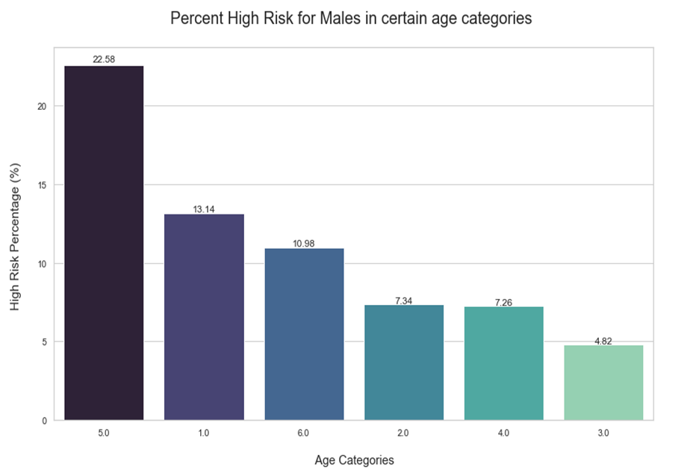
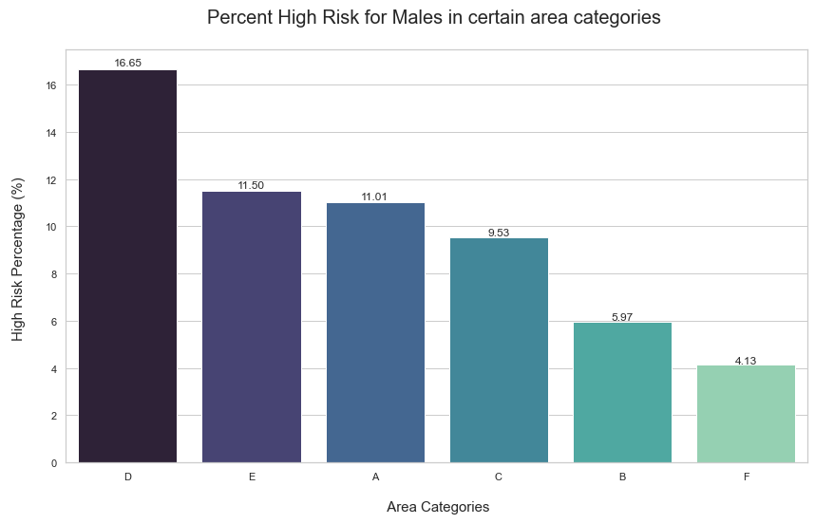
Focusing on males (majority) - High Risk

Slide 12
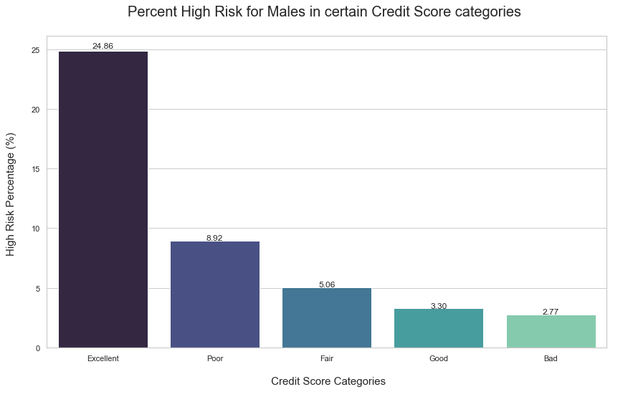
Focusing on males (majority) - High Risk

Slide 13
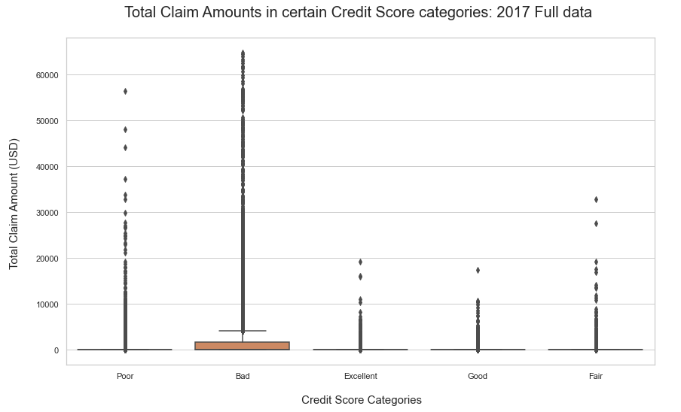
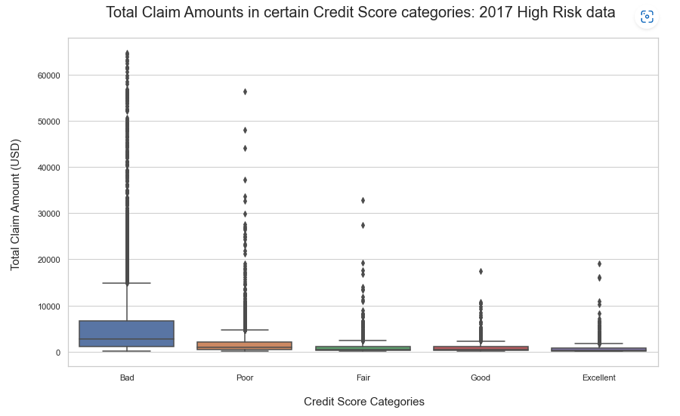
Credit Score vs Total Claim Amounts

Slide 14
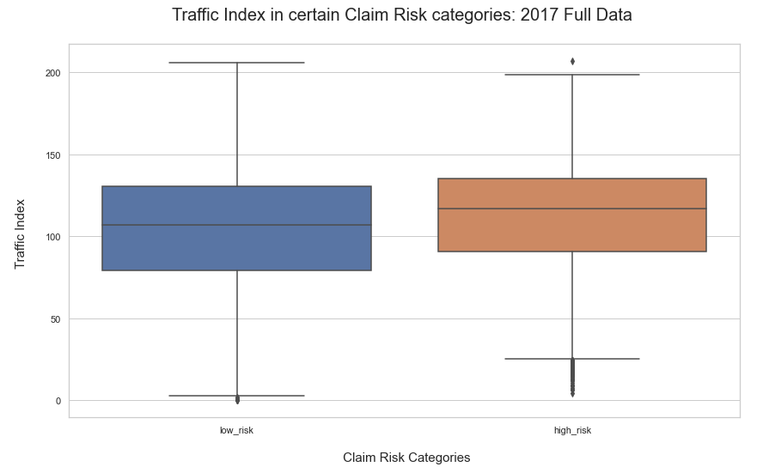
Traffic Index vs Claim Risk Categories

Slide 15
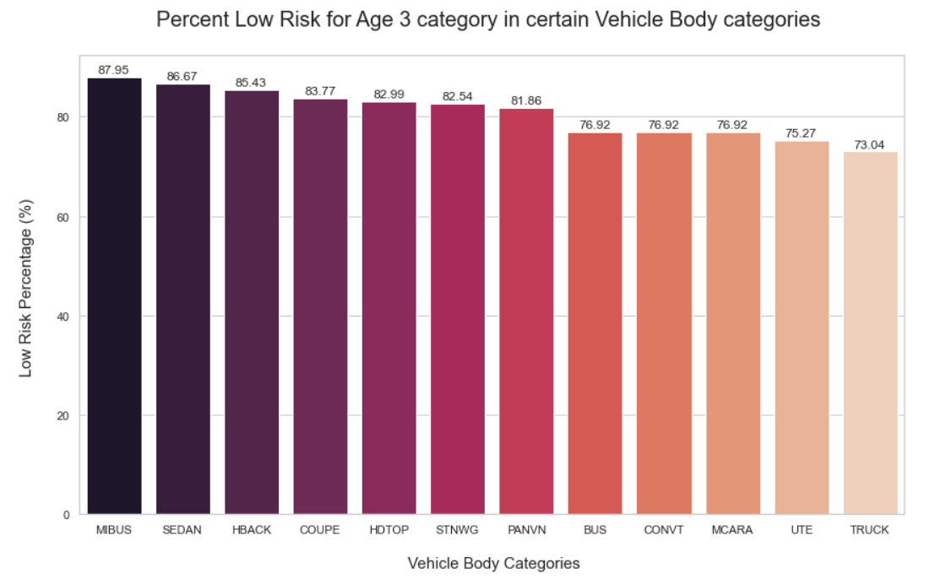
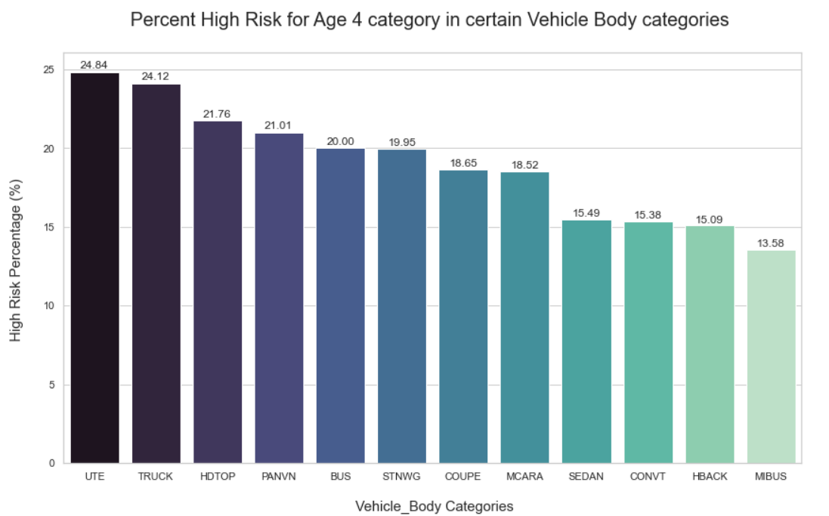
Vehicle Age Evaluation
Category 3 (majority) - Low Risk
Category 4 (majority) - High Risk

Slide 16
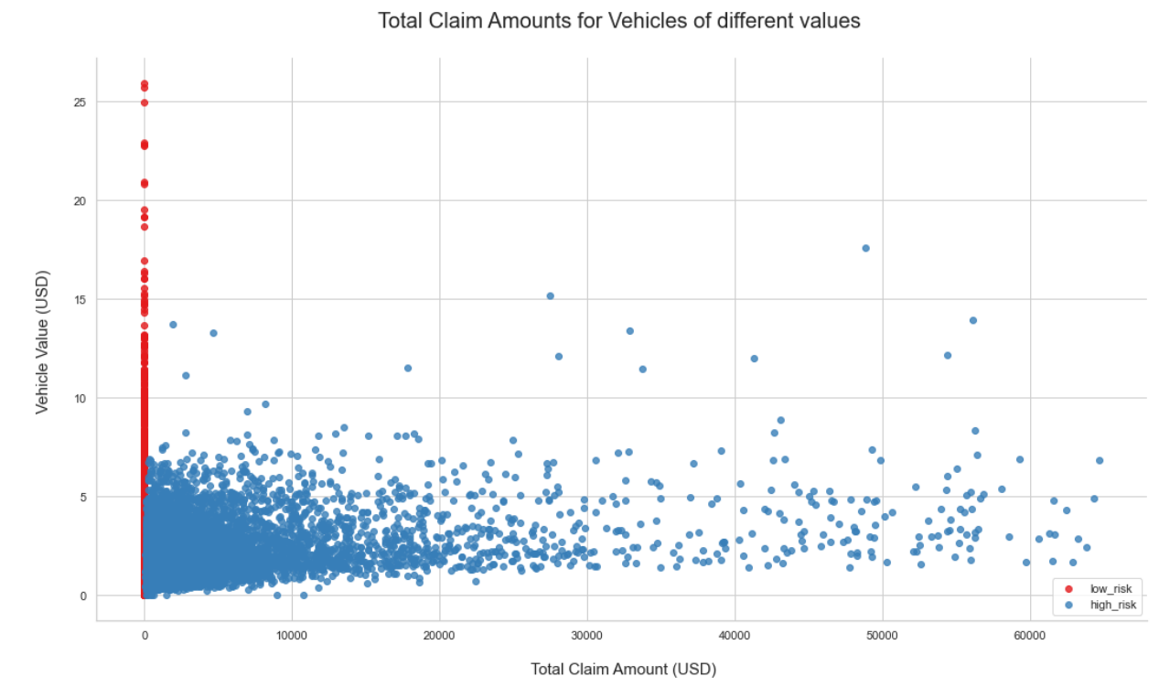
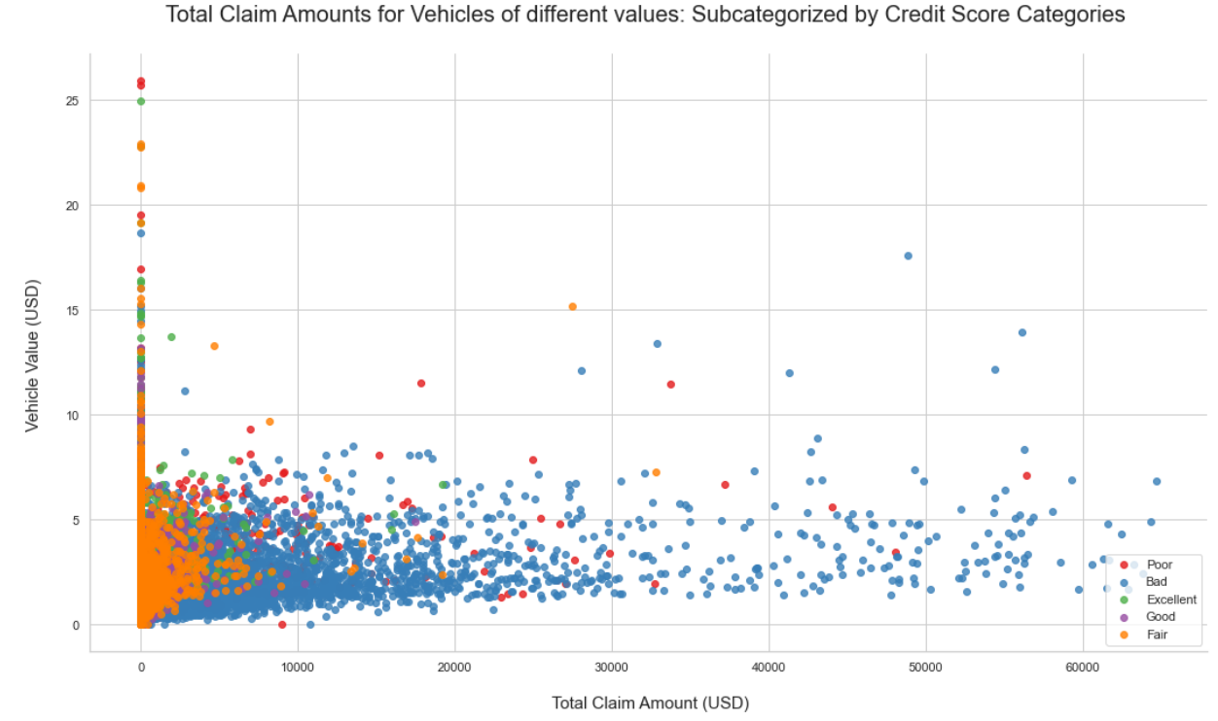
Vehicle Value Evaluation

Slide 17
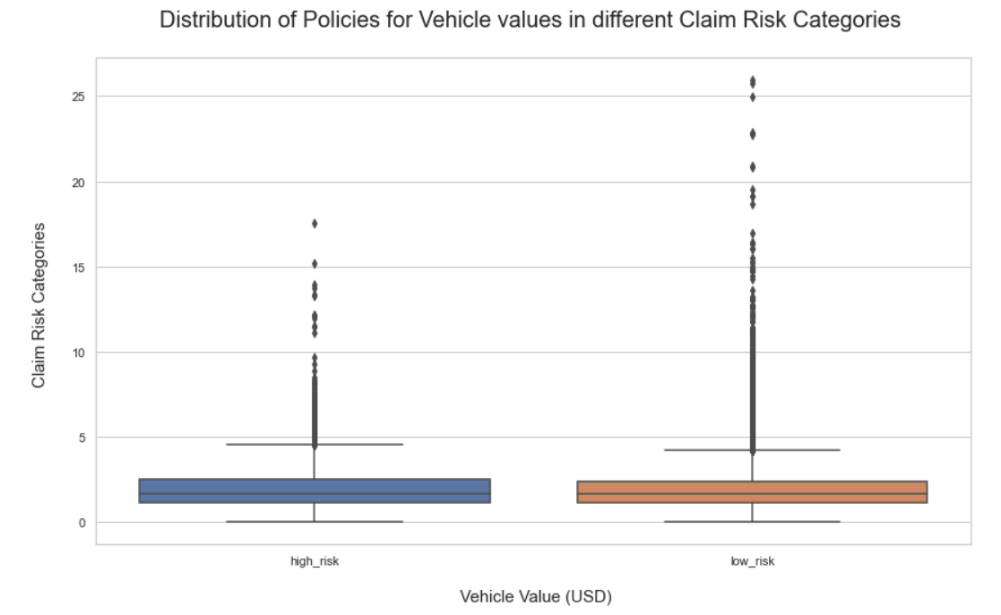
Vehicle Value Evaluation

Slide 18
Data Science Group Deck

Slide 19
Title and Content Layout with List
Add your first bullet point here
Add your second bullet point here
Add your third bullet point here

Slide 20
Title and Content Layout with Chart

Slide 21
Two Content Layout with Table
First bullet point here
Second bullet point here
Third bullet point here
Class | Group A | Group B
Class 1 | 82 | 95
Class 2 | 76 | 88
Class 3 | 84 | 90

Slide 22
Two Content Layout with SmartArt
Group A
Task 1
Group B
Task 1
Task 2
Task 2
Group C
Task 1
Task 2
First bullet point here
Second bullet point here
Third bullet point here

