Slide 1
Auto Insurance Case Study
Suhita Acharya

Slide 2
Marketing Group Deck

Slide 3
Current 2017 Policies Study
Study conducted on 60,392 policies, out of which 10,030 policies had at least one claim.
Policy holder information studied:
Gender
Age Categories
Area of residence
Number of claims
Total claim amounts
Vehicle age, value, and body type
Credit Score
Cost-per-claim

Slide 4
Current 2017 Policies Study (cont..)
Goal: Identifying low-risk policy/group characteristics.
2017 Policy Data studied to identify low and high-risk groups and apply the same to 2018 Potential Policy data.
EDA (Exploratory Data Analysis) study aided by certain data groupings:
Claim Risk Groups
Low Risk: 0 claims
High Risk: >0 claims
Credit Risk Groups
Based on credit scores: Excellent, Good, Fair, etc.
Study is also accompanied by data modeling to add risk categories for 2018 potential data.

Slide 5
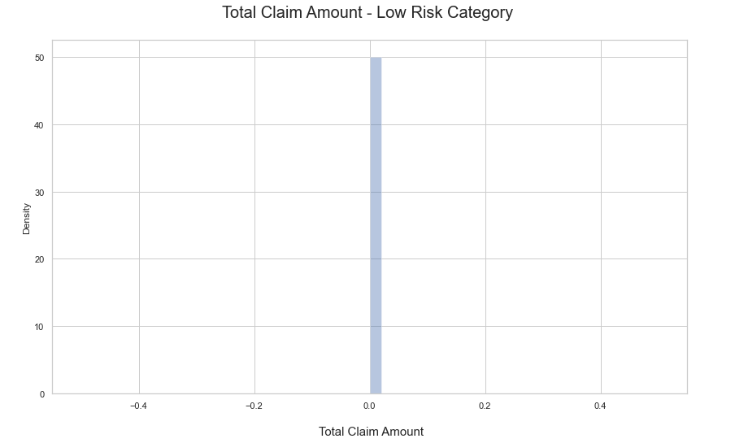
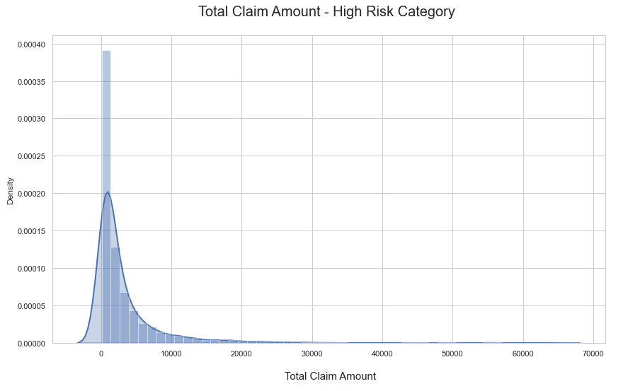
2017 Policy Data EDA:
Total Claim Amount

Slide 6
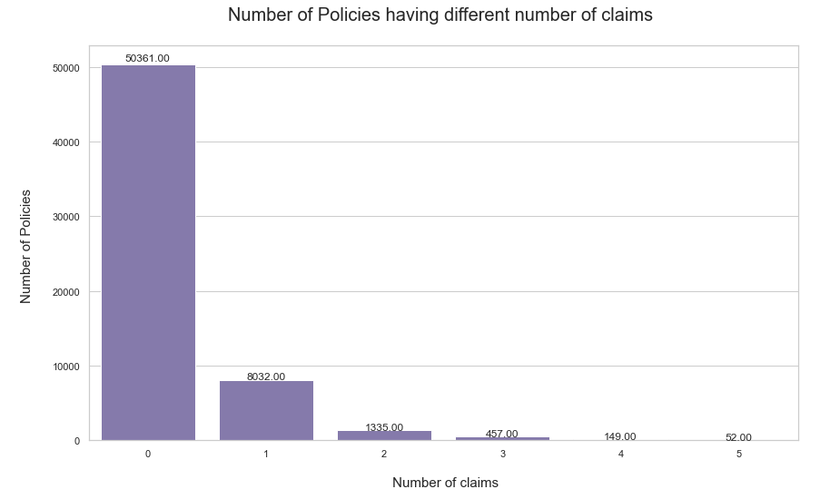
2017 Policy Data EDA:
Number of Claims (Info used to create risk categories):

Slide 7
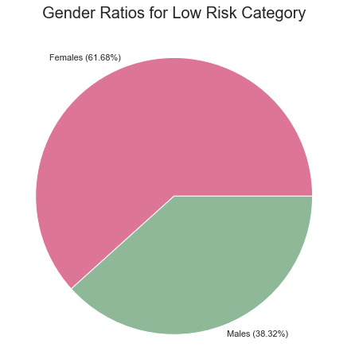
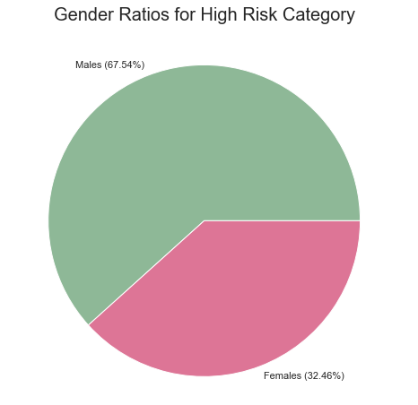
Gender Evaluation

Slide 8
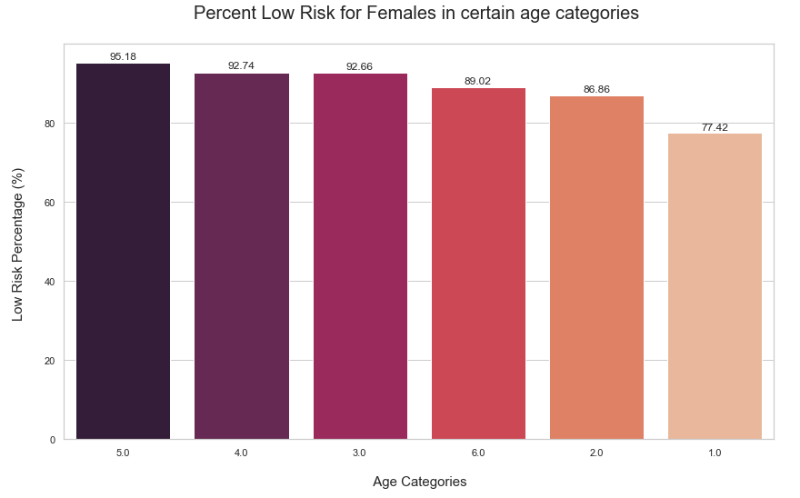
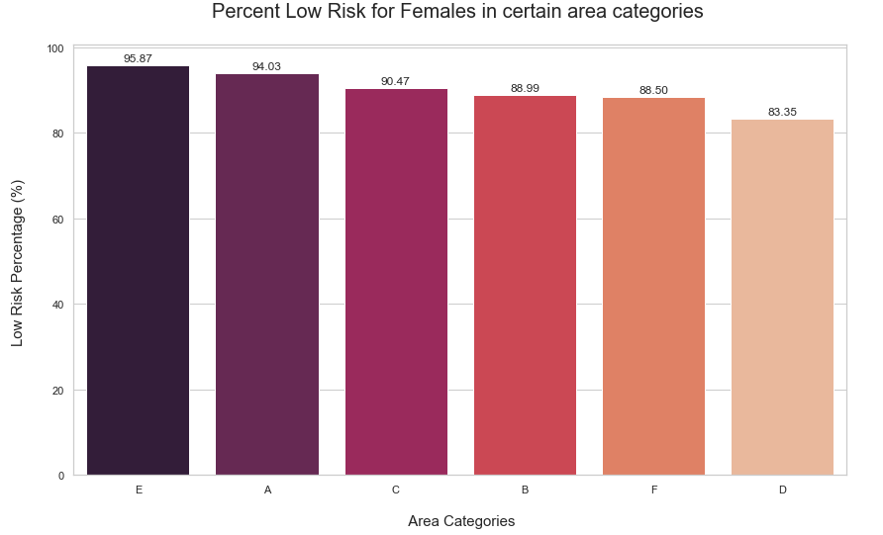
Focusing on females (majority) - Low Risk

Slide 9
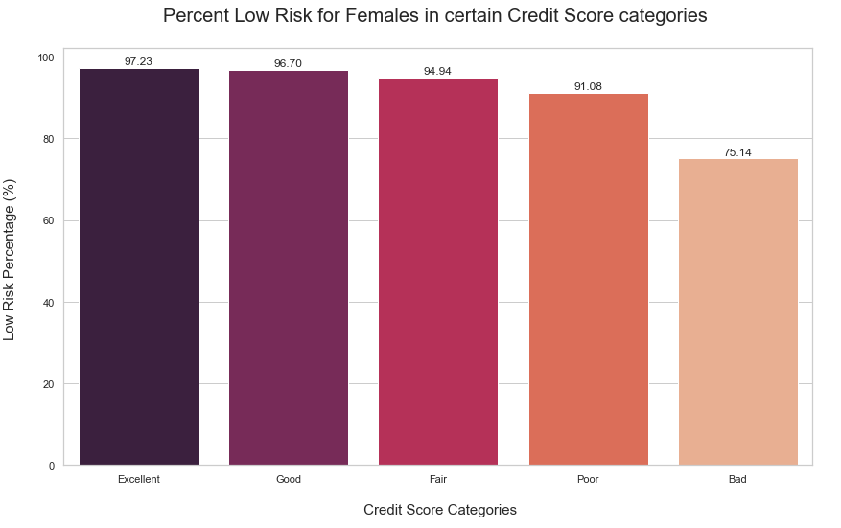
Focusing on females (majority) - Low Risk

Slide 10
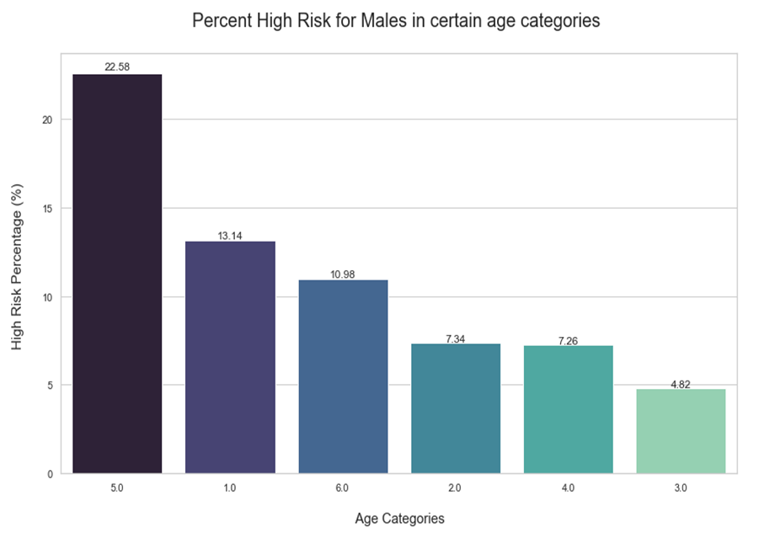
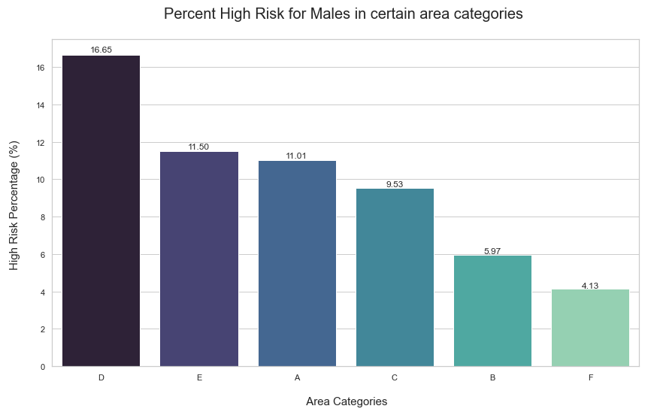
Focusing on males (majority) - High Risk

Slide 11
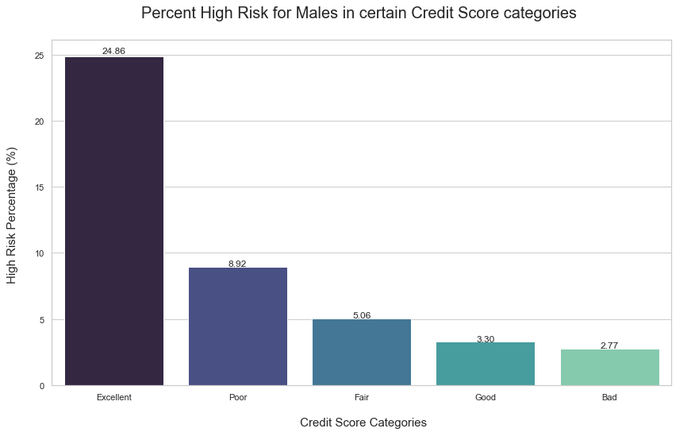
Focusing on males (majority) - High Risk

Slide 12
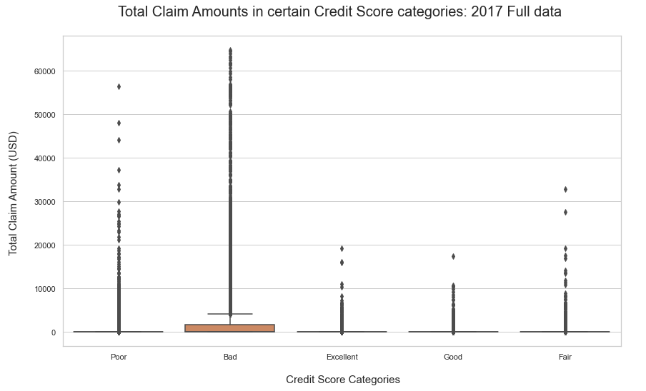
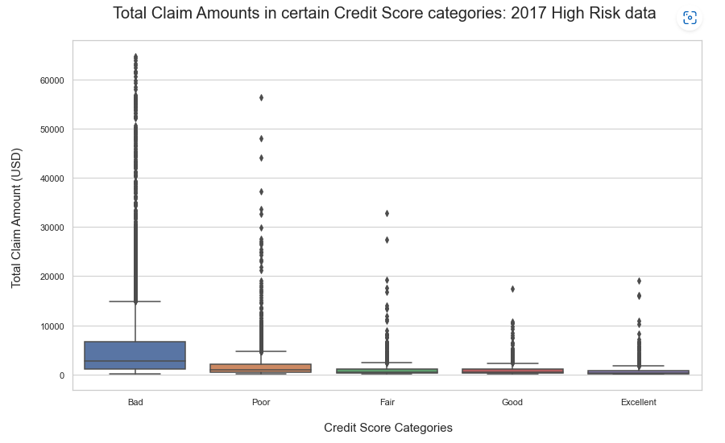
Credit Score vs Total Claim Amounts

Slide 13
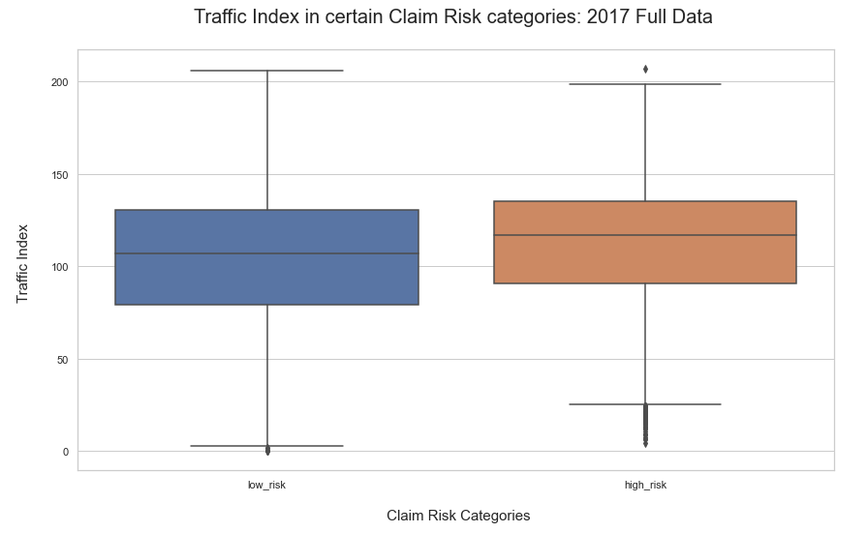
Traffic Index vs Claim Risk Categories

Slide 14
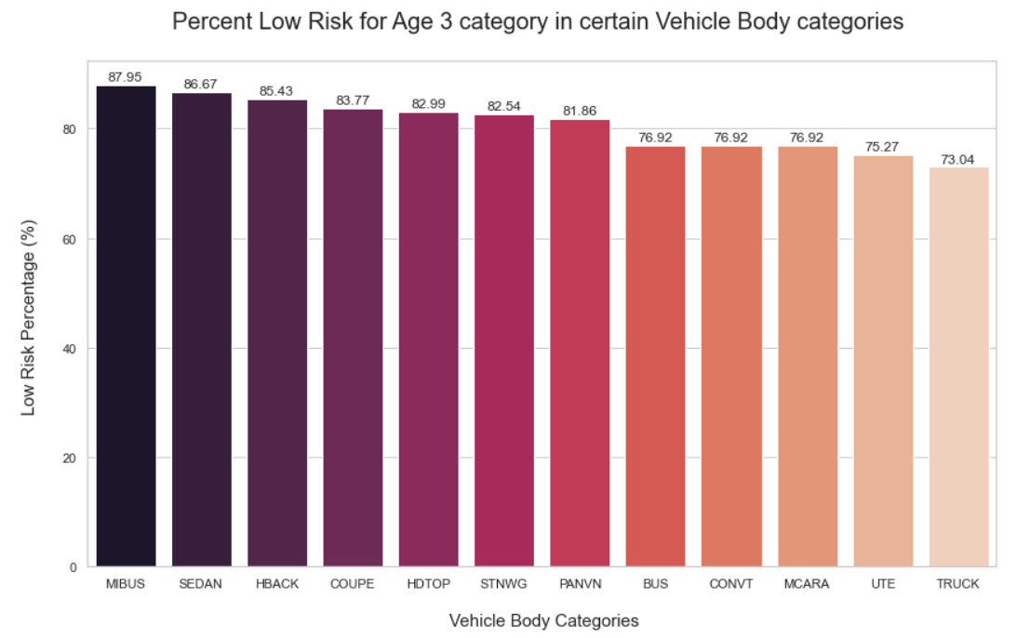
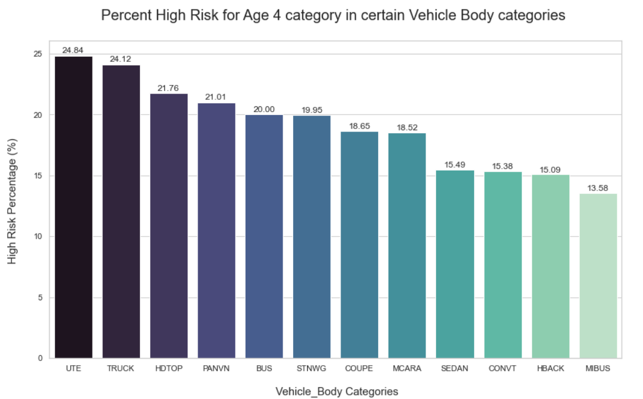
Vehicle Age Evaluation
Category 3 (majority) - Low Risk
Category 4 (majority) - High Risk

Slide 15
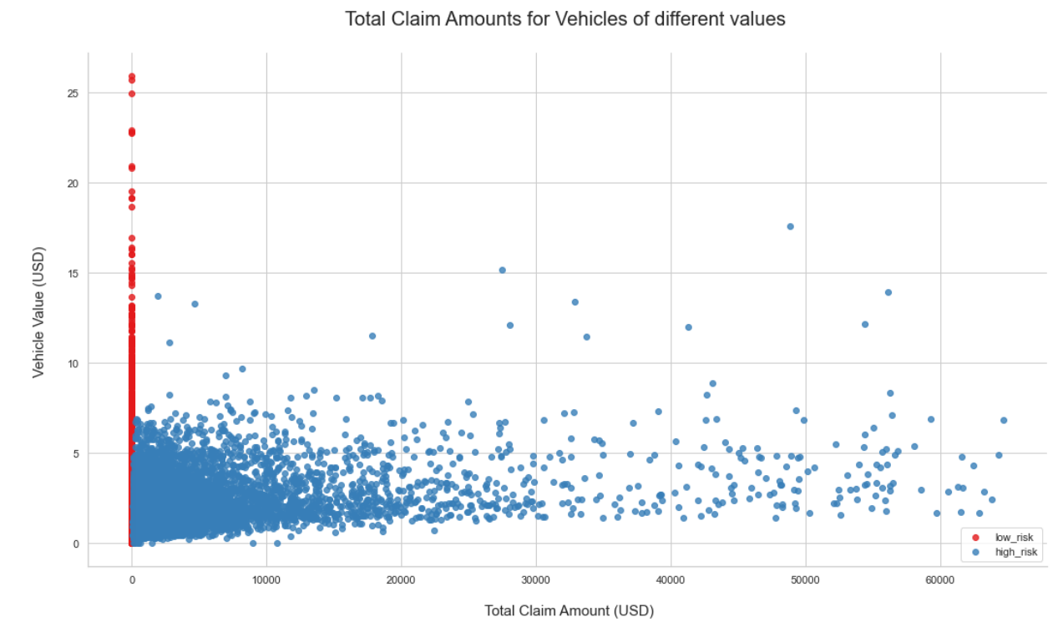
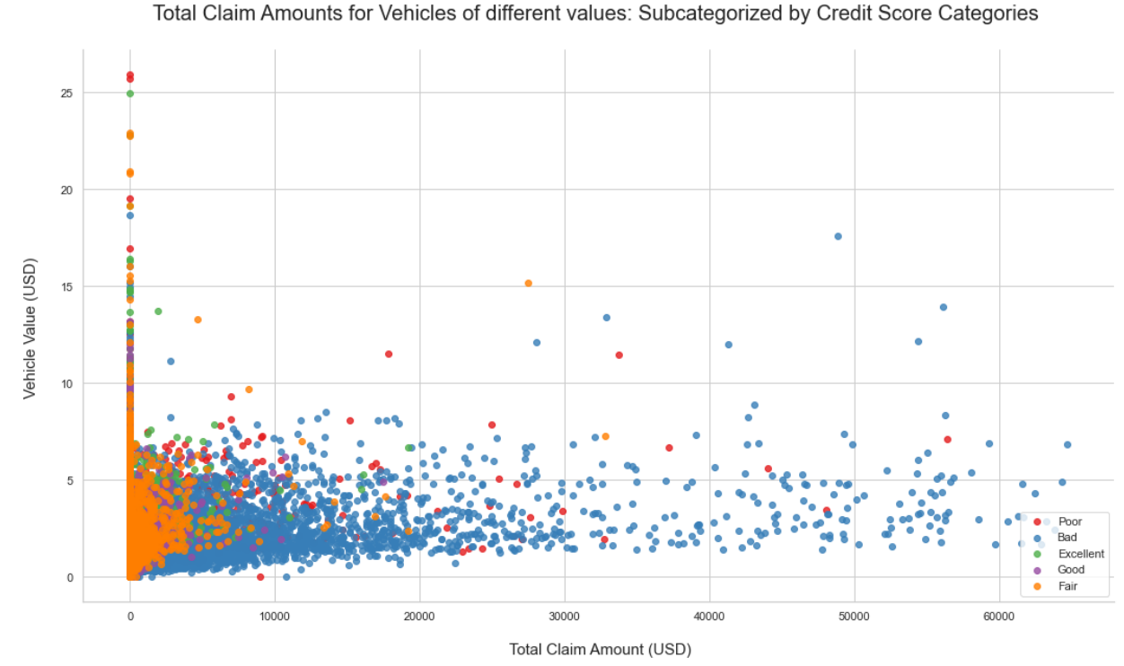
Vehicle Value Evaluation

Slide 16
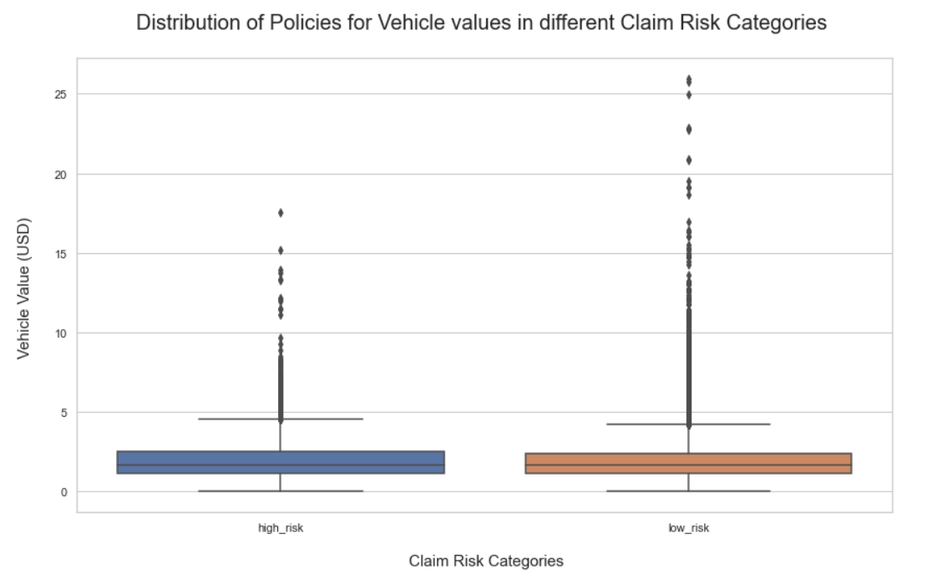
Vehicle Value Evaluation

Slide 17
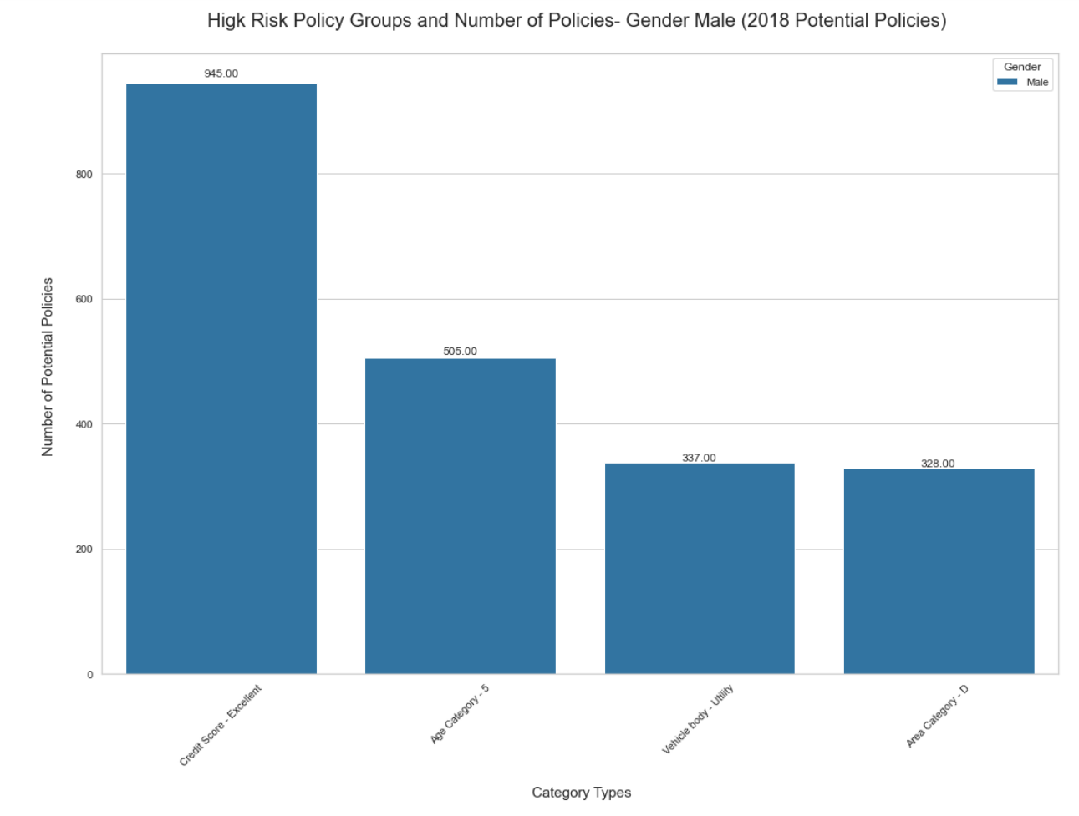
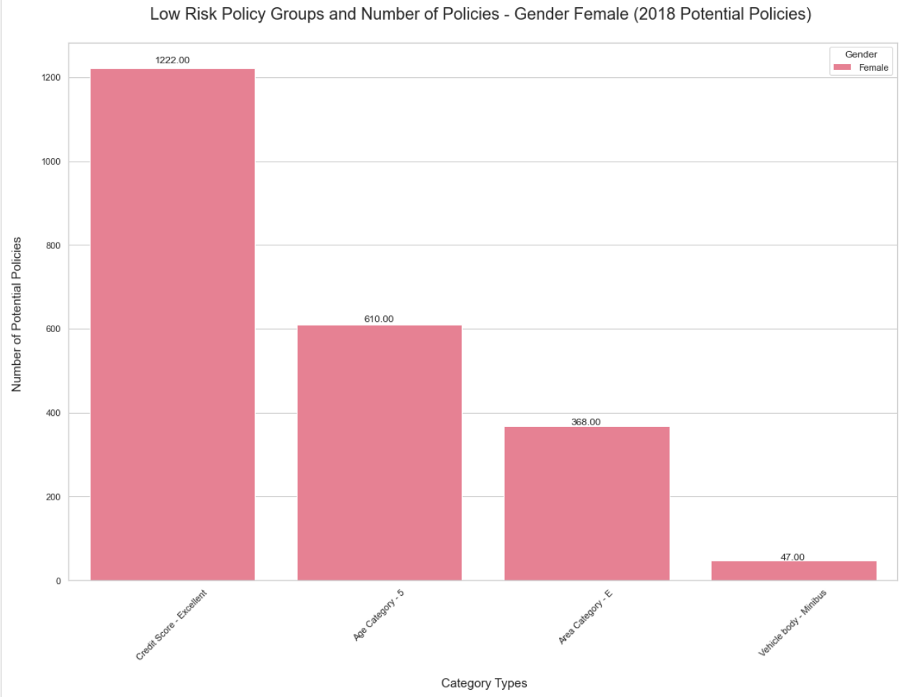
2018 Data Evaluation: Groups Identification

Slide 18
Study Findings
Policies of vehicles of lower value are at high claim risk.
Worse the credit score; the higher the claim amount.
Low Risk Group | High Risk Group
Female population: Second oldest Age Category Living in Area E Driving a Minibus With an Excellent credit score | Male population: Second oldest Age Category Living in Area D Driving a Utility Vehicle With an Excellent credit score
Policies with vehicle age category 3 | Policies with vehicle age category 4
Areas with slightly lower than median traffic index. | Areas with slightly higher than median traffic index.

Slide 19
Data Science Group Deck

Slide 20
2017 Policy Data EDA:
Total Claim Amount

Slide 21
2017 Policy Data EDA:
Number of Claims (Info used to create risk categories):

Slide 22
Gender Evaluation

Slide 23
Focusing on females (majority) - Low Risk

Slide 24
Focusing on females (majority) - Low Risk

Slide 25
Focusing on males (majority) - High Risk

Slide 26
Focusing on males (majority) - High Risk

Slide 27
Credit Score vs Total Claim Amounts

Slide 28
Traffic Index vs Claim Risk Categories

Slide 29
Vehicle Age Evaluation
Category 3 (majority) - Low Risk
Category 4 (majority) - High Risk

Slide 30
Vehicle Value Evaluation

Slide 31
Vehicle Value Evaluation

Slide 32
2018 Data Evaluation: Groups Identification

Slide 33
Study Findings
Policies of vehicles of lower value are at high claim risk.
Worse the credit score; the higher the claim amount.
Low Risk Group | High Risk Group
Female population: Second oldest Age Category Living in Area E Driving a Minibus With an Excellent credit score | Male population: Second oldest Age Category Living in Area D Driving a Utility Vehicle With an Excellent credit score
Policies with vehicle age category 3 | Policies with vehicle age category 4
Areas with slightly lower than median traffic index. | Areas with slightly higher than median traffic index.

