Slide 1
Auto Insurance Case Study
Suhita Acharya

Slide 2
Marketing Group Deck

Slide 3
Current 2017 Policies Study
Study conducted on 60,392 policies, out of which 10,030 policies had at least one claim.
Policy holder information studied:
Gender
Age Categories
Area of residence
Number of claims
Total claim amounts
Vehicle age, value, and body type
Credit Score
Cost-per-claim

Slide 4
Current 2017 Policies Study (cont..)
Goal: Identifying low-risk policy/group characteristics.
2017 Policy Data studied to identify low and high-risk groups and apply the same to 2018 Potential Policy data.
EDA (Exploratory Data Analysis) study aided by certain data groupings:
Claim Risk Groups
Low Risk: 0 claims
High Risk: >0 claims
Credit Risk Groups
Based on credit scores: Excellent, Good, Fair, etc.
Study is also accompanied by data modeling to add risk categories for 2018 potential data.

Slide 5
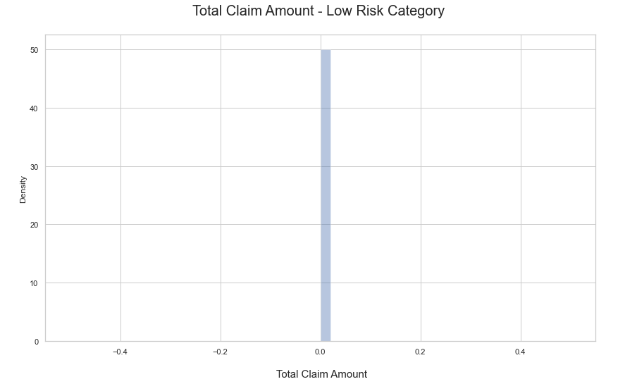
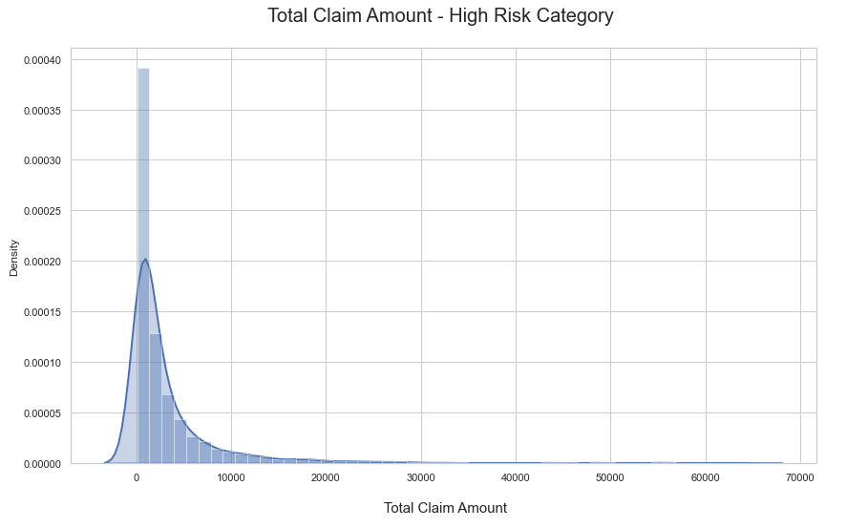
2017 Policy Data EDA:
Total Claim Amount

Slide 6
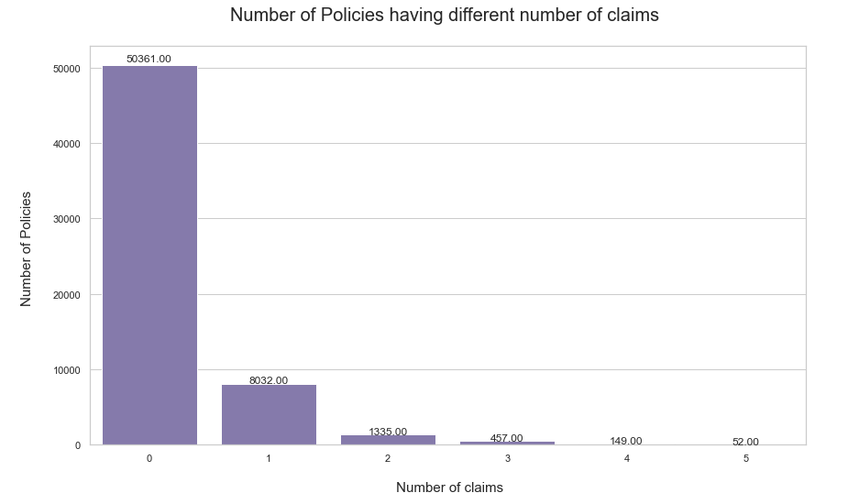
2017 Policy Data EDA:
Number of Claims (Info used to create risk categories):

Slide 7
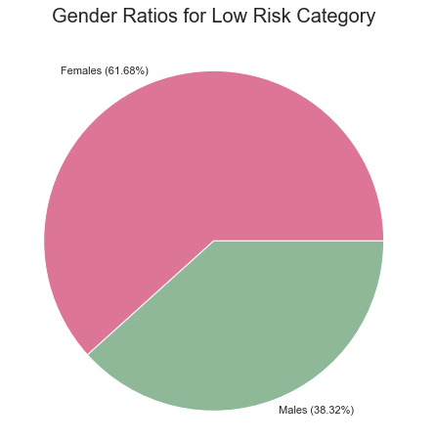
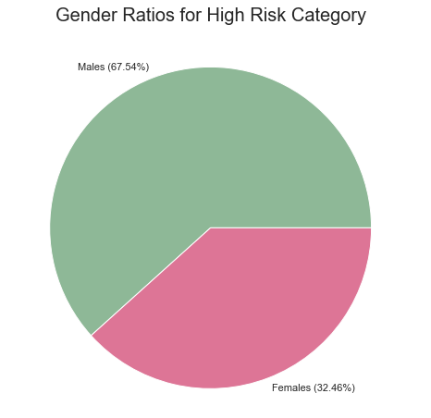
Gender Evaluation

Slide 8
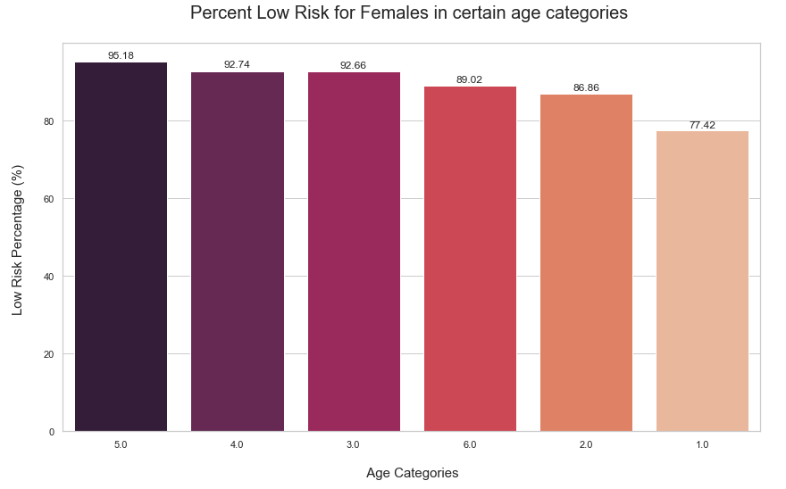
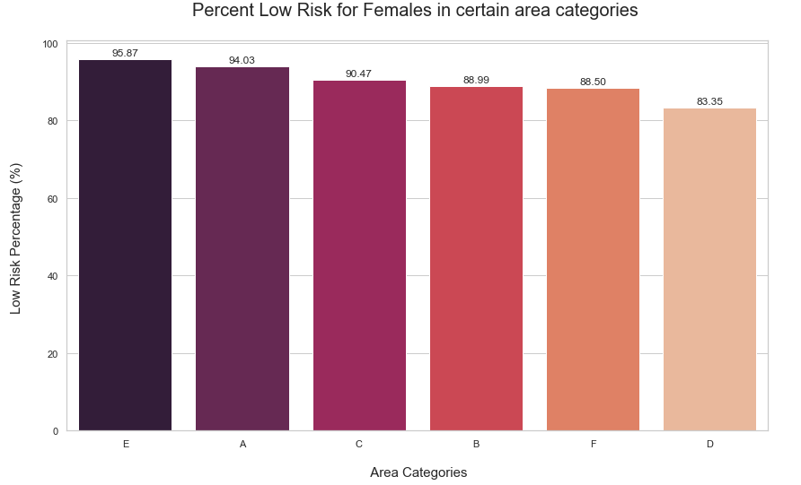
Focusing on females (majority) - Low Risk

Slide 9
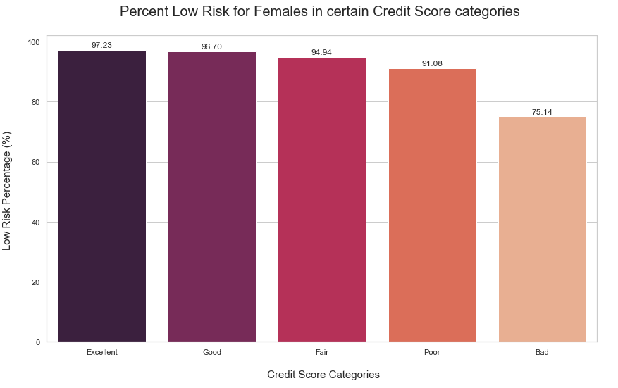
Focusing on females (majority) - Low Risk

Slide 10
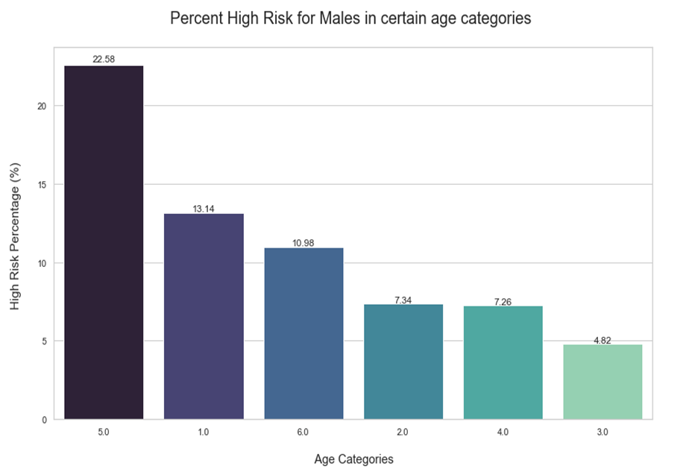
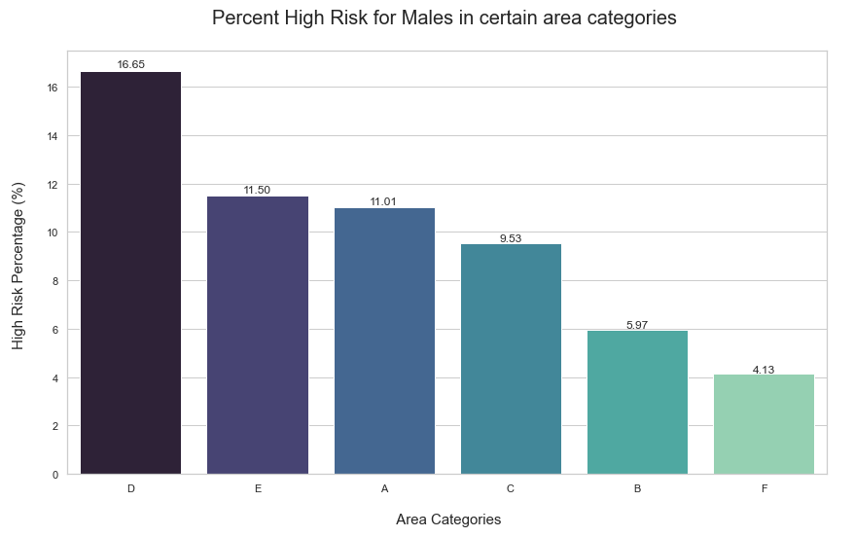
Focusing on males (majority) - High Risk

Slide 11
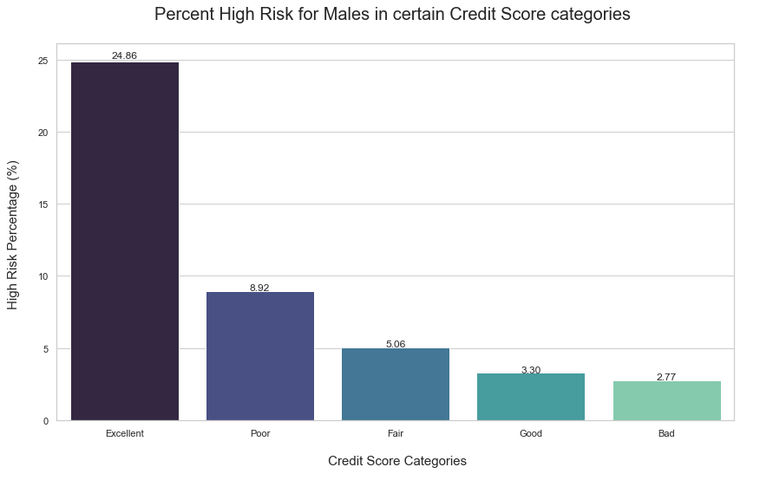
Focusing on males (majority) - High Risk

Slide 12
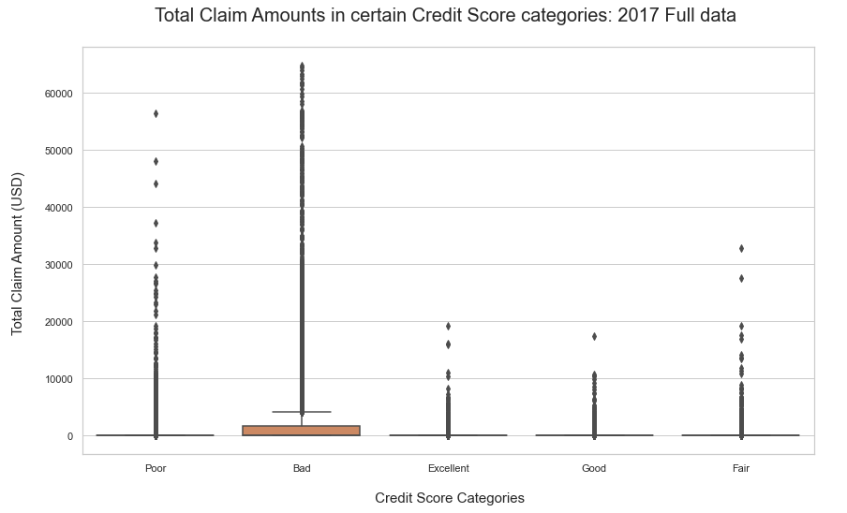
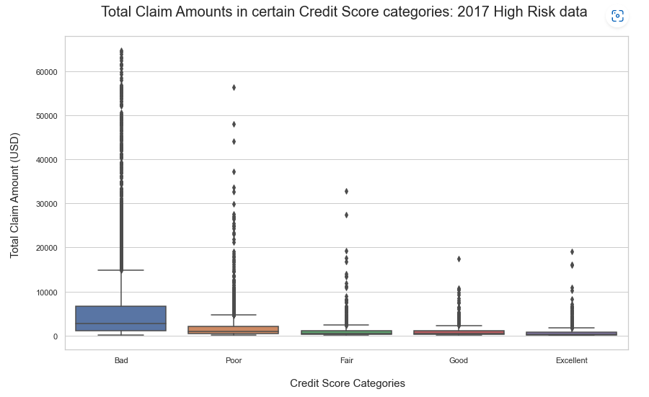
Credit Score vs Total Claim Amounts

Slide 13
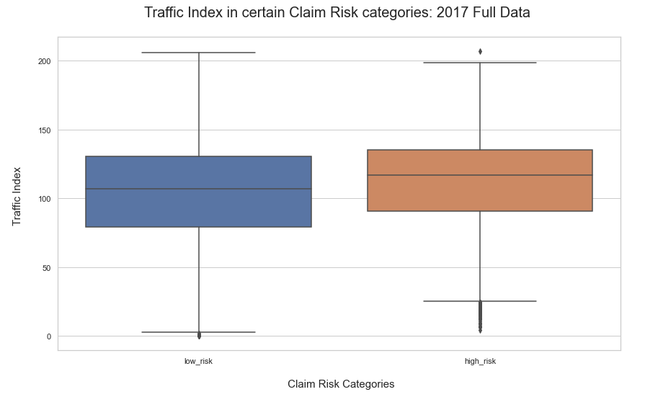
Traffic Index vs Claim Risk Categories

Slide 14
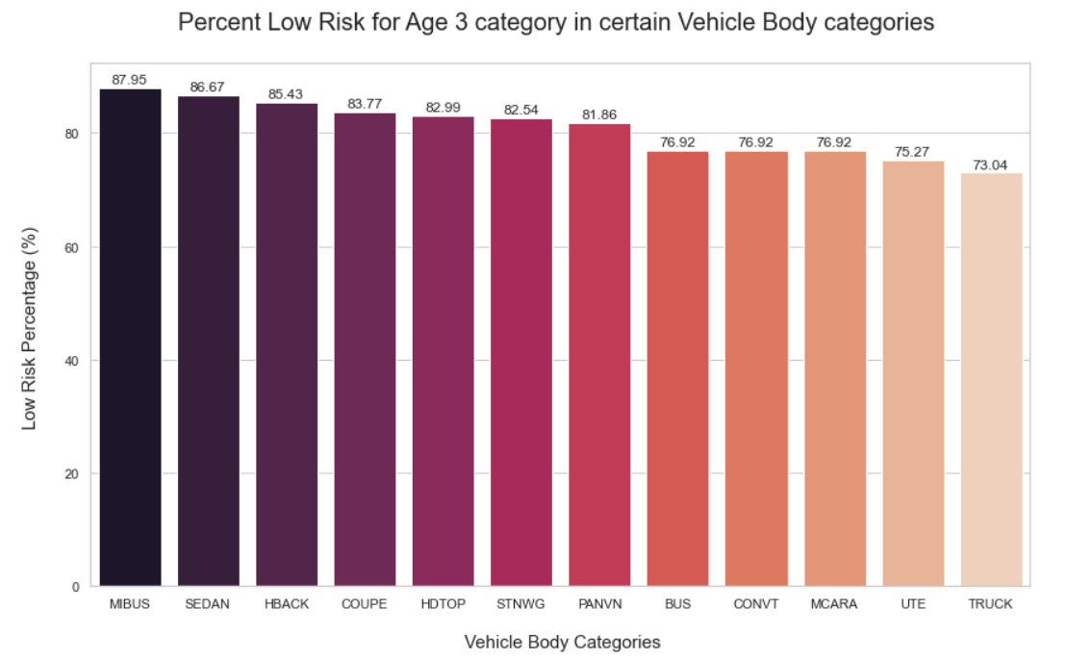
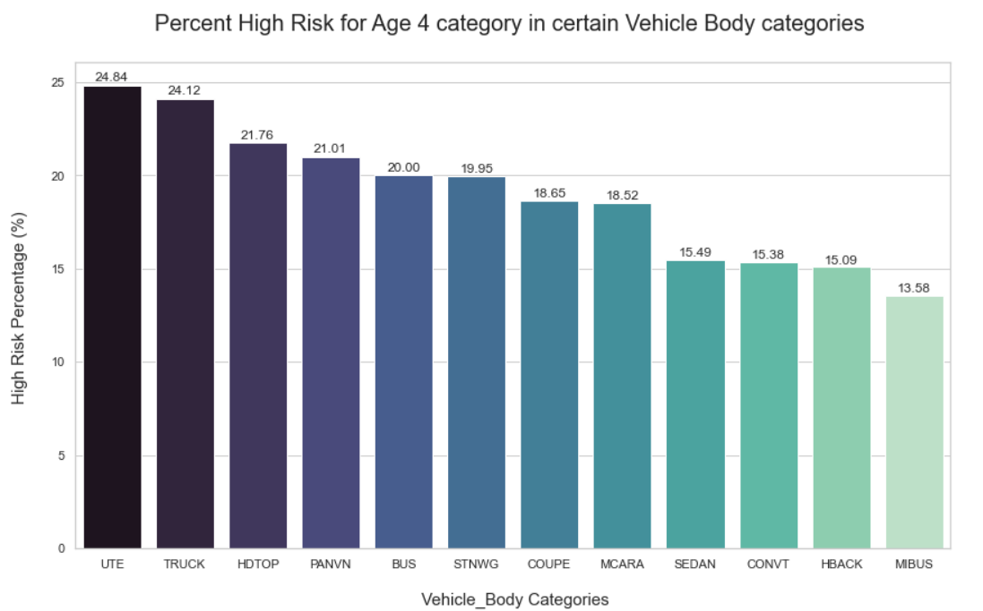
Vehicle Age Evaluation
Category 3 (majority) - Low Risk
Category 4 (majority) - High Risk

Slide 15
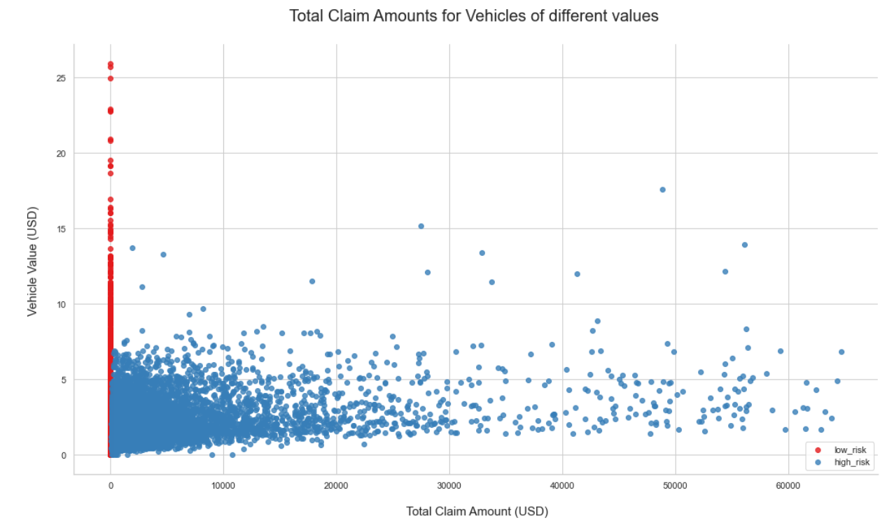
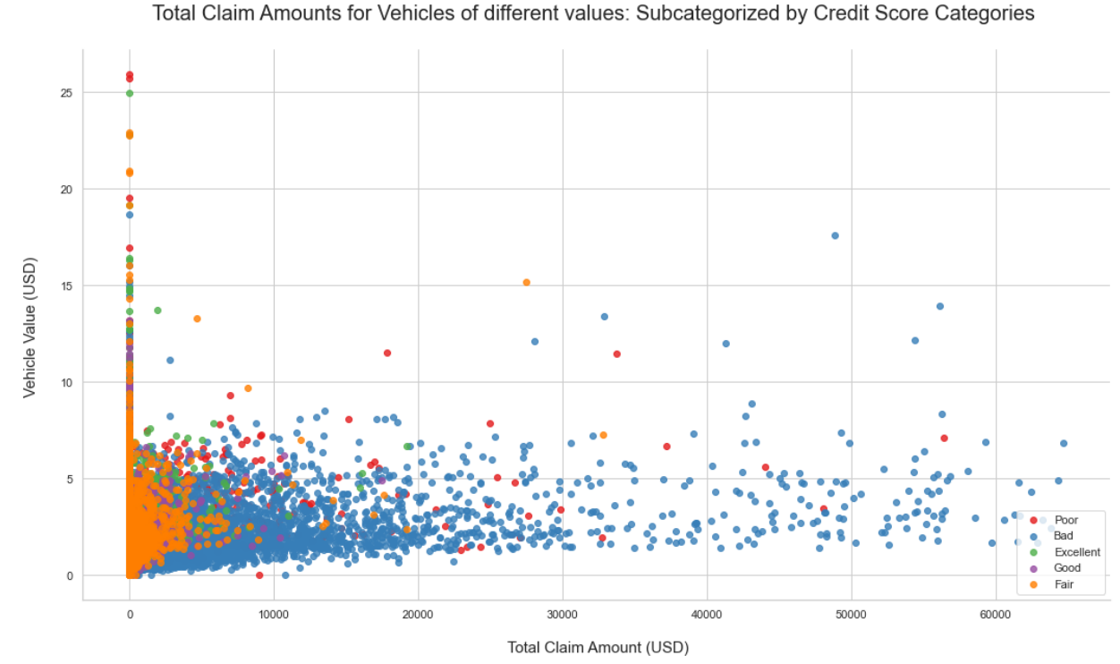
Vehicle Value Evaluation

Slide 16
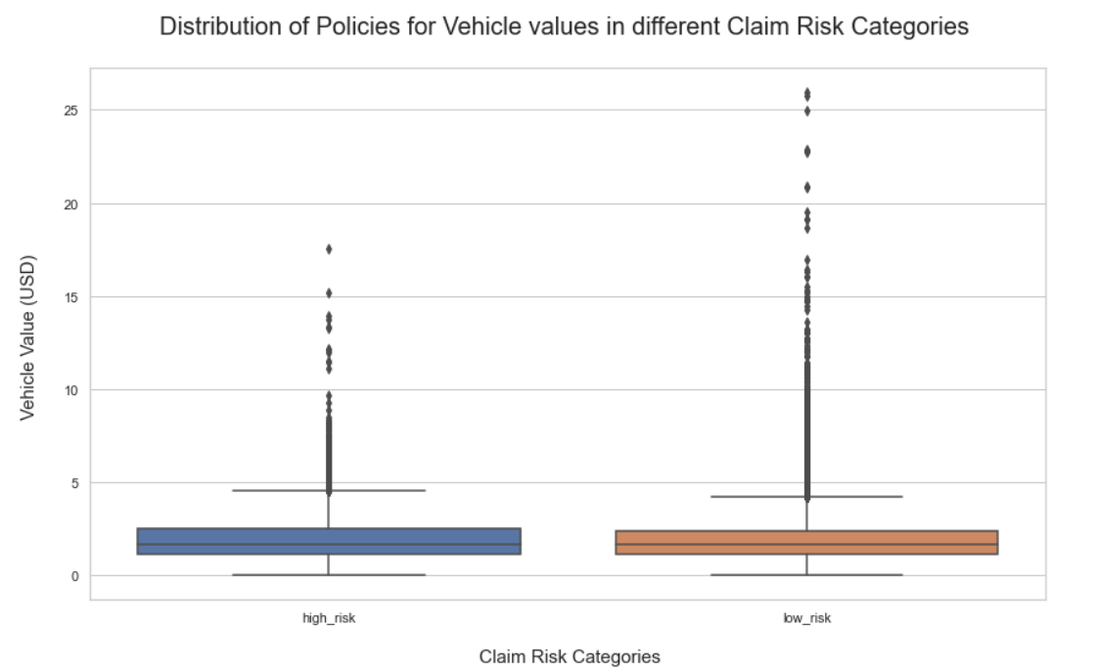
Vehicle Value Evaluation

Slide 17
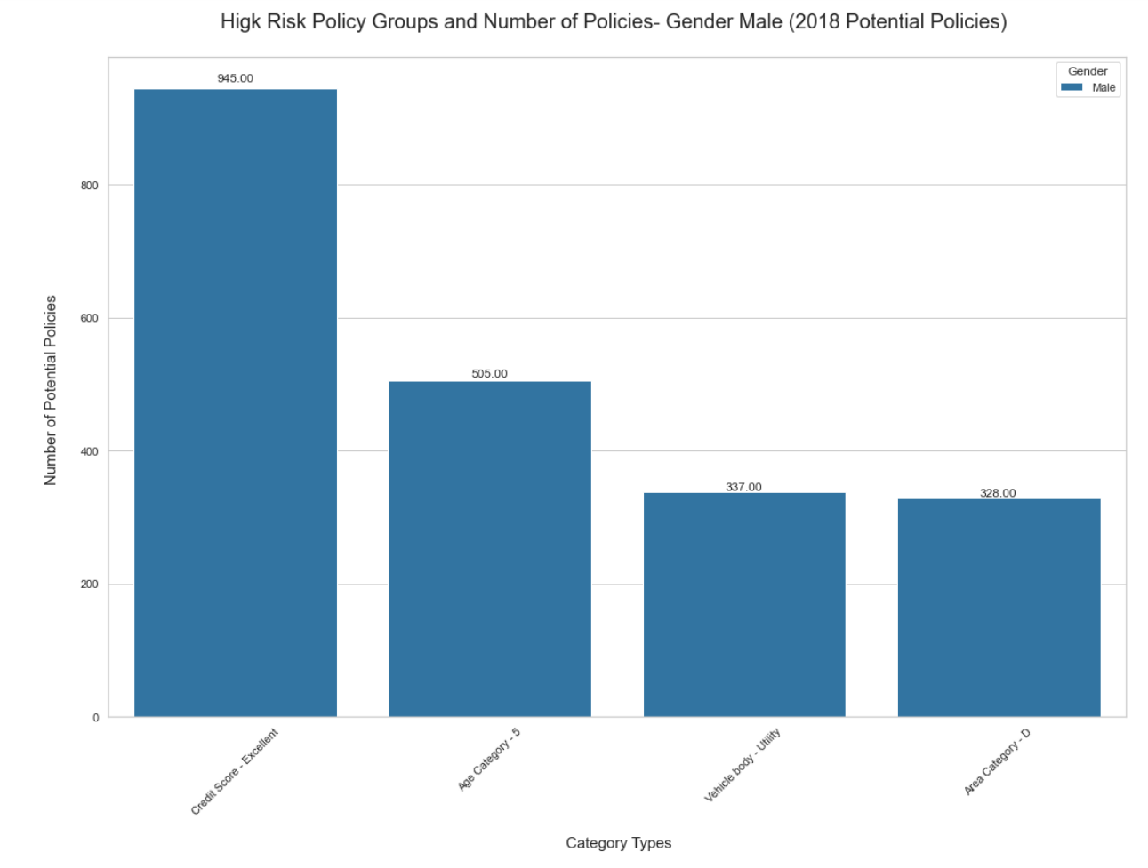
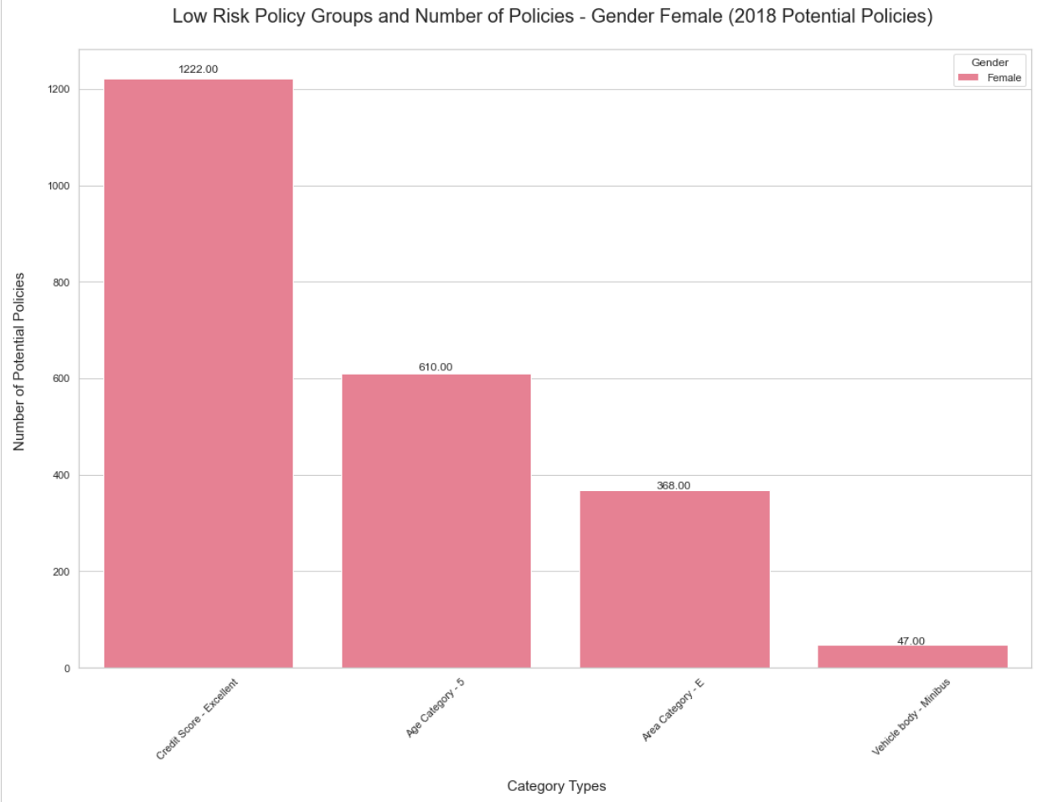
2018 Data Evaluation: Groups Identification

Slide 18
Study Findings
Policies of vehicles of lower value are at high claim risk.
Worse the credit score; the higher the claim amount.
Low Risk Group | High Risk Group
Female population: Second oldest Age Category Living in Area E Driving a Minibus With an Excellent credit score | Male population: Second oldest Age Category Living in Area D Driving a Utility Vehicle With an Excellent credit score
Policies with vehicle age category 3 | Policies with vehicle age category 4
Areas with slightly lower than median traffic index. | Areas with slightly higher than median traffic index.

Slide 19
Thank you!

Slide 20
Data Science Group Deck

Slide 21
Auto Insurance Claims Dataset
auto_policies_2017.csv
This data set is a set of personal auto insurance policies taken out in 2017.
There are 60,392 policies (rows), of which 10,030 had at least one claim.
auto_potential_customers_2018.csv
This is a list of 7,464 potential customers for 2018.
Goal:
Target the potential customers in 2018 which will result in the lowest claim amounts.
Creating a marketing campaign that engages with potential 2018 customers based on their risk profiles

Slide 22
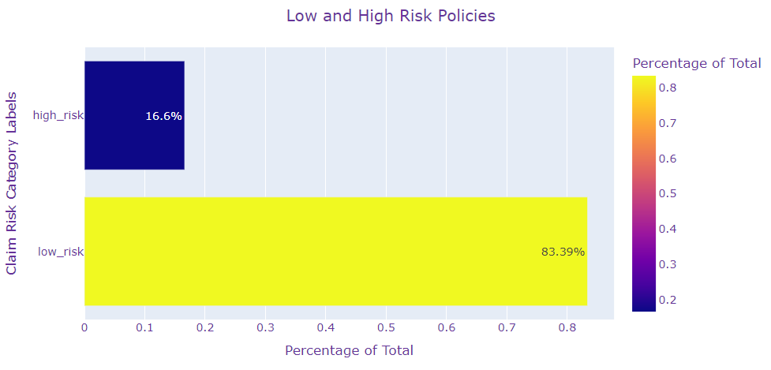
Credit Risk Categories
Credit Risk Categories Feature created:
Low Risk: Number of Claims 0; High Risk: Number of Claims >=1
Imbalanced Dataset as a high number of policies had no claim.
SMOTE Up-sampling technique used to solve this issue.

Slide 23
Data Preprocessing
Missing Data Imputed (both datasets):
age_category
credit_score
traffic_index
Outliers removed (both datasets):
claim_amount and vehicle_value
Label Encoding: All categorical features
New Feature Creation:
claim_risk_cat, credit_score_cat, cost_per_claim.
Dropped features:
With high null values, ID/date related features and columns, not in 2018 potential data.
Data was robust-scaled:
Due to the inclusion of outliers
SMOTE up sampling technique used.
LightGBM model attempted.
Hyperparameters were tuned based on the F1 metric via RandomizedSearchCV.
2017 Policy info dataset was used as training and the 2018 Potential Policy dataset was used as a test dataset and labels were predicted.
LightGBM Hyperparameters:
subsample: 0.8
num_leaves: 100
n_estimators: 120
max_depth: 6
learning_rate: 0.687
colsample_bytree: 1

Slide 24
2017 Policy Data EDA:
Total Claim Amount

Slide 25
2017 Policy Data EDA:
Number of Claims (Info used to create risk categories):

Slide 26
Gender Evaluation

Slide 27
Focusing on females (majority) - Low Risk

Slide 28
Focusing on females (majority) - Low Risk

Slide 29
Focusing on males (majority) - High Risk

Slide 30
Focusing on males (majority) - High Risk

Slide 31
Credit Score vs Total Claim Amounts

Slide 32
Traffic Index vs Claim Risk Categories

Slide 33
Vehicle Age Evaluation
Category 3 (majority) - Low Risk
Category 4 (majority) - High Risk

Slide 34
Vehicle Value Evaluation

Slide 35
Vehicle Value Evaluation

Slide 36
2018 Data Evaluation: Groups Identification

Slide 37
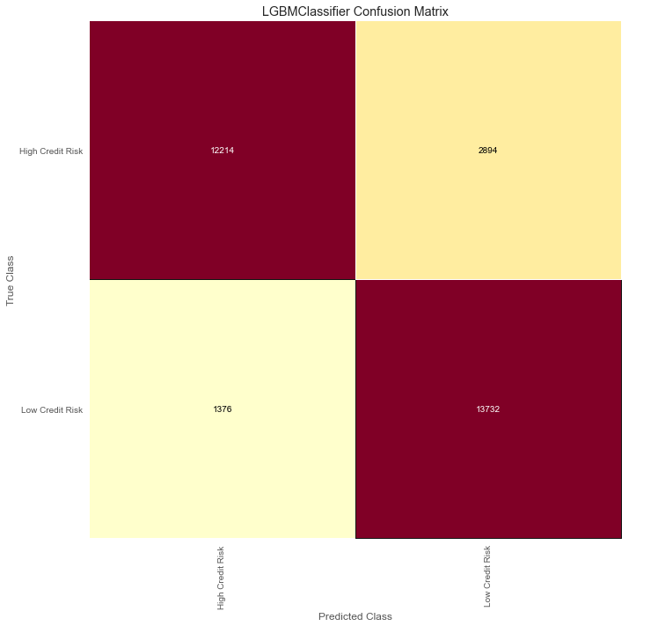
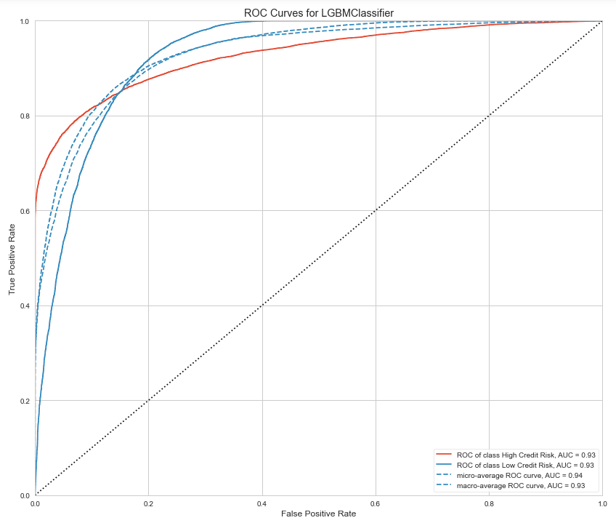
LightGBM Model (SMOTE data)

Slide 38
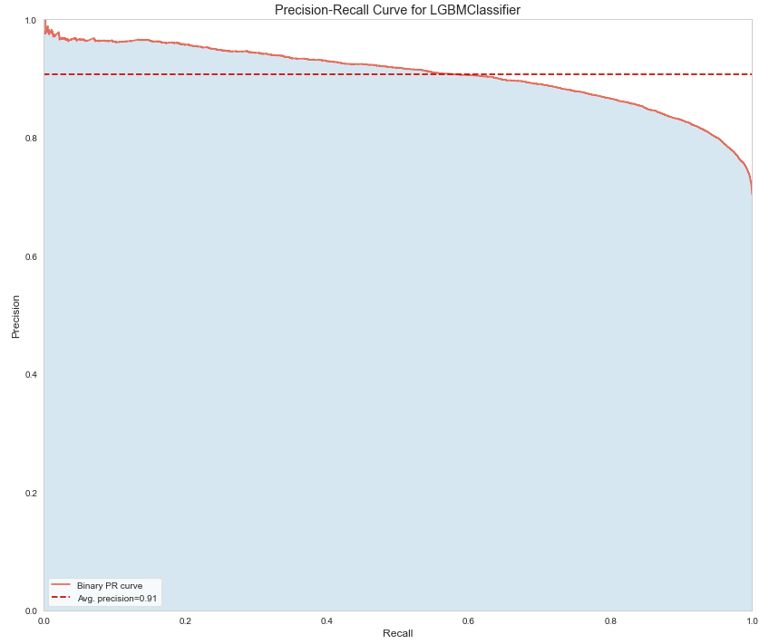
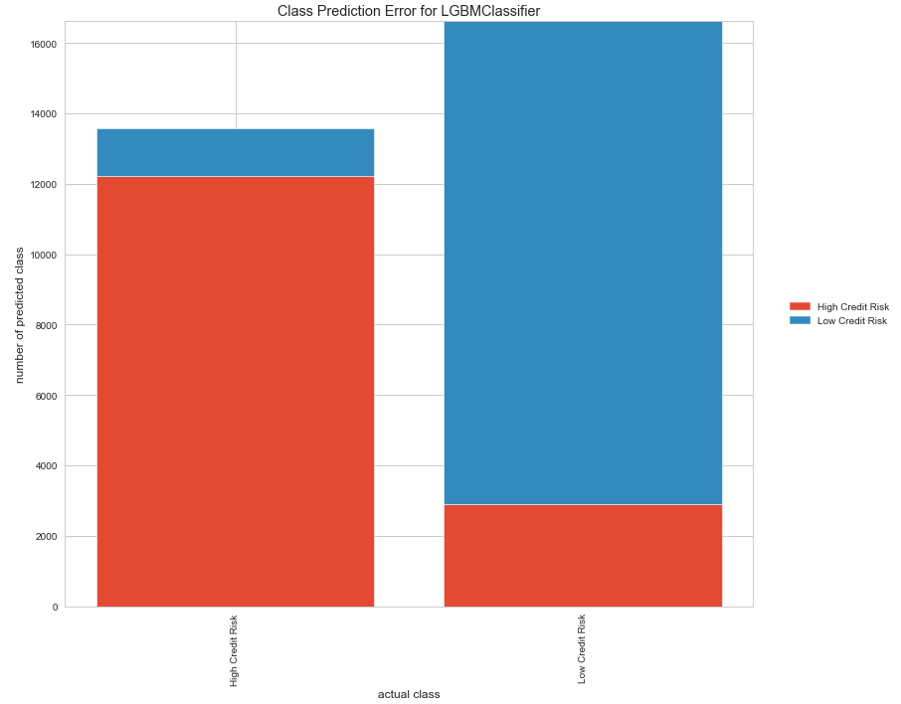
LightGBM Model (SMOTE data)

Slide 39
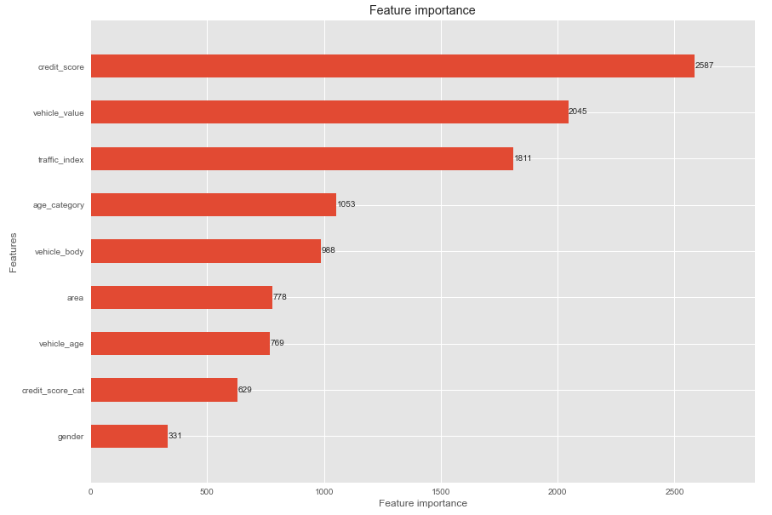
Feature Importance

Slide 40
Study Findings
Policies of vehicles of lower value are at high claim risk.
Worse the credit score; the higher the claim amount.
Low Risk Group | High Risk Group
Female population: Second oldest Age Category Living in Area E Driving a Minibus With an Excellent credit score | Male population: Second oldest Age Category Living in Area D Driving a Utility Vehicle With an Excellent credit score
Policies with vehicle age category 3 | Policies with vehicle age category 4
Areas with slightly lower than median traffic index. | Areas with slightly higher than median traffic index.

Slide 41
Thank you!

