Slide 1



Healthcare fraud detection
Suhita acharya

Slide 2


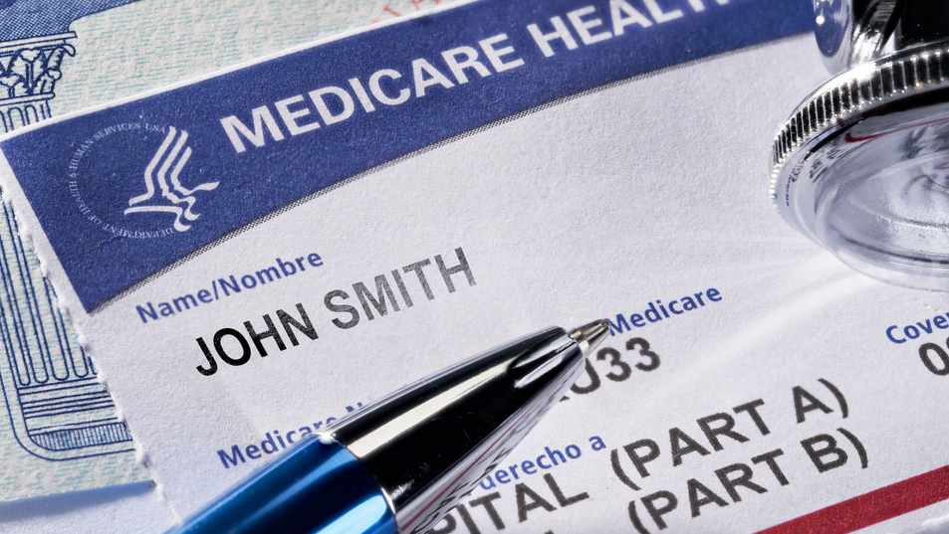
What is Medicare fraud?
Medical Frauds are committed by Doctors/Hospitals aided by medical malpractices.
Medical Providers try to maximize reimbursement received from Insurance companies via illegitimate activities such as submitting false claims:
How do they commit fraud?
Billing for care that they never rendered.
Submitting duplicate claims.
Falsifying claim/patient info.
Disguising non-covered services as covered services.
Using incorrect diagnosis/procedure codes.

Slide 3

Common Types of Health Care Fraud:
Double Billing
Phantom Billing
Upcoding
Unbundling
Kickbacks
Unnecessary Services
False price reporting

Slide 4
Medicare claims dataset
Beneficiary:
Info about patients for whom claims have been submitted
Inpatient:
Claim level data (with provider/doctor info) for the patients that have stayed at the hospital for the medical service.
Outpatient:
Claim level data (with provider/doctor info) for the patients that have stayed at the hospital for the medical service.
Inpatient
Outpatient
Beneficiary

Slide 5
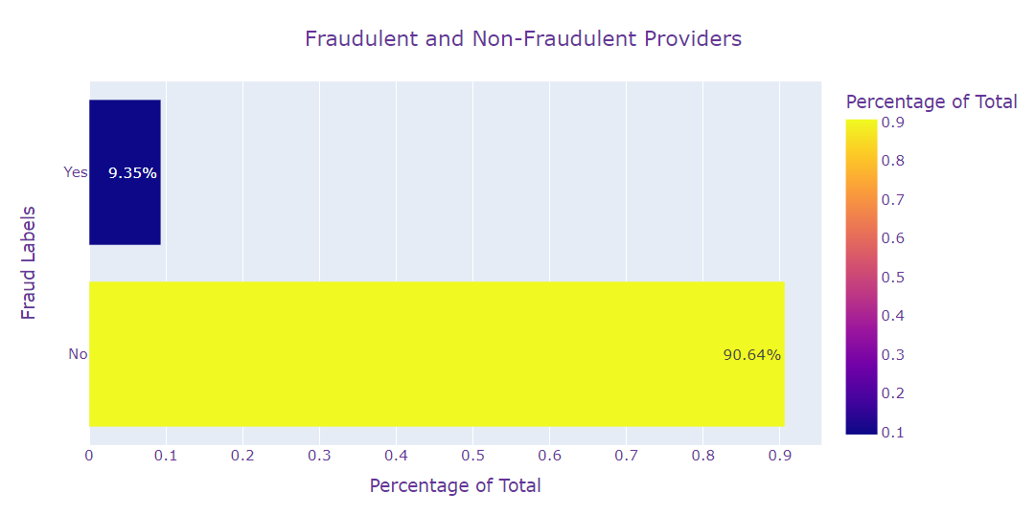
Fraud labels
Fraud labels provided for Hospitals.
Fraud/Non-Fraud providers:
Imbalanced dataset, imbalance handled via SMOTE.
SMOTE and BorderlineSMOTE up sampling technique employed before modeling.

Slide 6
DATA PREPROCESSING
Data was robust-scaled:
Due to the inclusion of outliers
Two different sets were evaluated for each model:
One using SMOTE and one using Borderline SMOTE upsampling
Different model types attempted:
Logistic Regression
Random Forest
Linear SVC
ADABoost
XGBoost
LightGBM
Hyperparameters were tuned based on the F1 metric.
Final parameters are chosen by Recursive Feature Selection
Missing Data Imputed:
Beneficiary:
Inpatient:
Outpatient:
Label Encoding: All categorical features
New Feature Creation:
Deceased, Tot_Reimbursed_Amt, Hospital_Stay, Claim_Duration, Physician_Count, Claim_Count, Chr_Cond_Count, etc.
Dropped features:
With high null values, ones from which other features were created, etc.
Combined all datasets with fraud labels.

Slide 7
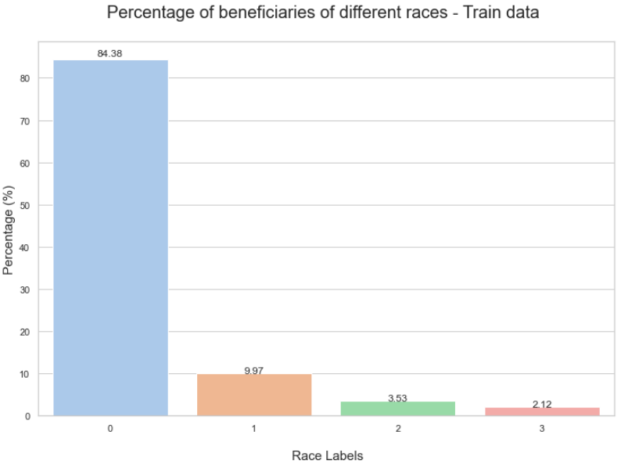
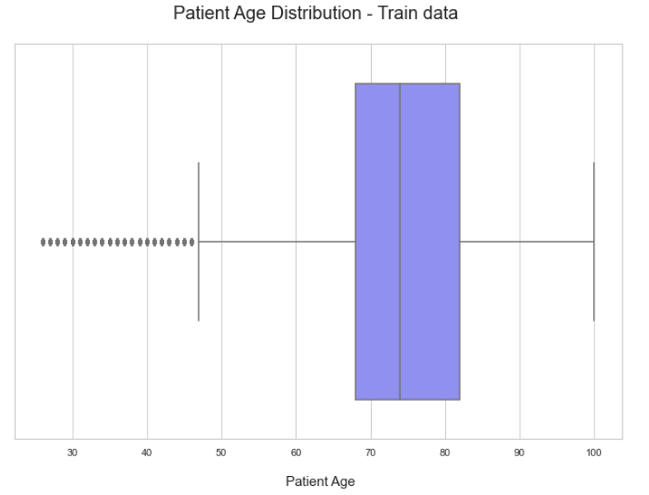
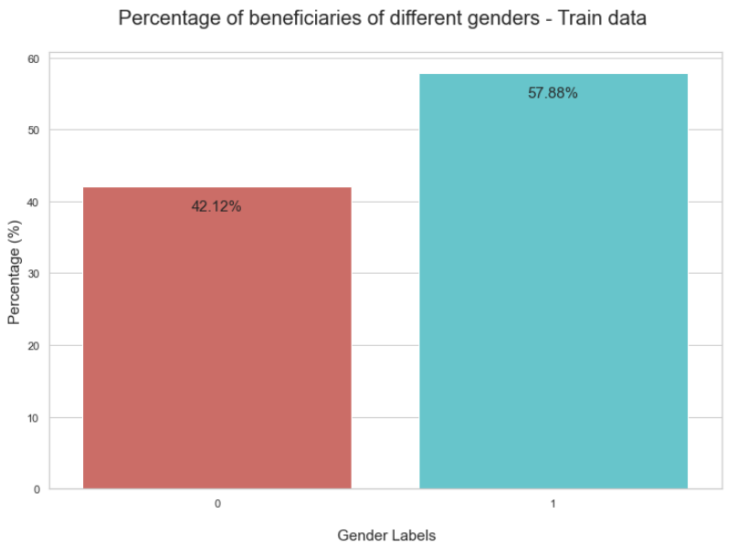
Before we proceed…
Basic Patient Information:
Most of the Beneficiaries that have Inpatient/Outpatient claims are alive.

Slide 8
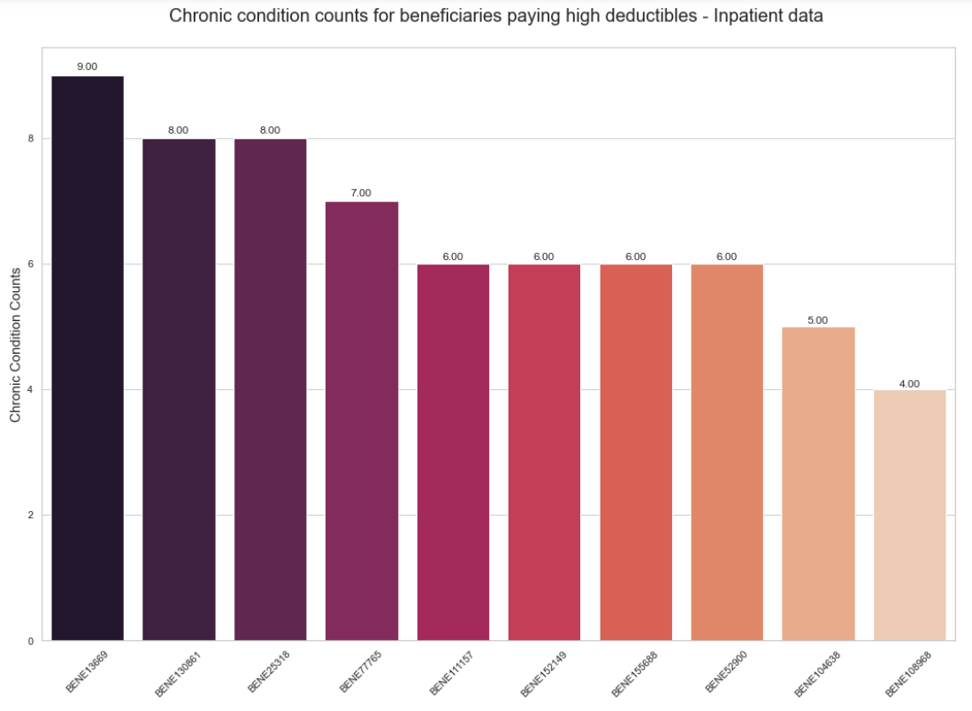
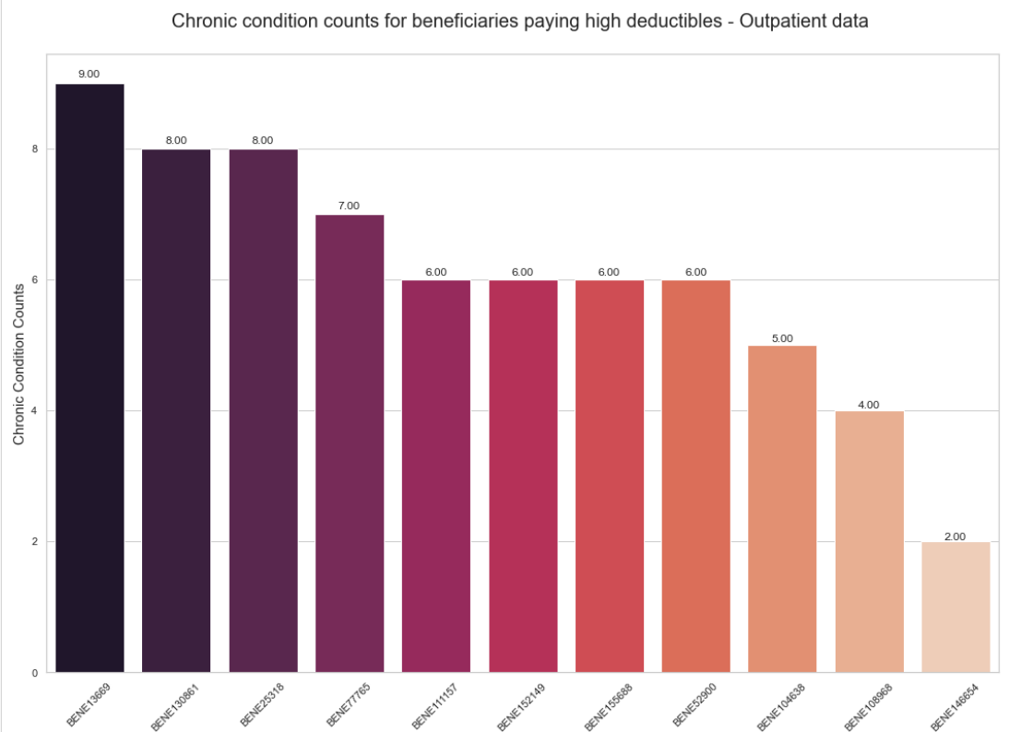
PATIENT INFORMATION (CONT..)
Notes:
Think of adding the high deduc reimburse graphs

Slide 9
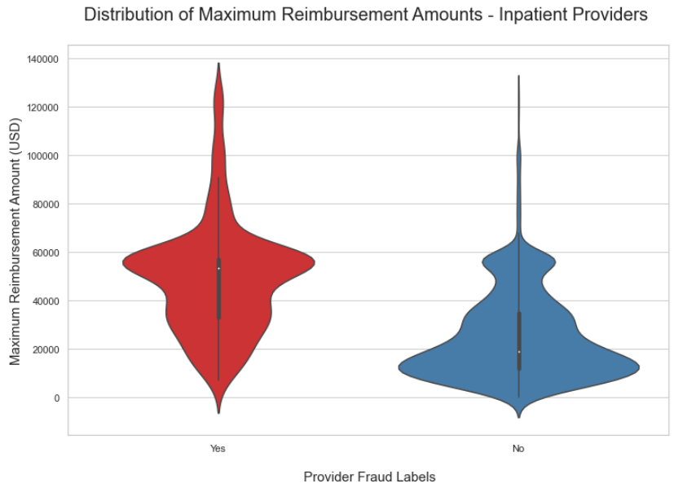
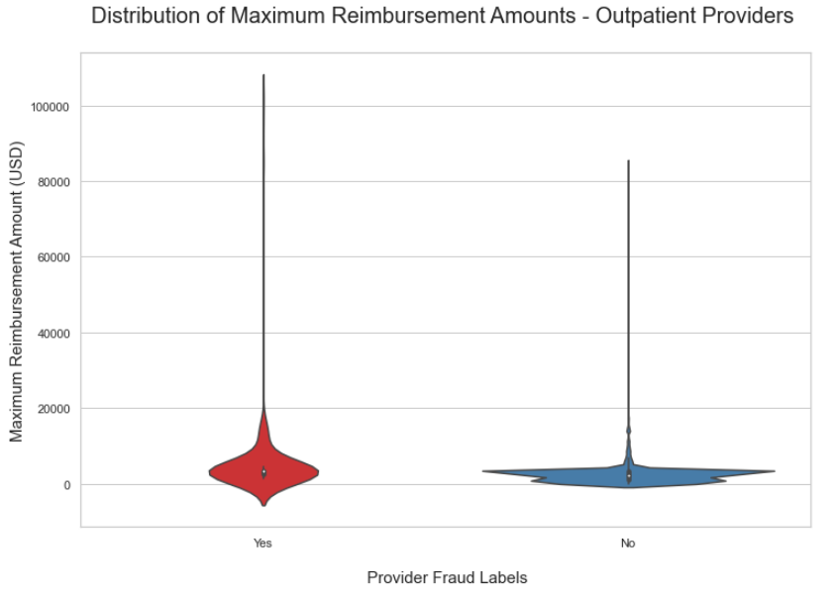
Fraud vs non-fraud provider study:

Slide 10
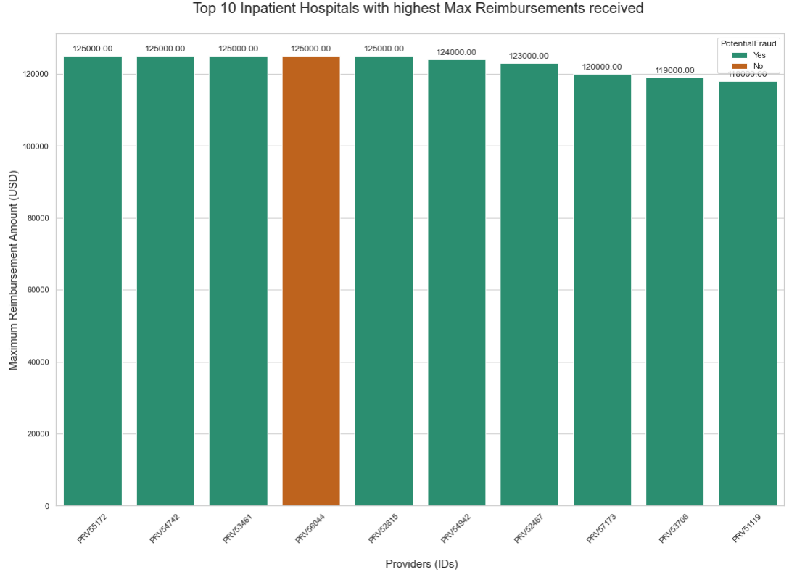
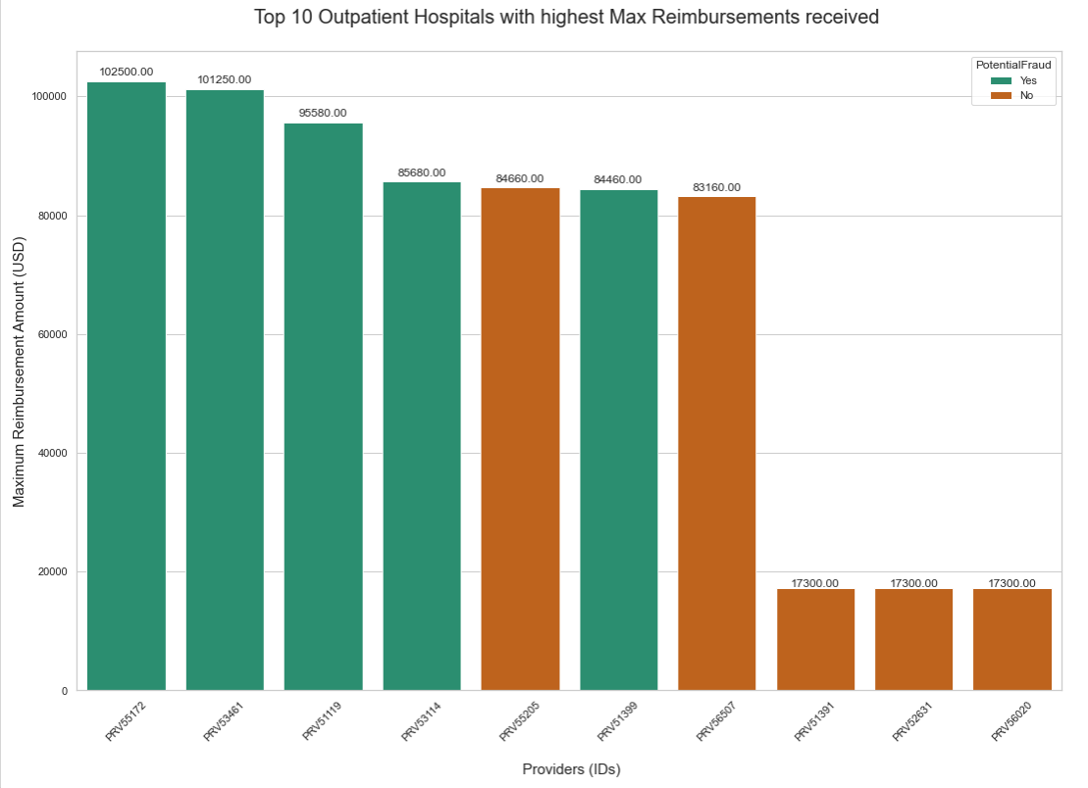
Fraud vs non-fraud provider study:

Slide 11
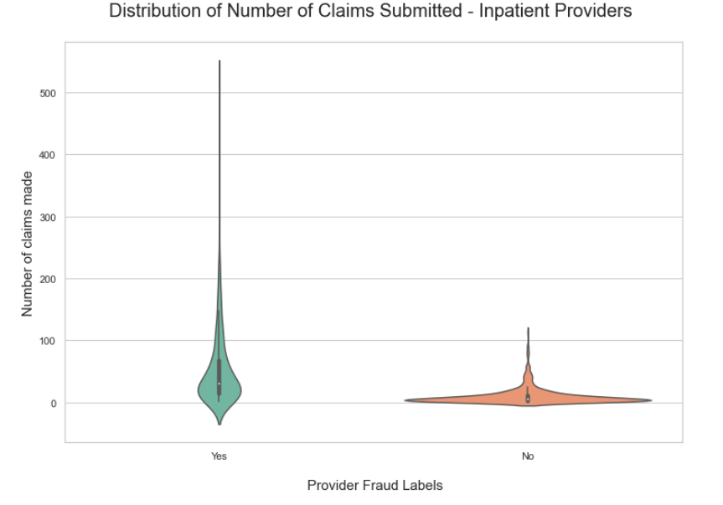
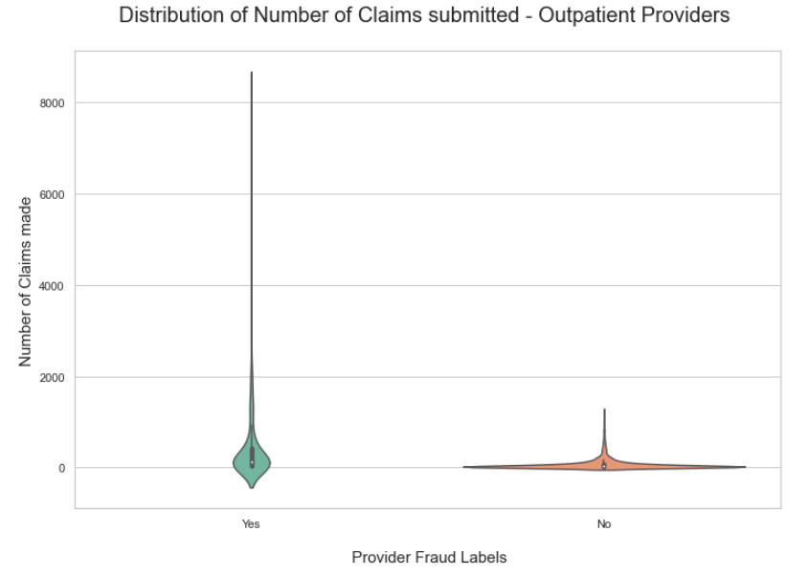
Fraud vs non-fraud provider study:

Slide 12
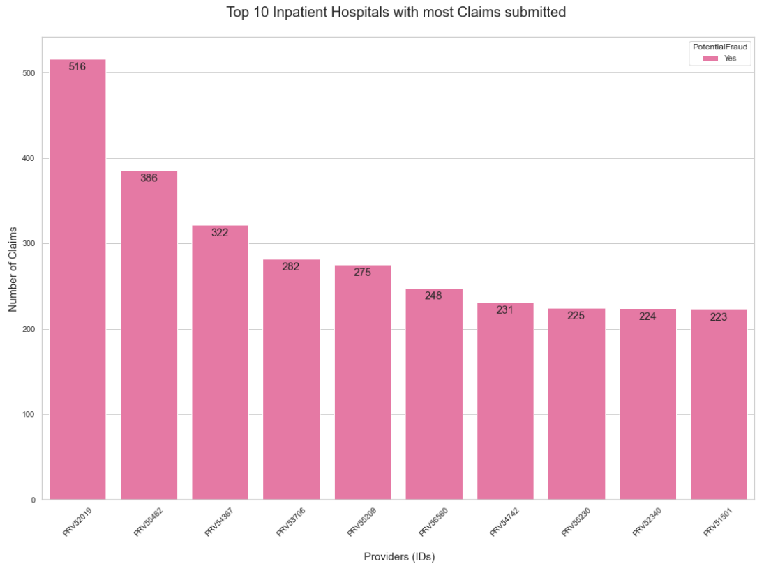
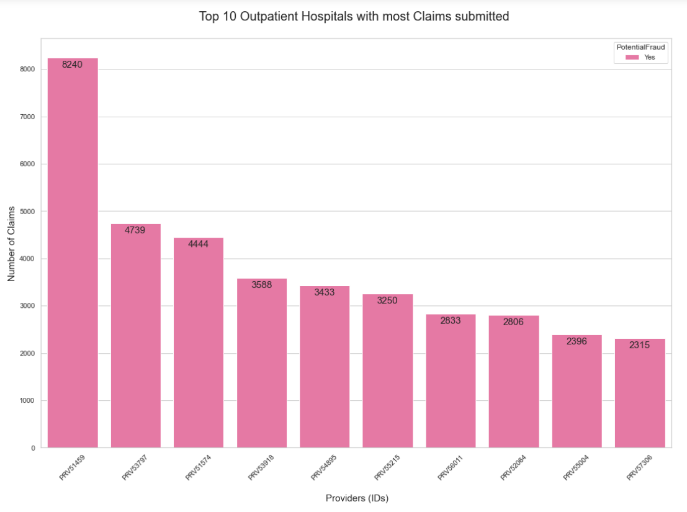
Fraud vs non-fraud provider study:

Slide 13
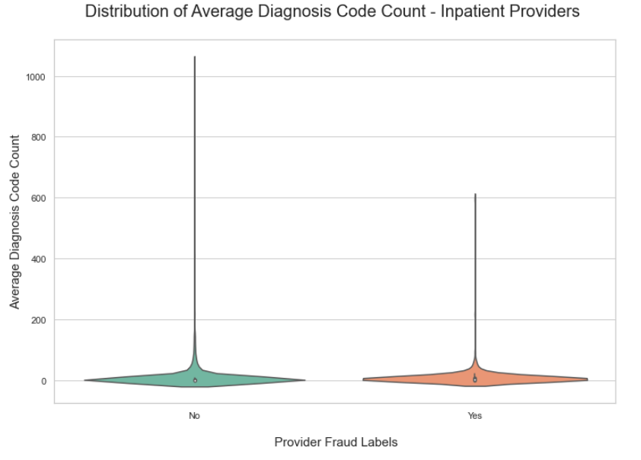
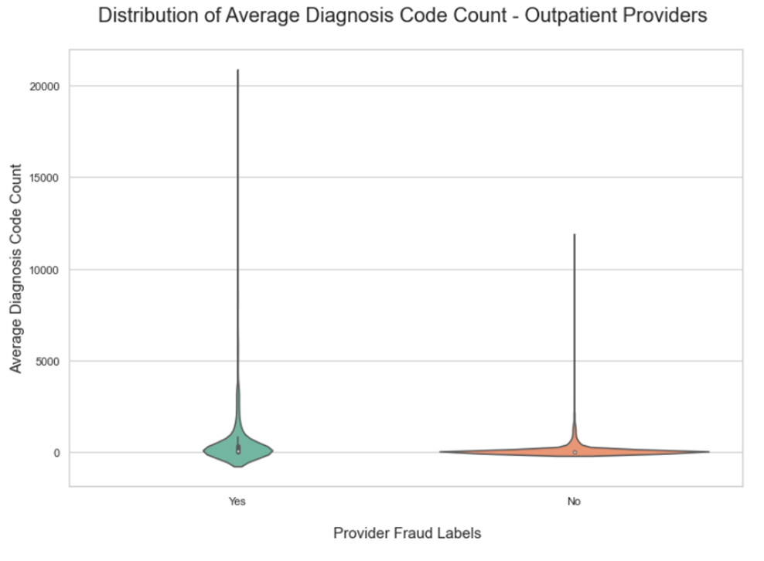
Fraud vs non-fraud provider study:

Slide 14
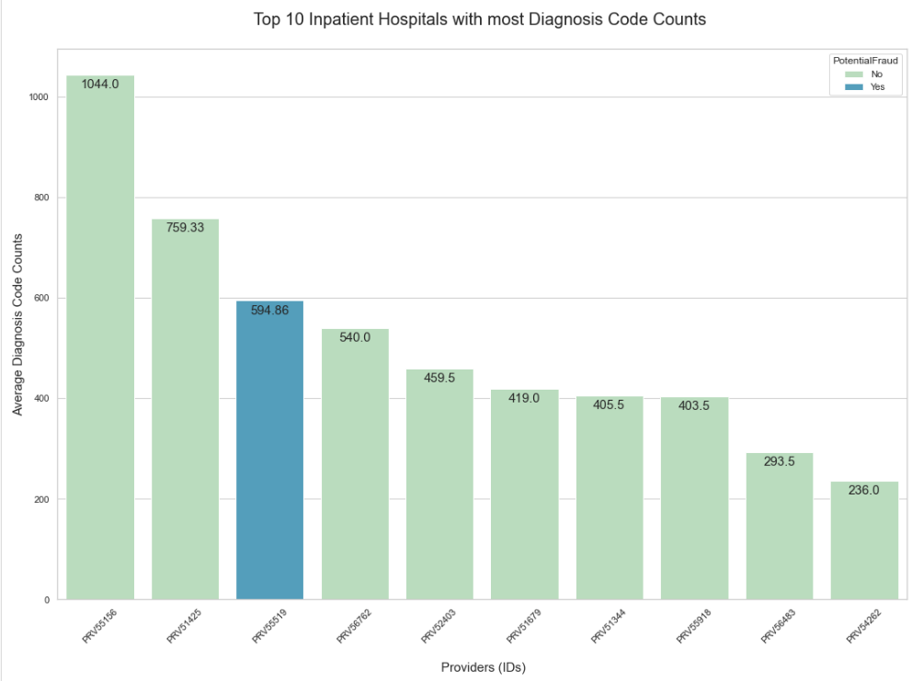
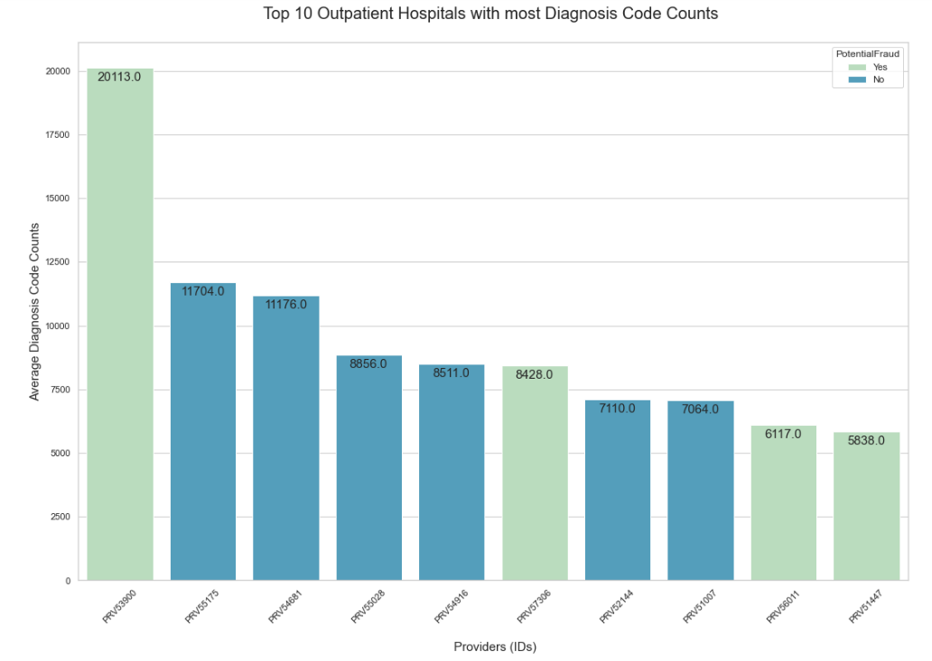
Fraud vs non-fraud provider study:

Slide 15
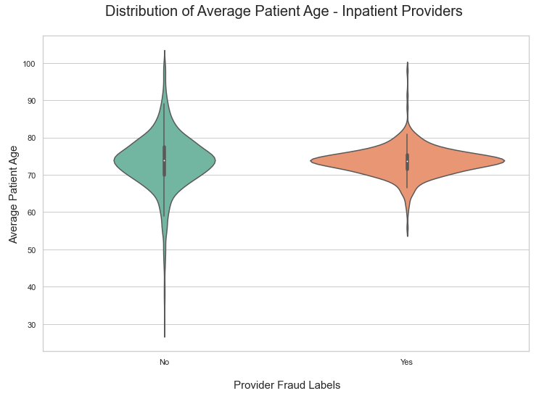
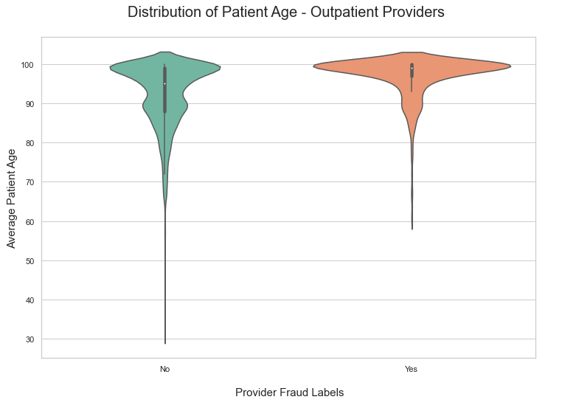
Fraud vs non-fraud provider study:

Slide 16
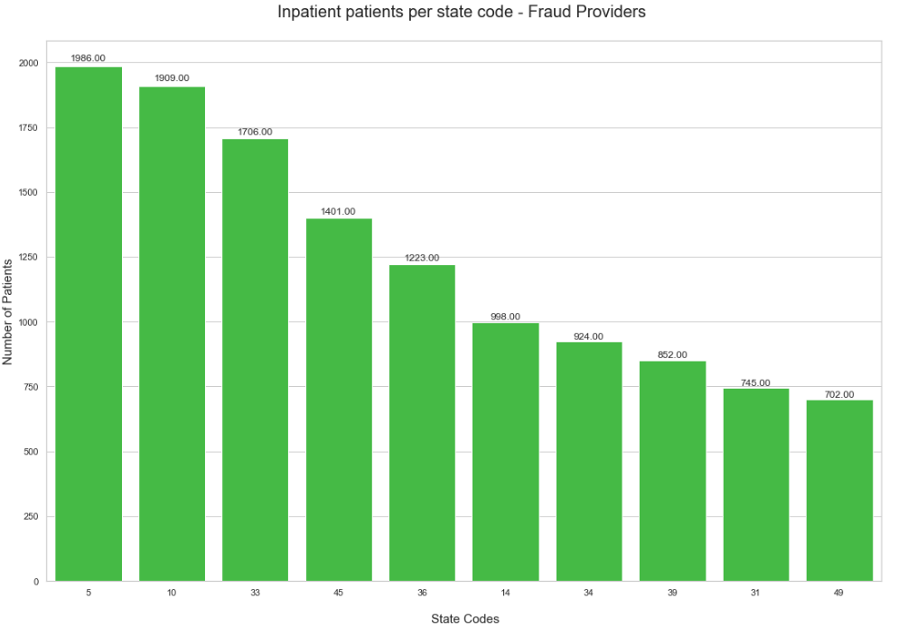
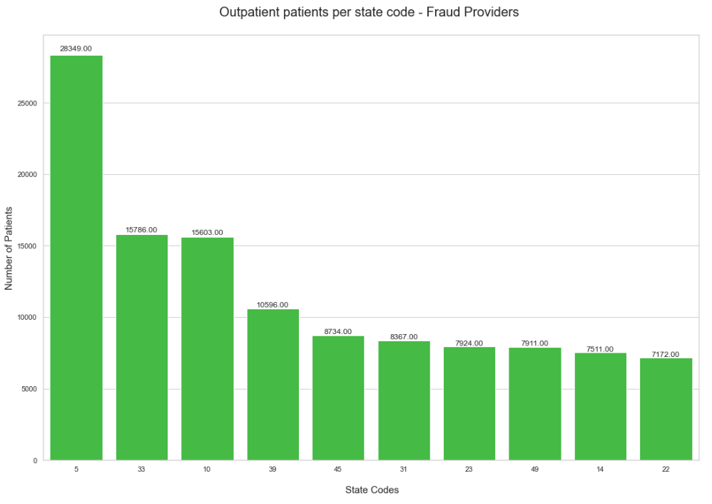
Fraud vs non-fraud provider study:

Slide 17
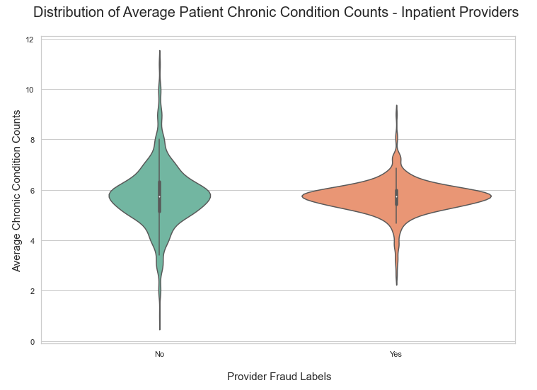
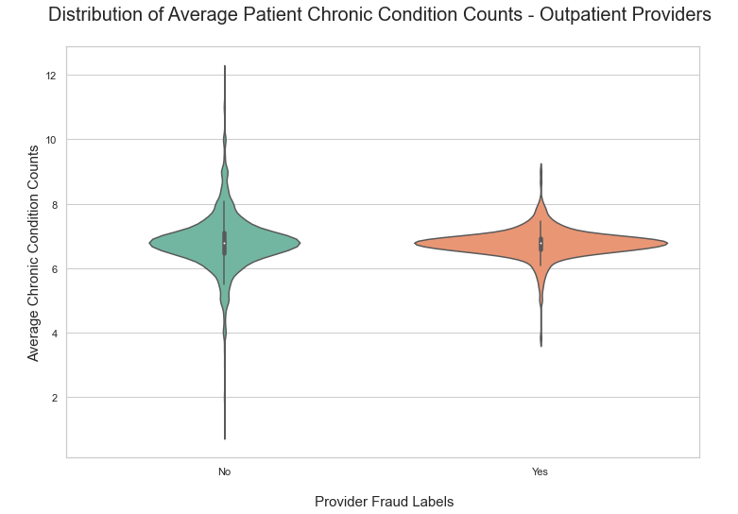
Fraud vs non-fraud provider study:

Slide 18

Thank You!
someone@example.com

