Slide 1
Ames, Iowa: House Sale Price prediction
Suhita Acharya

Slide 2
How can we decide on a house’s sales price?
Objective: To create a machine learning model that can assist home realtors/mortgage lenders to determine a house’s sales price
Several models will be developed, and one will be chosen to create an optimal price determination tool.
Let us start with listing some universal factors that affect house sales:
Location
Usable Space
House Condition (external and internal)
Remodeling
Number of bedrooms/bathrooms

Slide 3
What does sales data from Ames, Iowa tell us?
This dataset consists of sale price listings for several houses in Ames Iowa.
The dataset also includes 79 unique descriptors for each house listed.
The aim here is to use the descriptors in creating a model to best predict house prices.

Slide 4
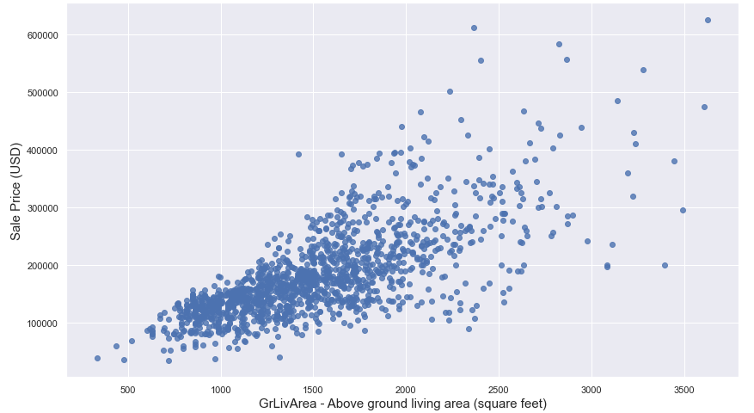
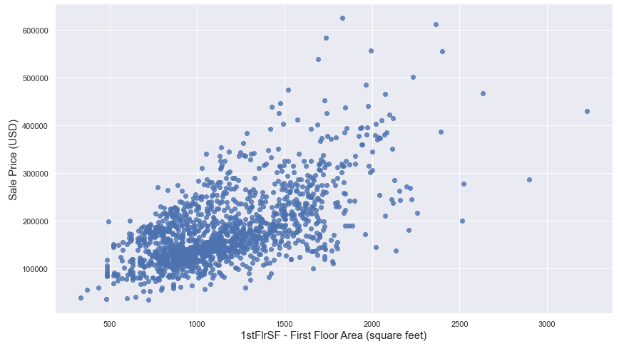
What does sales data from Ames, Iowa tell us?
Sale price relation to some area related features:

Slide 5
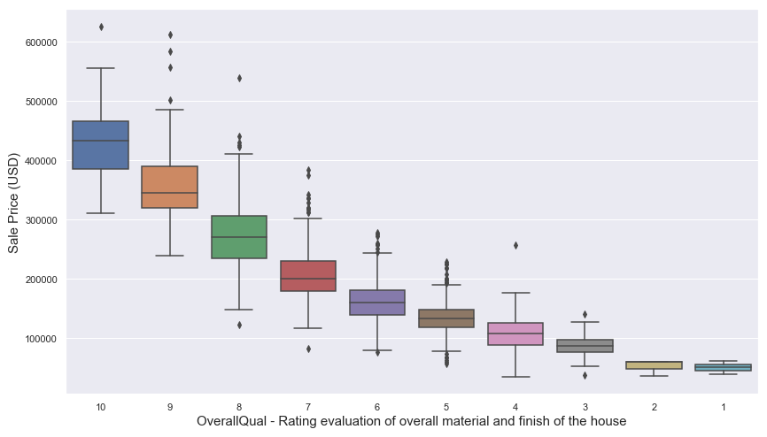
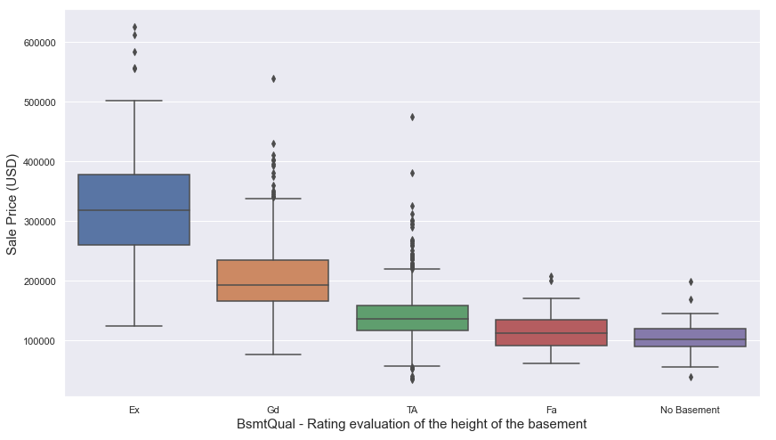
What does sales data from Ames, Iowa tell us?
Sale price relation to some quality/condition related features:

Slide 6
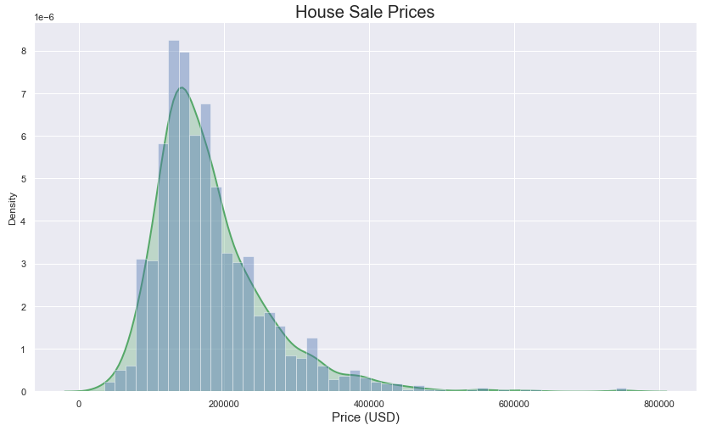
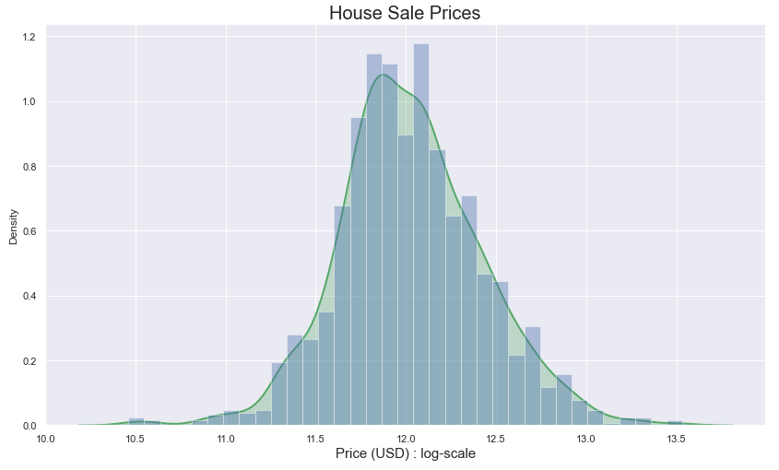
Data Preprocessing:
Missing Values:
Several features such as PoolQC, Alley, Fence, LotFrontage, GarageYrBlt, etc. included null values. Values were imputed accordingly.
Outliers removed:
Extreme outliers in columns such as Utilities, GrLivArea, TotalBsmtSF, LotFrontage, etc were removed.
Changing data type for some columns:
Numerical columns with year, and month-related information were converted to categories.
SalesPrice values:
Log-transformed for a more gaussian-like distribution.

Slide 7
Feature Engineering (all models):
New Numerical Features:
sold_age = Age of the house when it was sold
Usable_space = BsmtFinSF + GrLivArea + 1stFlrSF + 2ndFlrSF
yr_since_remod = Years since remodeling was done
Total_Halfbaths = sum of all half baths
Total_Fullbaths = sum of all full baths
Encl_Porch_tot = sum of all enclosed porch areas
BsmtFinSF = sum of Type 1 and Type 2 finished basement area
New Categorical Features:
remod_y_n: Whether house was remodeled or not

Slide 8
Feature Engineering (all models):
Combined values in categorical features:
LandContour : replacing values other than Lvl to Notlvl
Heating : replacing values other than GasA to Heat_other
Electrical : replacing values other than SBrkr to Electr_other
PavedDrive : replacing values other than Y to NP

Slide 9
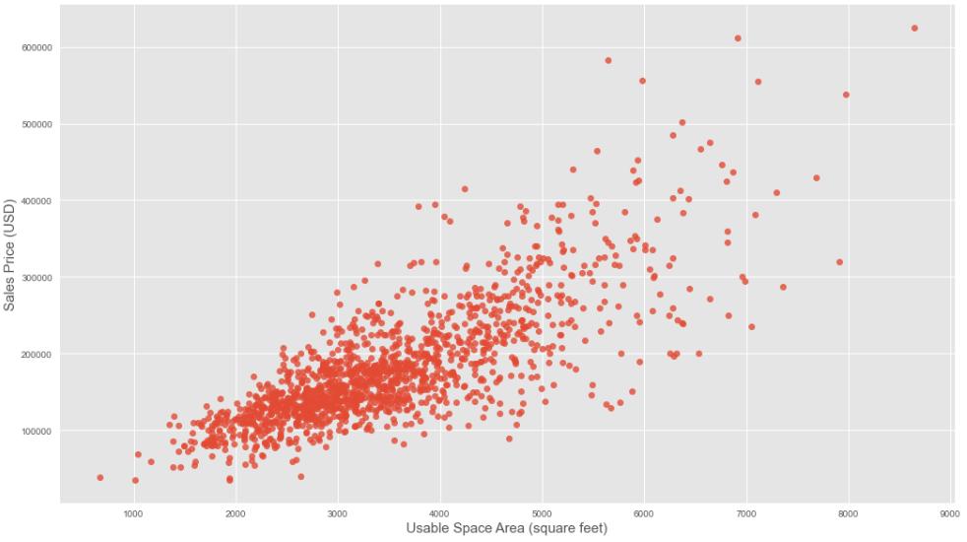
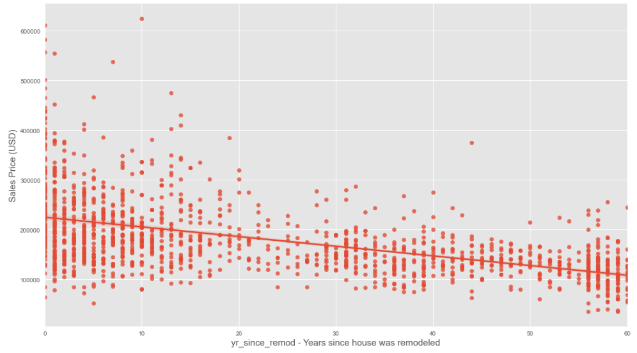
Relation of new features with Sales Prices

Slide 10
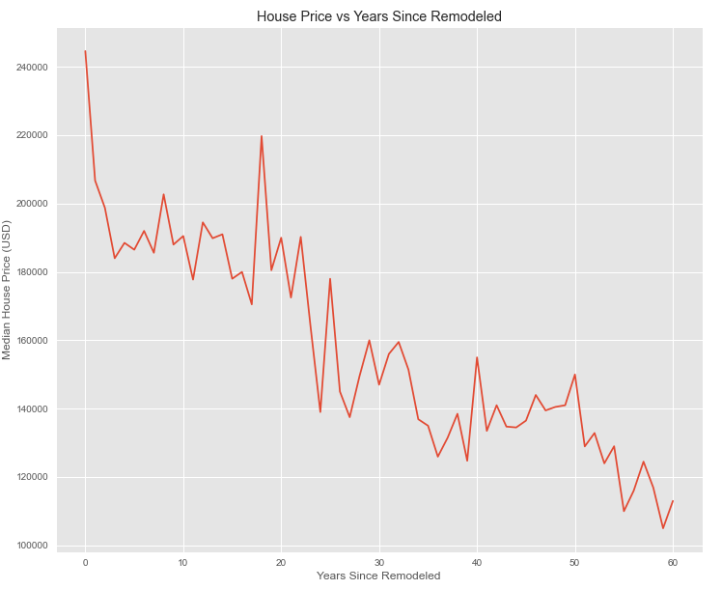
Relation of new features with Sales Prices

Slide 11
Linear Models

Slide 12
Thank you

