Slide 1
Ames, Iowa: House Sale Price prediction
Suhita Acharya

Slide 2
How can we decide on a house’s sales price?
Objective: To create a machine learning model that can assist home realtors/mortgage lenders to determine a house’s sales price
Several models will be developed, and one will be chosen to create an optimal price determination tool.
Let us start with listing some universal factors that affect house sales:
Location
Usable Space
House Condition (external and internal)
Remodeling
Number of bedrooms/bathrooms

Slide 3
What does sales data from Ames, Iowa tell us?
This dataset consists of sale price listings for several houses in Ames Iowa.
The dataset also includes 79 unique descriptors for each house listed.
The aim here is to use the descriptors in creating a model to best predict house prices.

Slide 4
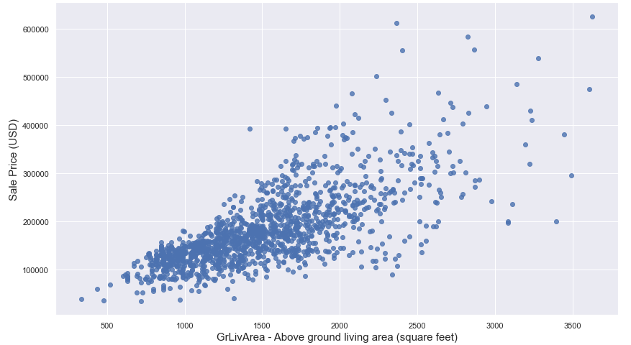
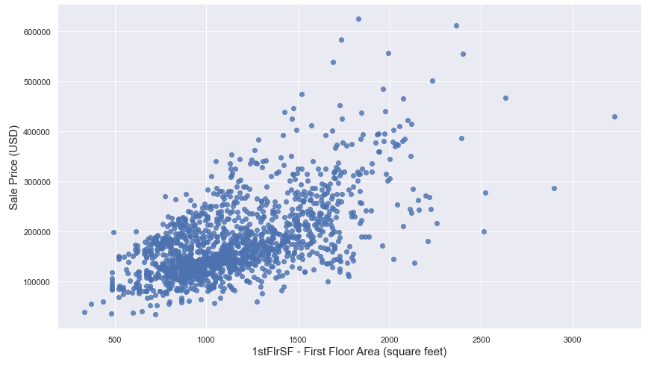
What does sales data from Ames, Iowa tell us?
Sale price relation to some area related features:

Slide 5
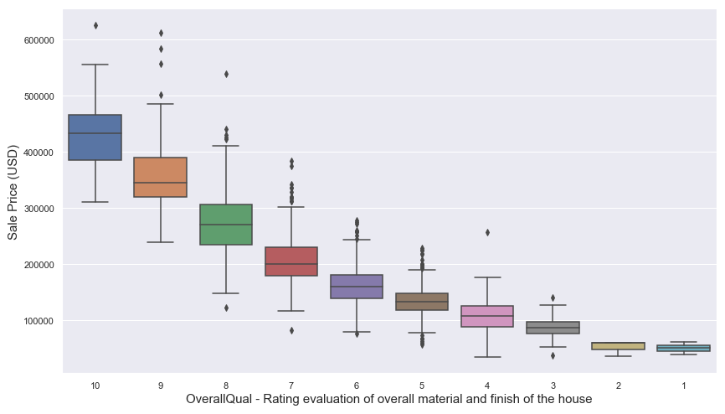
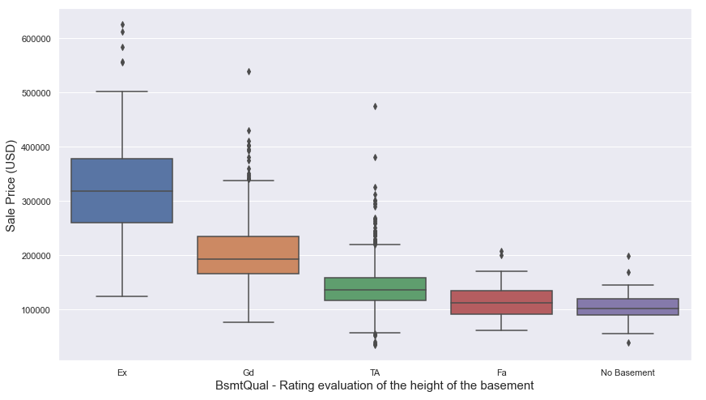
What does sales data from Ames, Iowa tell us?
Sale price relation to some quality/condition related features:

Slide 6
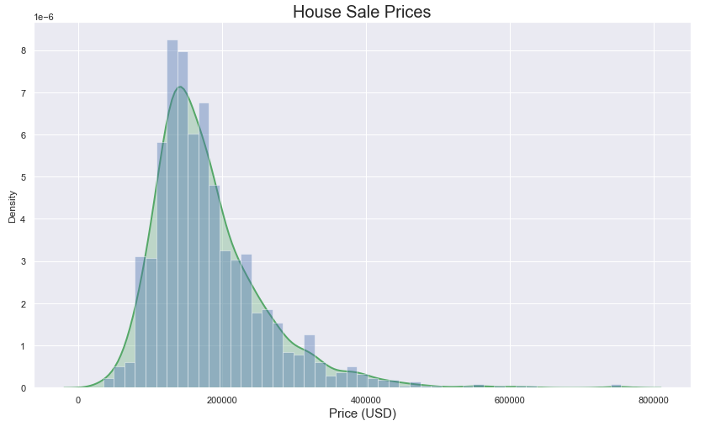
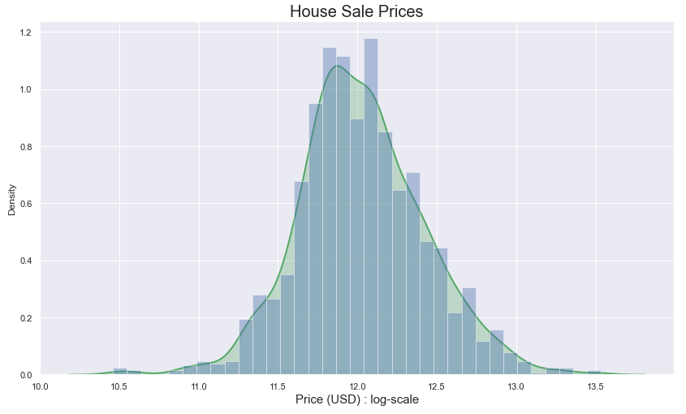
Data Preprocessing:
Missing Values:
Several features such as PoolQC, Alley, Fence, LotFrontage, GarageYrBlt, etc. included null values. Values were imputed accordingly.
Outliers removed:
Extreme outliers in columns such as Utilities, GrLivArea, TotalBsmtSF, LotFrontage, etc were removed.
Changing data type for some columns:
Numerical columns with year, and month-related information were converted to categories.
SalesPrice values:
Log-transformed for a more gaussian-like distribution.

Slide 7
Feature Engineering (all models):
New Numerical Features:
sold_age = Age of the house when it was sold
Usable_space = BsmtFinSF + GrLivArea + 1stFlrSF + 2ndFlrSF
yr_since_remod = Years since remodeling was done
Total_Halfbaths = sum of all half baths
Total_Fullbaths = sum of all full baths
Encl_Porch_tot = sum of all enclosed porch areas
BsmtFinSF = sum of Type 1 and Type 2 finished basement area
New Categorical Features:
remod_y_n: Whether house was remodeled or not

Slide 8
Feature Engineering (all models):
Combined values in categorical features:
LandContour : replacing values other than Lvl to Notlvl
Heating : replacing values other than GasA to Heat_other
Electrical : replacing values other than SBrkr to Electr_other
PavedDrive : replacing values other than Y to NP

Slide 9
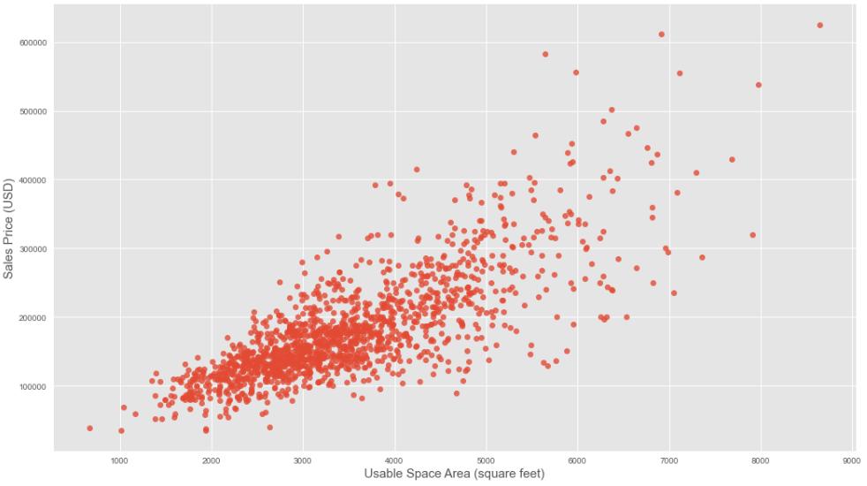
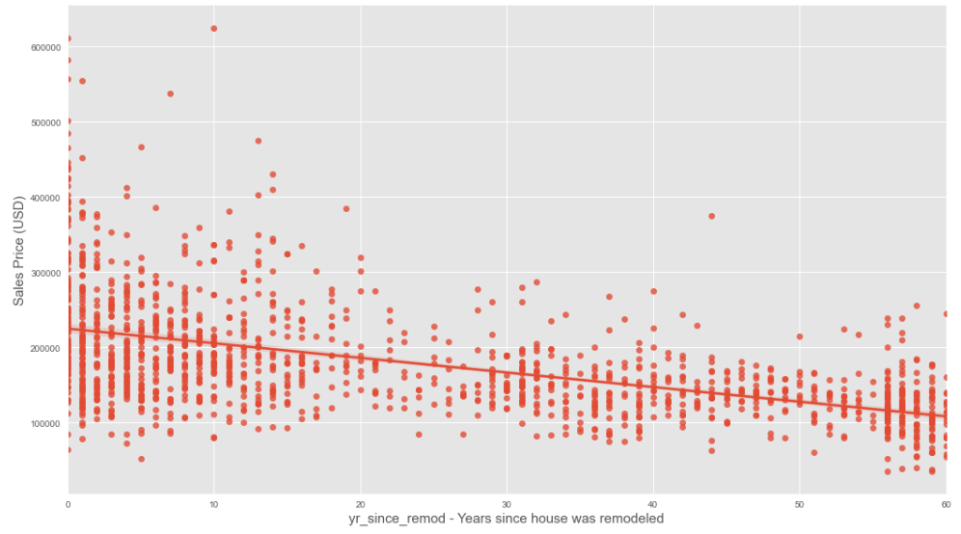
Relation of new features with Sales Prices

Slide 10
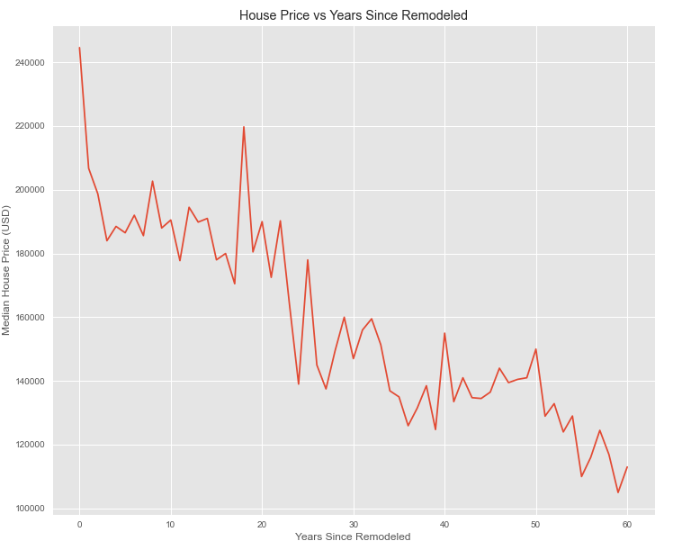
Relation of new features with Sales Prices

Slide 11
Linear Models and SVR
Models attempted:
Multiple Linear Regression (MLR), Ridge and Lasso Regression, and Support Vector Regression
For all the above-mentioned models, numerical features were standardized, and the categorical variables were either label-encoded or dummified.
Label-Encoding:
Dummification:
Categories related to quality, condition or rating.
For ex:- ExterQual, ExterCond, BsmtQual, BsmtCond, HeatingQC, KitchenQual, FireplaceQu, GarageQual, etc.
All the rest of the categorical features.
For ex:- Street, Alley, LandContour, Utilities, LotConfig, Condition1, Condition2, BldgType, HouseStyle, YearBuilt, YearRemodAdd, etc.
All dependent and independent variables were log-transformed.

Slide 12
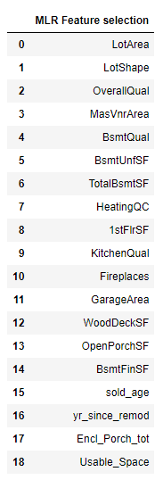
MLR Model Evaluation
Final MLR Model used log-transformed dependent and independent variables.
Model was trained/evaluated on a 70:30 train-test split.
Independent features were selected via Lasso regression (hyperparameter alpha chosen by grid search cross-validation).
Features with high multicollinearity were removed (based on VIF values):
RoofStyle, Exterior1st, Exterior2nd, GarageType, HouseStyle, MSSubClass, MSZoning, MasVnrType.
List of selected features (Lasso alpha=0.01) is shown over to the right.

Slide 13
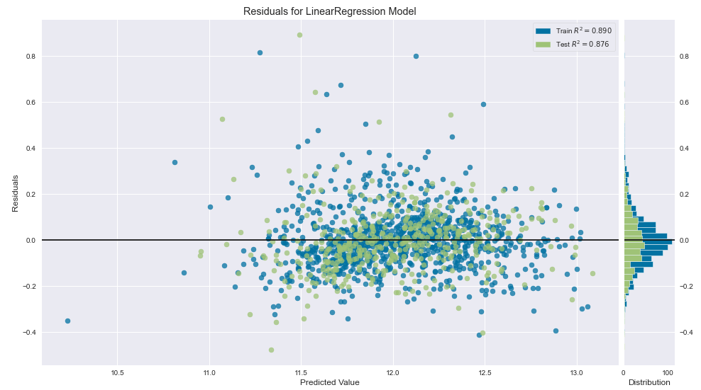
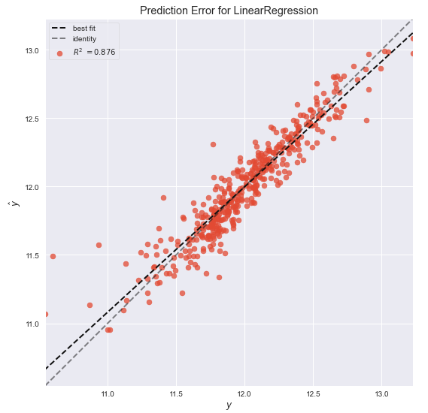
MLR Model Evaluation

Slide 14
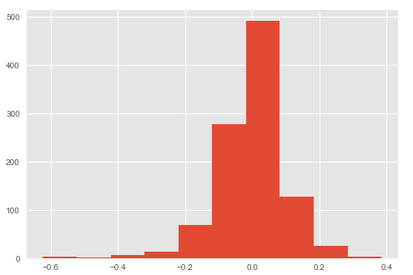
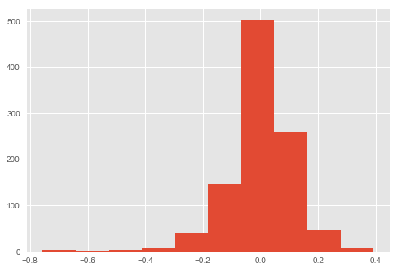
Penalized Regression (PLR) models
Final PLR Models used log-transformed dependent and independent variables.
Models were trained/evaluated on a 70:30 train-test split. Some features with high VIF values were removed
For Lasso model, data were normalized before model fitting.
Lasso Regression
Alpha Hyperparameter is chosen by Grid Search CV as 0.0003.
Ridge Regression
Alpha Hyperparameter is chosen by Grid Search CV as 11.12.

Slide 15
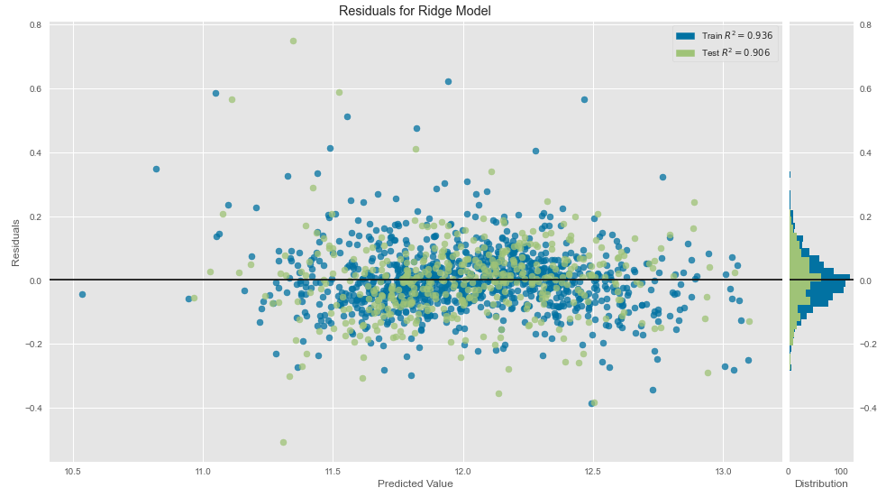
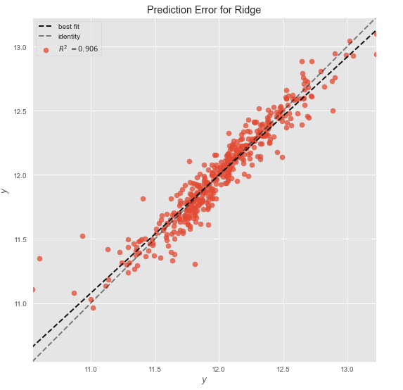
Ridge Regression model:

Slide 16
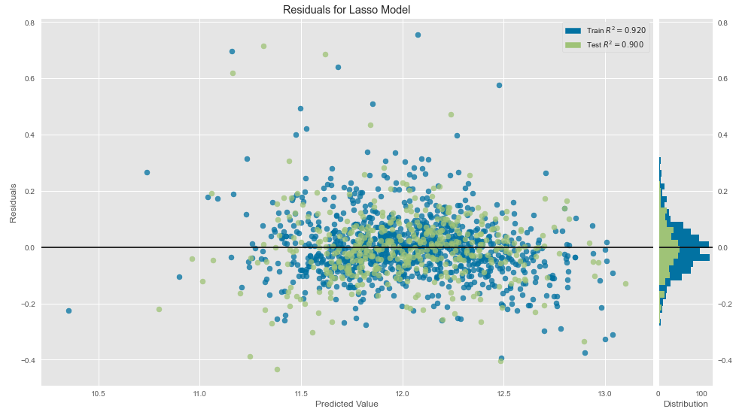
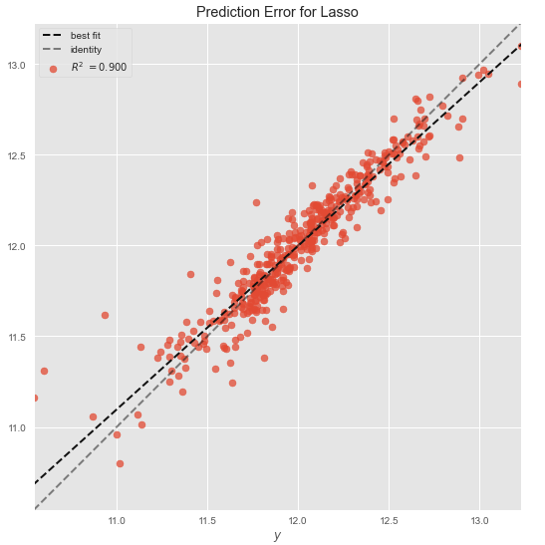
Lasso Regression Model:

Slide 17
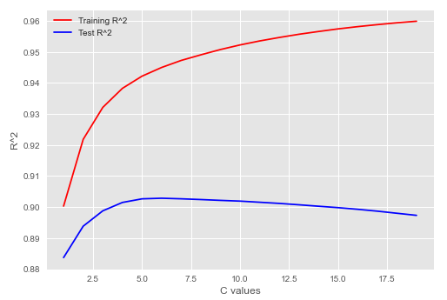
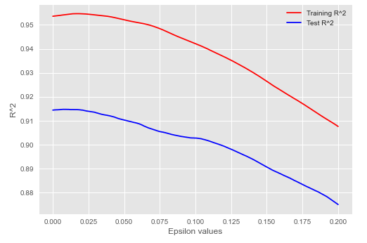
Support Vector Regression Model (SVR):
Final SVR Model used log-transformed dependent and independent variables.
Model was trained/evaluated on a 70:30 train-test split. Some features with high VIF values were removed.
Hyperparameter C and epsilon were determined from plotting R² and errors for train and test data.
Other hyperparameters (gamma and kernel in this case) were selected by Grid Search CV.
Hyperparameter | Value
C | 5
epsilon | 0.01
gamma | 0.001
kernel | rbf

Slide 18
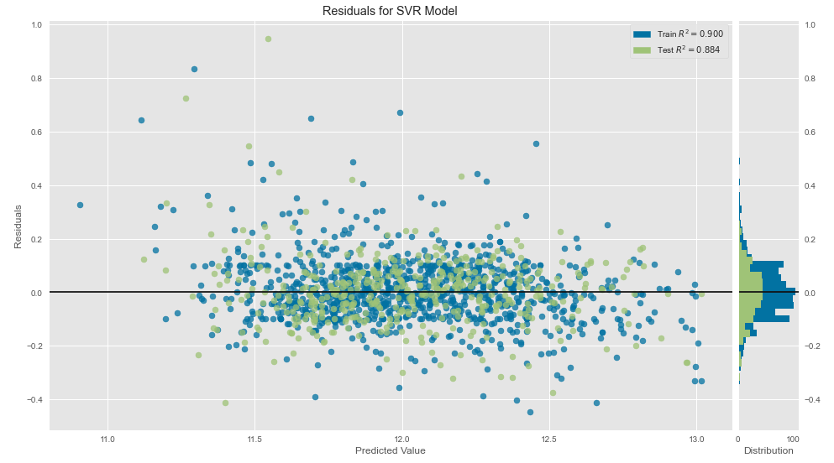
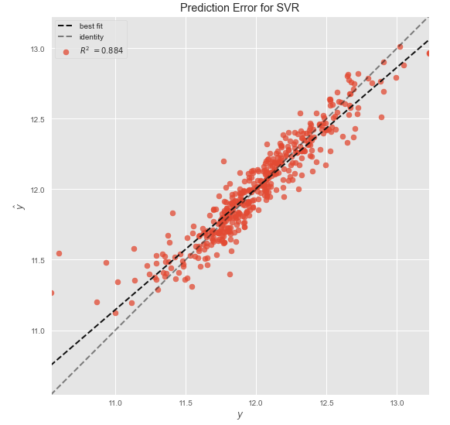
Support Vector Regression Model:

Slide 19
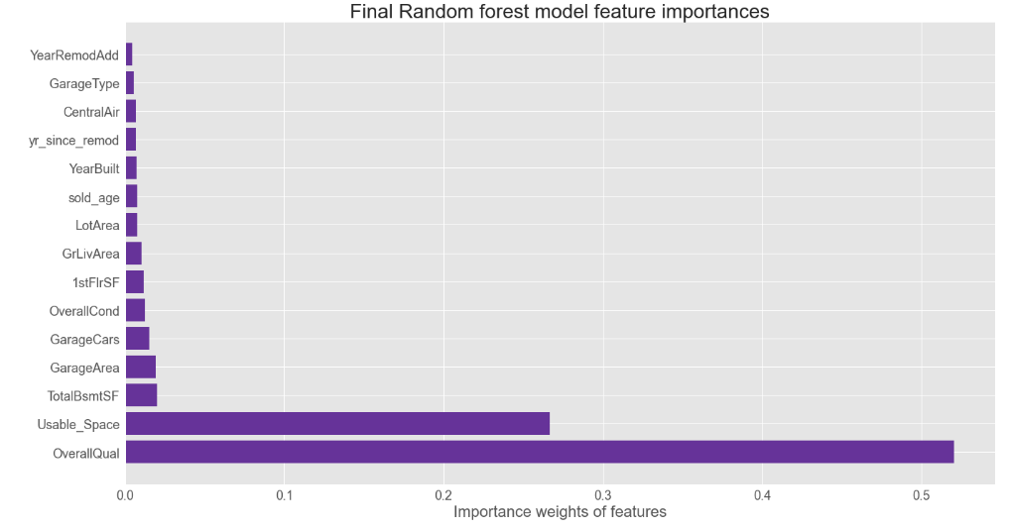
Tree-based models:
Models attempted:
Random Forest and XGBoost
For all the above-mentioned models, numerical features were standardized, and categorical variables were label-encoded only.
Features with high multicollinearity were not dropped.
Both models used log-transformed dependent and independent variables.
Models were trained/evaluated on a 70:30 train-test split.
For the Random Forest model, features importances are shown to the right and chosen hyperparameters (mostly by GridSearchCV) are listed below.
Hyperparameter | Value
max_depth | 16 (CV choose 7)
min_samples_leaf | 2
min_samples_split | 2
n_estimators | 150

Slide 20
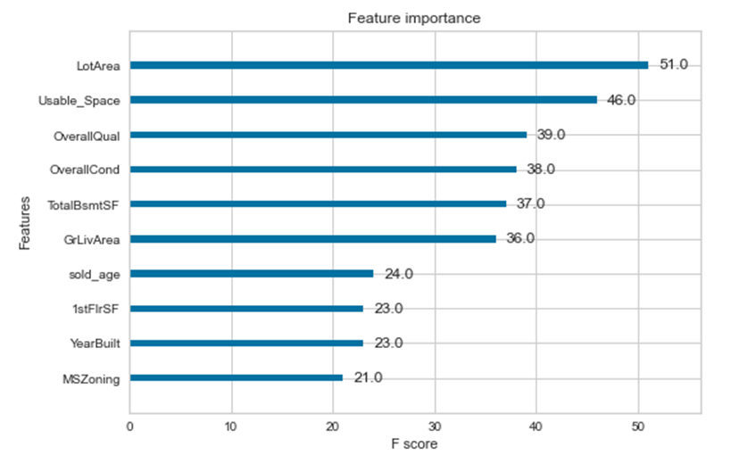
XGBoost Model
Hyperparameter max_depth was determined from plotting R2 and errors for train and test data. An eta hyperparameter value was selected to optimize performance.
Other hyperparameters were selected by Grid Search CV.
Hyperparameter | Value
max_depth | 3
learning_rate | 0.114
min_child_weight | 3
colsample_bytree | 0.7
subsample | 0.6

Slide 21
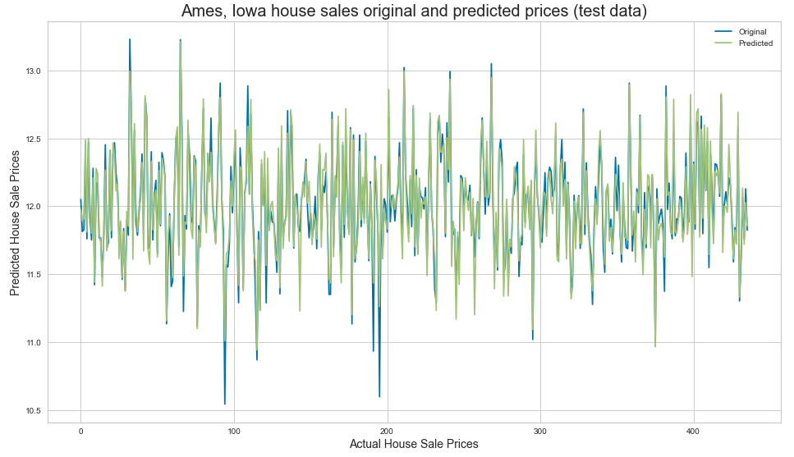
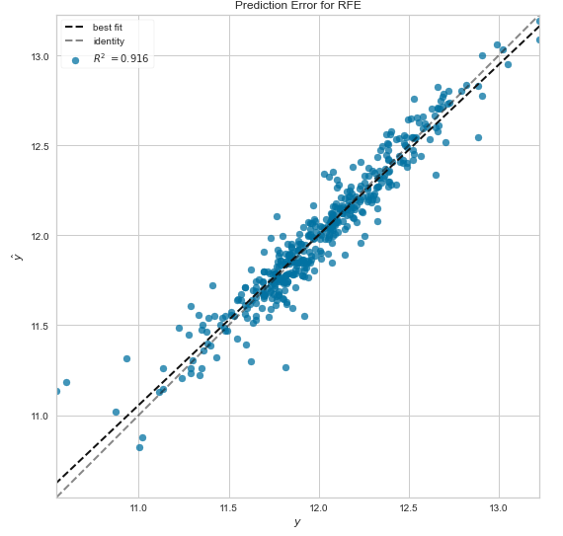
XGBoost model:

Slide 22
Final model Evaluation metrics:
 | MLR | Ridge | Lasso | SVR | Random Forest | XGBoost | XGBoost (RFE)*
Train R² | 0.890 | 0.936 | 0.920 | 0.939 | 0.975 | 0.955 | 0.946
Test R² | 0.876 | 0.906 | 0.900 | 0.914 | 0.893 | 0.913 | 0.916
Train RMSE | 0.133 | 0.101 | 0.113 | 0.099 | 0.063 | 0.084 | 0.092
Test RMSE | 0.137 | 0.119 | 0.123 | 0.114 | 0.127 | 0.115 | 0.113
For the second XGBoost model, features were selected via Sklearn’s Recursive Feature selection:
MSZoning, LotArea, OverallQual, OverallCond, YearBuilt, YearRemodAdd, ExterQual, BsmtQual, BsmtCond, TotalBsmtSF,
HeatingQC, CentralAir, 1stFlrSF, GrLivArea, KitchenAbvGr, Functional, Fireplaces, GarageType, GarageYrBlt, GarageCars,
ScreenPorch, SaleCondition, sold_age, yr_since_remod, Usable_Space

Slide 23
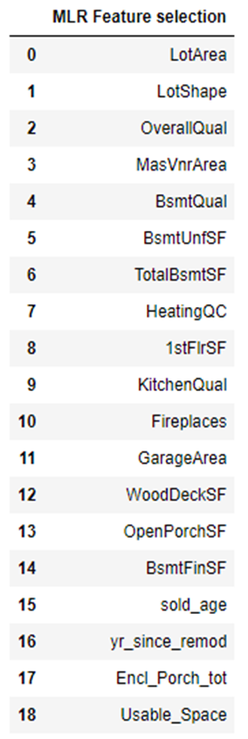
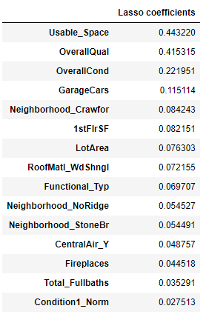
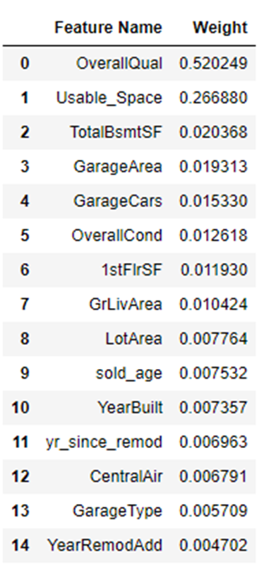
























What do these models tell us about which factors that affect sales prices?
XGBoost Model
Random Forest Model

Slide 24
Thank you

