Slide 1
Boardgames rating analysis
Python EDA Project
- Suhita V Acharya

Slide 2
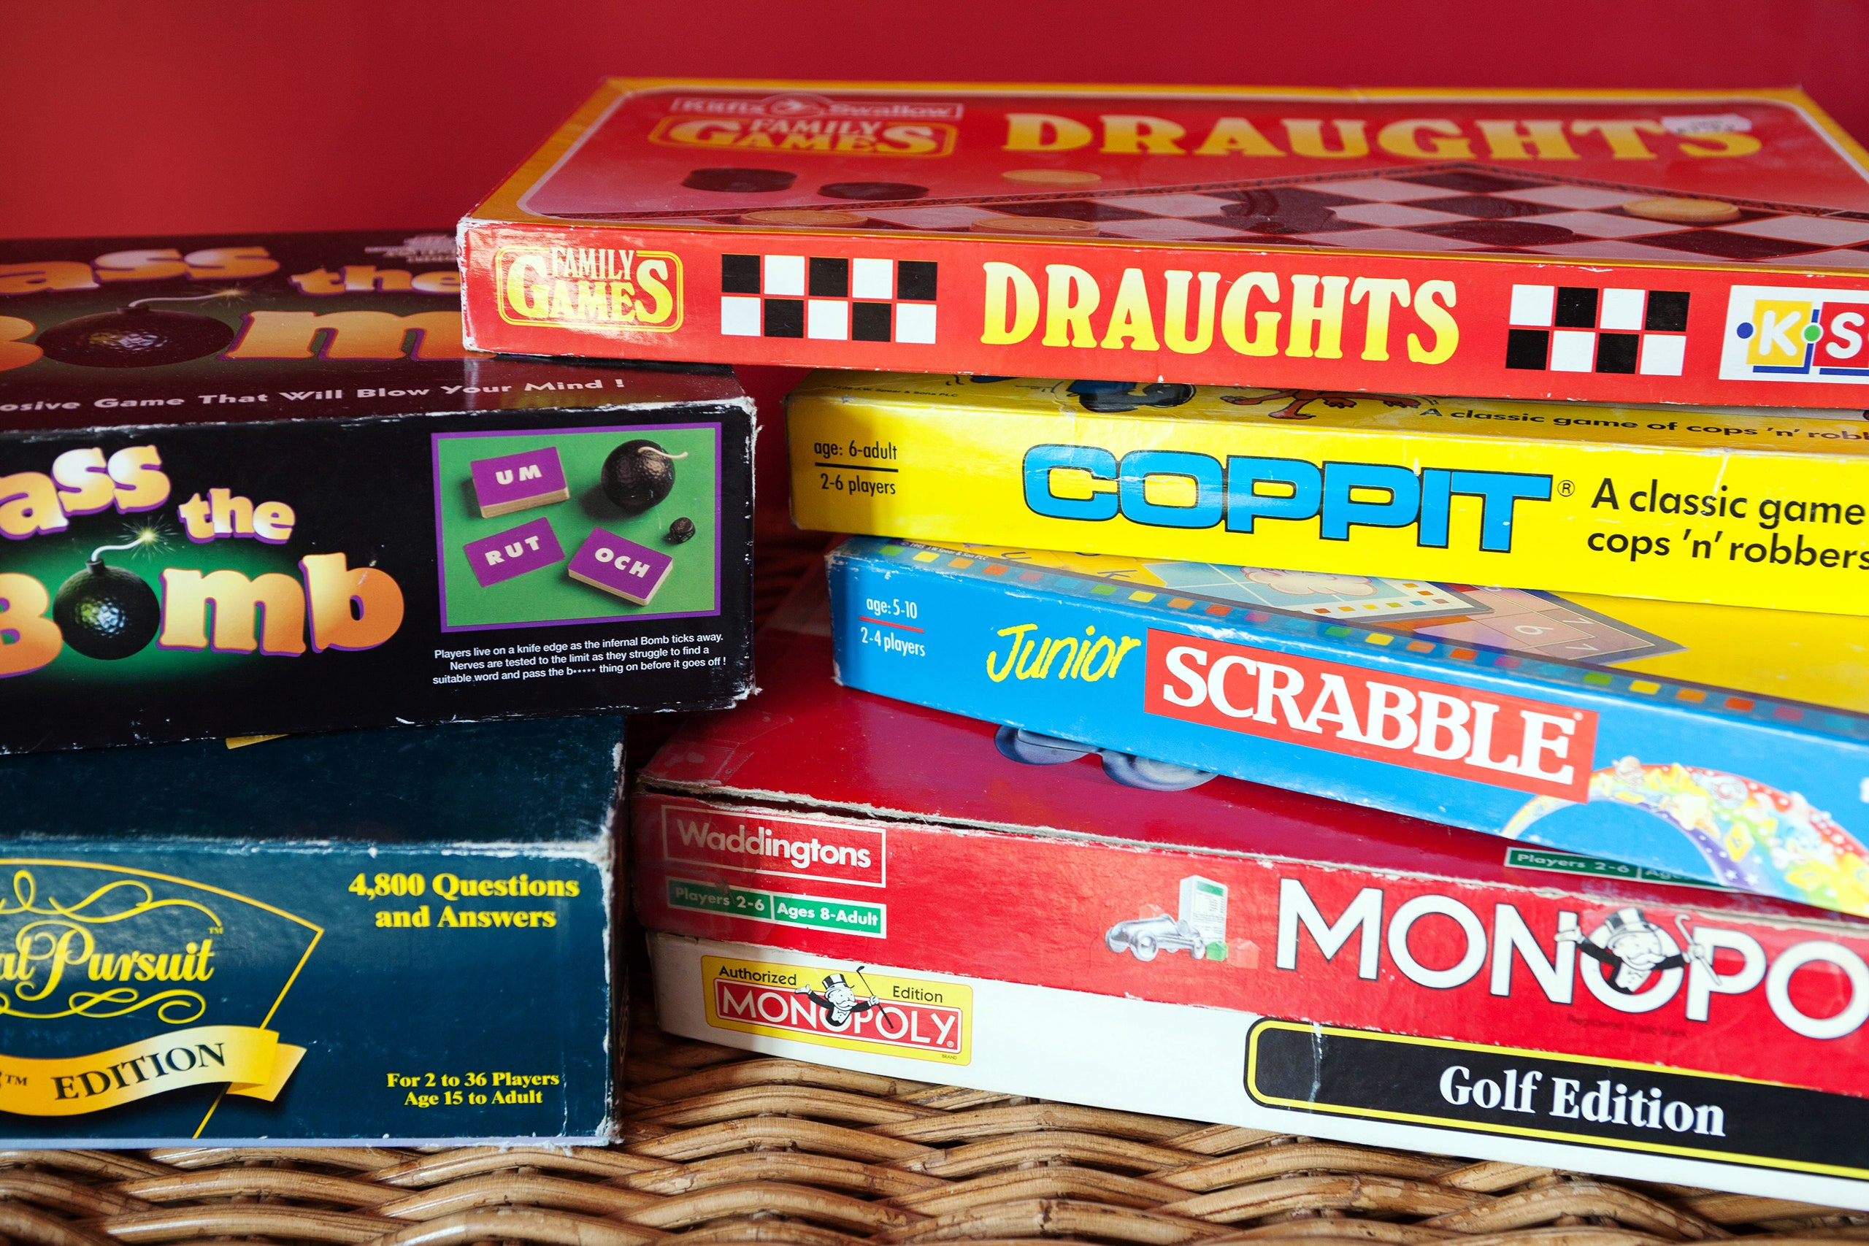
Question of interest
A boardgame’s user ratings on any online platform can be analogous to its overall popularity.
This project researches whether certain metrics on online boardgame databases contribute to board game rating/popularity.
This project compares BGG Geek Rating to different metrics to see if they influence the game’s rating in any way.

Slide 3
STAKEHOLDERS
Game Developers trying to increase their game's rating/popularity and eventually increase sales.
Game Developers developing a new game and looking to research best metrics to incorporate in order to maximize game ratings.

Slide 4
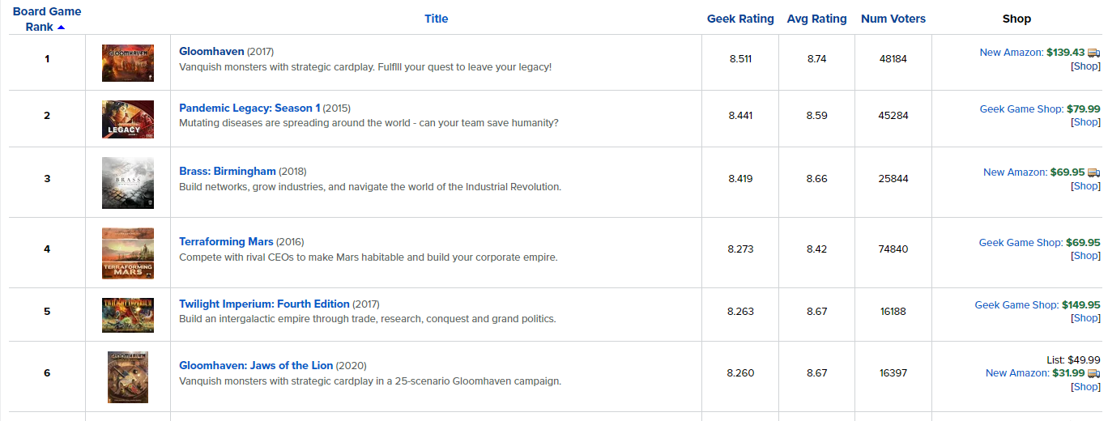
Dataset introduction
Online platform (BGG) - www.boardgamegeeks.com

Slide 5
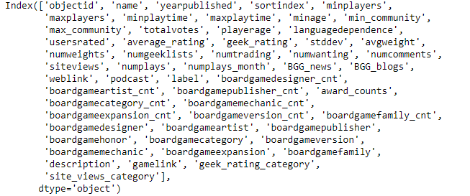
Dataset introduction (cont..)
Kaggle dataset –
20,000 Boardgames Dataset:
Dataset created from data scraped off BGG site for all ranked games.
For the 20,000 games, the dataset includes info ranging from ratings, player age, playing time to game designer names, genres and honor counts.
https://www.kaggle.com/extralime/20000-boardgames-dataset

Slide 6
Features of interest
Site views for games on BGG site
Mentions of the game in different media types such as news/online review articles, blog posts, and podcasts.
Total number of awards won by the game.
Different categories/genres of the game.
Minimum and maximum playing time for the game.

Slide 7
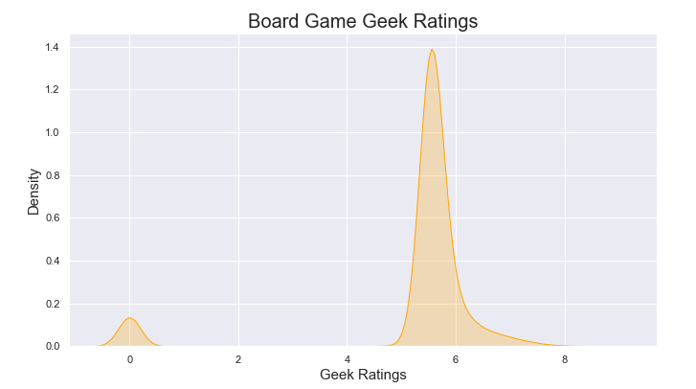
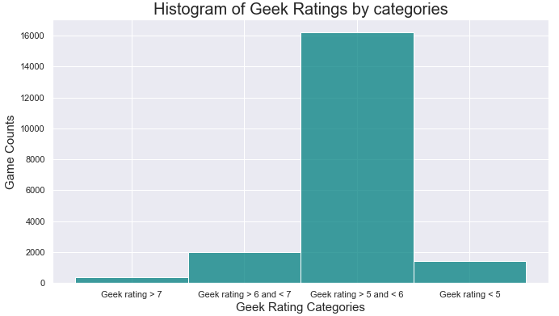
Evaluating geek ratings
Rating density plot for all games:
Rating categories focusing on ratings higher than 4.

Slide 8
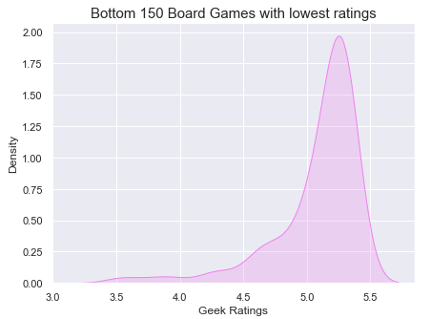
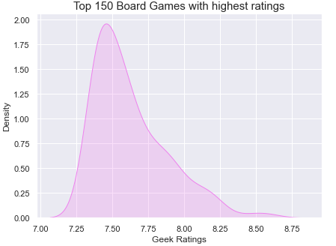
Evaluating geek ratings
Rating density evaluated for top 150 games (sorted by geek rating)
Rating density evaluated for bottom 150 games (sorted by geek rating)

Slide 9
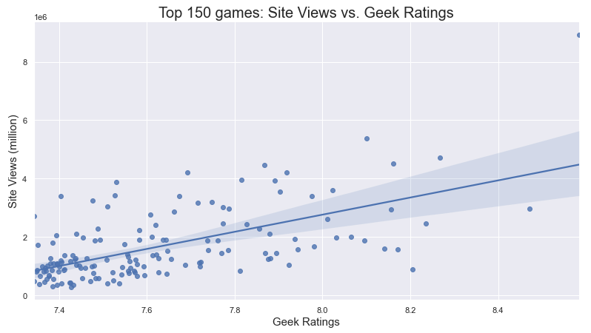
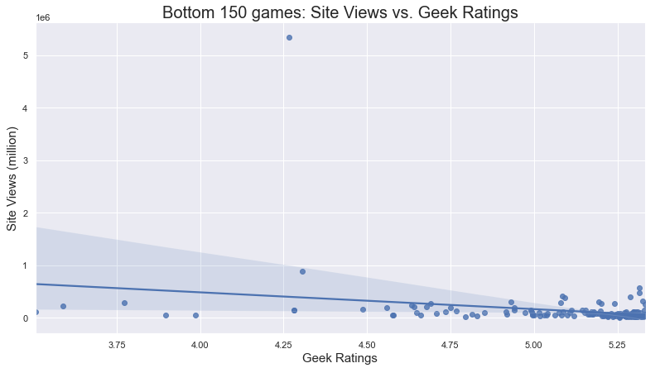
Site views evaluation
Notes:
Add a line.

Slide 10
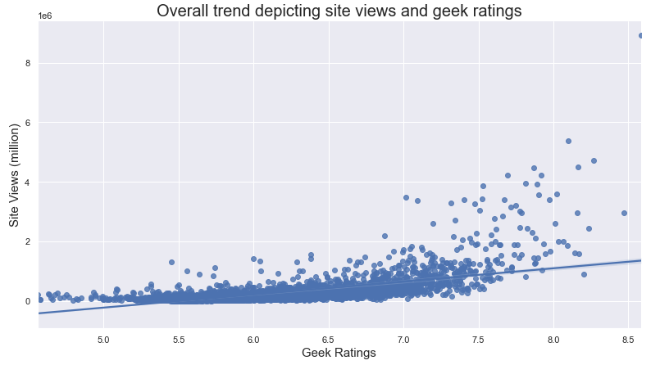
Site views evaluation (cont..)
Site views pick up as the game rating increases from 6.5 onwards.

Slide 11
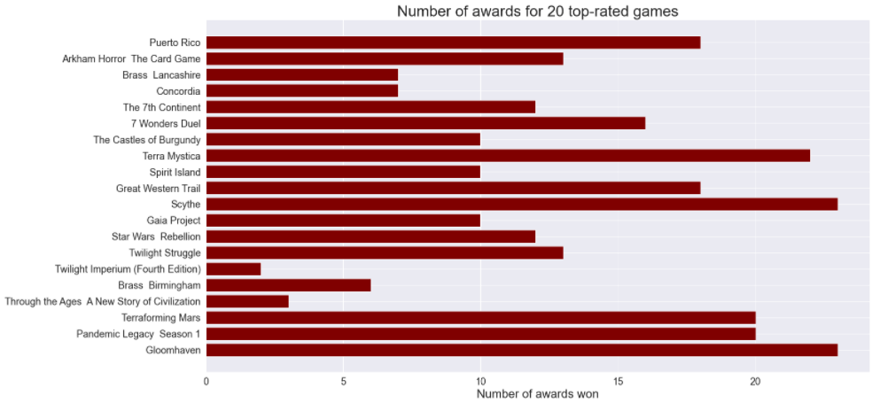
Game Awards evaluation
The award count range for top-rated games goes from 3 to 25 and above.

Slide 12
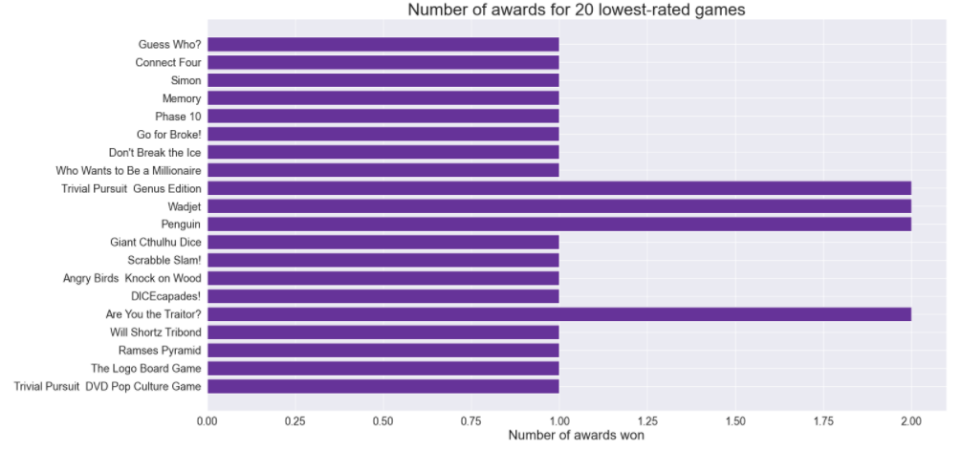
Game Awards evaluation (cont..)
The lowest-rated games only have won one or max two awards.

Slide 13
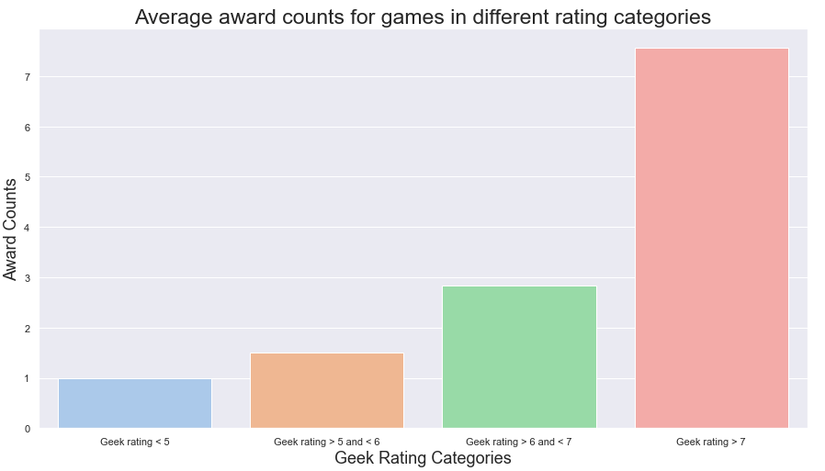
Game Awards evaluation(cont..)

Slide 14
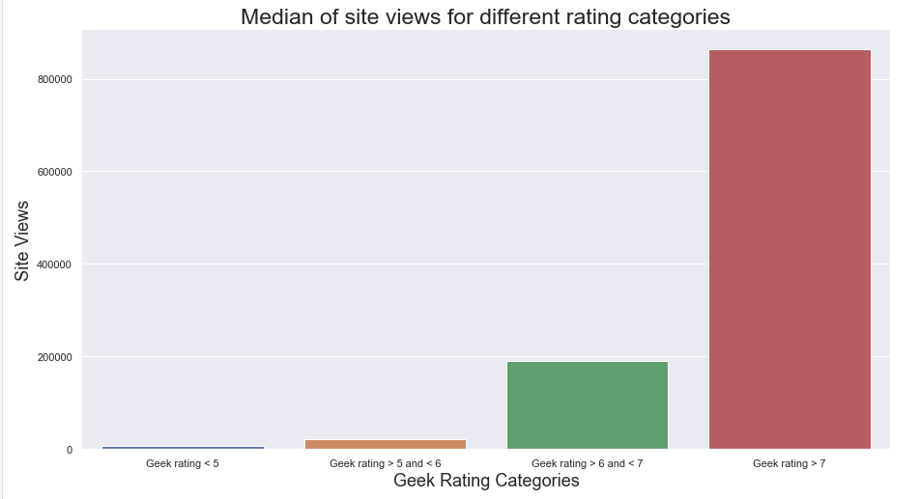
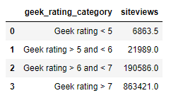
Media type evaluation
For the next evaluation, the feature of interest will be compared with site views as higher site views can translate to higher ratings:
Higher rating categories have high median site view count.

Slide 15
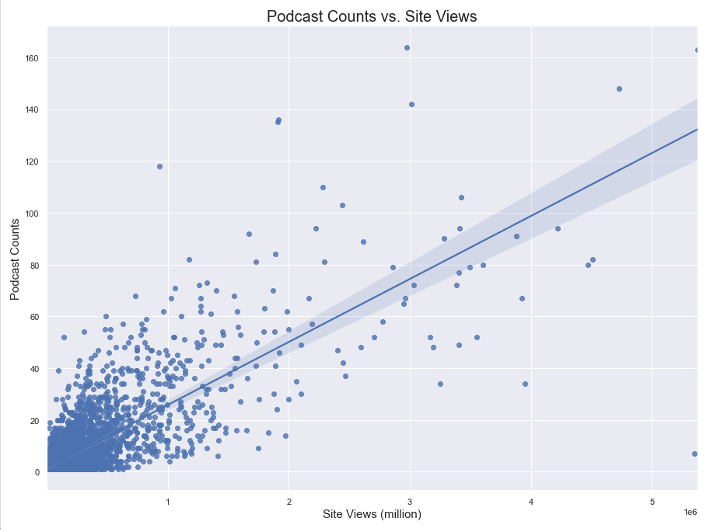
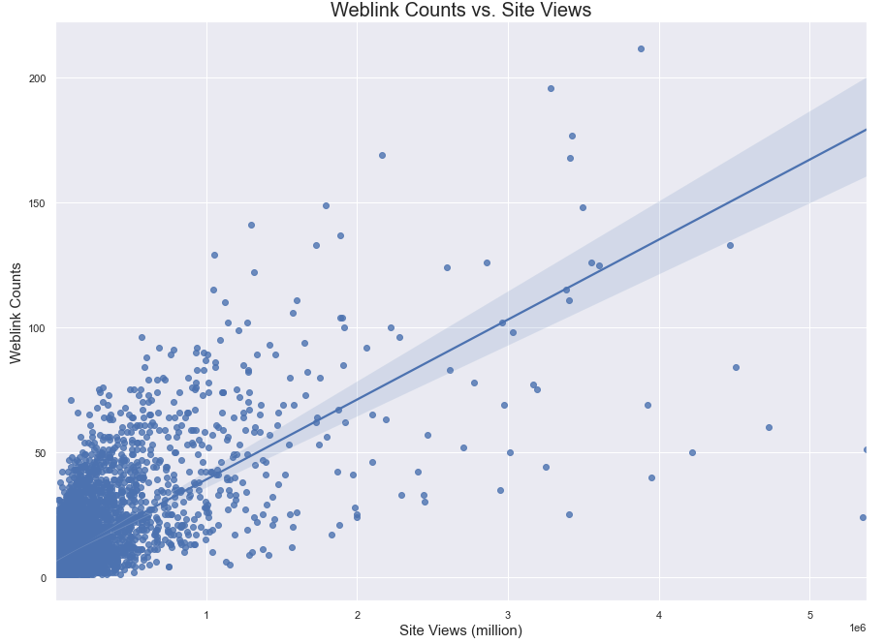
Media type evaluation (cont..)
Trend of number of podcast links for a game versus site views for the game
Trend of number of web article links for a game versus site views for the game
Games evaluated have at least one podcast and weblink listed

Slide 16
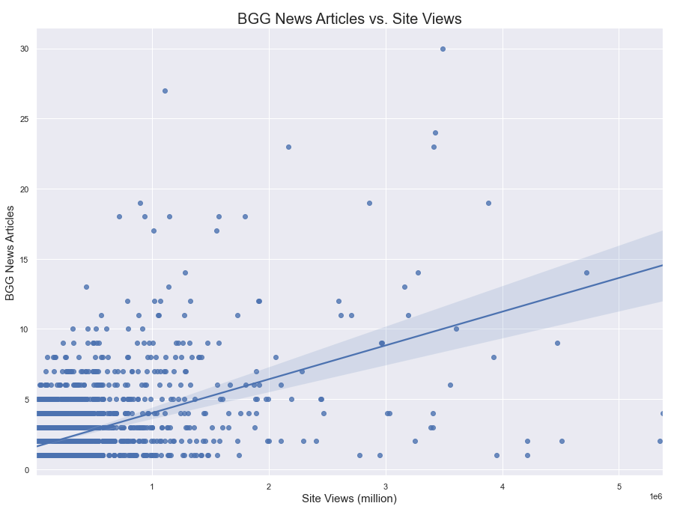
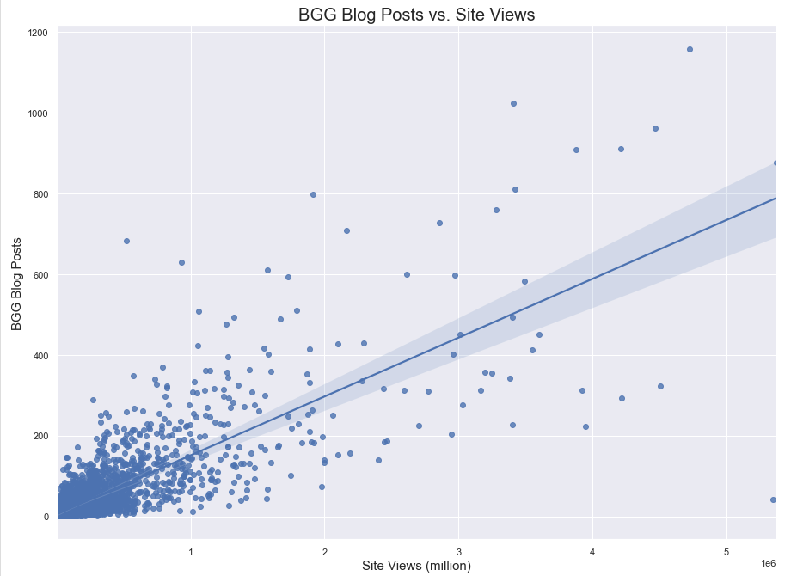
Media type evaluation (cont..)
Trend of BGG written news articles for a game versus site views for the game
Trend of BGG written blog posts for a game versus site views for the game
Games evaluated have at least one BGG news article or blog post listed

Slide 17
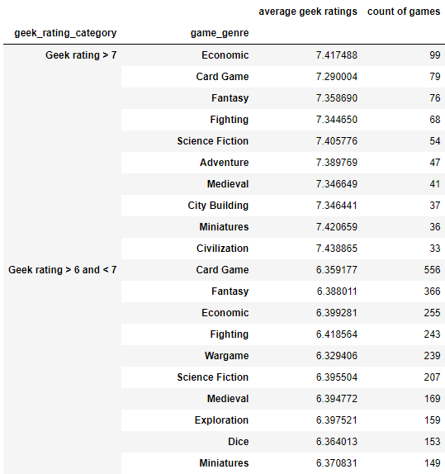
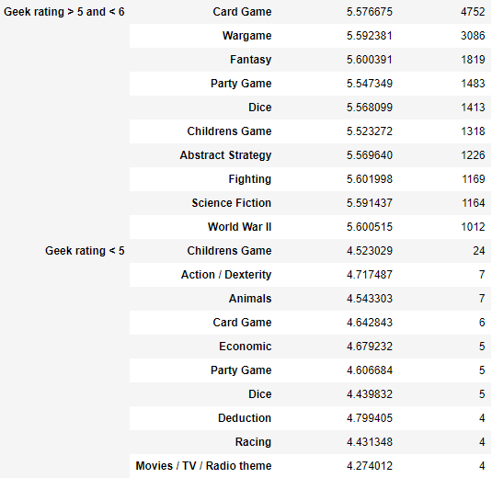









Game genre vs. rating evaluation
In this section, games with top rated genres and count of games that contributed to that average were looked at:

Slide 18
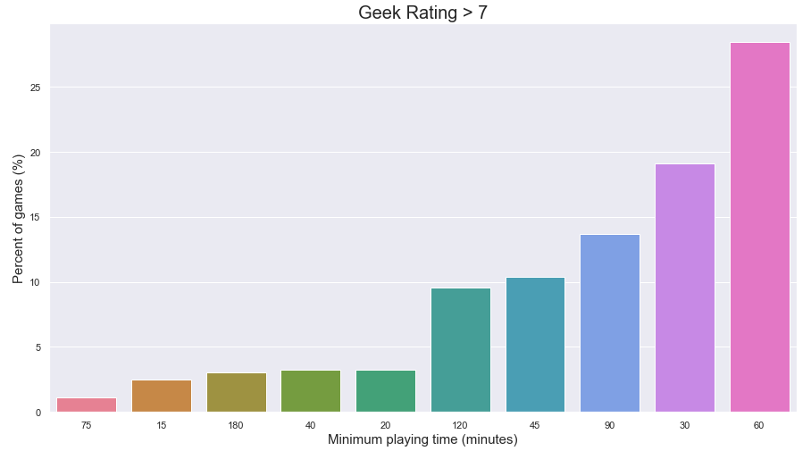
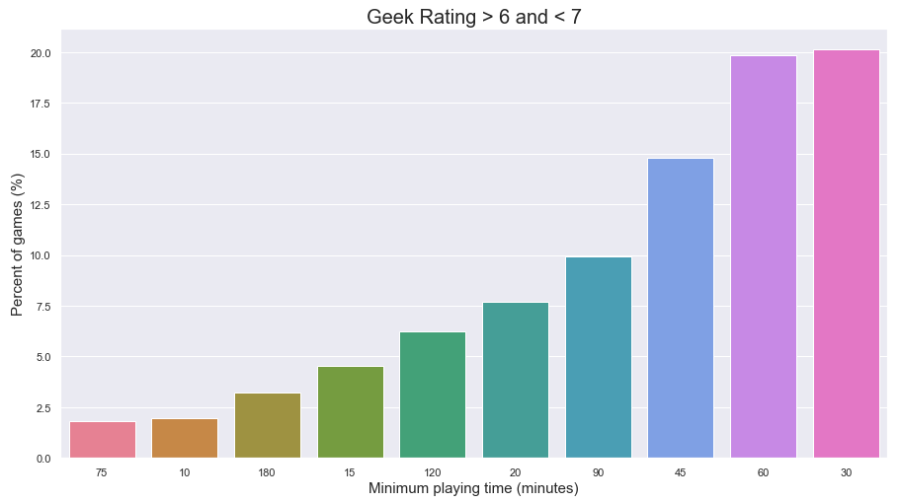

Minimum playing time per rating category
In this section, games in top rating categories with highest minimum and maximum playing times (in %) were investigated:
Minimum playing time (in minutes)

Slide 19
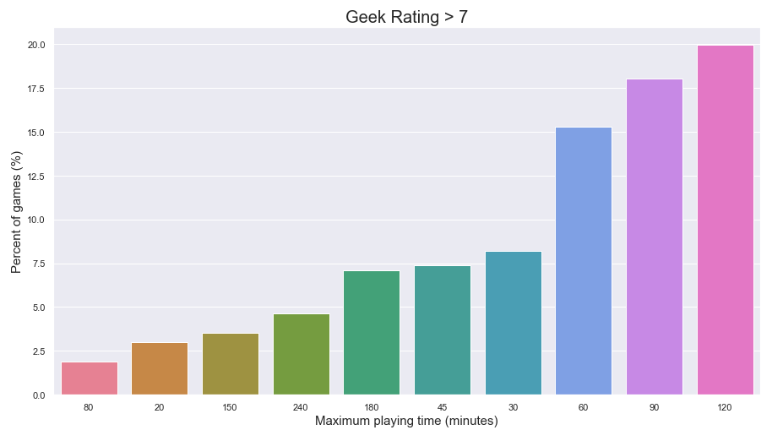
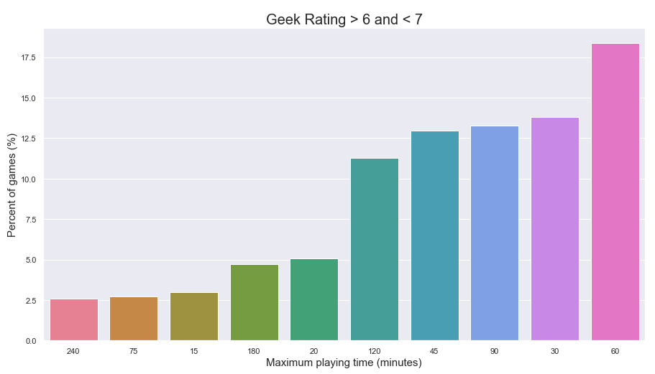
Minimum playing time per rating category (CONT..)
Maximum playing time (in minutes)

Slide 20
Takeaways/CONCLUSIONS
Game developers can work towards getting their game more exposure on gaming database sites. Quality game-related content on the site can boost viewability, possibly game rating and eventually sales.
Developers can promote awards the game has won on game sites or enter in more gaming competitions so the customers can read about it and gauge quality and competency of the game while making a sales related decision.
More publicity and media coverage a game would get, more popular it would be which may in turn drive up sales.
New game developers can focus on using a certain max/min playing time or genre for future game rating positive impact.

Slide 21
FUTURE WORK
Evaluation of data from other platforms to compare findings with.
Evaluate whether or not a game’s rating influences its price and sales.
Further research for rated games, to see the number of times consumers click on game sales link on database platforms (if available) to demonstrate interest in the game.

Slide 22
Questions?

